Slide 1
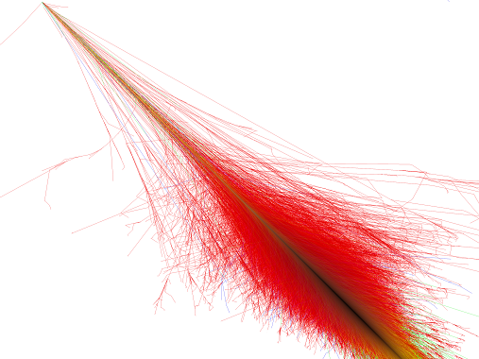




Measurement of the Muon content of EAS with the Pierre Auger Observatory
on behalf of the Pierre Auger Collaboration
João Pedro Espadanal
LIP , Portugal
XXX-th International Workshop on High Energy Physics
Protvino, 27th June 2014

Slide 2
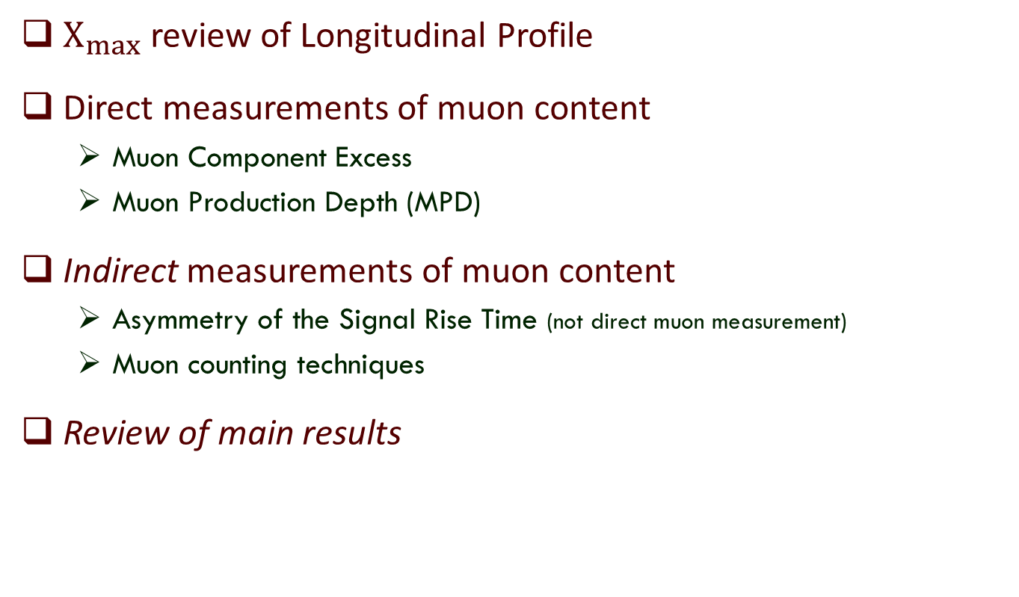
Outline
$X_{max}$ review of Longitudinal Profile
Direct measurements of muon content
  Muon Component Excess
  Muon Production Depth (MPD)
Indirect measurements of muon content
  Asymmetry of the Signal Rise Time (not direct muon measurement)
  Muon counting techniques
Review of main results

Slide 3
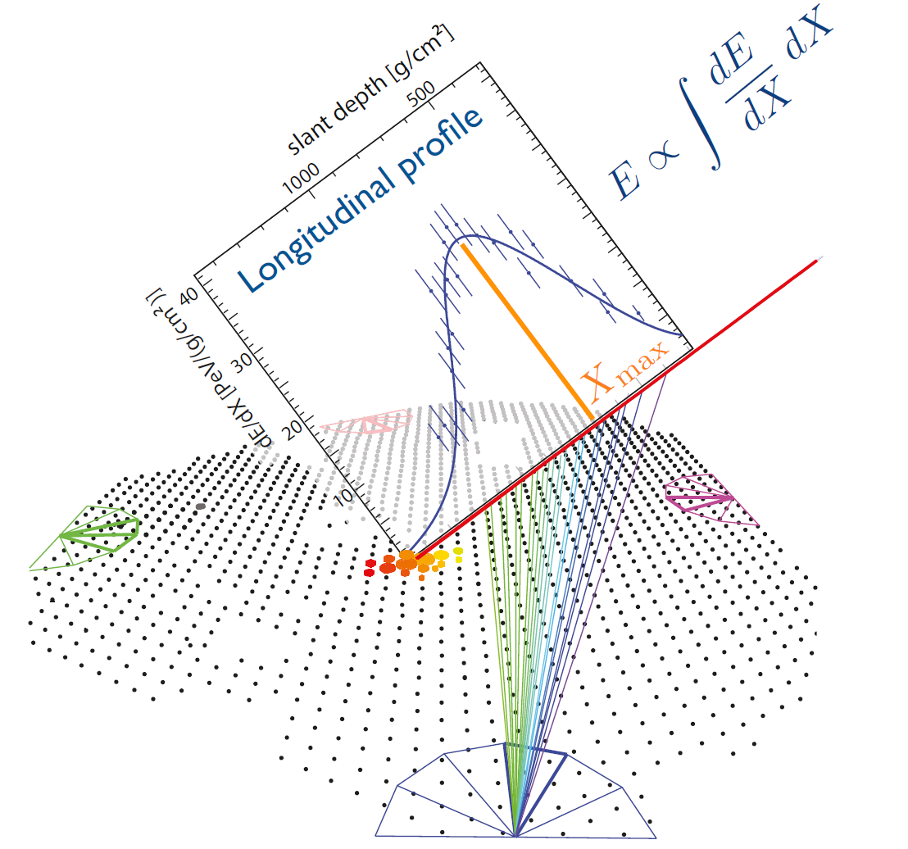
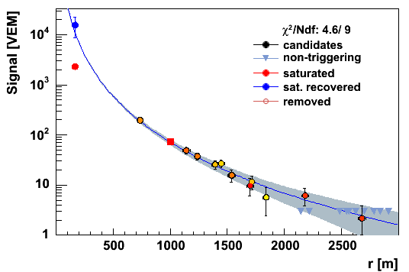
Pierre Auger detectors Review

Slide 4
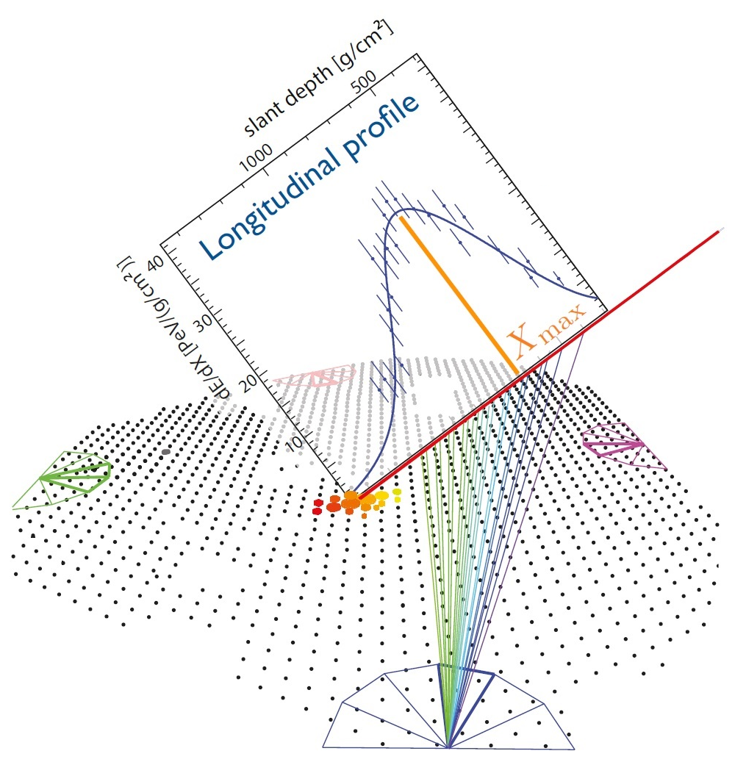
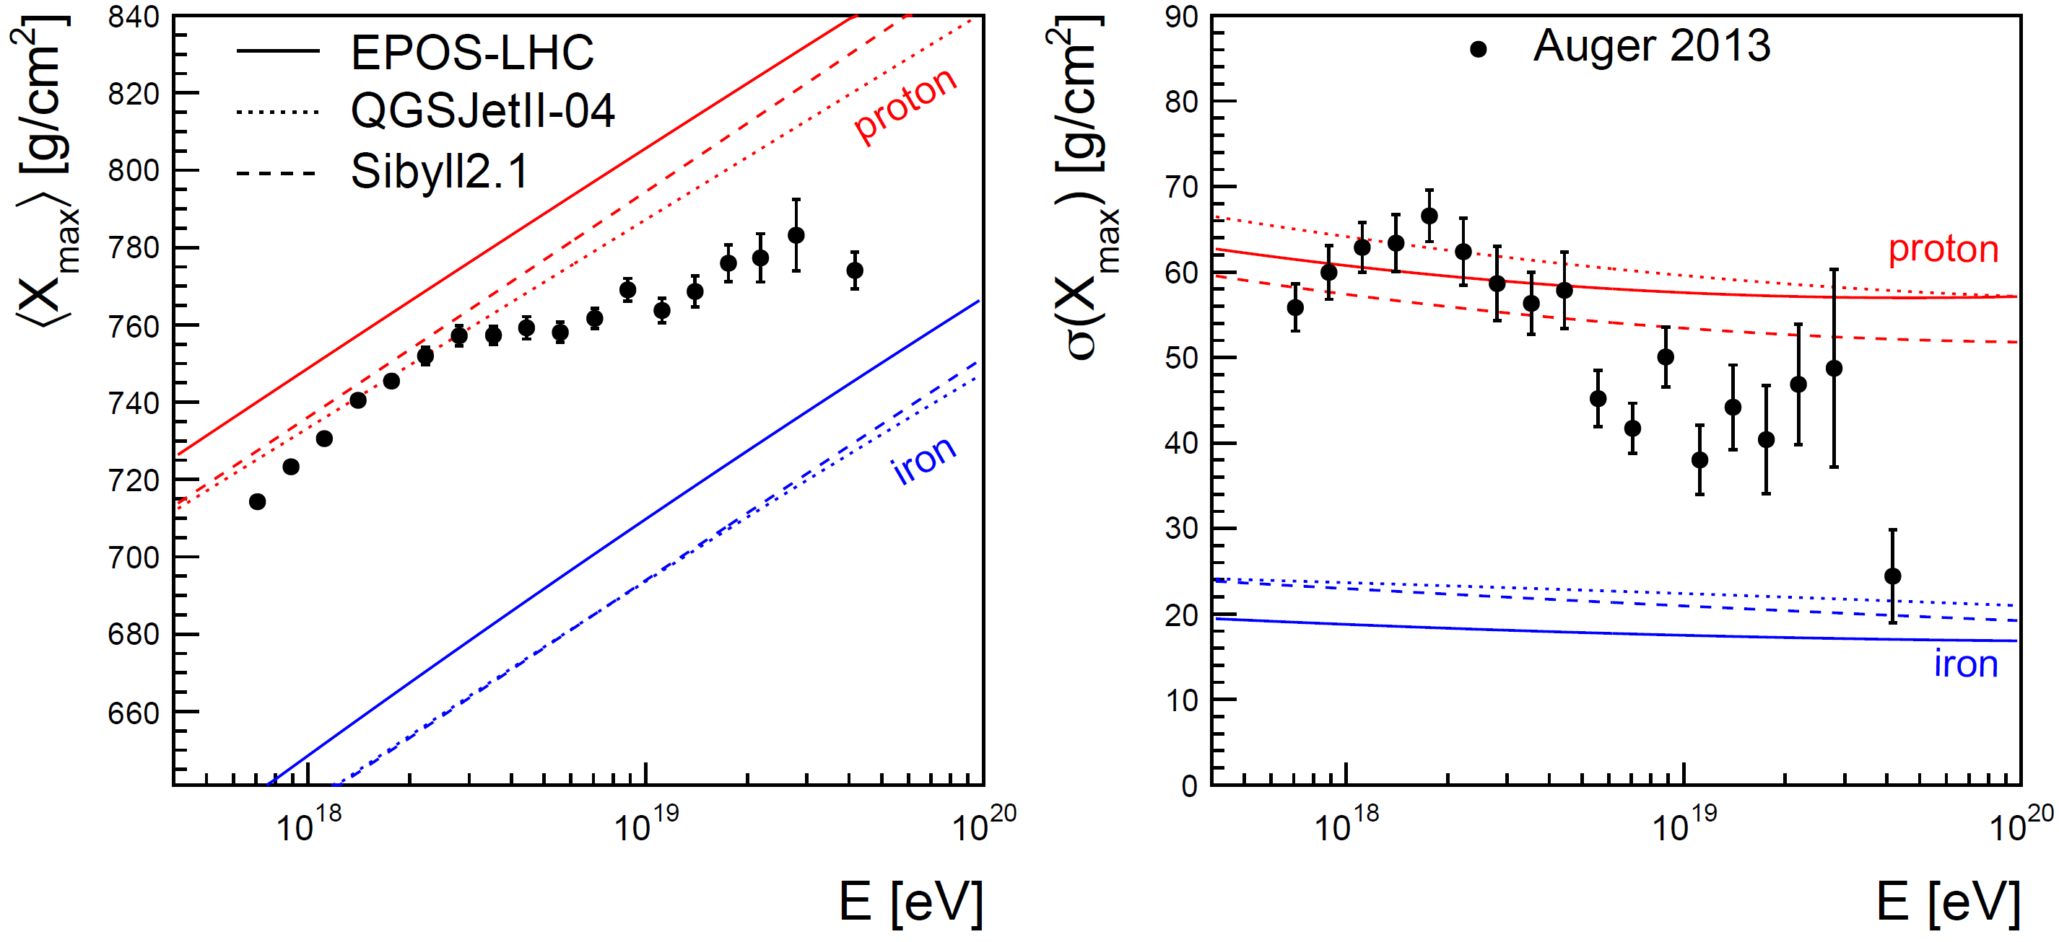


Remind previous presentation:
Depth of shower maximum
heavier
V. De Sousa ; E.J. Ahn ICRC2013 arXiv:1307.5059v1

Slide 5
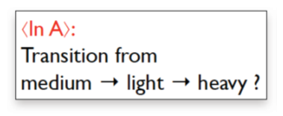
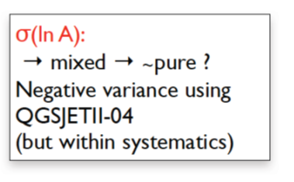
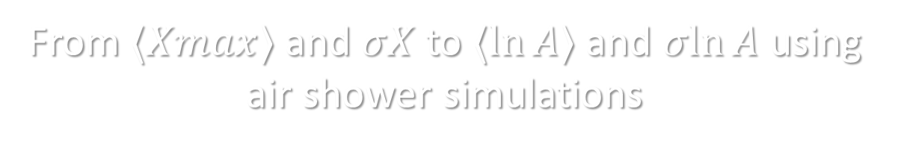
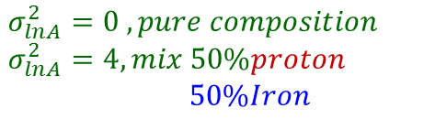
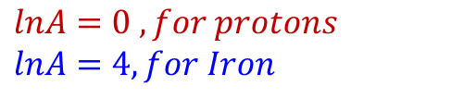
From $⟨Xmax⟩$and $σX$to $⟨ln⁡A⟩$and $σln⁡A$ using air shower simulations
heavier
$$lnA=0 , for protons$$
$$lnA=4, for Iron$$
Pure to mixed
$$σ_{lnA}^{2}=0 , pure composition$$
$$σ_{lnA}^{2}=4, mix 50\%proton$$
$50\%Iron$
E.J. Ahn ICRC2013 arXiv:1307.5059v1

Slide 6
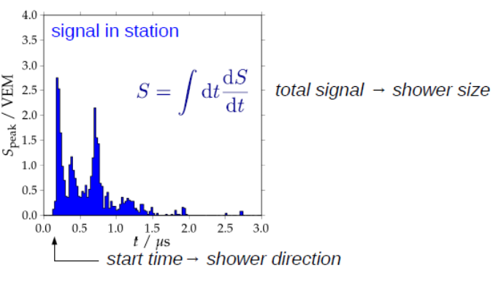
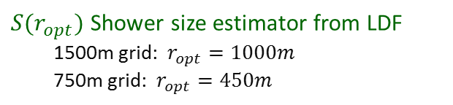
Air shower observables: Surface Detector Array
$S(r_{opt})$ Shower size estimator from LDF
1500m grid: $r_{opt}=1000m$
750m grid: $r_{opt}=450m$
Model, data-based

Slide 7
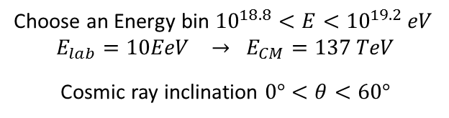
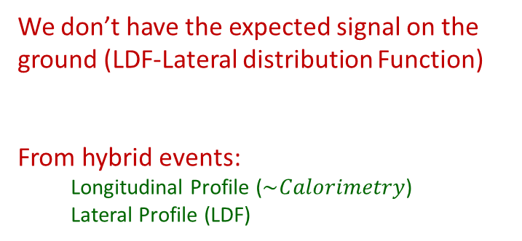

Muonic contribution in hybrid events
We don’t have the expected signal on the ground (LDF-Lateral distribution Function)
From hybrid events:
Longitudinal Profile ($\sim Calorimetry$)
Lateral Profile (LDF)
Atmosphere -> FD -> Longitudinal Profile
Choose an Energy bin ${10}^{18.8}<E<{10}^{19.2} eV$
$$E_{lab}=10EeV → E_{CM}=137 TeV$$
Cosmic ray inclination $0°<θ<60°$
Ground -> SD ->LDF (Lateral distribution Function)
Idea: Re-simulate measured hybrid events(FD+SD)
● Match longitudinal FD light profile
● Rescale ground signal to match SD data
● Contributions of EM and muon component vary with zenith angle
$$S_{resc}=R_{E}S_{EM}+ R_{E}^{α}R_{μ}S_{μ}$$
G. Farrar ICRC2013 arXiv:1307.5059v1

Slide 8

Muonic contribution in hybrid events
Ground Signal from MC
have different EM/muon component
$$S_{resc}=R_{E}S_{EM}+ R_{E}^{α}R_{μ}S_{μ}$$
Muon number in simulations is too low by at least a factor of 1.3
Beware: Fixing models with two factors is probably not the end of story
Energy Rescaling ⬄ EM rescaling:
G. Farrar ICRC2013 arXiv:1307.5059v1

Slide 9
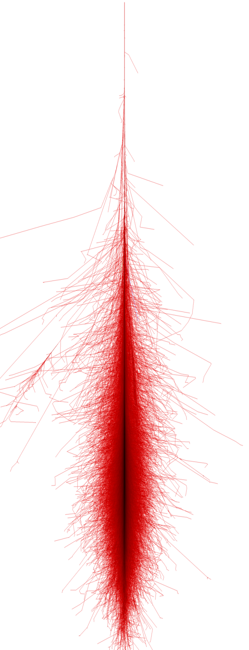
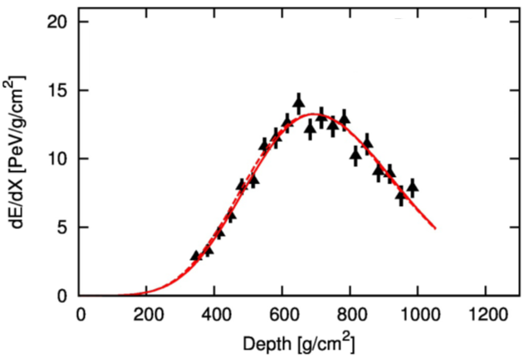
Direct Measurement of muons
Vertical Showers
Inclined Showers
Ground
Ground signal as function of the cosmic ray angle
Vertical events:
Have a big EM component
Very inclined events:
Almost all particles are muons

Slide 10
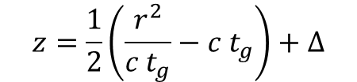
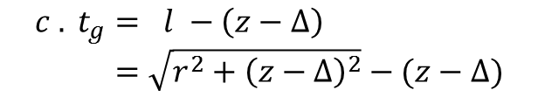
Muon Production Depth
Inclined events to avoid
EM contamination
Example at 60º
Geometric Delay of arriving muons:
Mapped to Muons Production Depth:
$$c . t_{g}= l −\left(z−Δ\right) \\ =\sqrt{r^{2}+{\left(z−Δ\right)}^{2}}−(z−Δ)$$
$$z=\frac{1}{2}\left(\frac{r^{2}}{c t_{g}}−c t_{g}\right)+Δ$$
D. Garcia-Gamez ICRC2013 arXiv:1307.5059v1

Slide 11
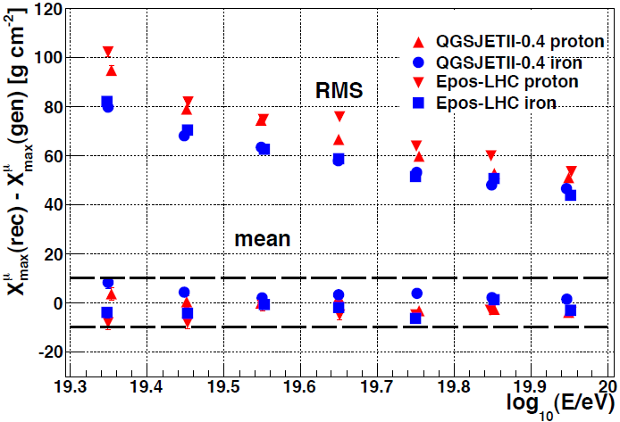

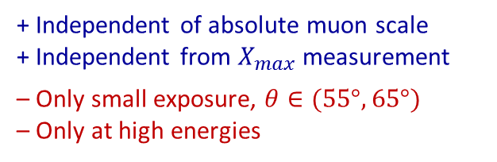
Muon Production Depth
Data from ICRC13
Reasonable resolution and bias compared to
$ΔX_{max}^{μ} (p, Fe) \sim 70 g cm^{−2}$
+ Independent of absolute muon scale
+ Independent from $X_{max}$ measurement
– Only small exposure, $θ∈(55°, 65°)$
– Only at high energies
D. Garcia-Gamez ICRC2013 arXiv:1307.5059v1
Notes:
Only high energy events at 60o zenith.
Poor resolution at the lowest energies due to
sparseness of the detector (low muon statistics)
Independent technique, allows additional constraints and further
understanding of high energy hadronic models

Slide 12
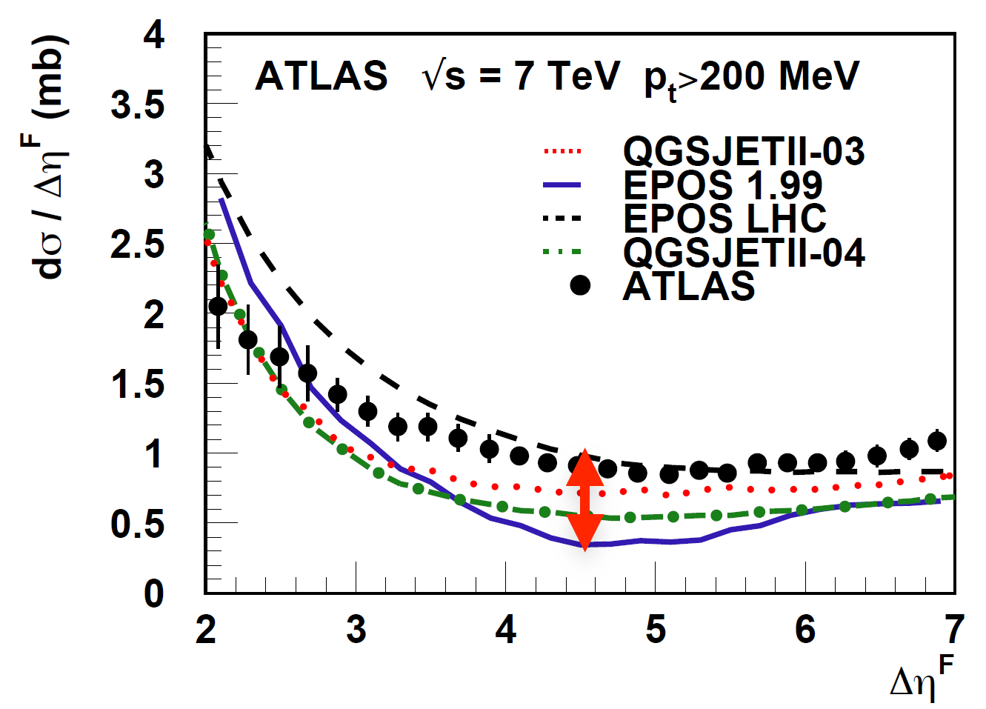
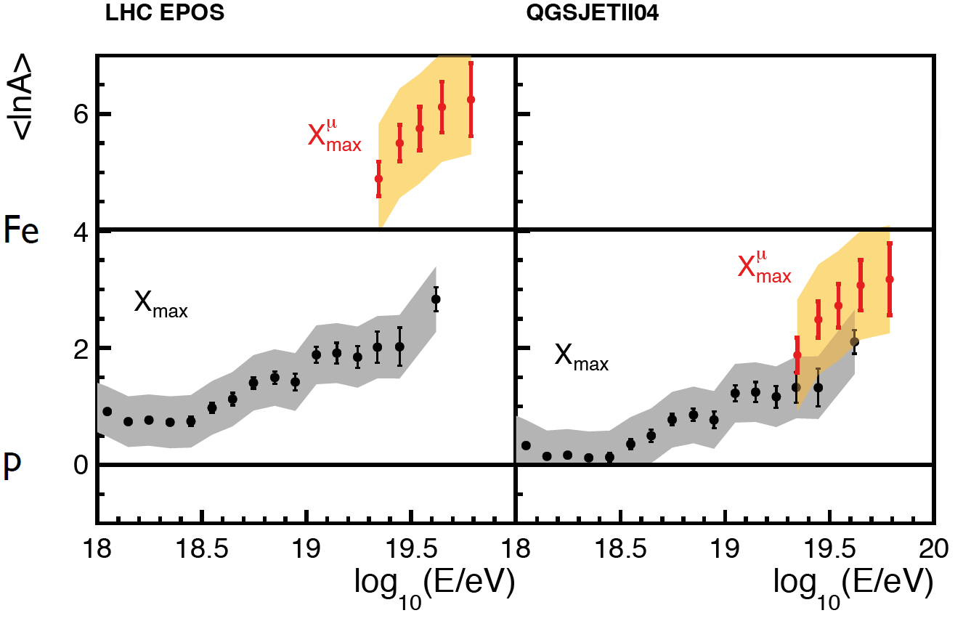



$⟨ln⁡A⟩$from $⟨X_{max}⟩$and muon production depth
See T. Pierog, Rencontres de Moriond,
VHEPU, La Thuille, March 2013
$X_{max}$ ->EM Component
$X_{μmax}$ ->muonic Component
Different pseudorapidity distributions

Slide 13
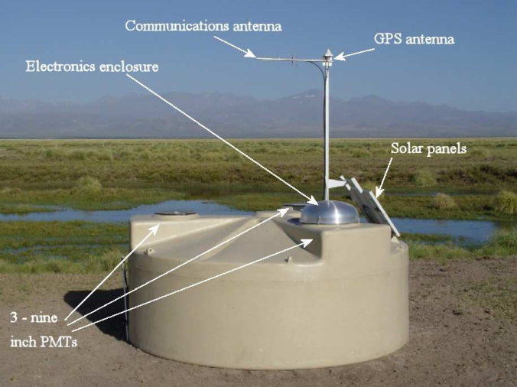
Indirect measurements
SD signal has detailed time structure → exploitable!
Water Cherenkov stations, Signal are digitalised with 25ns
muon rich
hadronic cosmic rays q > 60°
EM rich
hadronic cosmic rays q < 60°
neutrinos, photons

Slide 14
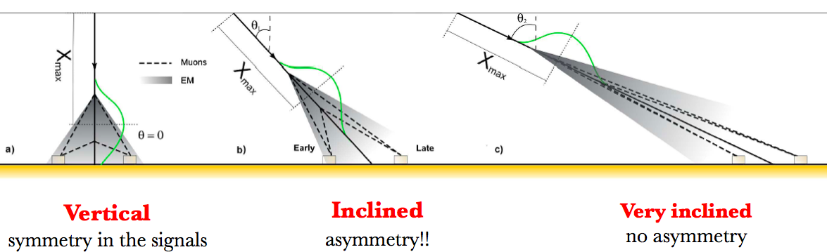

Asymmetry of the Signal Rise Time
See D. Garcia-Pinto, ICRC2011 ; M.Dova, F.Arqueros et al, Astropart.Phys.31:312-319,2009
-> look at the angles where the maximum difference is
$$t_{1/2}/r=a+b.cos⁡(ζ)$$

Slide 15
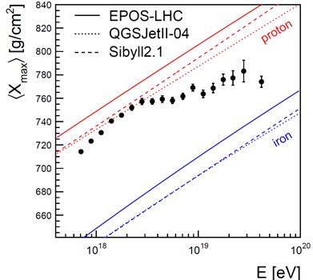
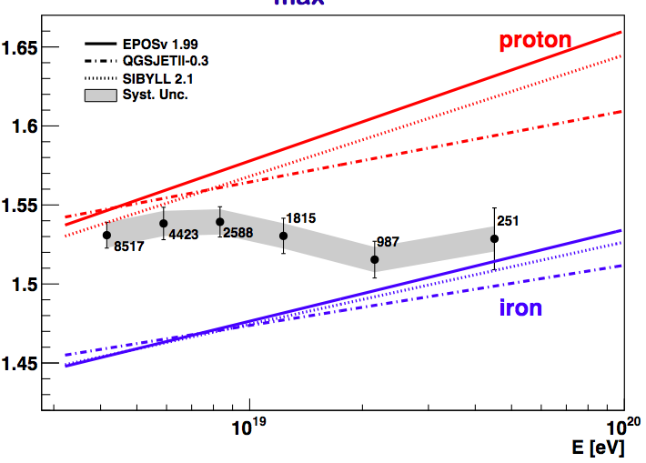
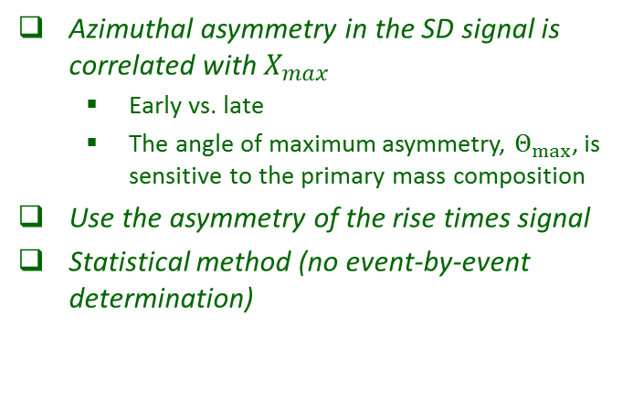
Asymmetry of the Signal Rise Time
See D. Garcia-Pinto, ICRC2011
Azimuthal asymmetry in the SD signal is correlated with $X_{max}$
  Early vs. late
  The angle of maximum asymmetry, $Θ_{max}$, is sensitive to the primary mass composition
Use the asymmetry of the rise times signal
Statistical method (no event-by-event determination)

Slide 16
Muon counting: Muon scale from very inclined air showers
Rμ = Nμ(event) / (E/10^19)
N19
N19
Very inclined air showers
● Long distance to ground, only muons survive
● First and most direct measurement of muon scale
I. Valino ICRC2013 arXiv:1307.5059v1

Slide 17
Indirect muon measurements
Water Cherenkov stations, Signal are digitalised with 25ns

Slide 18
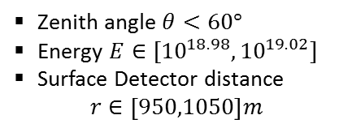

Muon counting: Muon fraction from signal shape
2 Methods
Smoothing Method
Multivariate Method
We want to estimate the muon fraction on the Surface signals
$$f_{μ}=S_{μ}/S$$
Compare the muon content with some reference
Muon component change with energy and zenith angle:
Zenith angle $θ<60°$
Energy $E∈[{10}^{18.98},{10}^{19.02}]$
Surface Detector distance
$r∈\left[950,1050\right]m$

Slide 19
Muon counting: Muon fraction from signal shape
Muonic signal is peaky,
e.m. signal smooth
Muon signal sharp spike with fast decay,
e.m. signal low and elongated
Model predictions for shapes are robust
Smoothing Method
– Smooth with low pass filter
– Assign positive difference to μ-signal
– Iterate until convergence
B. Kegl ICRC2013 arXiv:1307.5059v1

Slide 20

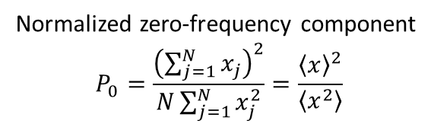
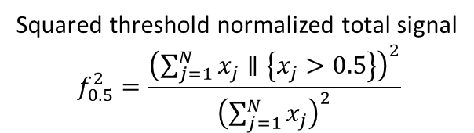
Muon counting: Muon fraction from signal shape
Multivariate Method
$f_{μ}=S_{μ}/S$
$$f_{μ}=a+bθ+cf_{0.5}^{2}+d θ P_{0}+e r$$
Squared threshold normalized total signal
$$f_{0.5}^{2}=\frac{{\left(\sum_{j=1}^{N}{x_{j}}∥\left\{x_{j}>0.5\right\}\right)}^{2}}{{\left(\sum_{j=1}^{N}{x_{j}}\right)}^{2}}$$
Normalized zero-frequency component
$$P_{0}=\frac{{\left(\sum_{j=1}^{N}{x_{j}}\right)}^{2}}{N\sum_{j=1}^{N}{x_{j}^{2}}}=\frac{{\left\langle x\right\rangle }^{2}}{\left\langle x^{2}\right\rangle }$$
B. Kegl ICRC2013 arXiv:1307.5059v1

Slide 21
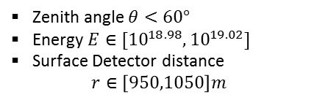



Muon counting: Muon fraction from signal shape
Total Signal Corrected for the center of the bin in radius and energy
$f_{μ}=S_{μ}/S$
$$S\left(1000\right)=S\frac{LDF(1000m)}{LDF(r)}$$
While the measured angular dependence of the muonic signal is found to be similar to the prediction obtained for proton showers and QGSJETII.04, the magnitude of the muonic signal is comparable to the predictions for iron showers.
$$S_{19}=S\left(1000\right)×C(E)$$
Zenith angle $θ<60°$
Energy $E∈[{10}^{18.98},{10}^{19.02}]$
Surface Detector distance
$r∈\left[950,1050\right]m$
B. Kegl ICRC2013 arXiv:1307.5059v1

Slide 22




Muon counting: Muon fraction from signal shape
$$+$$
Energy ${10}^{19}eV$
$$S_{μ19}\left(1000\right)=f_{μ}×S_{19}(1000)$$
$1.33±0.02(stat.)±0.05(sys.)$(multivariate)
$1.31±0.02(stat.)±0.09(sys.)$(smoothing)
B. Kegl ICRC2013 arXiv:1307.5059v1

Slide 23
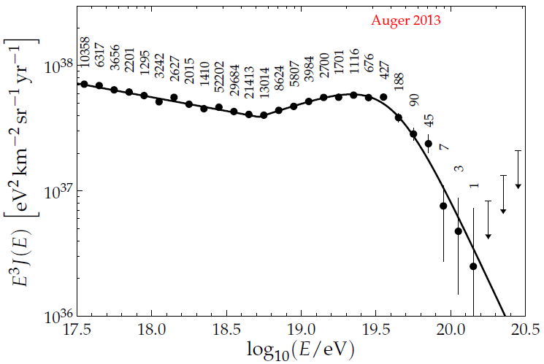


Review
Spectrum
$X_{max}$ and RMS
mass composition
Muon content
$${10}^{19} eV$$

Slide 24
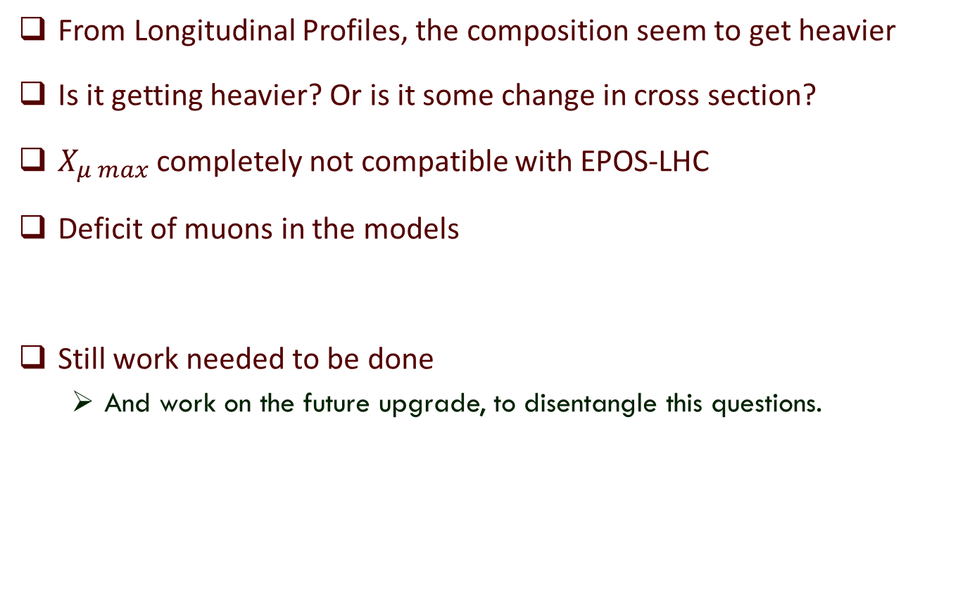
Summary
From Longitudinal Profiles, the composition seem to get heavier
Is it getting heavier? Or is it some change in cross section?
$X_{μ max}$ completely not compatible with EPOS-LHC
Deficit of muons in the models
Still work needed to be done
  And work on the future upgrade, to disentangle this questions.

Slide 25
Thank You!
Pierre Auger Collaboration
~550 scientists, technicians, students
94 institutions
19 countries

Slide 26
Backup Slides

Slide 27
MPD

Slide 28
arXiv:1109.2041
arXiv:1209.6474
$$σ_{p−air}=505±{22\left(stat\right)}_{−36}^{+28}\left(syst\right)mb$$
At 57 TeV
$$σ_{p−p}^{inel}=92±{7\left(stat\right)}_{−11}^{+9}\left(syst\right)±7(Glauber)mb$$

Slide 29
Rescaling by G. Farrar

Slide 30
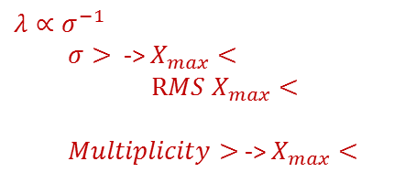



Shower Evolution
Electromagnetic component, feeded by $π^{0}$
$$λ∝σ^{−1}$$
$σ>$ -> $X_{max}<$
$RMS X_{max}<$
$Multiplicity>$ -> $X_{max}<$
Muonic component, mainly feeded by $π^{+/−}$
But high energy $π^{+/−}$ -> interacts producing $π^{+/−}+π^{0}$
Low energy $π^{+/−}$ -> decays to $μ^{+/−}$

Slide 31
From T. Pierog, Rencontres de Moriond, VHEPU, La Thuille, March 2013;
and doi:10.1088/1742-6596/409/1/012008
R. Ulrich (KIT) with Sibyll model and PAO data @ 1019 eV

Slide 32
See T. Pierog, Rencontres de Moriond,
VHEPU, La Thuille, March 2013;
doi:10.1088/1742-6596/409/1/012008
Similar Xmax results for the new models

Slide 36
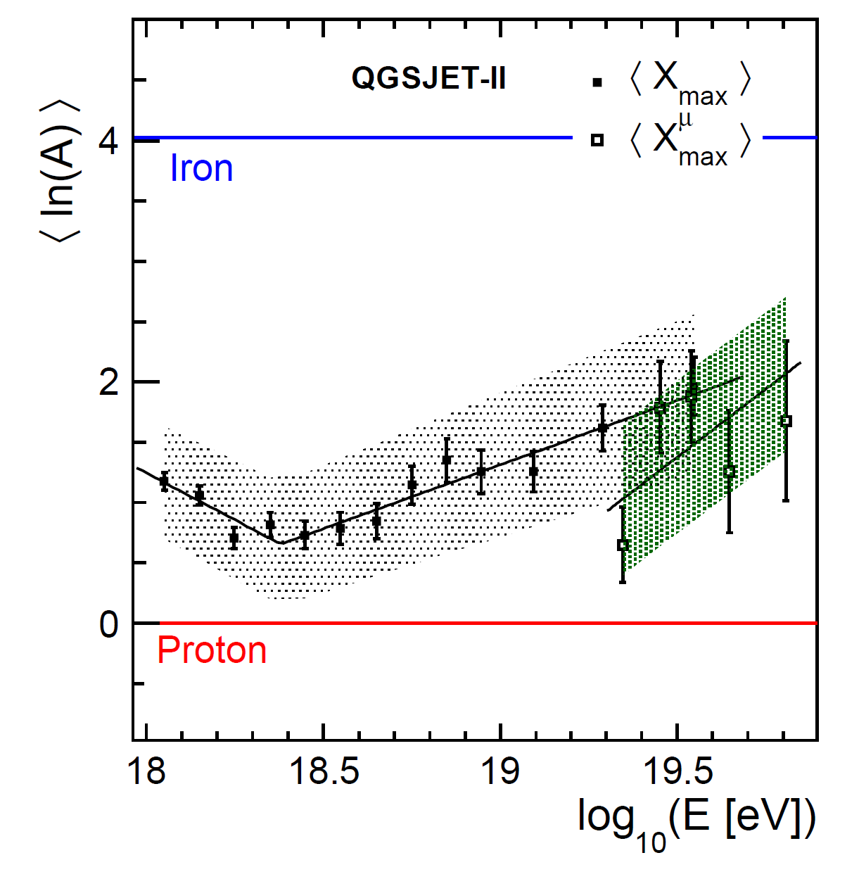
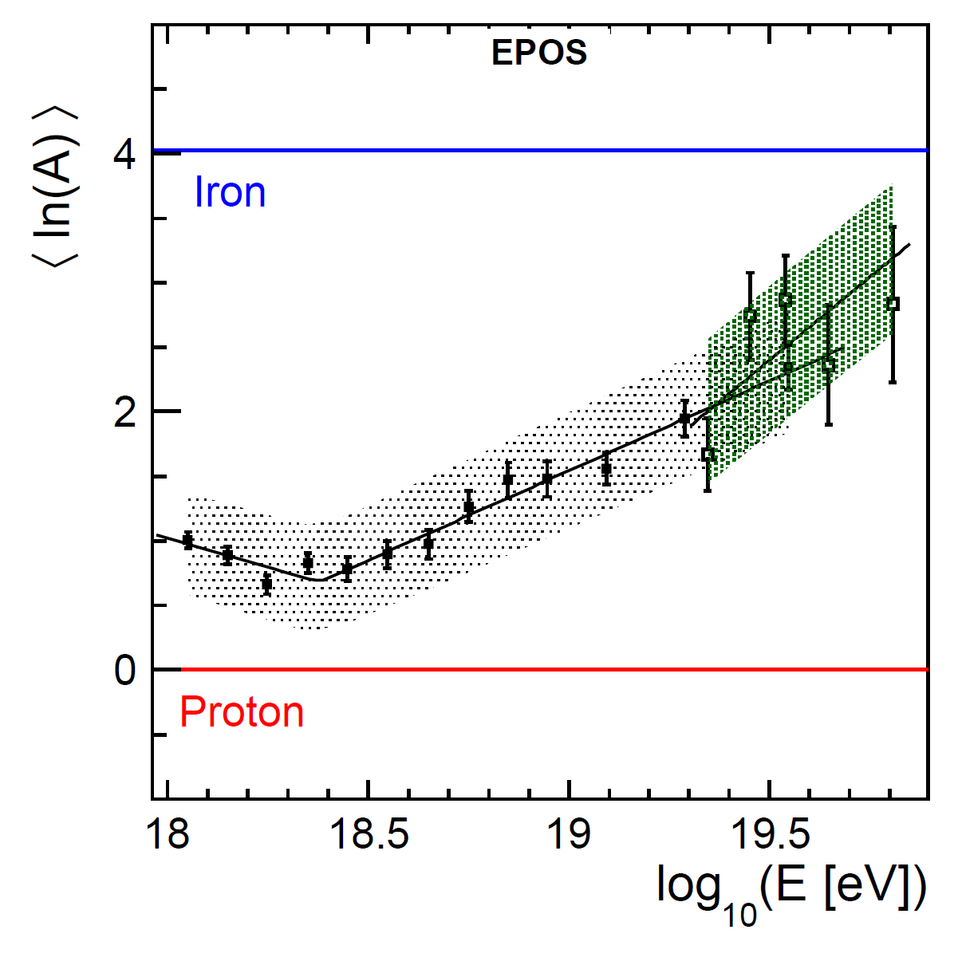
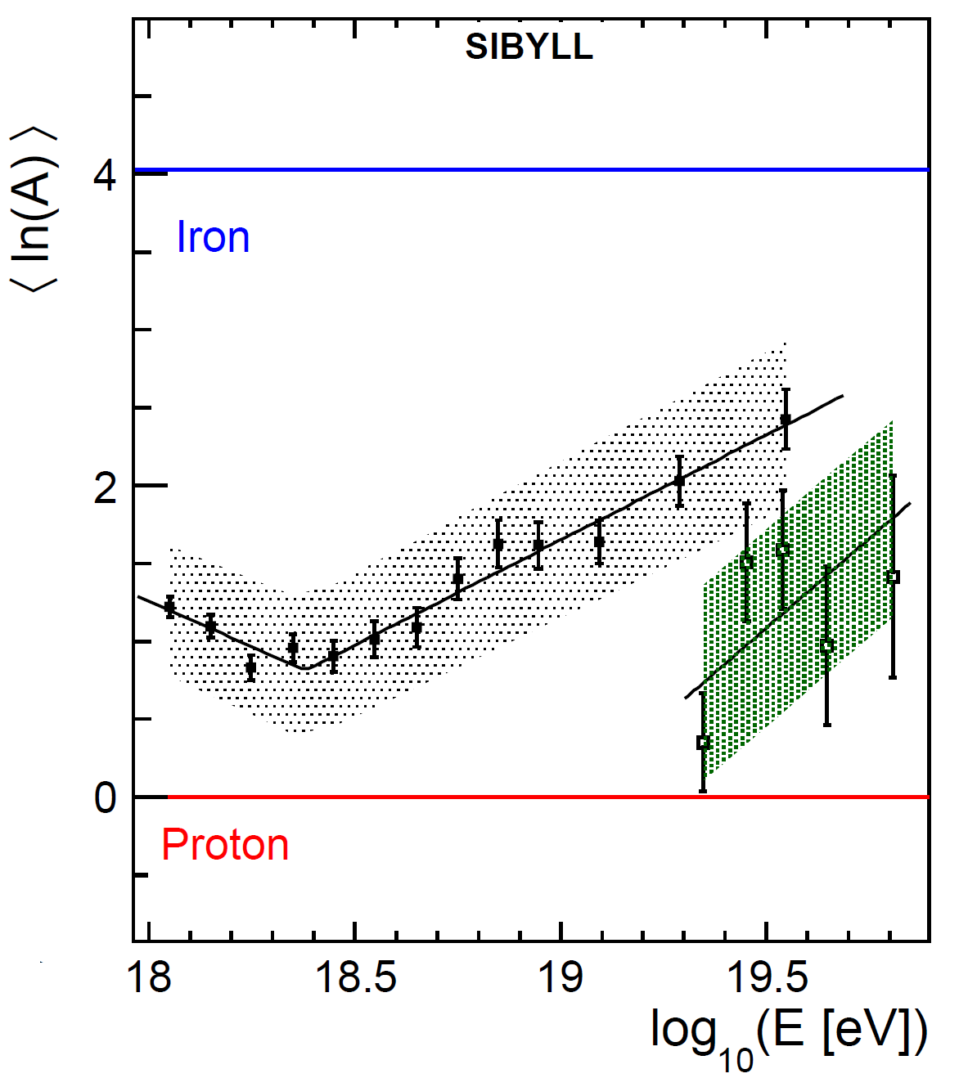
See T. Pierog, Rencontres de Moriond,
VHEPU, La Thuille, March 2013
QGSJetII-04
EPOS-LHC
QGSJETII.03
EPOS1.99

Slide 38
Old Versions

Slide 39
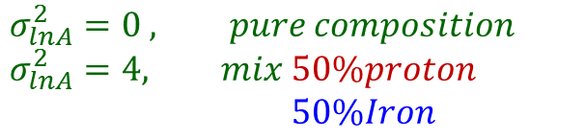
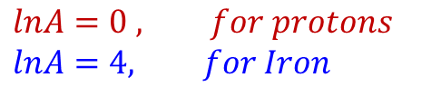
Old Versions
$$lnA=0 , for protons$$
$$lnA=4, for Iron$$
$$σ_{lnA}^{2}=0 , pure composition$$
$$σ_{lnA}^{2}=4, mix 50\%proton$$
$50\%Iron$
Energy from 10¹⁸ eV to 10^{19.6} eV
(increasing size points with energy)
New Versions

Slide 40
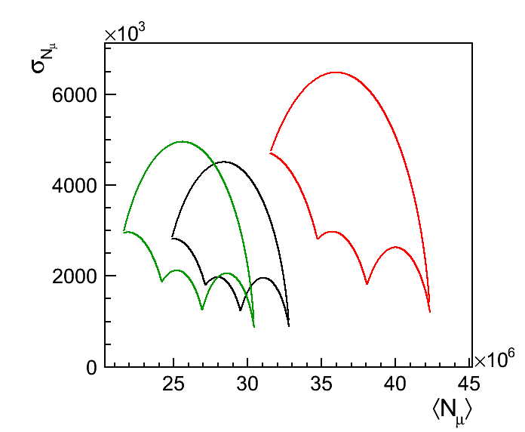
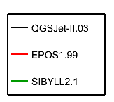
Xmax and Nμ
Correlate different variables
For a particular energy,
each model predicts different phase-space for mean and RMS values,
when we change the composition
This is a very important test to the hadronic models since the data points for a particular energy could be out of the model phase-space
A Multivariate analysis allows us to give very strong constrains and to rule out models
For a energy 10¹⁹eV the data point stays very far away from the phase space allowed by the models
P
He
N
Fe
GAP 2013-004

Slide 41
Old Versions
Diego Garca-Pinto ICRC2011 arXiv:1107.4804v1

Slide 42
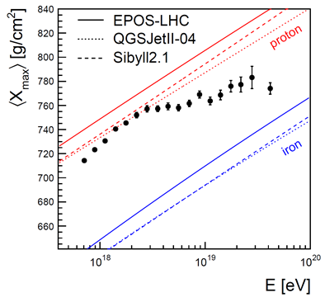
Distribution of Xmax
Pedro Facal ICRC2011 arXiv:1107.4804v1

Slide 43
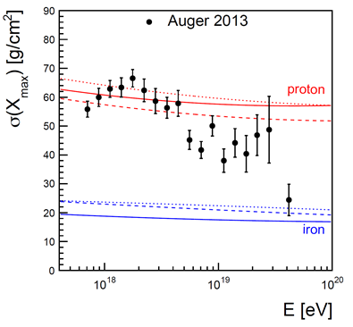
Shape of Xmax
Pedro Facal ICRC2011 arXiv:1107.4804v1

Slide 44
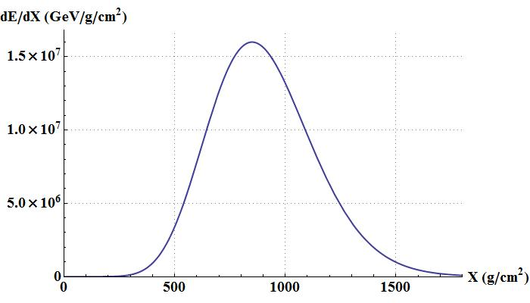
Xmax
Only with hybrid events
Recent Xmax results:
Xmáx
Cross section?
Or Composition?
ICRC 2013, arXiv:1307.5059v1

Slide 45

$X_{max}$ and cross section

Slide 46
Pedro Facal ICRC2011 arXiv:1107.4804v1

Slide 47
Pierre Auger Collaboration arXiv:1208.1520v2 ; Ralf Ulrich ICRC2011 arXiv:1107.4804v1

Slide 49
$$σ_{p−air}=505±{22\left(stat\right)}_{−36}^{+28}\left(syst\right)mb$$
At 57 TeV
$$σ_{p−p}^{inel}=92±{7\left(stat\right)}_{−11}^{+9}\left(syst\right)±7(Glauber)mb$$
Pierre Auger Collaboration arXiv:1208.1520v2 ; Ralf Ulrich ICRC2011 arXiv:1107.4804v1

Slide 50
$$σ_{p−air}=505±{22\left(stat\right)}_{−36}^{+28}\left(syst\right)mb$$
At 57 TeV
$$σ_{p−p}^{inel}=92±{7\left(stat\right)}_{−11}^{+9}\left(syst\right)±7(Glauber)mb$$
Pierre Auger Collaboration arXiv:1208.1520v2 ; Ralf Ulrich ICRC2011 arXiv:1107.4804v1

Slide 51
$$σ_{p−air}=505±{22\left(stat\right)}_{−36}^{+28}\left(syst\right)mb$$
At 57 TeV
$$σ_{p−p}^{inel}=92±{7\left(stat\right)}_{−11}^{+9}\left(syst\right)±7(Glauber)mb$$

Slide 52
Pierre Auger Collaboration arXiv:1208.1520v2 ; Ralf Ulrich ICRC2011 arXiv:1107.4804v1

Slide 53
Pierre Auger Collaboration arXiv:1208.1520v2 ; Ralf Ulrich ICRC2011 arXiv:1107.4804v1

Slide 55

Energy Calibration of the surface dectector
$$S_{1000}$$

Slide 56
Shower size/energy estimation
A. Schulz, D. Ravignani ICRC 2013 arXiv:1307.5059v1

Slide 57
A. Schulz, D. Ravignani ICRC 2013 arXiv:1307.5059v1

Slide 58
Calibrate shower size estimators to calorimetric FD energy using
unbiased subset of hybrid events
A. Schulz, D. Ravignani ICRC 2013 arXiv:1307.5059v1

Slide 59
Depth of shower maximum

Slide 60
Remind previous presentation:
Depth of shower maximum
Longitudinal Profile (on atmosphere)
Xmax
V. De Sousa ; E.J. Ahn ICRC2013 arXiv:1307.5059v1

Slide 61


Summary
From Longitudinal Profiles, the composition seem to get heavier
Is it getting heavier? Or is it some change in cross section?
$X_{μ max}$ completely not compatible with EPOS-LHC
Deficit of muons in the models
Still work needed to be done
  And work on the future upgrade, to disentangle this questions.
Muons and $X_{max}$
$${10}^{19} eV$$

