Slide 1
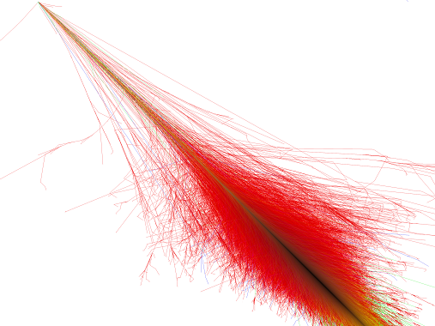


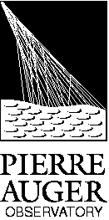

Recent results of the Pierre Auger Observatory
The Pierre Auger Collaboration
João Pedro Espadanal
LIP , Portugal
FÍSICA 2014 – 19ª Conferência Nacional de Física and 24º Encontro Ibérico para o Ensino da Física
Lisboa, 4th September 2014

Slide 2
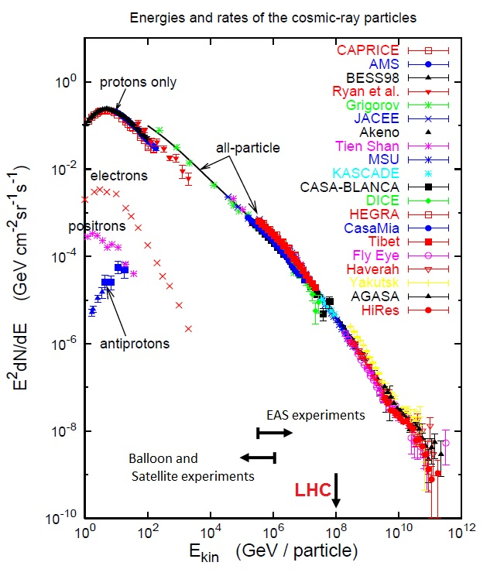
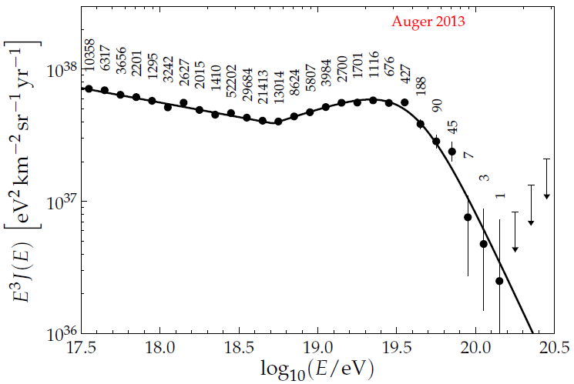
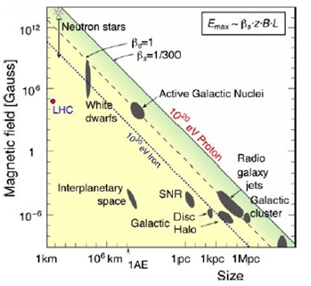
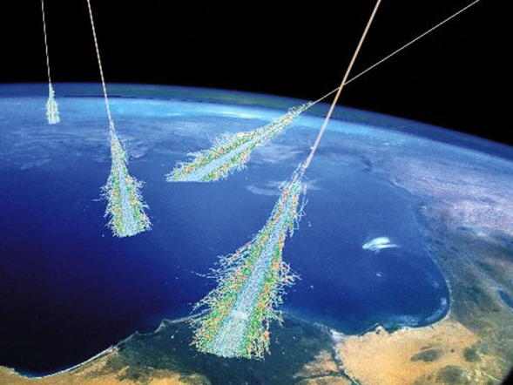
Cosmic Rays
Cosmic Rays
Extraterrestrial particles that hit the Earth
During early 20th century, most of the new particles were discovered in cosmic rays
Now, the most energetic particles we can access are cosmic rays
Recent Spectrum measure at Auger
Challenges:
  Small flux (difficult to detect directly)
  How to indirectly detect them?
  Which are their directions and sources?
  What is their composition?
  Are the interactions the same at those energies?
Cosmic Ray Suppression due to interaction with CMB?
Transition of cosmic rays origin from galactic to extragalactic?

Slide 3
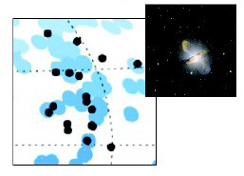
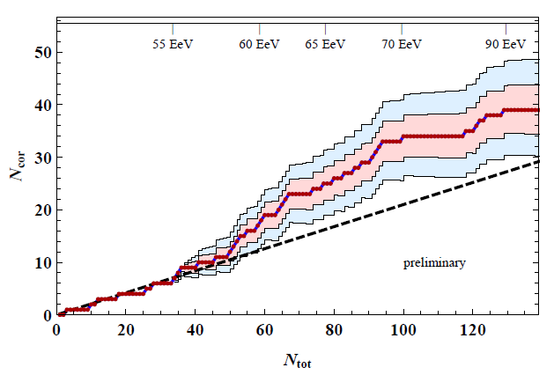
Cosmic Rays directions
Cosmic Rays directions at Auger
High Energy Centaurus A
(NGC 5128) excess
Events with E > 54 EeV
Points -> cosmic Rays
Blue circles > AGN from VCV catalogue
Anisotropy with almost 99%CL
Excess around Centaurus A
Gap 2013-092

Slide 4
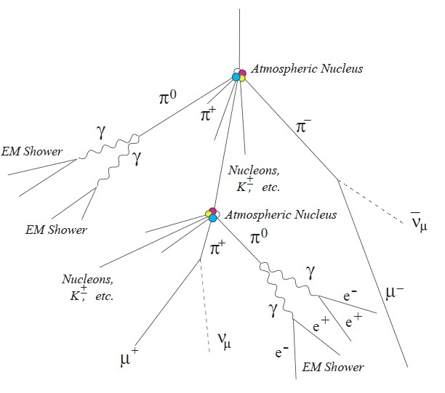
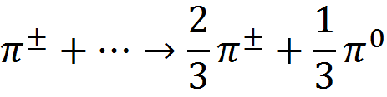
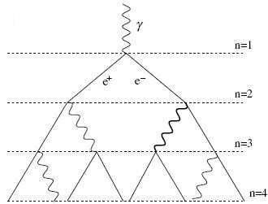


Extensive Air Shower
What is an Extensive Air Shower (EAS)?
Cosmic Ray
(p, Fe, ɣ ... )
Hadronic component
The hadronic interactions produce
p n π⁰ + π⁺ + π ⁻
+ К Λ η Ω Σ …
Electromagnetic Component
Produced mainly by
π⁰ → ɣ ɣ
Bremsstrahlung
Pair production
Compton scattering
Cherenkov
…
High energy pions
Muonic Component
Produced mainly by
Low energy pions can decay

Slide 5
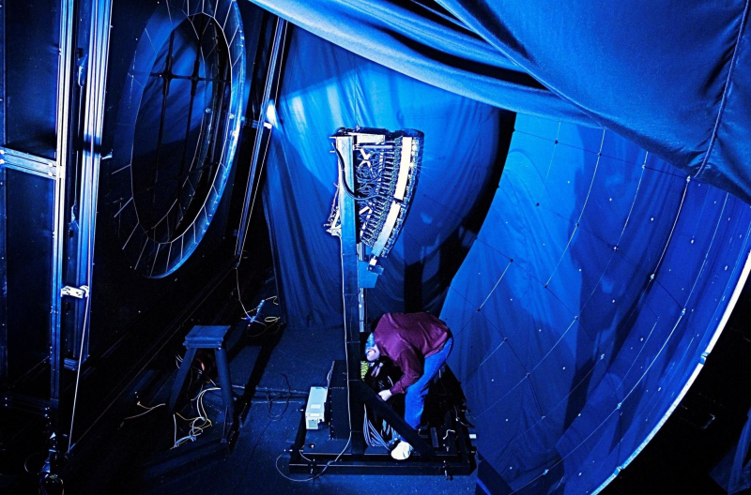
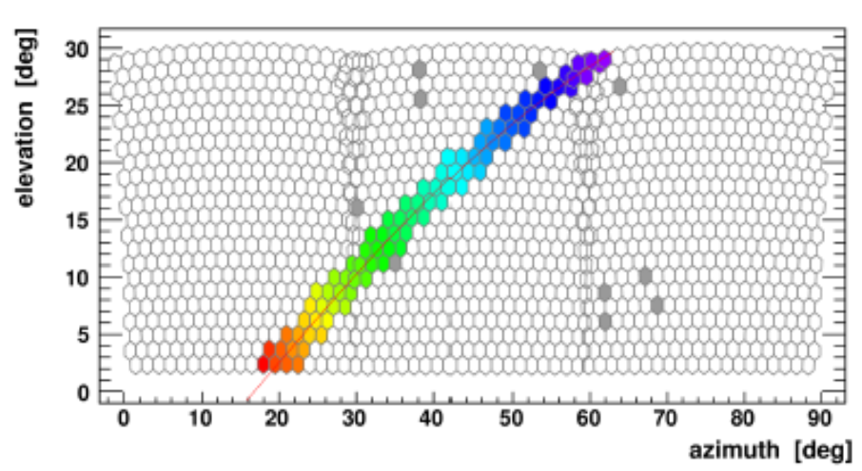
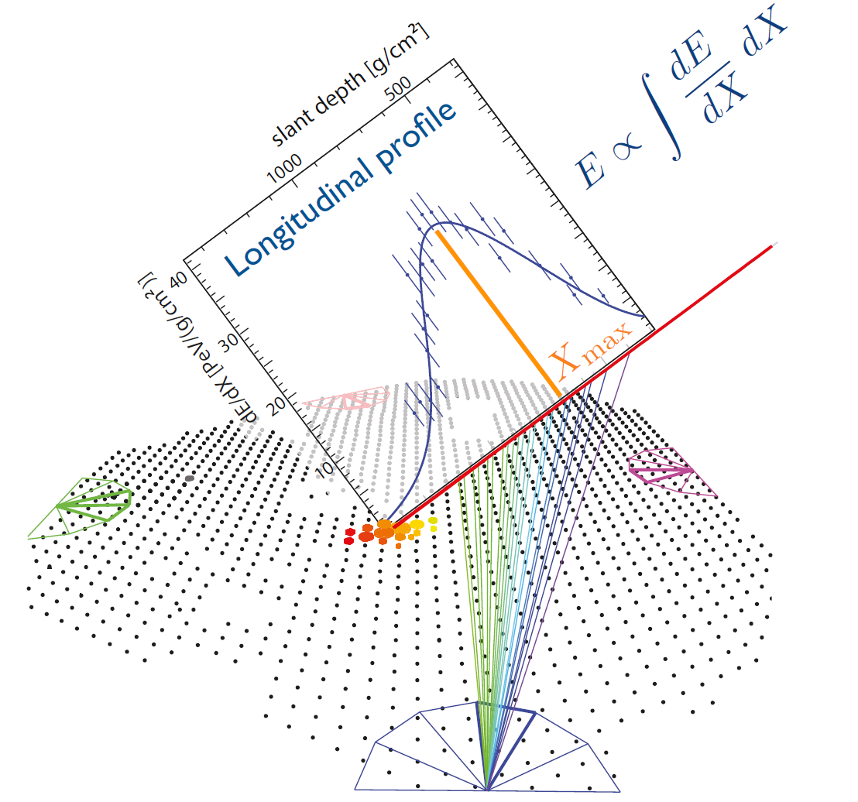
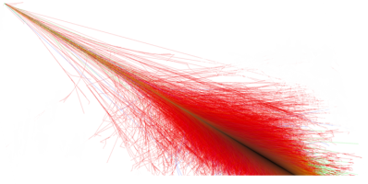
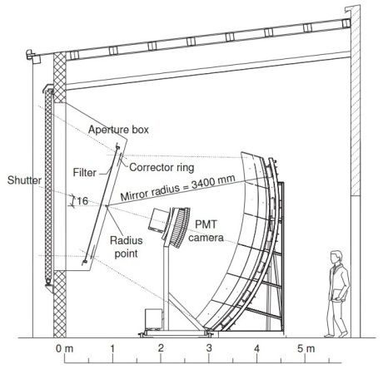
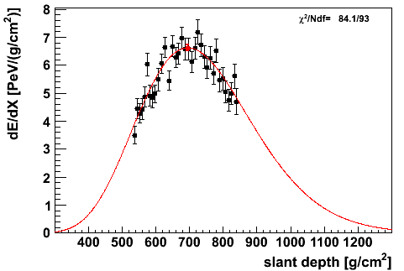
Fluorescence detectors
Image on the telescopes
Typical Event

Slide 6
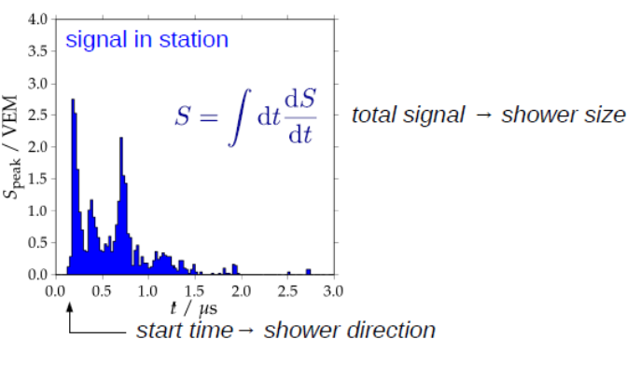
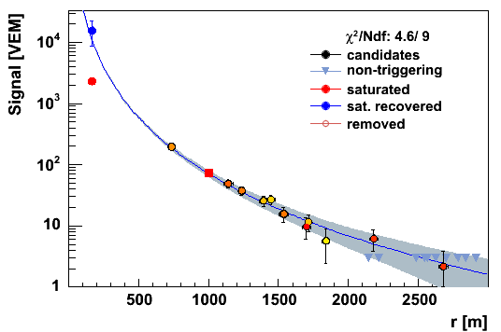
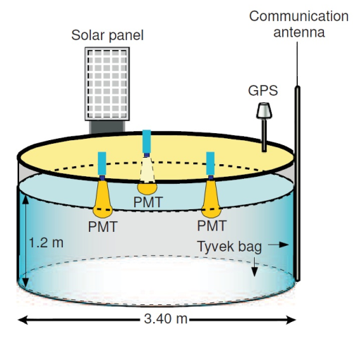
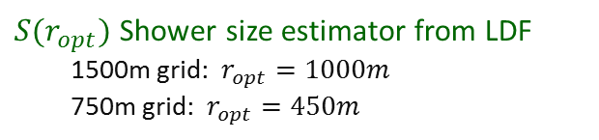
Surface Detectors
PMTs Signals:
$S(r_{opt})$ Shower size estimator from LDF
1500m grid: $r_{opt}=1000m$
750m grid: $r_{opt}=450m$
Model, data-based
LDF Lateral distribution function

Slide 7
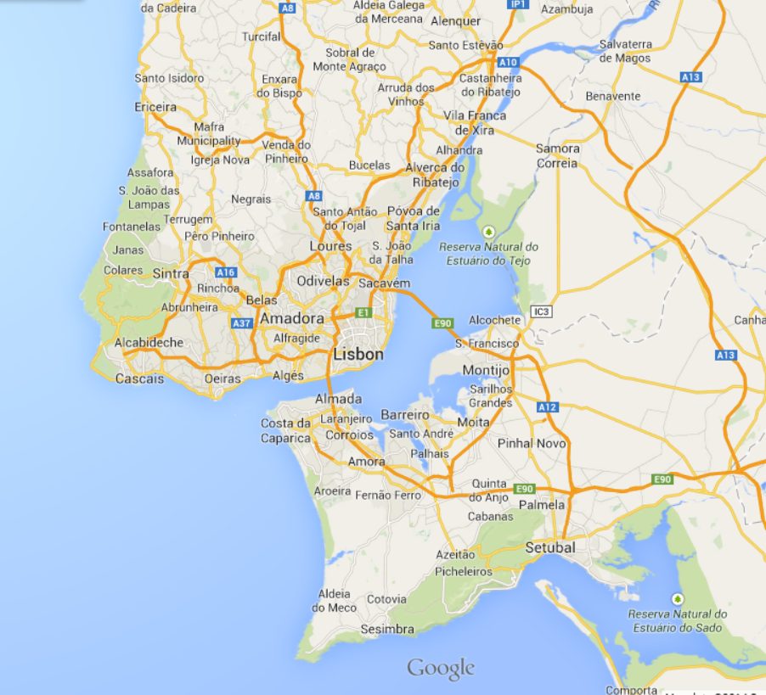
Pierre Auger Observatory
Pierre Auger Observatory
Fluorescence detector
Loma Amarilla: E>1018 eV
Coihueco
Los Morados
Los Leones
HEAT: E>1017 eV
The Pierre Auger Observatory (PAO) was completed in May 2008 (3000km², 1600 Cherenkov tanks and 4 FD facilities, ...)
Surface detector array
1500 m: E>1018.5 eV
750 m (AMIGA): E>1017.5 eV
Radio detection
AERA (MHz)
EASIER (MHz, GHz)
MIDAS (GHz)
Xlf
Clf
Calibration detectors
Lasers: Clf, Xlf
Lidar, Raman
Weather stations, IR camera

Slide 8
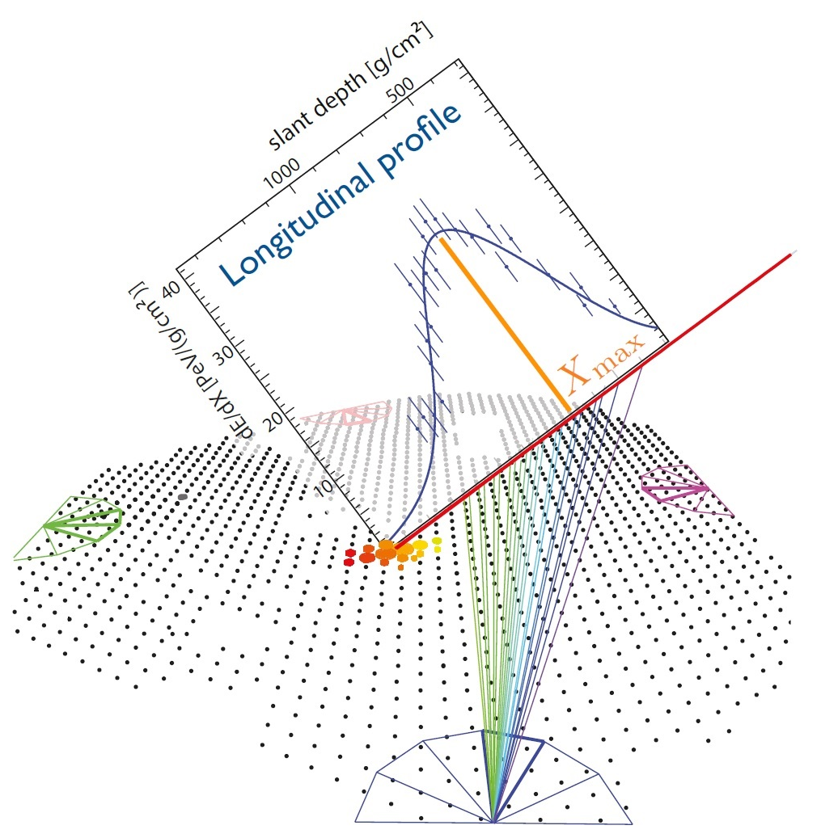
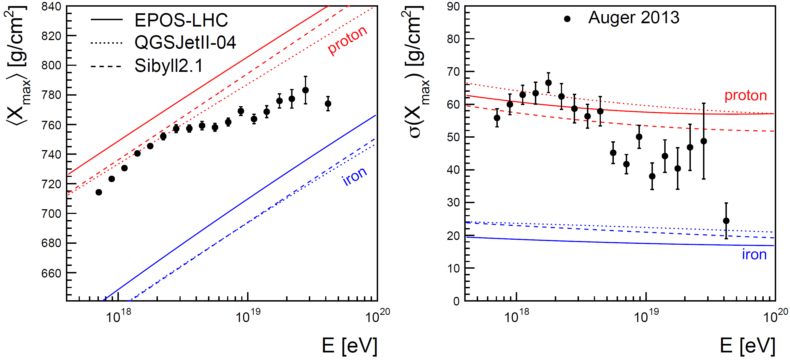


Depth of shower maximum
heavier
V. De Sousa ; E.J. Ahn ICRC2013 arXiv:1307.5059v1

Slide 9
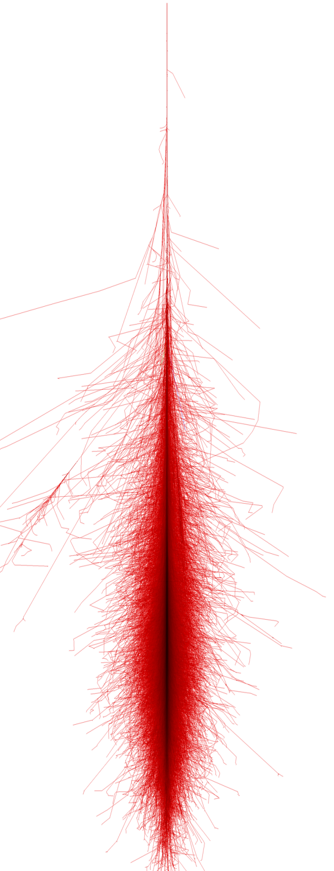
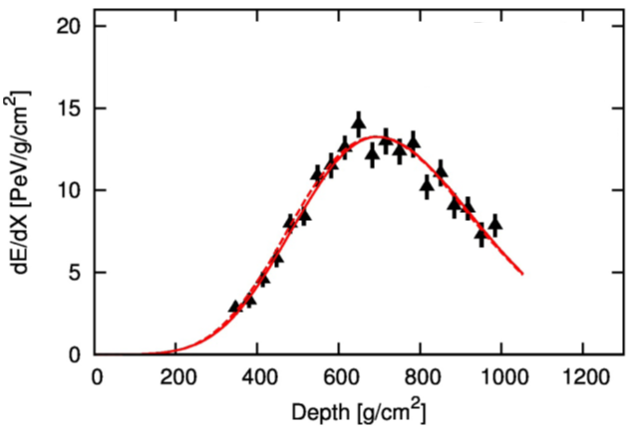
Direct Measurement of muons
Vertical Showers
Inclined Showers
Ground
Ground signal as function of the cosmic ray angle
Vertical events:
Have a big EM component
Very inclined events:
Almost all particles are muons

Slide 10


Muon counting: Muon scale from very inclined air showers
$$Rμ =\frac{N_{μ}\left(event\right)}{N_{μ,E={10}^{19}}}$$
N19
$$R_{μ} /(E/{10}^{19}eV)$$
Very inclined air showers
● Long distance to ground, only muons survive
● First and most direct measurement of muon scale
I. Valino ICRC2013 arXiv:1307.5059v1

Slide 11
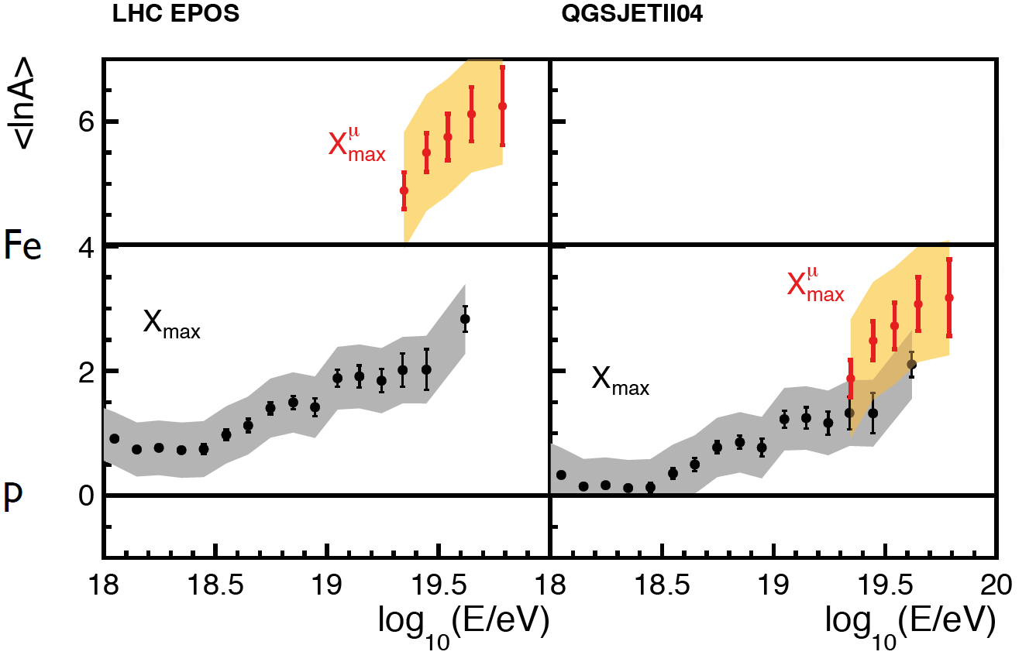
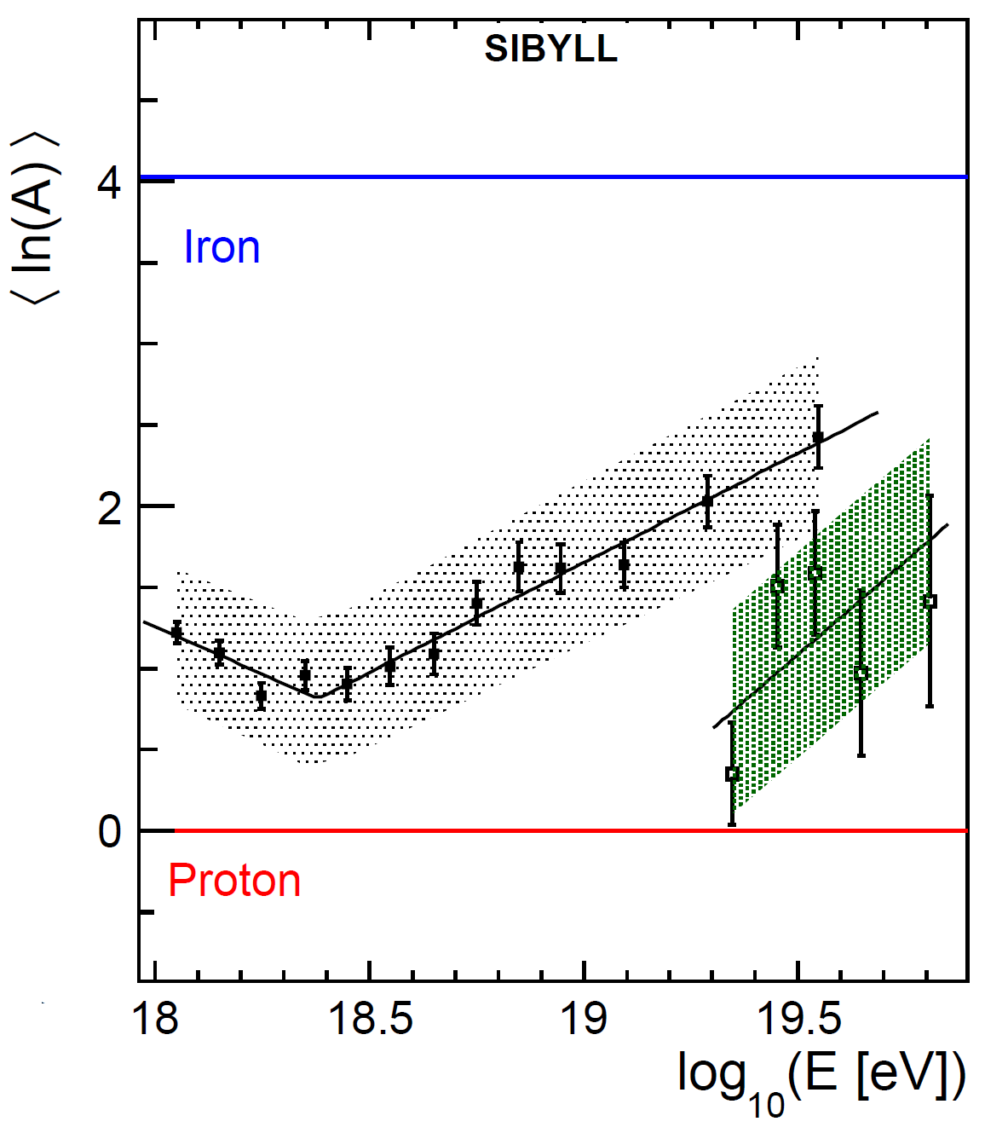
Composition with EM and μ components based on hadronic models
For further explanations about new models See
T. Pierog, Rencontres de Moriond,
VHEPU, La Thuille, March 2013
Composition with EM Component based on models
Composition with muonic Component based on models
SIBYLL

Slide 12

Review
Spectrum
$X_{max}$ and RMS
Muon content
mass composition

Slide 13
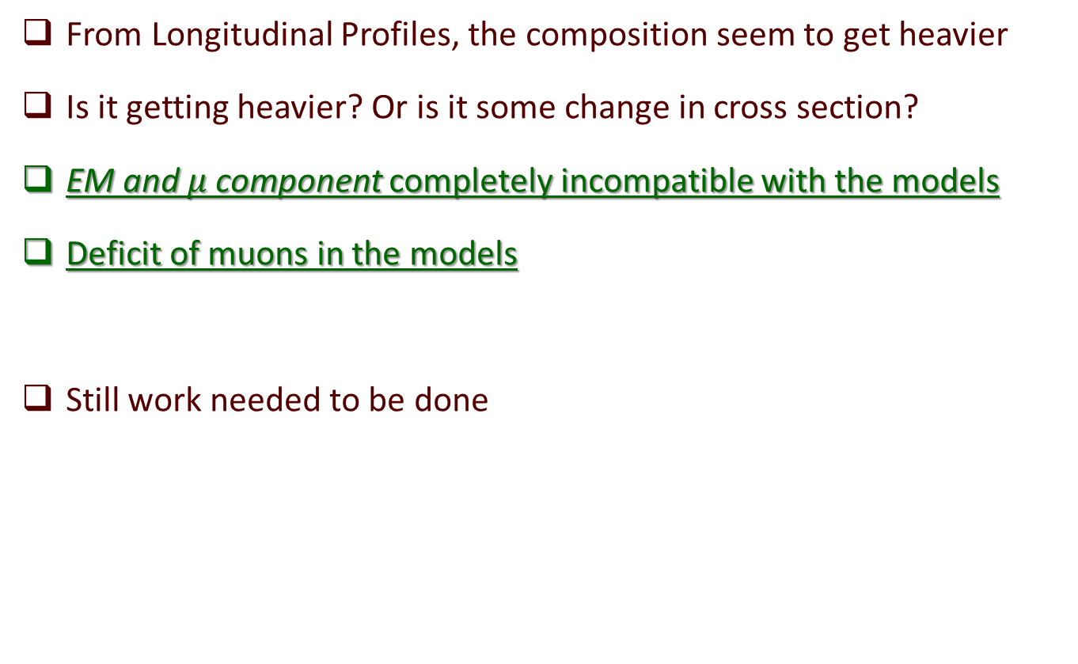
Summary
From Longitudinal Profiles, the composition seem to get heavier
Is it getting heavier? Or is it some change in cross section?
EM and $μ$ component completely incompatible with the models
Deficit of muons in the models
Still work needed to be done
  We are working on a future upgrade.
  A new detector called MARTA, with the purpose to detect the muons
  See Francisco Diogo Poster

Slide 14
Thank You!
Pierre Auger Collaboration
~550 scientists, technicians, students
94 institutions
19 countries

Slide 15
Backup Slides

Slide 17
Remind previous presentation:
Depth of shower maximum
heavier
V. De Sousa ; E.J. Ahn ICRC2013 arXiv:1307.5059v1

Slide 18
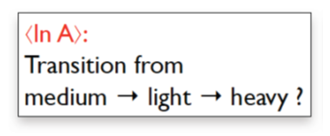
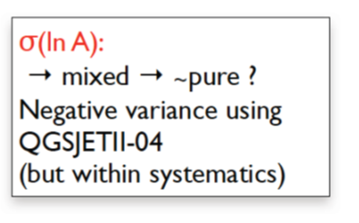
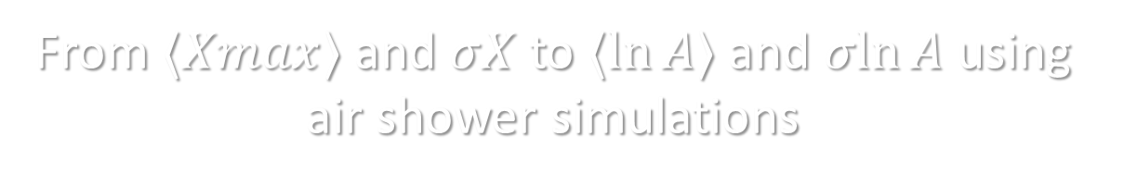
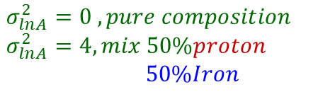
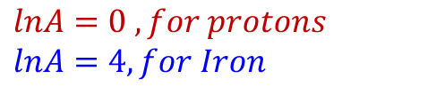
From $⟨Xmax⟩$and $σX$to $⟨ln⁡A⟩$and $σln⁡A$ using air shower simulations
heavier
$$lnA=0 , for protons$$
$$lnA=4, for Iron$$
Pure to mixed
$$σ_{lnA}^{2}=0 , pure composition$$
$$σ_{lnA}^{2}=4, mix 50\%proton$$
$50\%Iron$
E.J. Ahn ICRC2013 arXiv:1307.5059v1

Slide 19
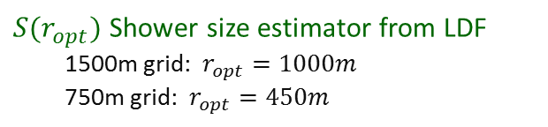
Air shower observables: Surface Detector Array
$S(r_{opt})$ Shower size estimator from LDF
1500m grid: $r_{opt}=1000m$
750m grid: $r_{opt}=450m$
Model, data-based

Slide 20
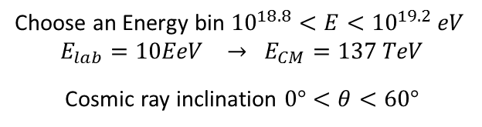
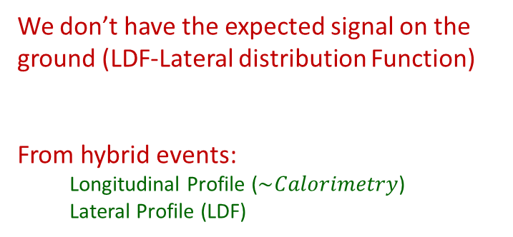

Muonic contribution in hybrid events
We don’t have the expected signal on the ground (LDF-Lateral distribution Function)
From hybrid events:
Longitudinal Profile ($\sim Calorimetry$)
Lateral Profile (LDF)
Atmosphere -> FD -> Longitudinal Profile
Choose an Energy bin ${10}^{18.8}<E<{10}^{19.2} eV$
$$E_{lab}=10EeV → E_{CM}=137 TeV$$
Cosmic ray inclination $0°<θ<60°$
Ground -> SD ->LDF (Lateral distribution Function)
Idea: Re-simulate measured hybrid events(FD+SD)
● Match longitudinal FD light profile
● Rescale ground signal to match SD data
● Contributions of EM and muon component vary with zenith angle
$$S_{resc}=R_{E}S_{EM}+ R_{E}^{α}R_{μ}S_{μ}$$
G. Farrar ICRC2013 arXiv:1307.5059v1

Slide 21

Muonic contribution in hybrid events
Ground Signal from MC
have different EM/muon component
$$S_{resc}=R_{E}S_{EM}+ R_{E}^{α}R_{μ}S_{μ}$$
Muon number in simulations is too low by at least a factor of 1.3
Beware: Fixing models with two factors is probably not the end of story
Energy Rescaling ⬄ EM rescaling:
G. Farrar ICRC2013 arXiv:1307.5059v1

Slide 22
Direct Measurement of muons
Vertical Showers
Inclined Showers
Ground
Ground signal as function of the cosmic ray angle
Vertical events:
Have a big EM component
Very inclined events:
Almost all particles are muons

Slide 23
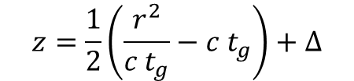
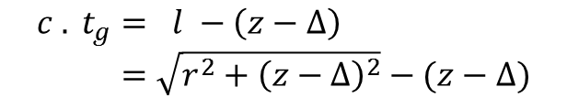
Muon Production Depth
Inclined events to avoid
EM contamination
Example at 60º
Geometric Delay of arriving muons:
Mapped to Muons Production Depth:
$$c . t_{g}= l −\left(z−Δ\right) \\ =\sqrt{r^{2}+{\left(z−Δ\right)}^{2}}−(z−Δ)$$
$$z=\frac{1}{2}\left(\frac{r^{2}}{c t_{g}}−c t_{g}\right)+Δ$$
D. Garcia-Gamez ICRC2013 arXiv:1307.5059v1

Slide 24
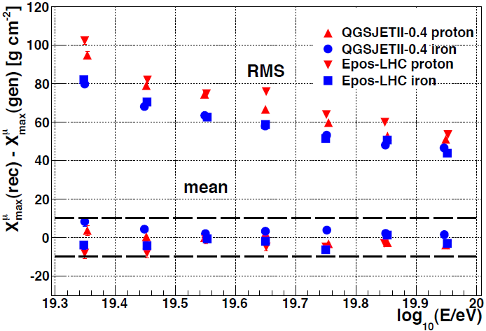

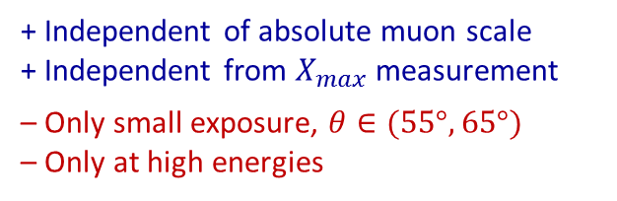
Muon Production Depth
Data from ICRC13
Reasonable resolution and bias compared to
$ΔX_{max}^{μ} (p, Fe) \sim 70 g cm^{−2}$
+ Independent of absolute muon scale
+ Independent from $X_{max}$ measurement
– Only small exposure, $θ∈(55°, 65°)$
– Only at high energies
D. Garcia-Gamez ICRC2013 arXiv:1307.5059v1
Notes:
Only high energy events at 60o zenith.
Poor resolution at the lowest energies due to
sparseness of the detector (low muon statistics)
Independent technique, allows additional constraints and further
understanding of high energy hadronic models

Slide 25
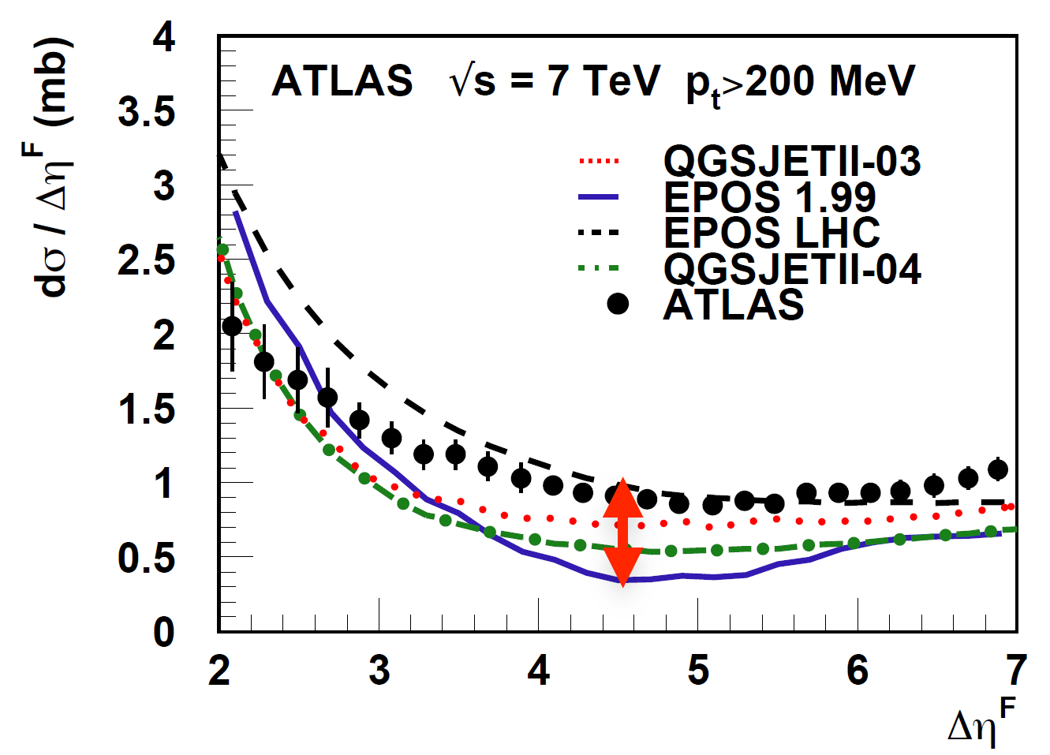



$⟨ln⁡A⟩$from $⟨X_{max}⟩$and muon production depth
See T. Pierog, Rencontres de Moriond,
VHEPU, La Thuille, March 2013
$X_{max}$ ->EM Component
$X_{μmax}$ ->muonic Component
Different pseudorapidity distributions

Slide 26
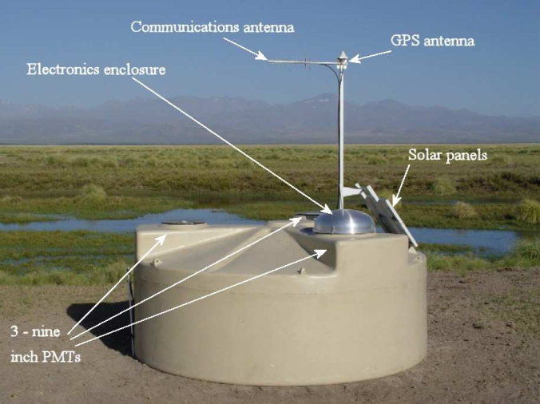
Indirect measurements
SD signal has detailed time structure → exploitable!
Water Cherenkov stations, Signal are digitalised with 25ns
muon rich
hadronic cosmic rays q > 60°
EM rich
hadronic cosmic rays q < 60°
neutrinos, photons

Slide 27
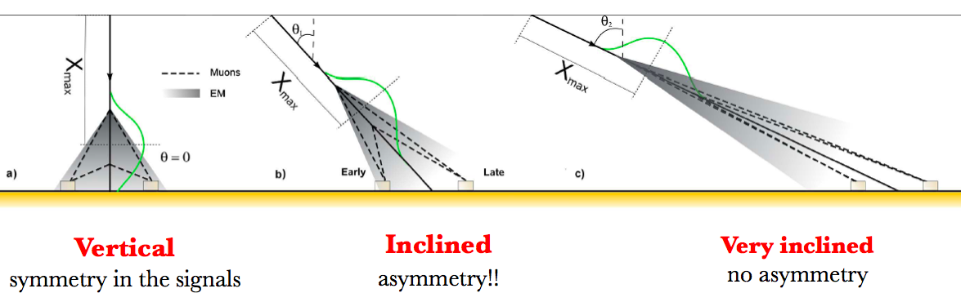

Asymmetry of the Signal Rise Time
See D. Garcia-Pinto, ICRC2011 ; M.Dova, F.Arqueros et al, Astropart.Phys.31:312-319,2009
-> look at the angles where the maximum difference is
$$t_{1/2}/r=a+b.cos⁡(ζ)$$

Slide 28
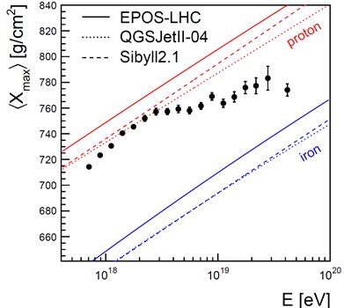
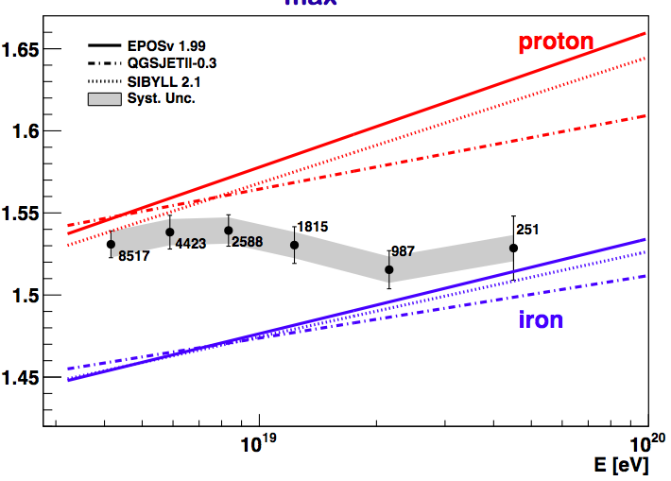
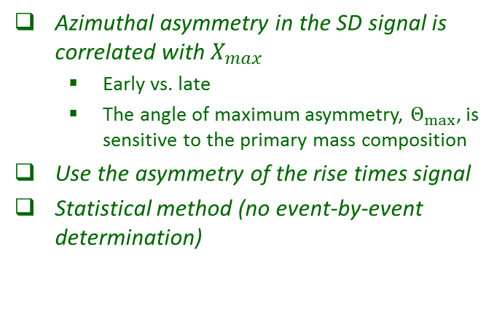
Asymmetry of the Signal Rise Time
See D. Garcia-Pinto, ICRC2011
Azimuthal asymmetry in the SD signal is correlated with $X_{max}$
  Early vs. late
  The angle of maximum asymmetry, $Θ_{max}$, is sensitive to the primary mass composition
Use the asymmetry of the rise times signal
Statistical method (no event-by-event determination)

Slide 29
Muon counting: Muon scale from very inclined air showers
Rμ = Nμ(event) / (E/10^19)
N19
N19
Very inclined air showers
● Long distance to ground, only muons survive
● First and most direct measurement of muon scale
I. Valino ICRC2013 arXiv:1307.5059v1

Slide 30
Indirect muon measurements
Water Cherenkov stations, Signal are digitalised with 25ns

Slide 31
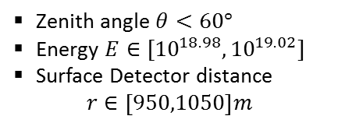

Muon counting: Muon fraction from signal shape
2 Methods
Smoothing Method
Multivariate Method
We want to estimate the muon fraction on the Surface signals
$$f_{μ}=S_{μ}/S$$
Compare the muon content with some reference
Muon component change with energy and zenith angle:
Zenith angle $θ<60°$
Energy $E∈[{10}^{18.98},{10}^{19.02}]$
Surface Detector distance
$r∈\left[950,1050\right]m$

Slide 32
Muon counting: Muon fraction from signal shape
Muonic signal is peaky,
e.m. signal smooth
Muon signal sharp spike with fast decay,
e.m. signal low and elongated
Model predictions for shapes are robust
Smoothing Method
– Smooth with low pass filter
– Assign positive difference to μ-signal
– Iterate until convergence
B. Kegl ICRC2013 arXiv:1307.5059v1

Slide 33

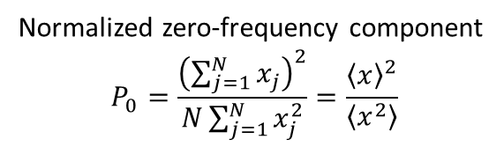
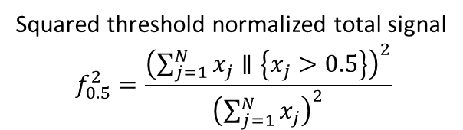
Muon counting: Muon fraction from signal shape
Multivariate Method
$f_{μ}=S_{μ}/S$
$$f_{μ}=a+bθ+cf_{0.5}^{2}+d θ P_{0}+e r$$
Squared threshold normalized total signal
$$f_{0.5}^{2}=\frac{{\left(\sum_{j=1}^{N}{x_{j}}∥\left\{x_{j}>0.5\right\}\right)}^{2}}{{\left(\sum_{j=1}^{N}{x_{j}}\right)}^{2}}$$
Normalized zero-frequency component
$$P_{0}=\frac{{\left(\sum_{j=1}^{N}{x_{j}}\right)}^{2}}{N\sum_{j=1}^{N}{x_{j}^{2}}}=\frac{{\left\langle x\right\rangle }^{2}}{\left\langle x^{2}\right\rangle }$$
B. Kegl ICRC2013 arXiv:1307.5059v1

Slide 34




Muon counting: Muon fraction from signal shape
Total Signal Corrected for the center of the bin in radius and energy
$f_{μ}=S_{μ}/S$
$$S\left(1000\right)=S\frac{LDF(1000m)}{LDF(r)}$$
While the measured angular dependence of the muonic signal is found to be similar to the prediction obtained for proton showers and QGSJETII.04, the magnitude of the muonic signal is comparable to the predictions for iron showers.
$$S_{19}=S\left(1000\right)×C(E)$$
Zenith angle $θ<60°$
Energy $E∈[{10}^{18.98},{10}^{19.02}]$
Surface Detector distance
$r∈\left[950,1050\right]m$
B. Kegl ICRC2013 arXiv:1307.5059v1

Slide 35




Muon counting: Muon fraction from signal shape
$$+$$
Energy ${10}^{19}eV$
$$S_{μ19}\left(1000\right)=f_{μ}×S_{19}(1000)$$
$1.33±0.02(stat.)±0.05(sys.)$(multivariate)
$1.31±0.02(stat.)±0.09(sys.)$(smoothing)
B. Kegl ICRC2013 arXiv:1307.5059v1

Slide 36

Review
Spectrum
$X_{max}$ and RMS
mass composition
Muon content
$${10}^{19} eV$$

Slide 37
Backup Slides

Slide 38
MPD

Slide 39
arXiv:1109.2041
arXiv:1209.6474
$$σ_{p−air}=505±{22\left(stat\right)}_{−36}^{+28}\left(syst\right)mb$$
At 57 TeV
$$σ_{p−p}^{inel}=92±{7\left(stat\right)}_{−11}^{+9}\left(syst\right)±7(Glauber)mb$$

Slide 40
Rescaling by G. Farrar

Slide 41




Shower Evolution
Electromagnetic component, feeded by $π^{0}$
$$λ∝σ^{−1}$$
$σ>$ -> $X_{max}<$
$RMS X_{max}<$
$Multiplicity>$ -> $X_{max}<$
Muonic component, mainly feeded by $π^{+/−}$
But high energy $π^{+/−}$ -> interacts producing $π^{+/−}+π^{0}$
Low energy $π^{+/−}$ -> decays to $μ^{+/−}$

Slide 42
From T. Pierog, Rencontres de Moriond, VHEPU, La Thuille, March 2013;
and doi:10.1088/1742-6596/409/1/012008
R. Ulrich (KIT) with Sibyll model and PAO data @ 1019 eV

Slide 43
See T. Pierog, Rencontres de Moriond,
VHEPU, La Thuille, March 2013;
doi:10.1088/1742-6596/409/1/012008
Similar Xmax results for the new models

Slide 47


See T. Pierog, Rencontres de Moriond,
VHEPU, La Thuille, March 2013
QGSJetII-04
EPOS-LHC
QGSJETII.03
EPOS1.99

Slide 49
Old Versions

Slide 50


Old Versions
$$lnA=0 , for protons$$
$$lnA=4, for Iron$$
$$σ_{lnA}^{2}=0 , pure composition$$
$$σ_{lnA}^{2}=4, mix 50\%proton$$
$50\%Iron$
Energy from 10¹⁸ eV to 10^{19.6} eV
(increasing size points with energy)
New Versions

Slide 51


Xmax and Nμ
Correlate different variables
For a particular energy,
each model predicts different phase-space for mean and RMS values,
when we change the composition
This is a very important test to the hadronic models since the data points for a particular energy could be out of the model phase-space
A Multivariate analysis allows us to give very strong constrains and to rule out models
For a energy 10¹⁹eV the data point stays very far away from the phase space allowed by the models
P
He
N
Fe
GAP 2013-004

Slide 52
Old Versions
Diego Garca-Pinto ICRC2011 arXiv:1107.4804v1

Slide 53

Distribution of Xmax
Pedro Facal ICRC2011 arXiv:1107.4804v1

Slide 54

Shape of Xmax
Pedro Facal ICRC2011 arXiv:1107.4804v1

Slide 55

Xmax
Only with hybrid events
Recent Xmax results:
Xmáx
Cross section?
Or Composition?
ICRC 2013, arXiv:1307.5059v1

Slide 56

$X_{max}$ and cross section

Slide 57
Pedro Facal ICRC2011 arXiv:1107.4804v1

Slide 58
Pierre Auger Collaboration arXiv:1208.1520v2 ; Ralf Ulrich ICRC2011 arXiv:1107.4804v1

Slide 60
$$σ_{p−air}=505±{22\left(stat\right)}_{−36}^{+28}\left(syst\right)mb$$
At 57 TeV
$$σ_{p−p}^{inel}=92±{7\left(stat\right)}_{−11}^{+9}\left(syst\right)±7(Glauber)mb$$
Pierre Auger Collaboration arXiv:1208.1520v2 ; Ralf Ulrich ICRC2011 arXiv:1107.4804v1

Slide 61
$$σ_{p−air}=505±{22\left(stat\right)}_{−36}^{+28}\left(syst\right)mb$$
At 57 TeV
$$σ_{p−p}^{inel}=92±{7\left(stat\right)}_{−11}^{+9}\left(syst\right)±7(Glauber)mb$$
Pierre Auger Collaboration arXiv:1208.1520v2 ; Ralf Ulrich ICRC2011 arXiv:1107.4804v1

Slide 62
$$σ_{p−air}=505±{22\left(stat\right)}_{−36}^{+28}\left(syst\right)mb$$
At 57 TeV
$$σ_{p−p}^{inel}=92±{7\left(stat\right)}_{−11}^{+9}\left(syst\right)±7(Glauber)mb$$

Slide 63
Pierre Auger Collaboration arXiv:1208.1520v2 ; Ralf Ulrich ICRC2011 arXiv:1107.4804v1

Slide 64
Pierre Auger Collaboration arXiv:1208.1520v2 ; Ralf Ulrich ICRC2011 arXiv:1107.4804v1

Slide 66

Energy Calibration of the surface dectector
$$S_{1000}$$

Slide 67
Shower size/energy estimation
A. Schulz, D. Ravignani ICRC 2013 arXiv:1307.5059v1

Slide 68
A. Schulz, D. Ravignani ICRC 2013 arXiv:1307.5059v1

Slide 69
Calibrate shower size estimators to calorimetric FD energy using
unbiased subset of hybrid events
A. Schulz, D. Ravignani ICRC 2013 arXiv:1307.5059v1

Slide 70
Depth of shower maximum

Slide 71
Remind previous presentation:
Depth of shower maximum
Longitudinal Profile (on atmosphere)
Xmax
V. De Sousa ; E.J. Ahn ICRC2013 arXiv:1307.5059v1

Slide 72



Summary
From Longitudinal Profiles, the composition seem to get heavier
Is it getting heavier? Or is it some change in cross section?
$X_{μ max}$ completely not compatible with EPOS-LHC
Deficit of muons in the models
Still work needed to be done
  And work on the future upgrade, to disentangle this questions.
Muons and $X_{max}$
$${10}^{19} eV$$

