Slide 1
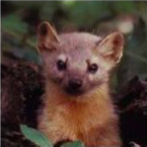

Mean muon LDFs and Energy resolution with MARTA
5th MARTA Progress Meeting
Auger LIP Group
João Espadanal, Patricia Gonçalves,
Mário Pimenta, Sofia Andringa
Biblioteca Nacional, Lisboa
24th September 2014
1

Slide 2
Outline
LDF for Proton and Iron in MARTA
  LDF Parameter slope
  Silent Stations
Energy Reconstruction on MARTA

Slide 3
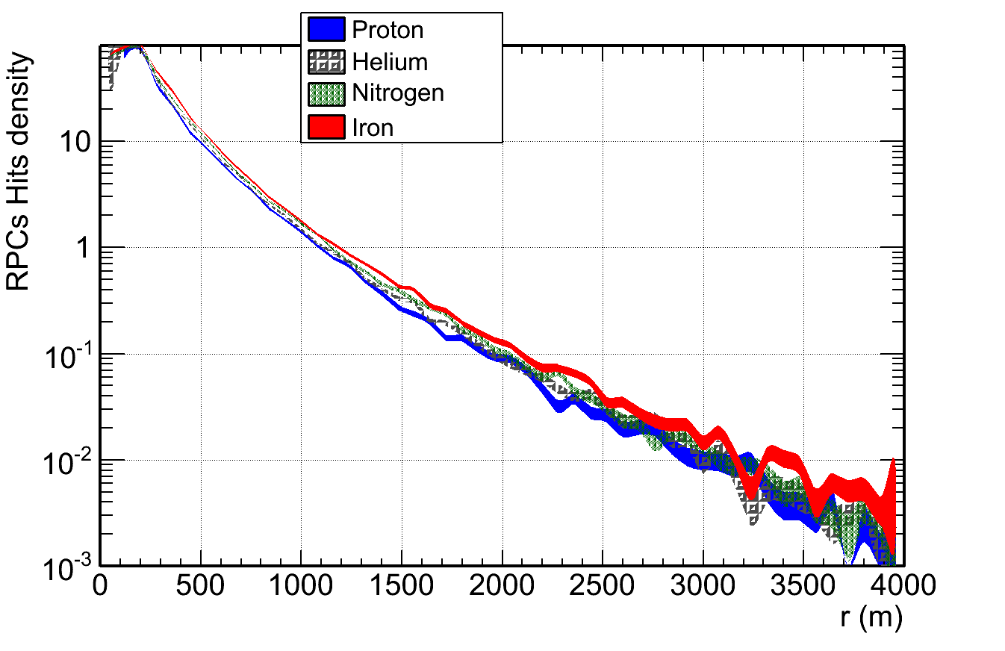

Mean LDF on MARTA
$E=10^{19}eV$ $θ=38°$

Slide 4
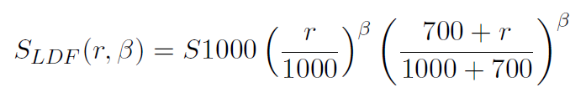
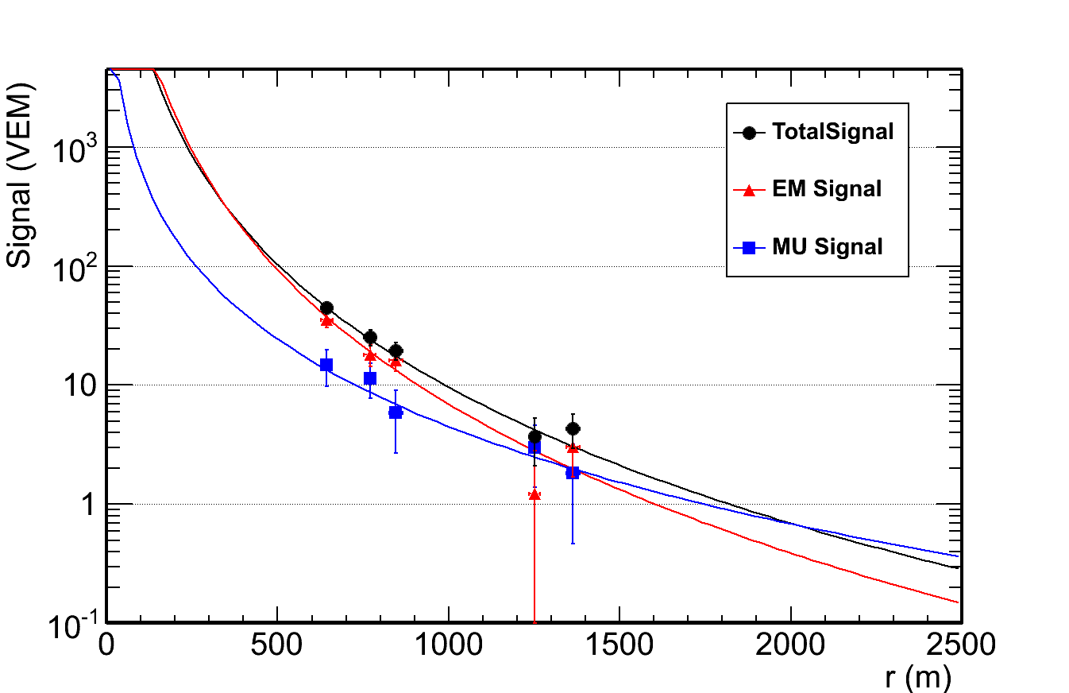
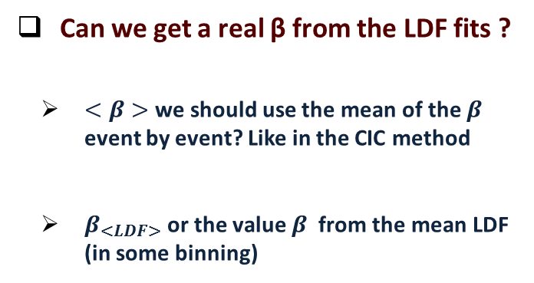

Analyzing the slope β
$$θ={21}^{∘}$$
Can we get a real β from the LDF fits ?
$<β>$ we should use the mean of the $β$ event by event? Like in the CIC method
$β_{<LDF>}$ or the value $β$ from the mean LDF (in some binning)

Slide 5
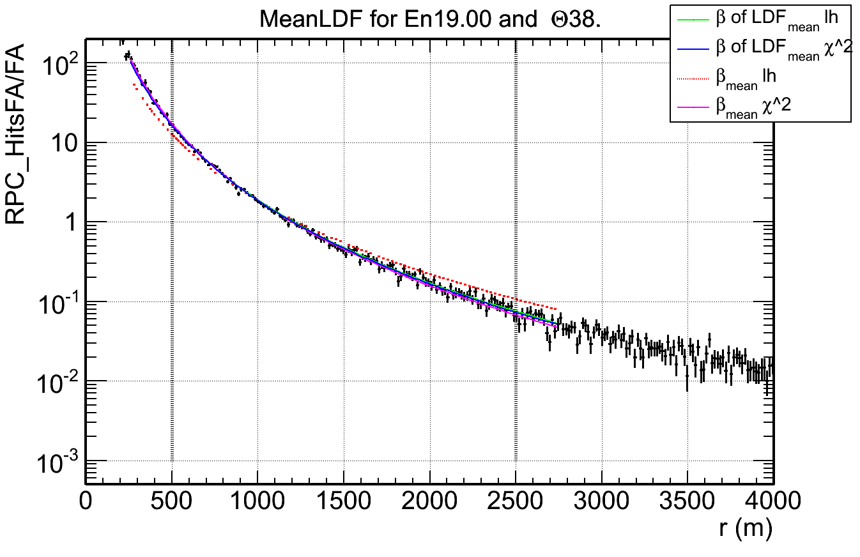
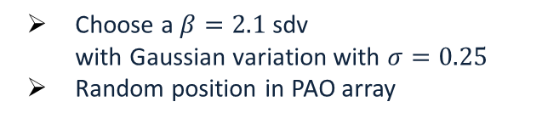
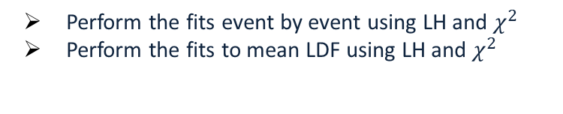
LDF with a toy Model
Choose a $β=2.1$ sdv
with Gaussian variation with $σ=0.25$
Random position in PAO array
Perform the fits event by event using LH and $χ^{2}$
Perform the fits to mean LDF using LH and $χ^{2}$

Slide 6
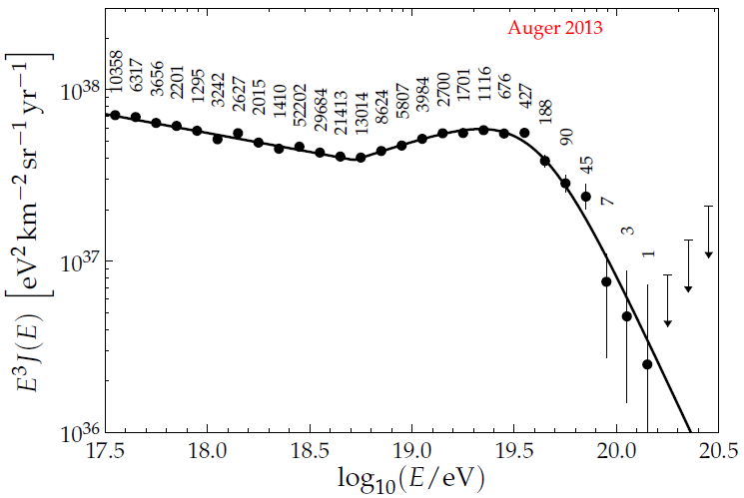
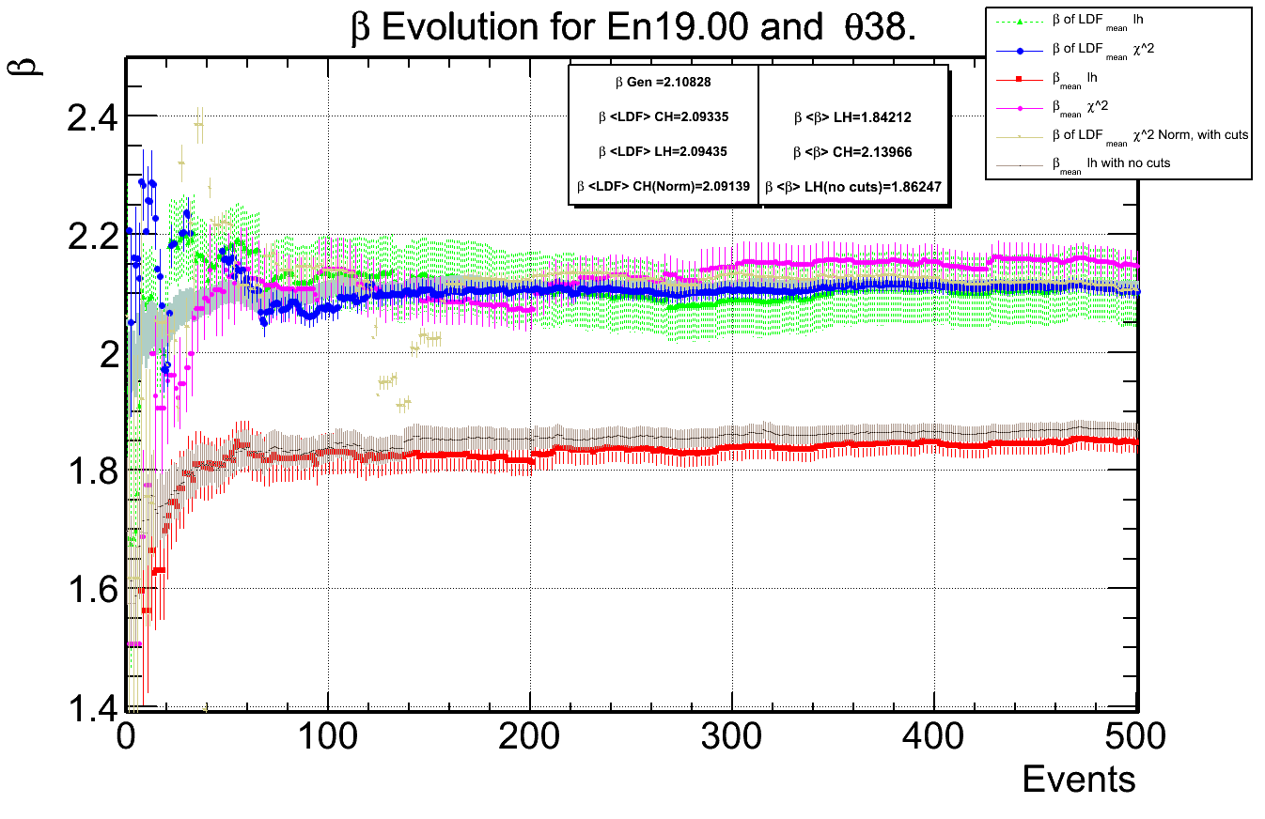
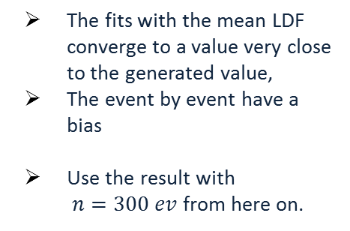

LDF with a toy Model
Fit results for every option,
evolution with number events used,
After some number of events we get a value of beta stable for each
$β=2.1$, $σ=0.25$ and $ρ_{1000}=2.0$
The fits with the mean LDF converge to a value very close to the generated value,
The event by event have a bias
Use the result with
$n=300 ev$ from here on.

Slide 7
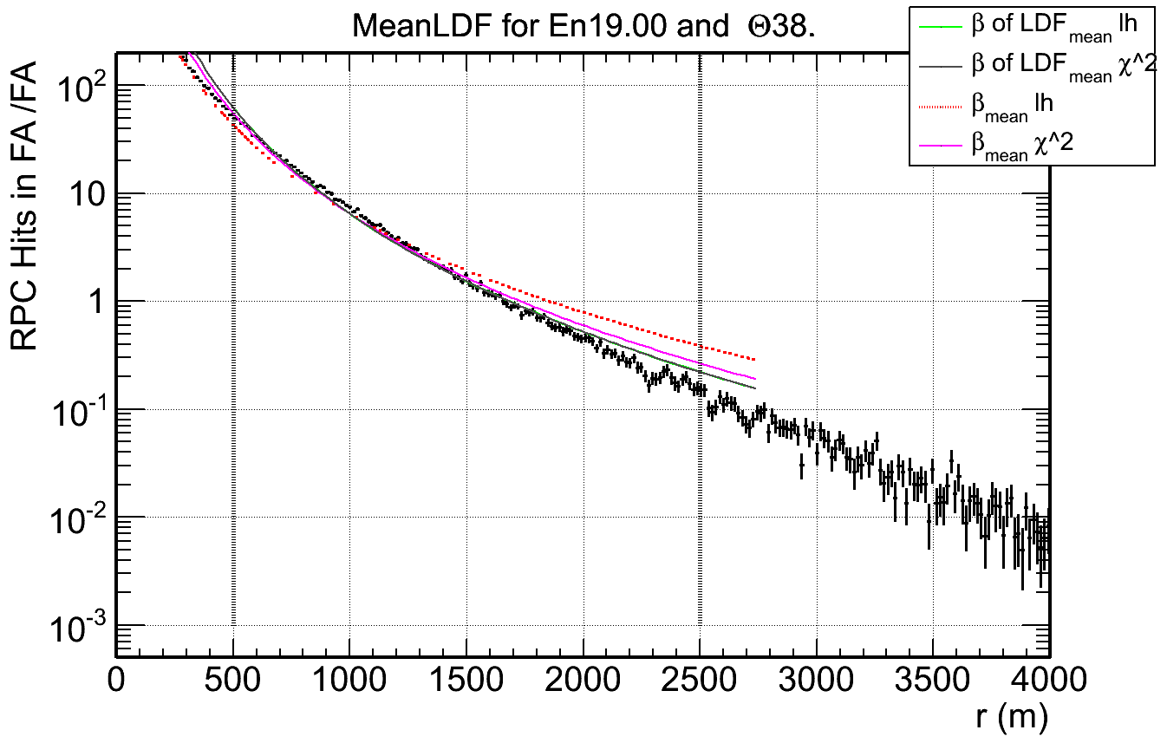
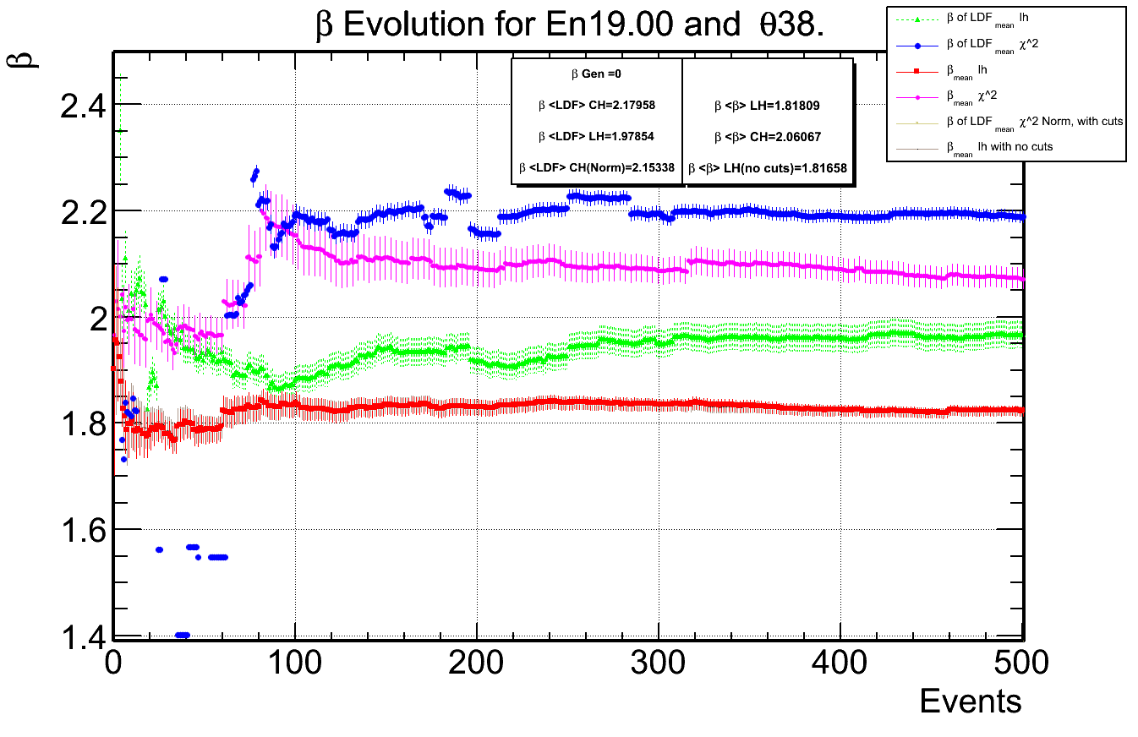
slope β on MARTA

Slide 8
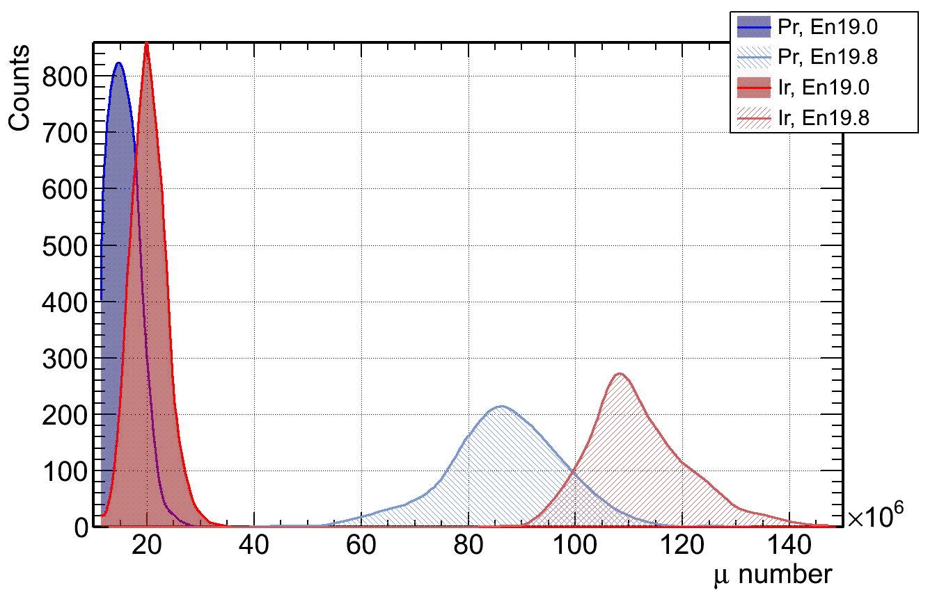
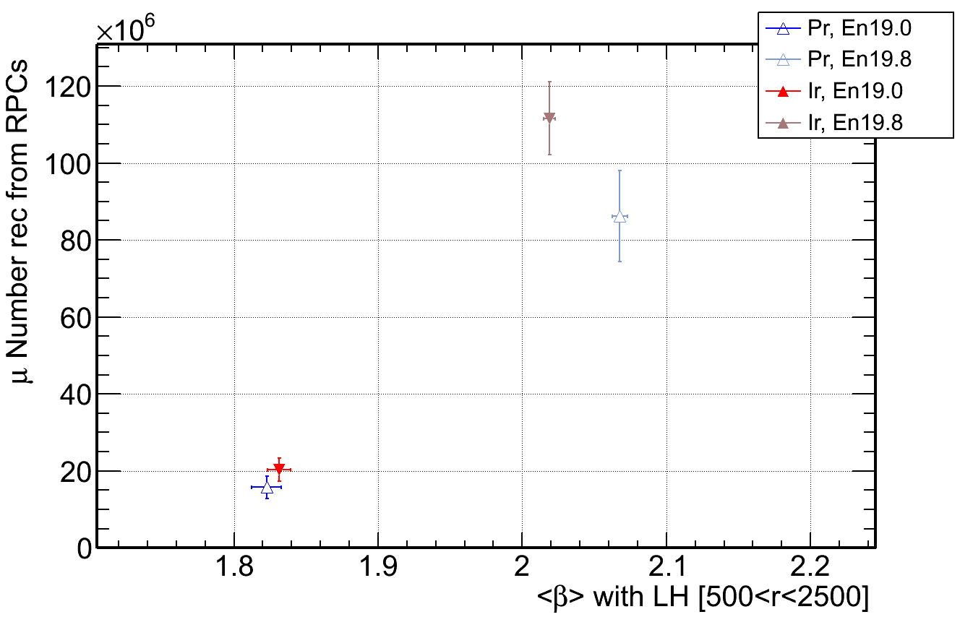
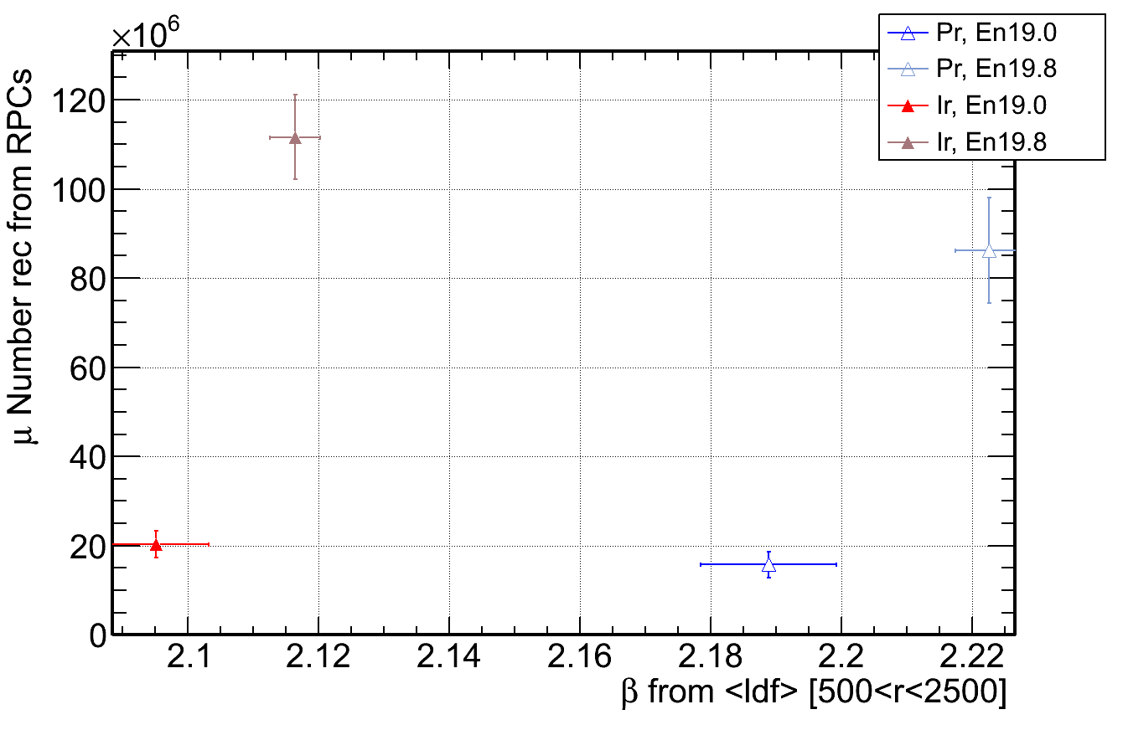



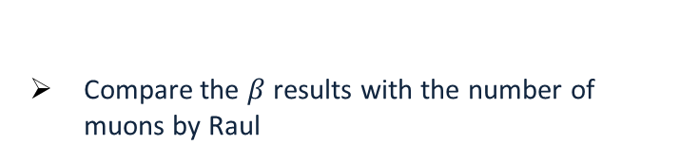

slope β and other variables
Compare the $β$ results with the number of muons by Raul
$<β>$ event by event
$β_{<LDF>}$ mean LDF
$$θ=38°$$
$$θ=38°$$

Slide 9
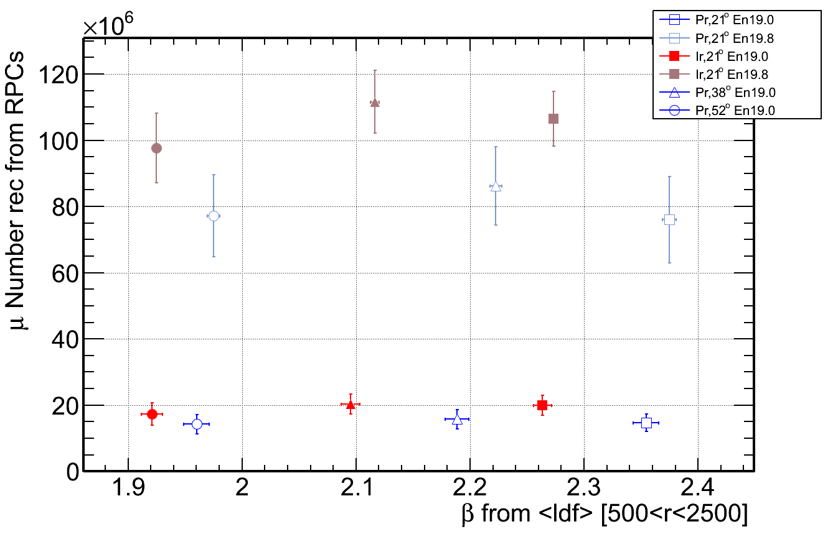



slope β vs μ number
$$θ=21°$$
$$θ=38°$$
$$θ=52°$$

Slide 10
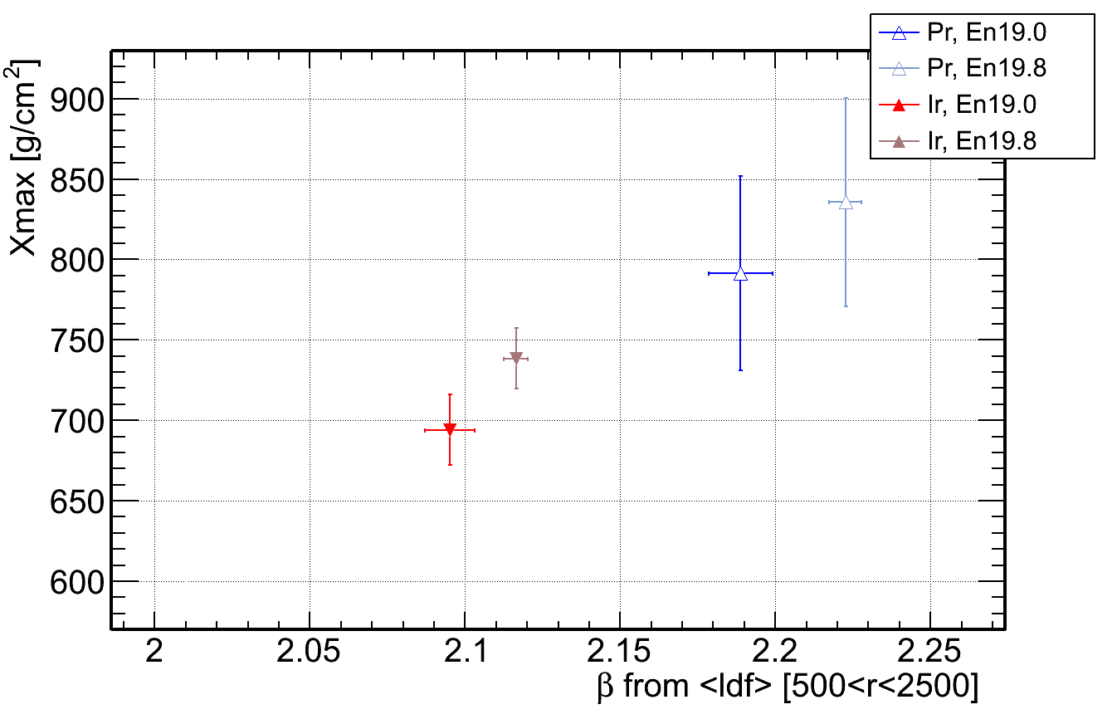
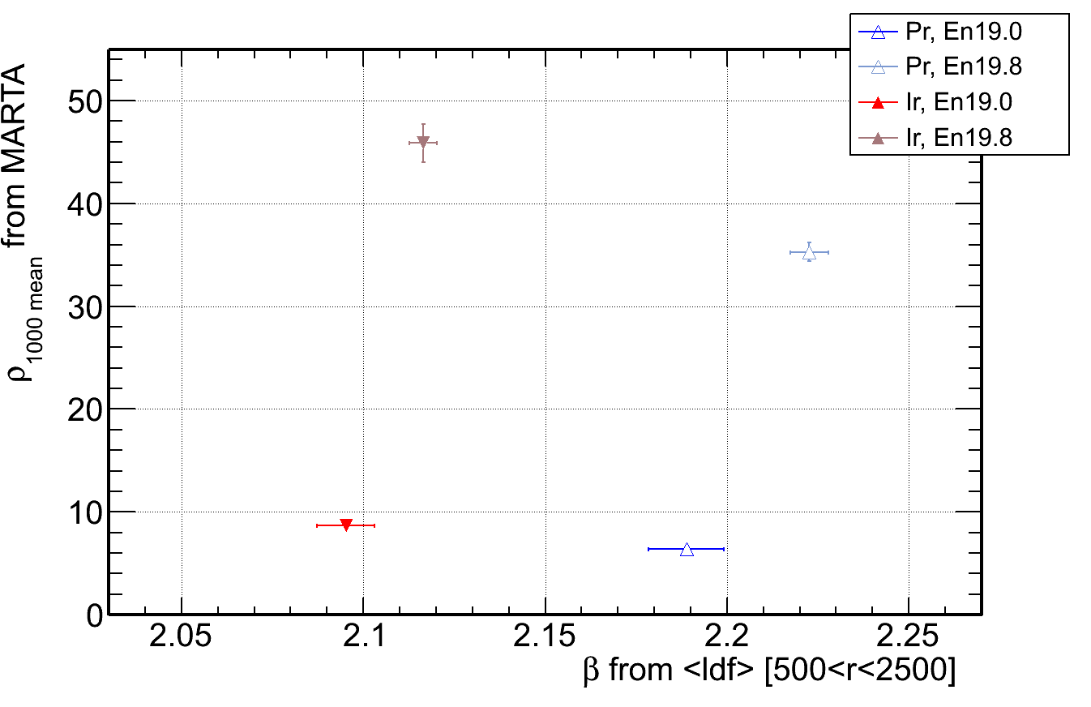
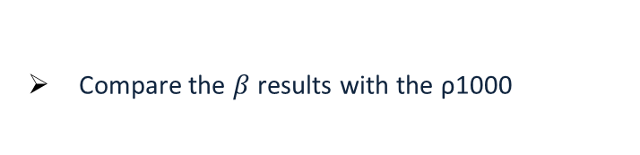
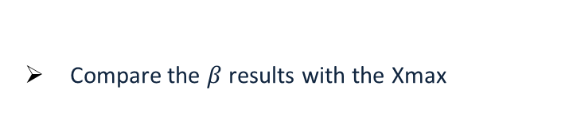
slope β vs Xmax and ρ1000
Compare the $β$ results with the Xmax
Compare the $β$ results with the ρ1000

Slide 11
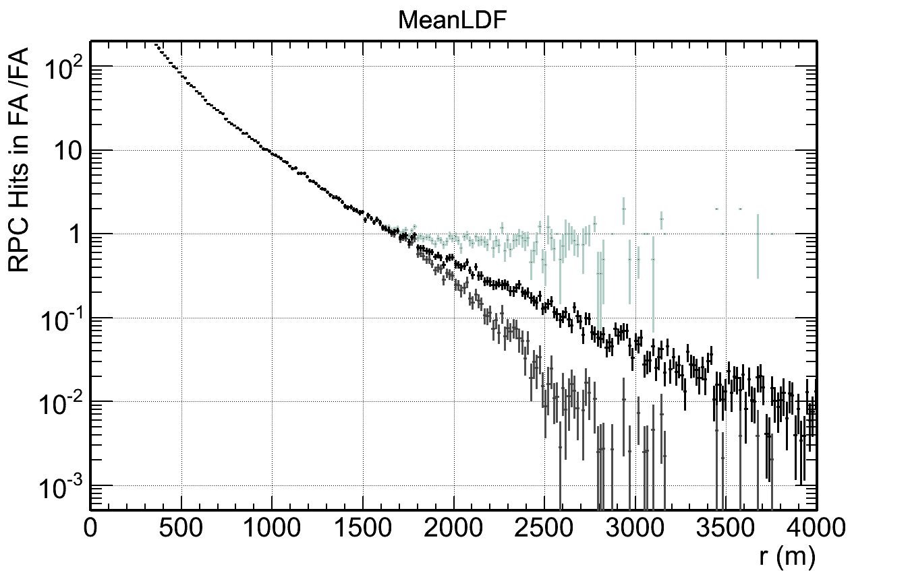
Problem! Station with no trigger!
No trigger -> Silent Stations
No MARTA stations
Use all MARTA stations
No trigger -> Silent Stations
MARTA stations Signal=0

Slide 12

New possible Fit!
Poisson distribution
$$F_{+}\left(S1000,β,r\right)=\frac{\sum_{k>cut}{Poisson\left[LDF\left(S1000,β,r\right)\right]∗k } }{\sum_{k>cut}{Poisson\left[LDF\left(S1000,β,r\right)\right]}}$$
$$F_{−}\left(S1000,β,r\right)=\frac{\sum_{k>cut}{Poisson\left[LDF\left(S1000,β,r\right)\right]∗k }}{1}$$
Trigger CUT

Slide 13
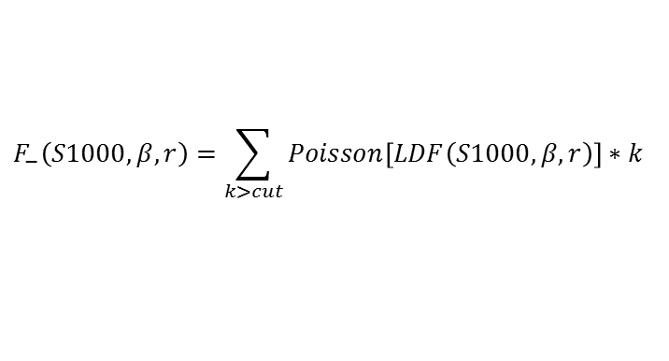
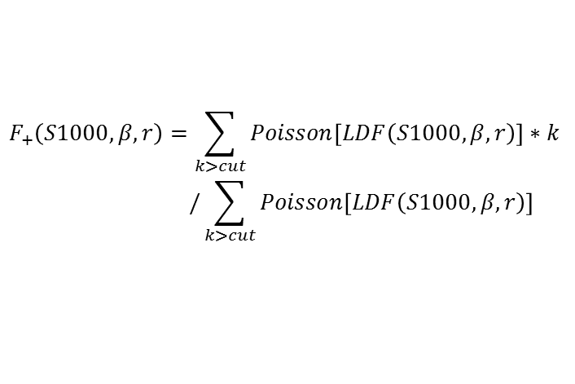
$$F_{+}\left(S1000,β,r\right)=\sum_{k>cut}{Poisson\left[LDF\left(S1000,β,r\right)\right]∗k } \\ /\sum_{k>cut}{Poisson\left[LDF\left(S1000,β,r\right)\right]}$$
$$F_{−}\left(S1000,β,r\right)=\sum_{k>cut}{Poisson\left[LDF\left(S1000,β,r\right)\right]∗k }$$

Slide 14
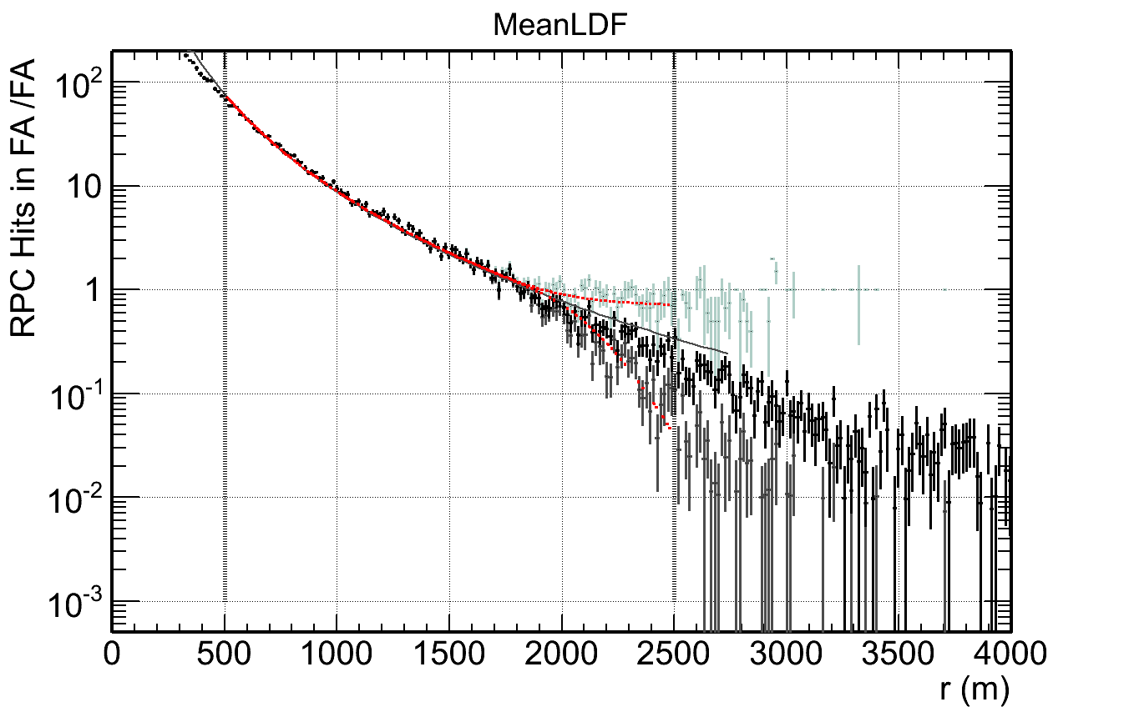
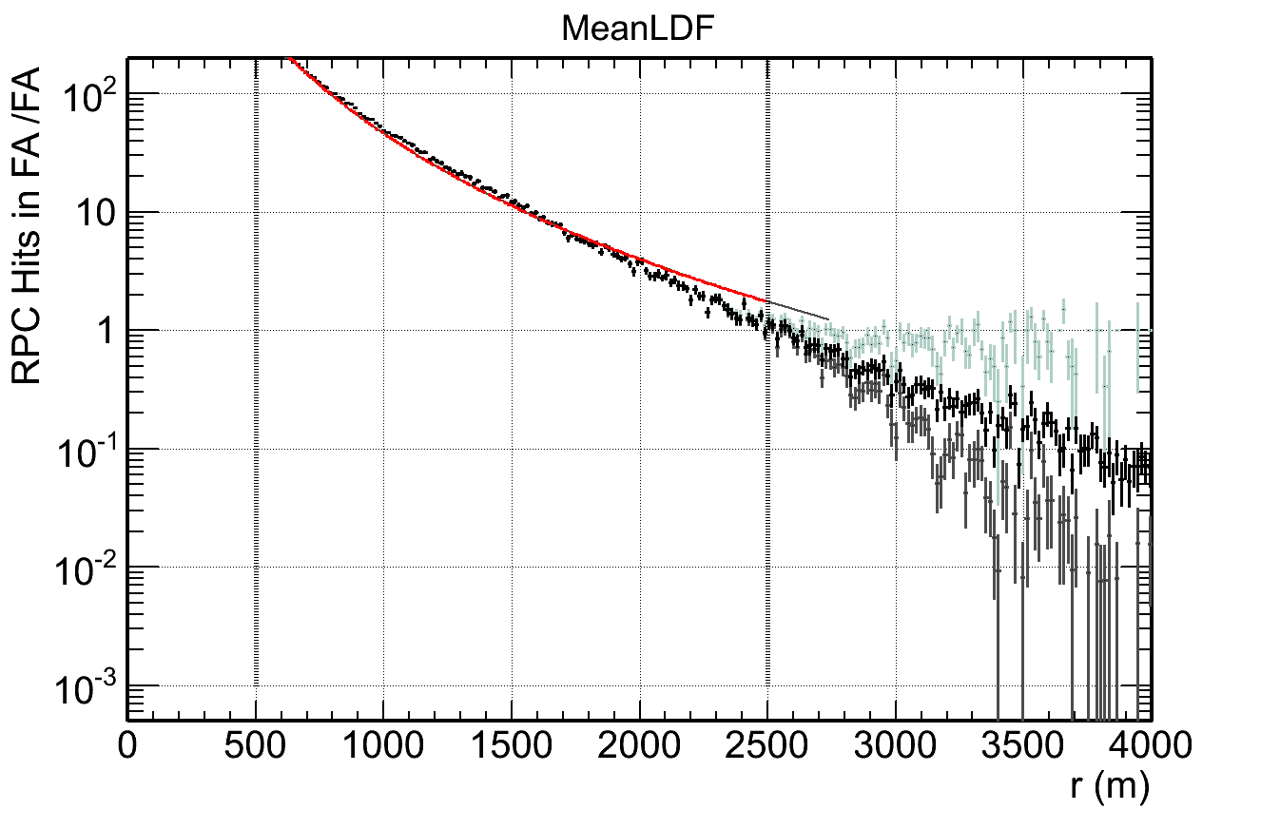
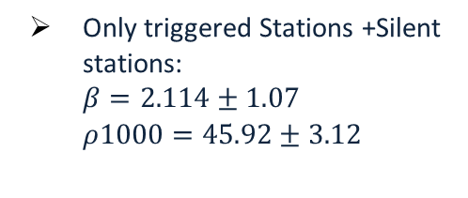
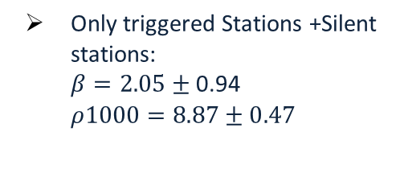
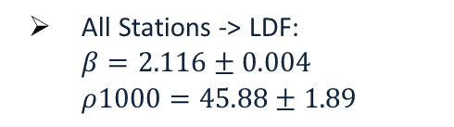
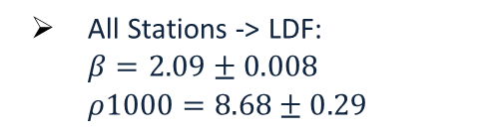


MARTA new FIT
$E=10^{19}$ $38°$
All Stations -> LDF:
$$β=2.09±0.008$$
$ρ1000=8.68±0.29$
Only triggered Stations +Silent stations:
$β=2.05±$ 0.94
$ρ1000=8.87±0.47$
$E=10^{19.8}$ $38°$
All Stations -> LDF:
$$β=2.116±0.004$$
$ρ1000=45.88±1.89$
Only triggered Stations +Silent stations:
$β=2.114±1.07$
$ρ1000=45.92±3.12$

Slide 15
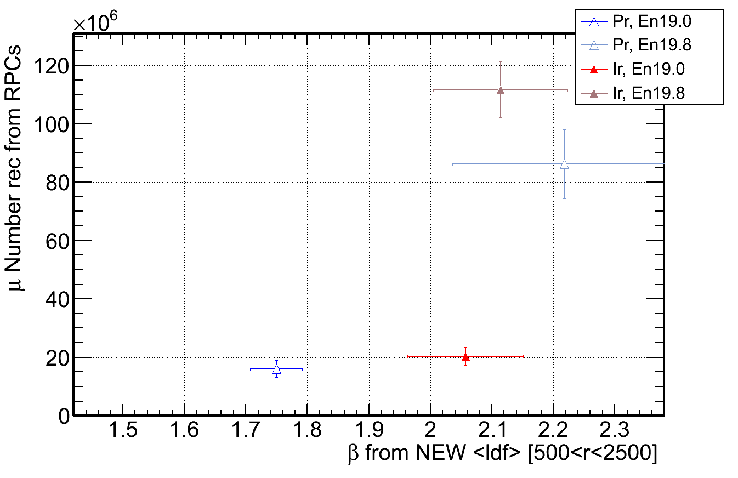
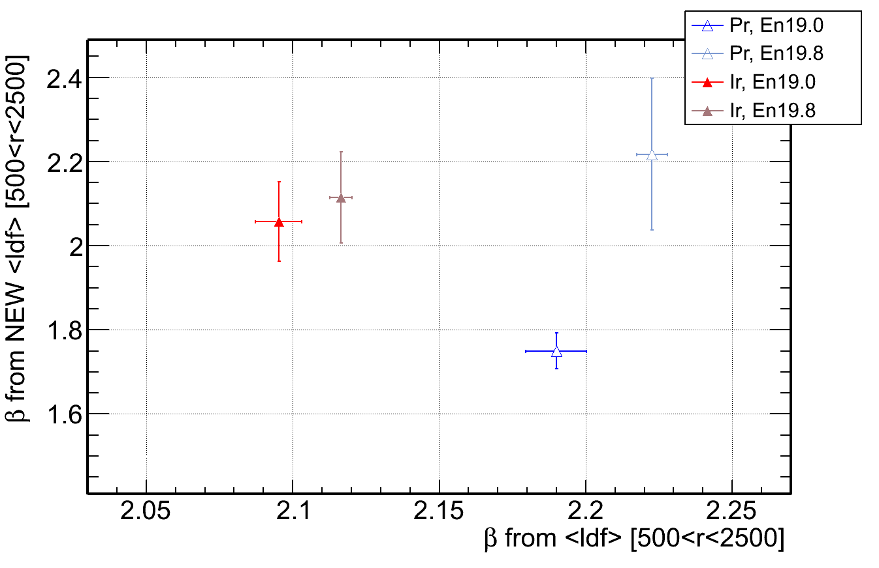


MARTA new FIT
$$θ=38°$$
$$θ=38°$$

Slide 16
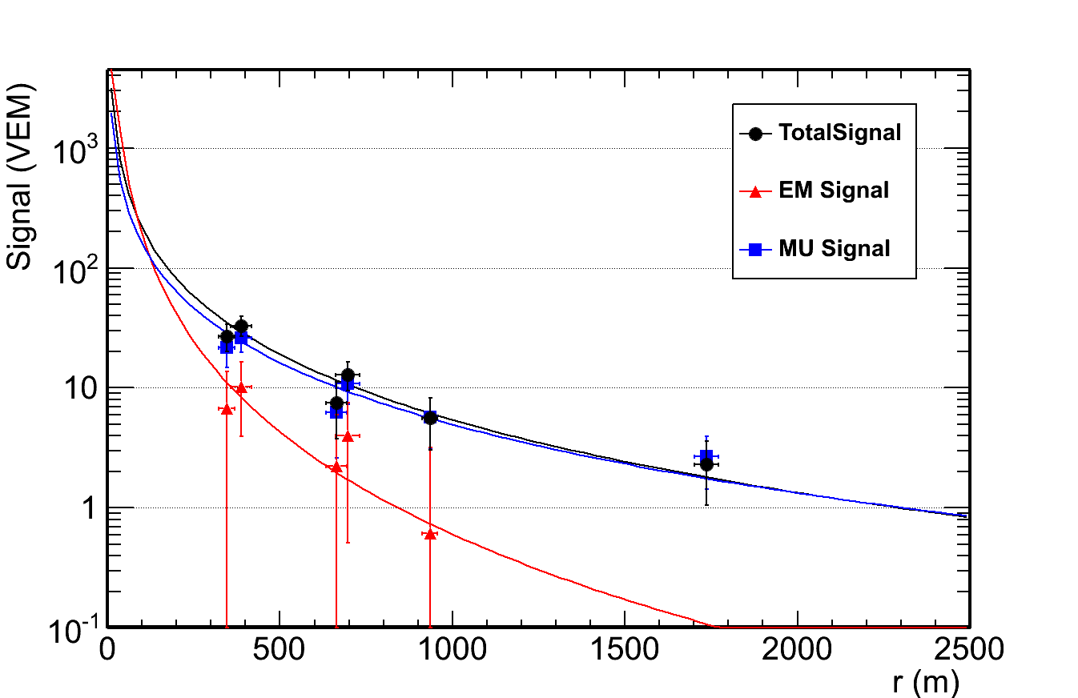


Energy Calibration on MARTA : CIC method
$$θ={60}^{∘}$$
$$θ={21}^{∘}$$
Currently from SD Signal:
We determine the energy
We estimate the number of muons
Combining MARTA with the tank:
Is possible to estimate the electromagnetic signal and calibrate the energy with it
We can measure the muon number independently
number of muons
Energy
Are correlated
(more or less according to Shower angle
and on SD only Analysis)

Slide 17
Energy Calibration on MARTA
Using MARTA, we can recover the EM and MU components
It would be important to estimate the energy independently from the muon number
As you have seen in the previous presentation by Sofia Andringa

Slide 18
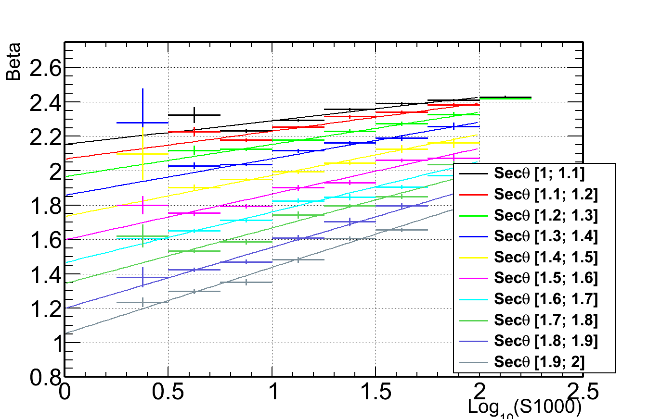
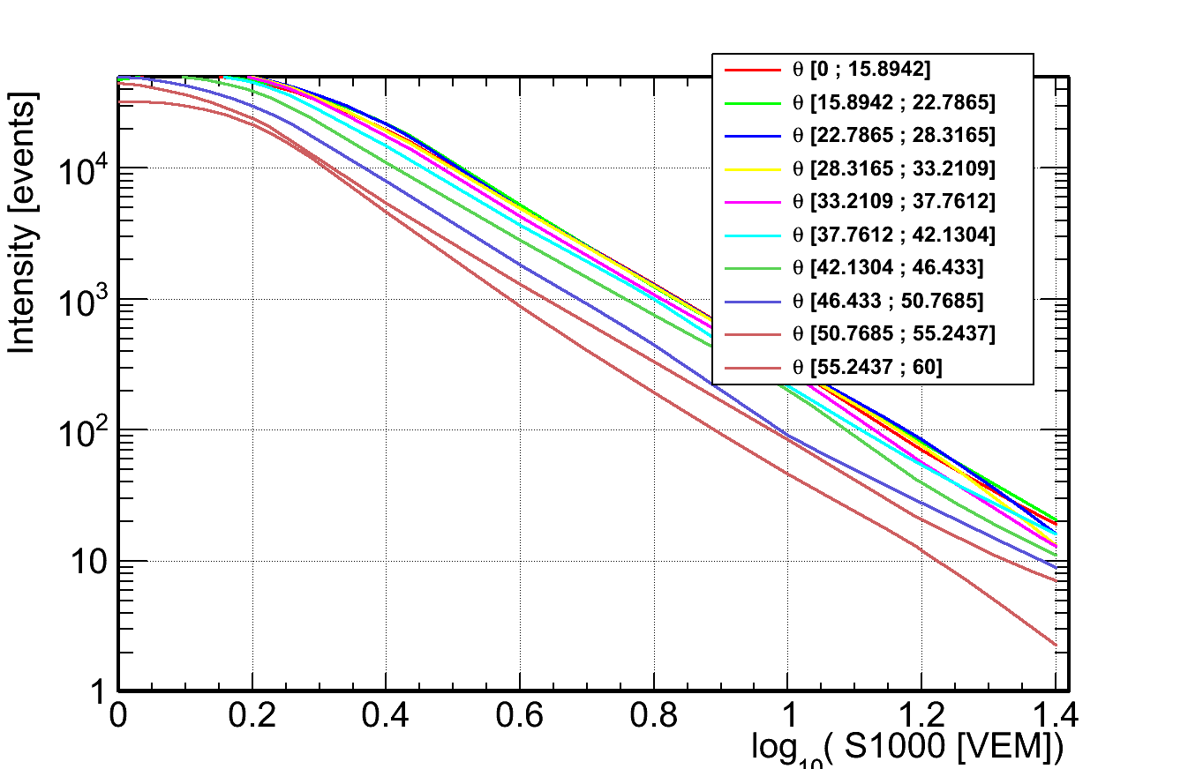
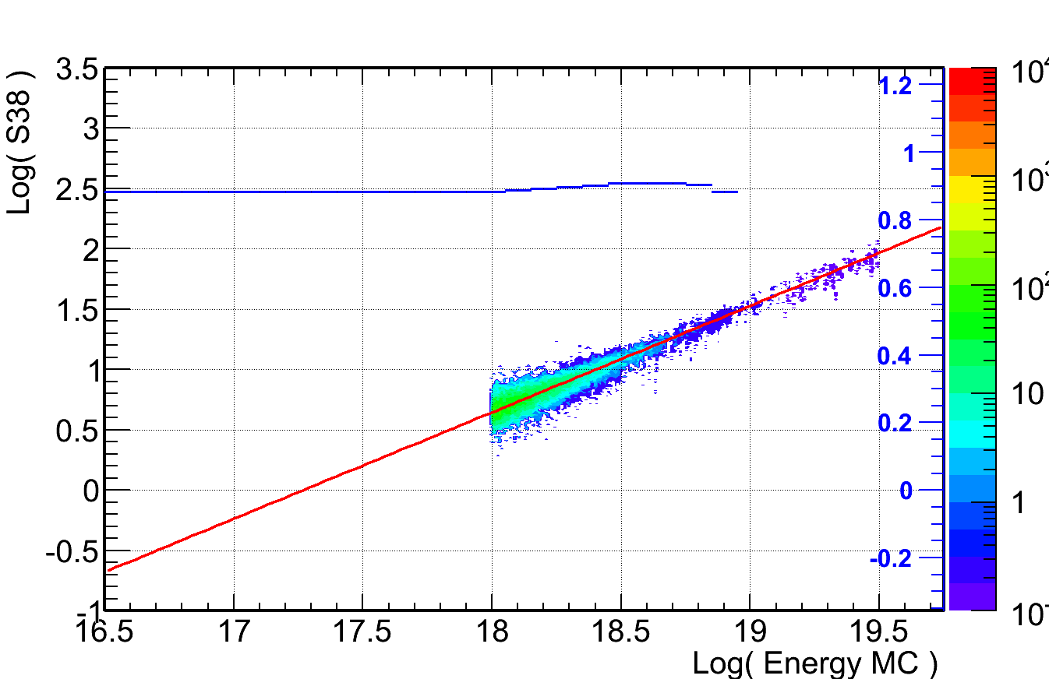
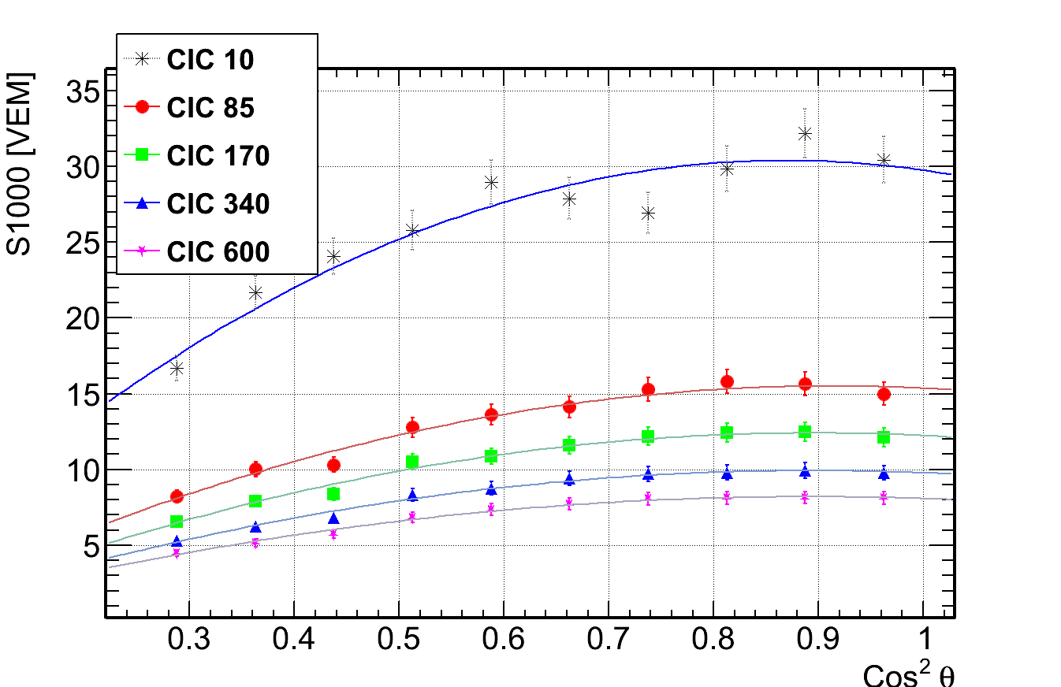



CIC method
Intensity for Total S1000
Beta from Total Signal
Parametrize $β$ and re-fit the events
Intensity distributions
Attenuation curves to obtain $S38$
Calibrate $S38$ with energy
Total S38
Total CIC

Slide 19
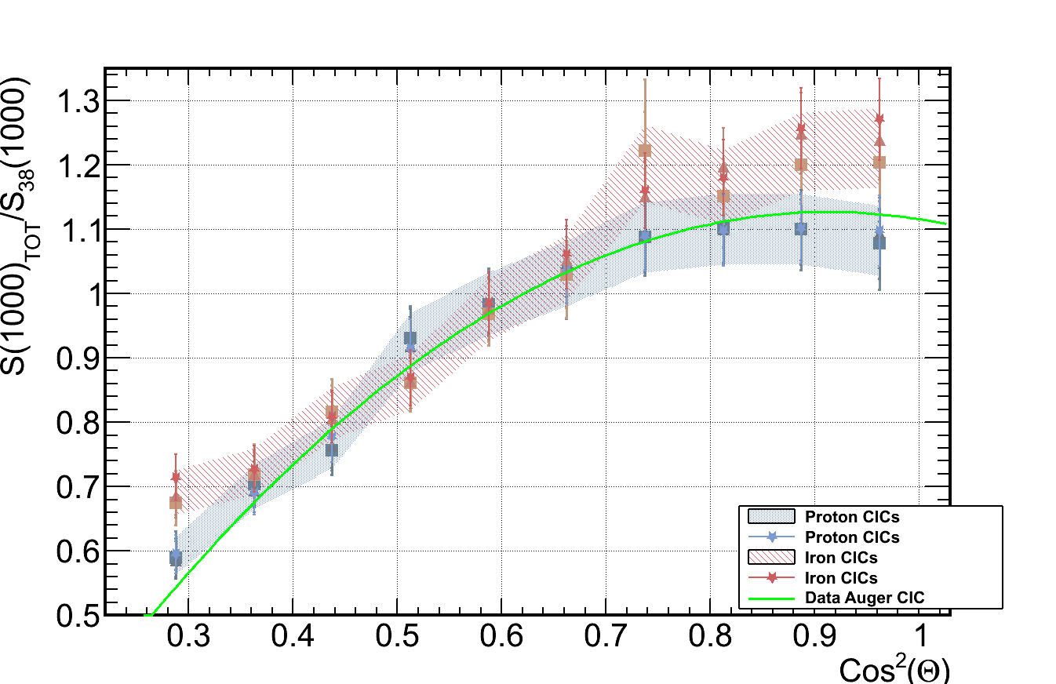
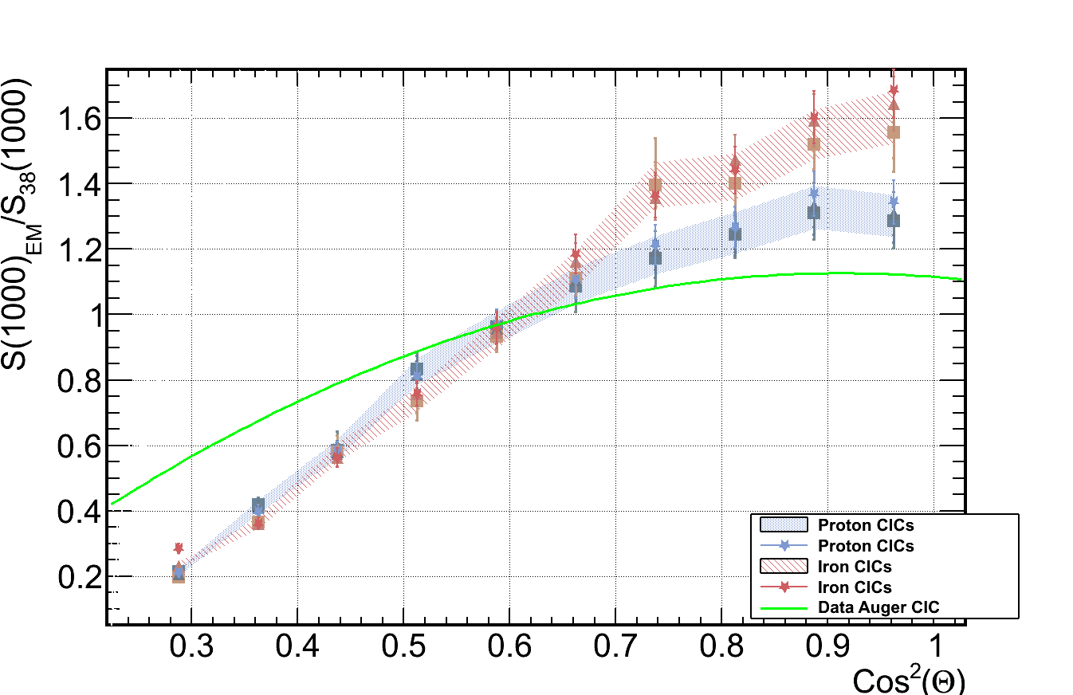
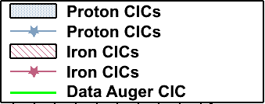
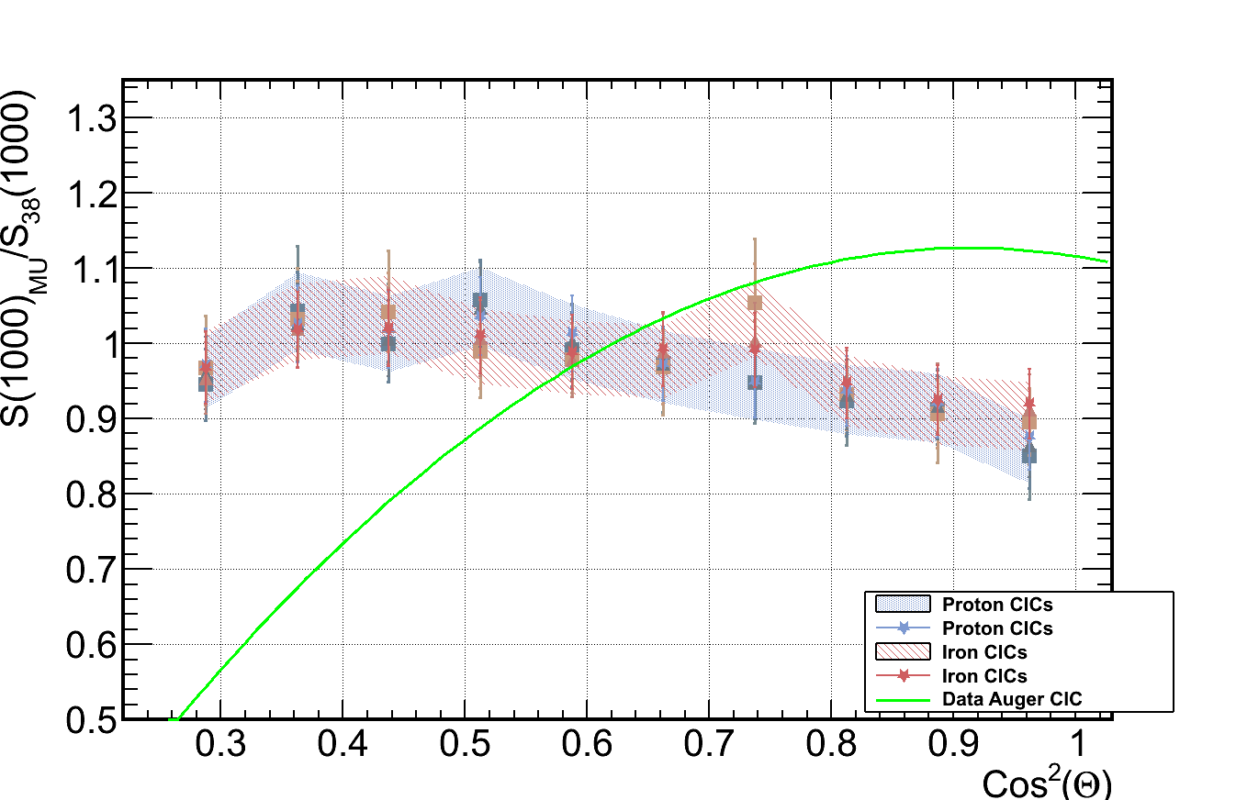
CIC for Proton and Iron
Total signal
EM signal
CIC function (it is normalized to S38)
MU signal
The Muonic CIC for proton and iron are basically the same.
The difference between each one comes from the electromagnetic CIC

Slide 20
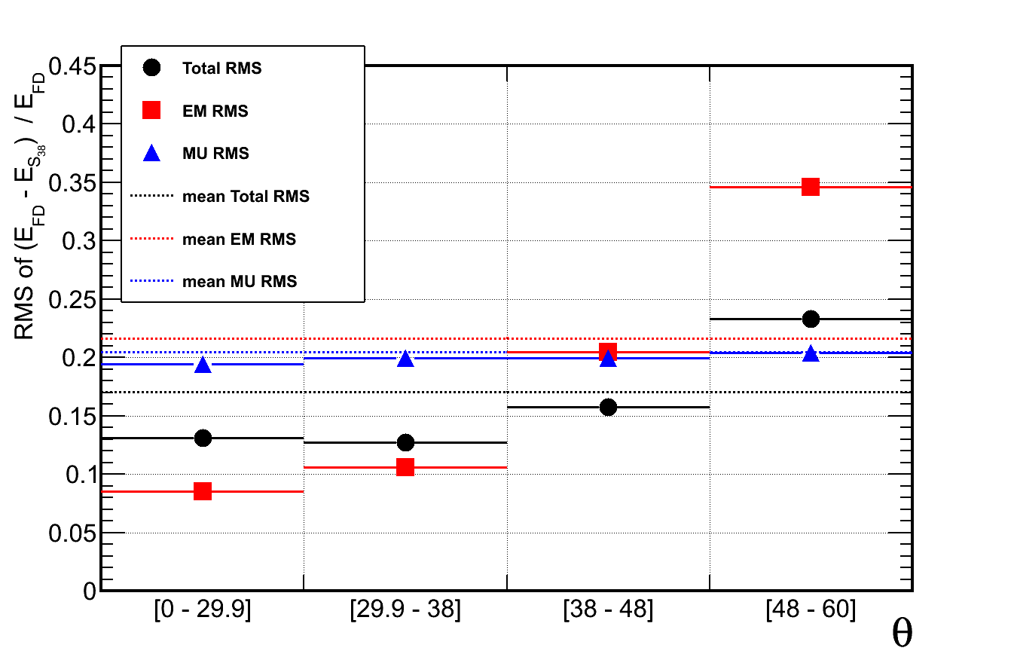
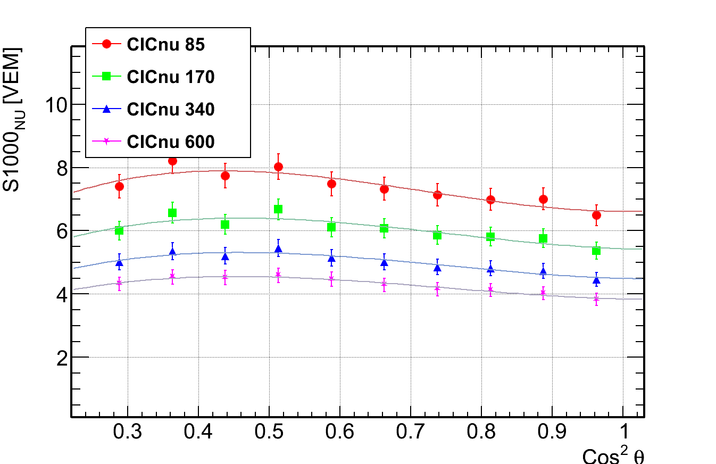
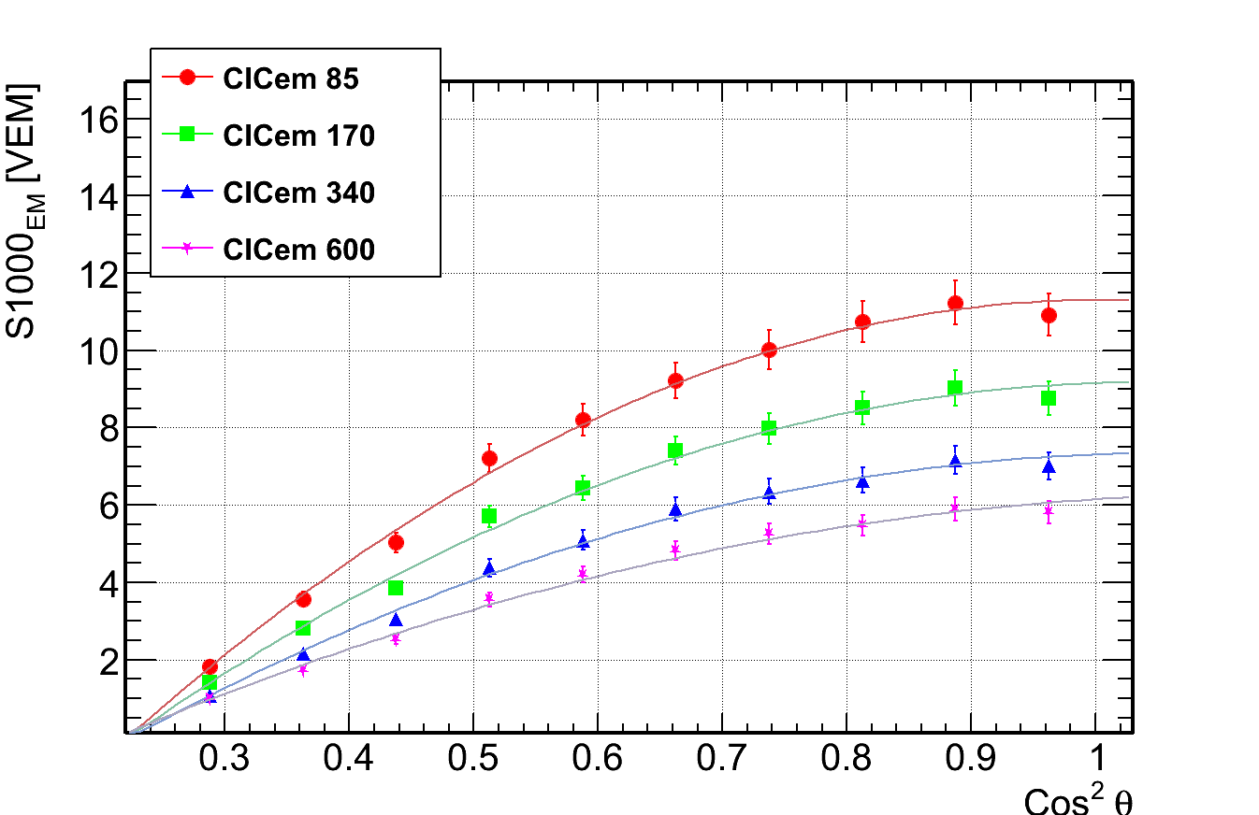
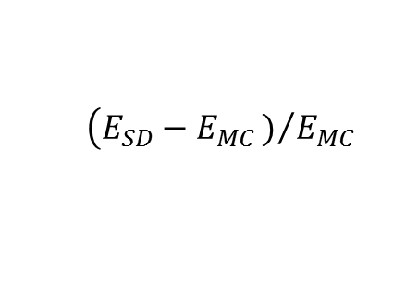
Energy reconstructed RMS
RMS of the Energy calibration
$$\left(E_{SD}−E_{MC})/{E_{MC}}\right.$$
Total RMS
Total RMS
Total RMS
We can use the EM component to calibrate the energy,
However, since for higher angle the EM signal is very low, the uncertainty on the calibration grows very quickly

Slide 21
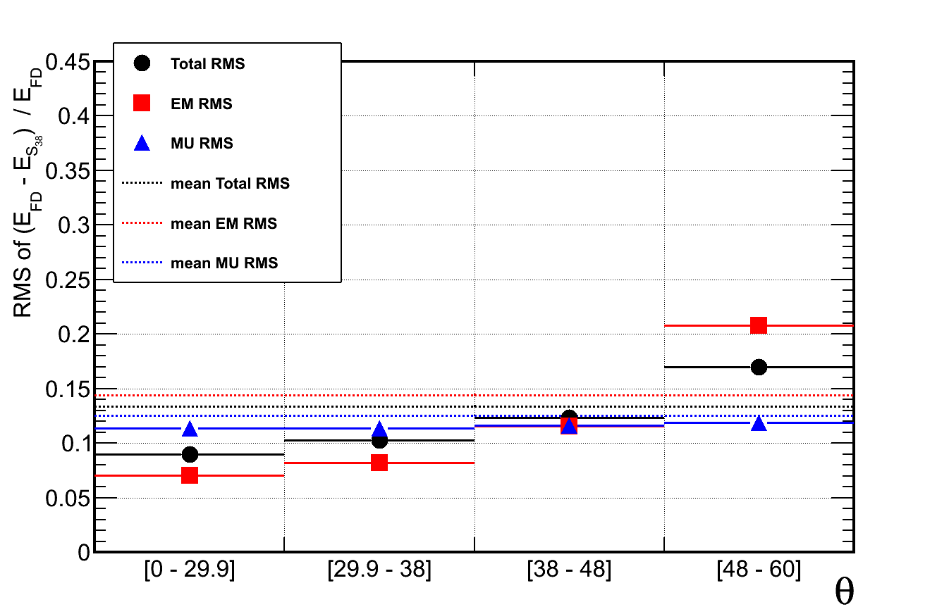
Energy reconstructed RMS
Proton
Iron
Due to higher multiplicities in Iron showers, we will have less fluctuations in this showers and the RMS should be smaller.

Slide 22
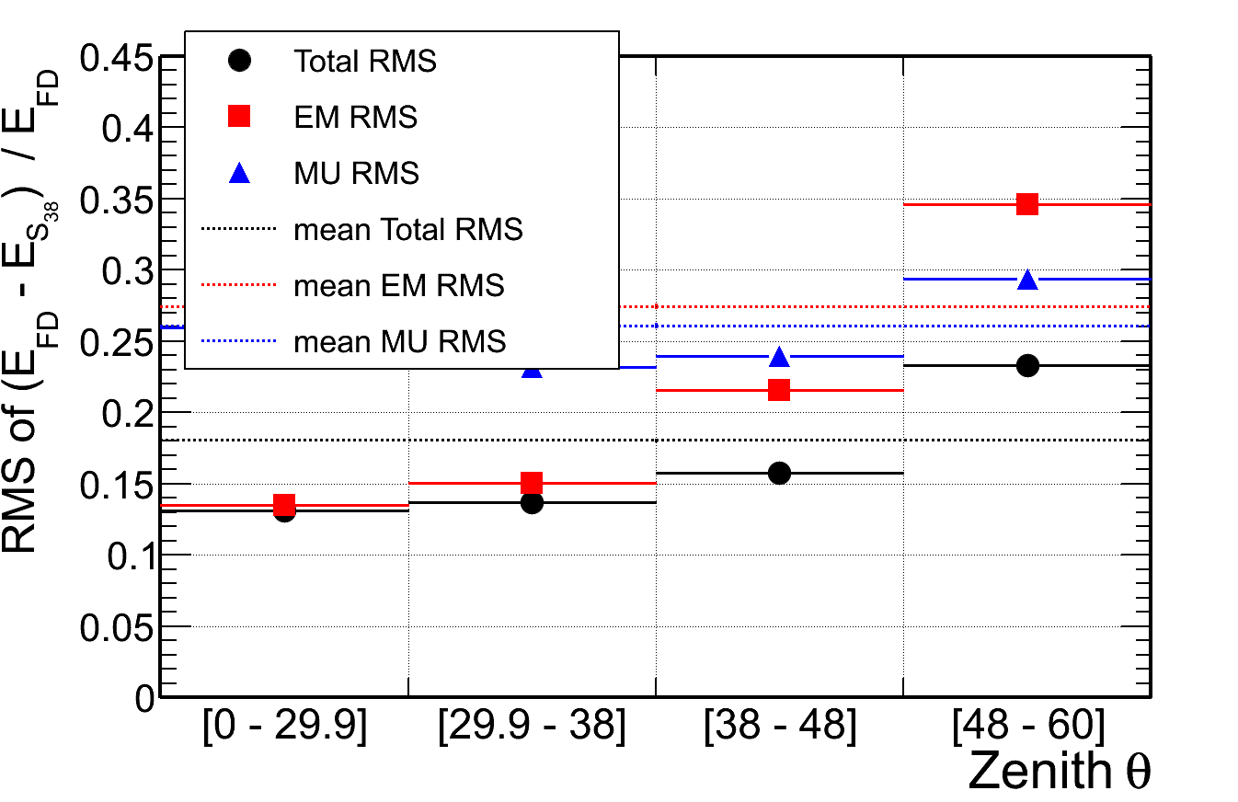
Performance
Proton
Proton + 25% degradation

Slide 23
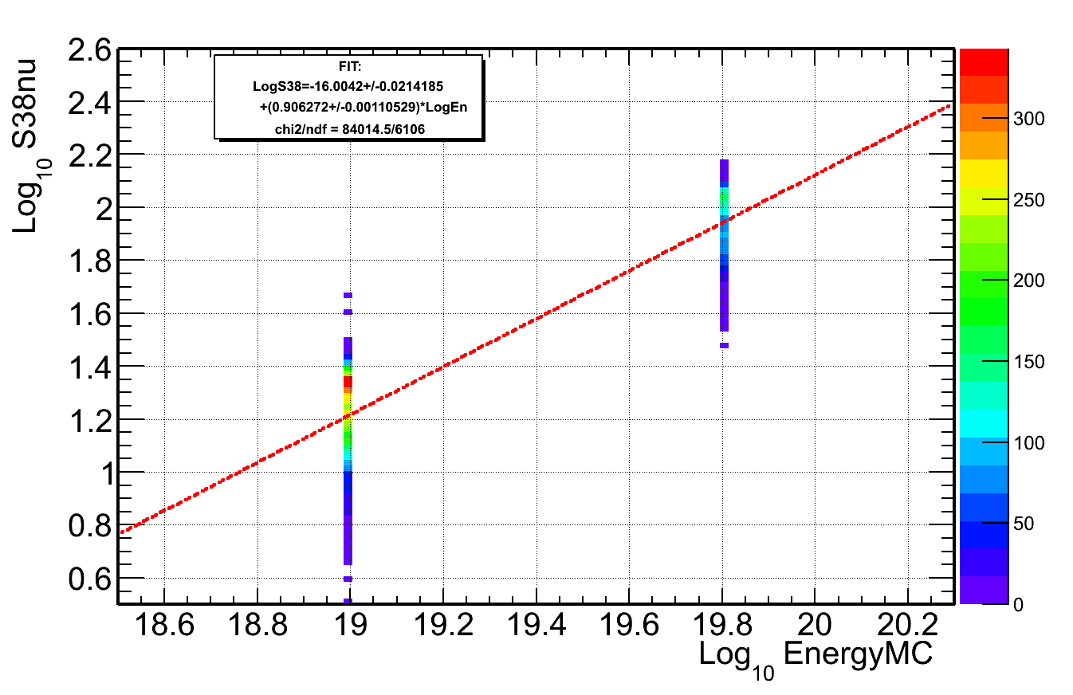
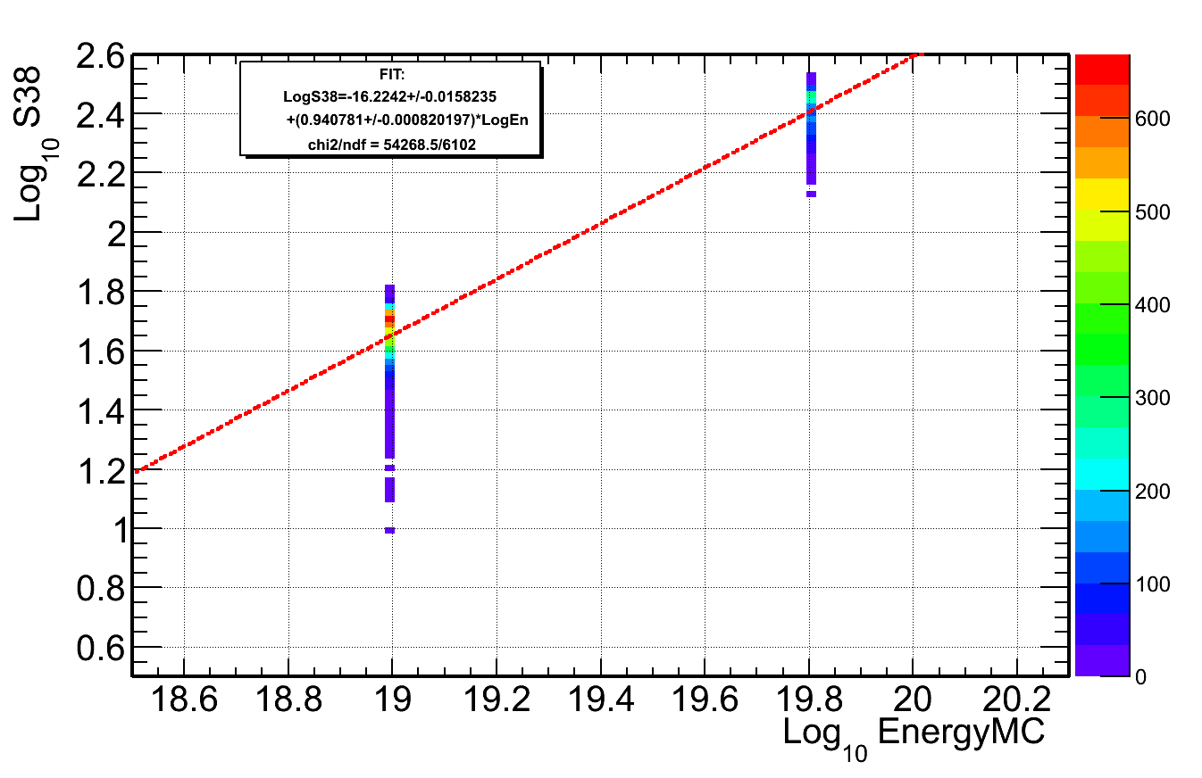


Energy reconstructed for a Mix Composition
Using a MARTA Simulation only with the $38º$ angle bin and $Energy ={10}^{19},{10}^{19.8}$
50% Proton/Iron

Slide 24




Energy reconstructed for a Mix Composition
All Components
EM Component
All
Proton
Iron
All
Proton
Iron
TOT Component
MU Component
All
All
Proton
Proton
Iron
Iron

Slide 25

Energy reconstructed for a Mix Composition
TOT Component
All
Proton
Iron
Iron will appear with higher energy
Proton will appear with lower energy
Iron
This Increases the separation of Proton/Iron for Xmax
But decreases it for $ρ1000$ or $N_{μ}$
Proton

Slide 26
Conclusions
We could use the slope β as an extra variable to separate composition and other studies.
  However we have to deal with the trigger of the stations.
We can use the EM component to calibrate the energy,
  However, for higher angle the EM signal is very low, and the uncertainty on the calibration grows very quickly
With MARTA, since we have the muonic signal, and with total signal from the tanks, we could recover the EM component
An Energy calibration for mix composition:
  Iron will appear with higher energy, and Proton will appear with lower energy
Future analyse for 750m array

Slide 27
Thank You

Slide 28
Back up slides

Slide 29


Motivation
We have an excess of muons in our data that is not understood
Currently from SD Signal:
We determine the energy
We estimate the number of muons
number of muons
Energy
Are correlated
(more or less according to Shower angle
and on SD only Analysis)
Combining MARTA with the tank:
Is possible to estimate the electromagnetic signal and calibrate the energy with it
We can measure the muon number independently

Slide 30
Outline
Study of the Beta parameter from LDF
For muon, em and total LDF,
for proton and iron.
Energy calibration with EM signal
CIC, S38 calibration
Comparison between Proton and Iron
Further studies…
EM Assimetry
Xmax from SD

Slide 31


Beta LDF Calibration
Two events from our sample
$$θ={21}^{∘}$$
$$θ={60}^{∘}$$
For each component and angle we have different beta in LDF
As it is done in Offline, we should parametrize beta in the LDF

Slide 32





Beta LDF Calibration
beta LDF parametrization, with Log(S1000) and Secθ
Beta from Total Signal
Beta from EM Signal
$${θ=0}^{∘}$$
$${θ=60}^{∘}$$
Beta from MU Signal
Beta from Data
With 10 bins of Secθ, Fitted to a polynomial in S1000 and Secθ
Different models will change beta values
Difference between Total Beta and Data Beta is due to the difference in the Muon component
polynomial in S1000 and Secθ:

Slide 33




Beta for Proton and Iron
Both electromagnetic and Muonic beta look very similar between Proton and Iron
Proton
Iron
EM signal
MU signal

Slide 34






Beta for Proton and Iron
Proton
Iron
The Beta LDF from the total signal has a shift between proton and iron,
as should be expected from different electromagnetic/Muonic ratio.

Slide 35


Constante Intensity Cut method:
Intensity curves
Intensity for Total S1000
For each Cos²θ bin, we make an intensity plot (dif colors)
The intensity in each S1000 point will be the sum of all events with S1000 higher than the S1000 of the bin:
If we cut in Intensity=85, we are choosing the 85 most energetic events in each Cos2 θ bin.
Since the bins have the same statistics, we obtain the S1000 evolution with zenith θ, for the same primary energy
Intensity for EM S1000
Intensity for MU S1000
I=600
I=340
I=170
I= 85

Slide 36
CIC method: CIC curves
Total CIC
Constant Intensity Cut (CIC) is fitted to polynomial in Cos²θ (3rd degree for muonic CIC only)
The different intensity CIC should differ only in the normalization
Total CIC is dominated by MU in high zenith angles, and dominated by EM at low zenith angles.
With the CIC curve we obtain the S38 for all events
EM CIC
MU CIC
I= 85
I=170
I=340
I=600
polynomial in Cos²θ:
3rd degree only for muonic CIC

Slide 37
CIC for Proton and Iron
Total signal
EM signal
CIC function (it is normalized to S38)
MU signal
The Muonic CIC for proton and iron are basically the same.
The difference between each one comes from the electromagnetic CIC

Slide 38




CIC method: CIC curves
Horizontal Shower
Vertical Shower
$${60}^{∘}$$
$$0^{∘}$$
Dominated by EM component
Dominated by muon component
$${\sim 36}^{∘}$$
We can see that the total CIC is highly dependent on the muon component, being dominated by it for high zenith angles (low Cos2 θ )
As for both EM and MU, the 4 fractions CIC_{i}/CIC_{TOT} are overlaped, the method is consistent

Slide 39



CIC method: CIC curves
$${60}^{∘}$$
$$0^{∘}$$
Proton
Iron
The CIC in Iron is dominated by the Muonic component.

Slide 40


Energy Calibration
Total S38
Linear calibration between log (S38) and Energy
Muon component is less dependent on energy than the EM component (slope ~0.95)
EM_{slope} ~0.95
TOT_{slope} ~0.9
MU_{slope} ~0.8
Linear Slope
EM S38
MU S38
Linear Slope
Linear Slope

Slide 41




Further studies…
Assimetry in the LDF signal due to Shower inclination
The assimetry is less important in the total signal since muons decay in a lower rate.
But it will be important in the em signal
The final RMS energy difference, in progress
signal
signal
$$Energy {10}^{19}−{10}^{19.5}eV \\ θ [0°;10°]$$
$$Energy {10}^{19}−{10}^{19.5}eV \\ θ [50°;60°]$$

Slide 42





Further studies…
Try to find a way to get Xmax from SD signal (on progress)
Similar procedure to the beta calibration:
$$Xmax=A−Be^{τ \frac{S{1000}_{em}}{S{1000}_{mu}}}$$
$A, B and τ are polymials in Secθ$

Slide 43
Conclusions
We can use the EM component to calibrate the energy,
However, for higher angle the EM signal is very low, and the uncertainty on the calibration grows very quickly
Further studies are needed for higher energies where EM signal is higher
Iron CIC and Beta parameterizations are similar to the proton’s, except for total beta that depends more on the muonic/electromagnetic ratio.
With MARTA, since we have the muonic signal, and with total signal from the tanks, we could recover the EM component
In this way, it could be possible to access the Muon number independently from the Energy calibration

Slide 44
Thank You

Slide 45
Back up slides

Slide 46


Beta LDF Calibration
Beta from Data Signal
Beta from Total Signal
Beta from EM Signal
Beta from MU Signal
Sinal | a0 | a1 | b0 | b1 | c0 | c1 | χ2/ndf
Data | -3.72 | 0.0967 | 1.74 | -0.242 | -0.274 | 0.0349
Total | -2.60 | -0.0234 | -0.102 | 0.0357 | 0.470 | -0.116 | 13.9
EM | -2.35 | -0.0517 | -0.380 | -0.0503 | 0.355 | -0.0450 | 6.8
MU | -2.53 | -0.118 | 1.28 | -0.227 | -0.211 | 0.0260 | 14.7

Slide 47
Beta LDF Calibration
Proton
Sinal | a0 | a1 | b0 | b1 | c0 | c1 | χ2/ndf
Data | -3.72 | 0.0967 | 1.74 | -0.242 | -0.274 | 0.0349
Total | -2.60 | -0.0234 | -0.102 | 0.0357 | 0.470 | -0.116 | 13.9
EM | -2.35 | -0.0517 | -0.380 | -0.0503 | 0.355 | -0.0450 | 6.8
MU | -2.53 | -0.118 | 1.28 | -0.227 | -0.211 | 0.0260 | 14.7
Iron
Sinal | a0 | a1 | b0 | b1 | c0 | c1 | χ2/ndf
Total | -2.82 | -0.237 | 0.544 | 0.185 | 0.194 | -0.124 | 15.0
EM | -2.94 | 0.734 | 0.529 | -1.28 | 0.0220 | 0.437 | 3.2
MU | -2.252 | -0.256 | 0.917 | -0.00230 | -0.118 | -0.0385 | 12.1

Slide 48








Beta LDF for Proton / Iron
Total Signal

Slide 49









Beta LDF for Proton / Iron
MU Signal

Slide 50










Beta LDF for Proton / Iron
EM Signal

Slide 51



Constante Intensity Cut method:
Intensity curves
We divide the events in 10 equal bins of Cos^2 θ

Slide 52


Constante Intensity Cut method:
Intensity curves
In each Cos2 θ bin, we make an intensity plot
The intensity in each S1000 point will be the sum of all events with S1000 higher than the S1000 of the bin

Slide 53
Constante Intensity Cut curves
Total CIC
EM CIC
MU CIC
Fitt for Intensity=170
Sinal | S38 | a | b | c | χ2/ndf
Total | 11.6 ± 0.3 | 0.771 ± 0.067 | -1.47 ± 0.31 | - | 2.7
EM | 7.00 ± 0.14 | 1.66 ± 0.074 | -2.11 ± 0.26 | - | 3.7
Mu | 6.55 ± 0.15 | -0.335 ± 0.185 | -0.786 ± 0.349 | 1.73 ± 2.01 | 1.9

Slide 54
Constante Intensity Cut curves
Fitt for Intensity=170
Sinal | S38 | a | b | c | χ2/ndf
Total | 11.6 ± 0.3 | 0.771 ± 0.067 | -1.47 ± 0.31 | - | 2.7
EM | 7.00 ± 0.14 | 1.66 ± 0.074 | -2.11 ± 0.26 | - | 3.7
Mu | 6.55 ± 0.15 | -0.335 ± 0.185 | -0.786 ± 0.349 | 1.73 ± 2.01 | 1.9
Sinal | S38 | a | b | c | χ2/ndf
Total | 10.85 ± 0.3 | 0.884 ± 0.073 | -0.490 ± 0.351 | - | 6.3
EM | 5.63 ± 0.11 | 2.17 ± 0.08 | -0.764 ± 0.284 | - | 5.6
Mu | 8.07 ± 0.23 | -0.191 ± 0. 187 | -0.547 ± 0.358 | 0.502 ± 2.03 | 4.1

Slide 55
Energy Calibration
Total S38
EM S38
MU S38
Sinal | a | b
Total | 17.26 | 1.14
EM | 17.56 | 1.07
Mu | 17.47 | 1.26
Sinal | A | B | χ2/ndf
Total | -15.19 | 0.88 | 5.2
EM | -16.43 | 0.94 | 7.3
Mu | -13.84 | 0.79 | 20.5
Sinal | a | b
Total | 17.22 | 1.13
EM | 17.64 | 1.04
Mu | 17.28 | 1.29
Sinal | A | B | χ2/ndf
Total | -15.27 | 0.89 | 4.4
EM | -17.00 | 0.96 | 2.9
Mu | -13.39 | 0.78 | 4.3
Directly from plot

Slide 56










Xmax from SD signal FOR proton and iron

Slide 57

Xmax from proton

Slide 58



Xmax from iron

