Slide 1
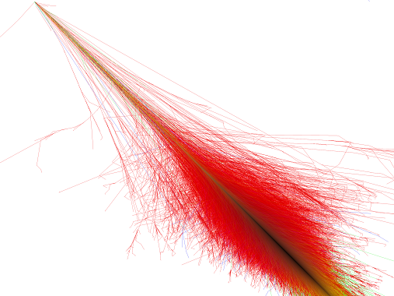


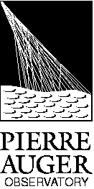

Studies and results at
Pierre Auger Observatory
Jornadas do LIP 2014
Auger LIP Group
João Pedro Espadanal
Pavilhão do Conhecimento, Lisboa
22nd March 2014

Slide 2
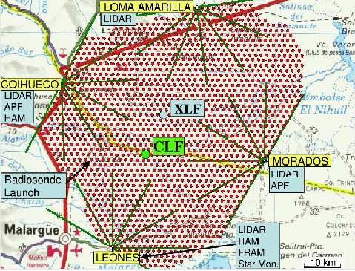
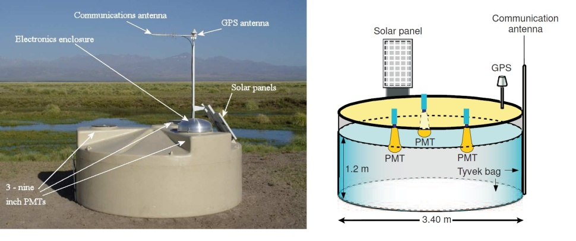
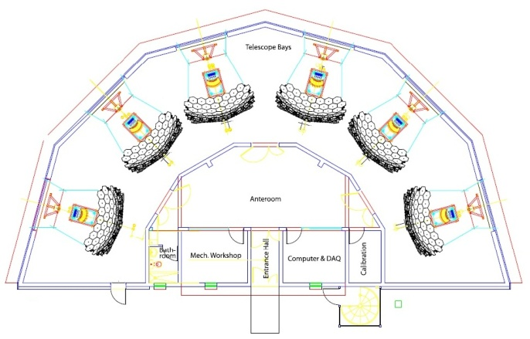
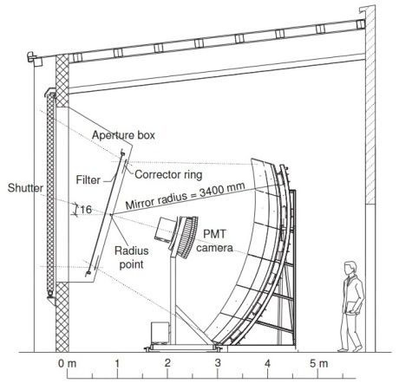
Pierre Auger Observatory
Pierre Auger Observatory
Malargue, Argentina
Area 3000km2
1600 Cherenkov tanks on the surface
27 telescopes
With this experiment we have better quality and higher number of cosmic ray events than ever
Have a very good atmospheric control to better estimate the systematic uncertainty
SD detectors
FD detectors

Slide 3
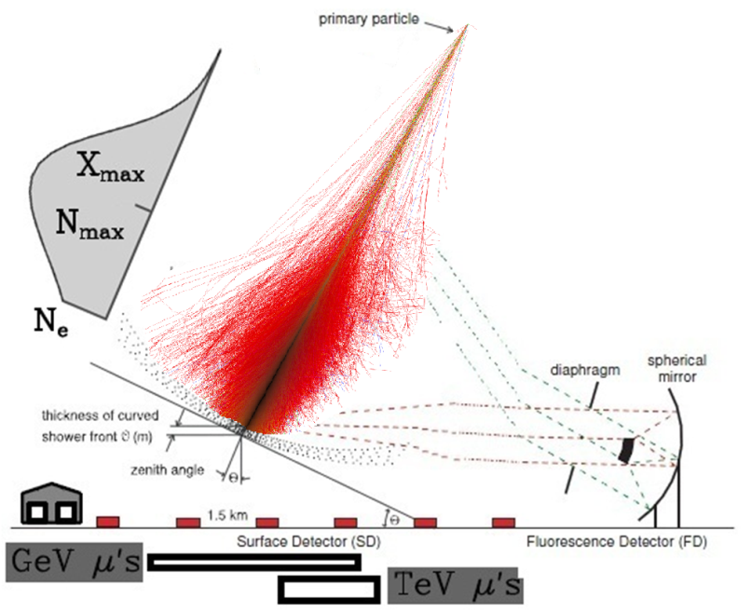
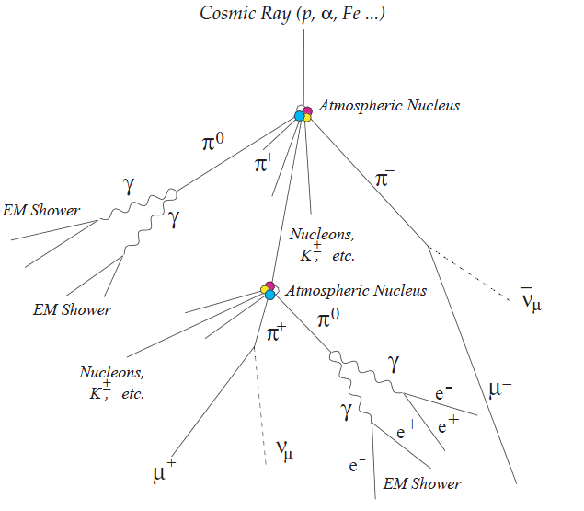
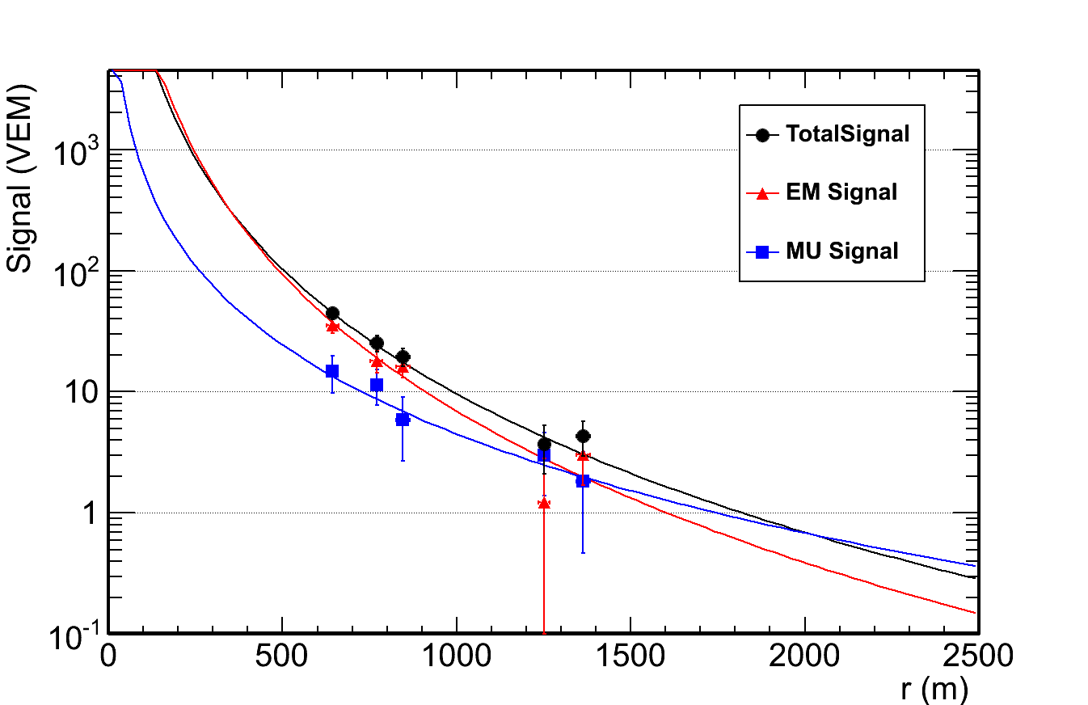
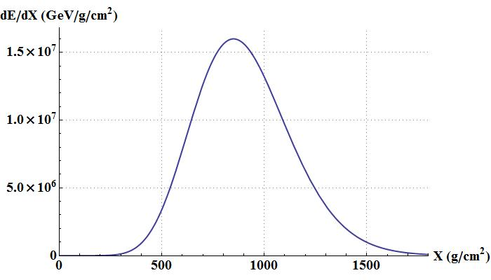
Extensive air showers
Air shower Detection:
Shower development
Longitudinal Profile .
...
Lateral Profile
(dE/dX)max
Maximum light intensity
or maximum number of particles
Xmax

Slide 4
Recent Auger results
Energy Spectrum and Anisotropies
Composition
Interaction Models
  Muon Production
  Other Longitudinal Studies
Photon and Neutrino Fluxes

Slide 5
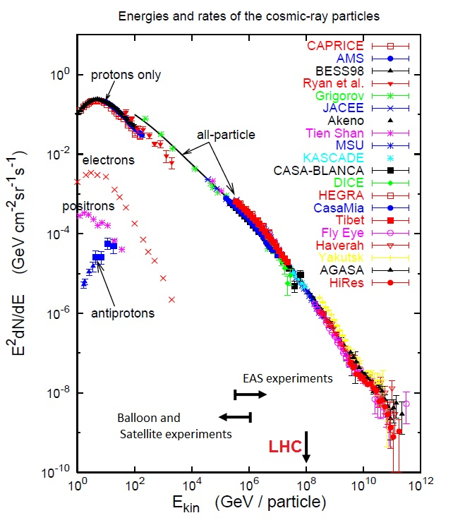
Cosmic Rays spectrum
Ankle
Recent Results:
Problems:
  Small flux (difficult to detect directly)
  How to indirectly detect them?
  Which are their directions and sources?
  What is their composition?
  Are the interactions the same at those energies?
GZK cutoff!!
Ankle
Galactic particles
Extragalactic particles
ICRC 2013, arXiv:1307.5059v1

Slide 6
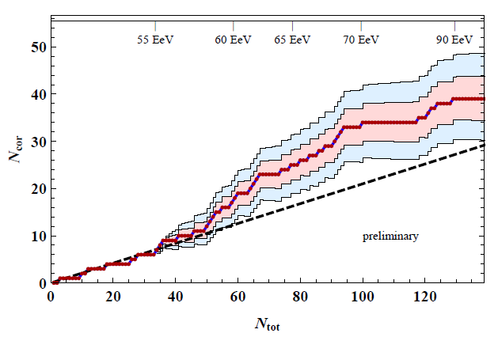
Anisotropies
Cosmic Rays directions
Events with E > 54 EeV
Points -> cosmic Rays
Blue circles > AGN from VCV catalogue
Anisotropy with 99%CL
Excess around Centaurus A
Gap 2013-092

Slide 7
Xmax and cross section
Xmax distribution for
Energy 10¹⁸ to 10^{18,5} eV ~ 57 TeV
Only with hybrid events
Xmáx
Proton-air cross section
$$σ_{p−air}=505±{22\left(stat\right)}_{−36}^{+28}\left(syst\right)mb$$
$$σ_{p−p}^{inel}=92±{7\left(stat\right)}_{−11}^{+9}\left(syst\right)7(Glauber)mb$$
arXiv:1208.1520v2

Slide 8
Xmax
Only with hybrid events
Recent Xmax results:
Xmáx
Cross section?
Or Composition?
ICRC 2013, arXiv:1307.5059v1

Slide 9
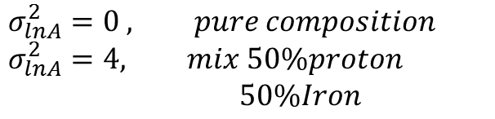
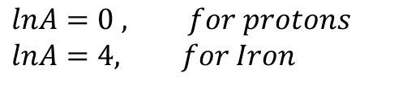
Composition phase space
Xmax depends on the first interaction
And on the number of interactions until some critical energy
(that depends of the energy per nucleon)
$$lnA=0 , for protons$$
$$lnA=4, for Iron$$
$$σ_{lnA}^{2}=0 , pure composition$$
$$σ_{lnA}^{2}=4, mix 50\%proton$$
$50\%Iron$
Energy from 10¹⁸ eV to 10^{19.6} eV
(increasing size points with energy)

Slide 10
Studies at LIP

Slide 11
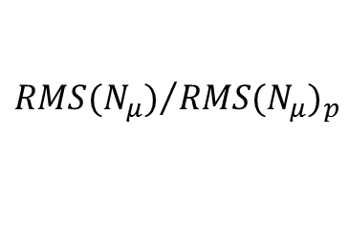
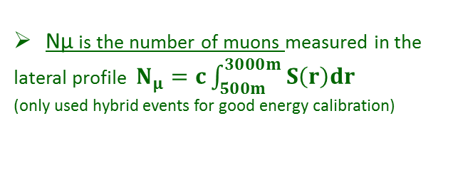
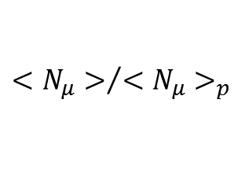
Muon Number
$${<N_{μ}>}/{{<N_{μ}>}_{p}}$$
We detect the electromagnetic and muonic component together
At large zenith angle and distance from core, the electromganetic part is negligible compared to the muonic
?
Events with
62º < θ < 80º
We can get the muon number
$${RMS(N_{μ})}/{{RMS(N_{μ})}_{p}}$$
Nμ is the number of muons measured in the lateral profile $N_{μ}=c\int_{500m}^{3000m}{S\left(r\right)dr}$
(only used hybrid events for good energy calibration)
?
Large Muon deficit in the models
Muon number observed larger than expected
GAP 2013-053
ICRC 2013, arXiv:1307.5059v1

Slide 12
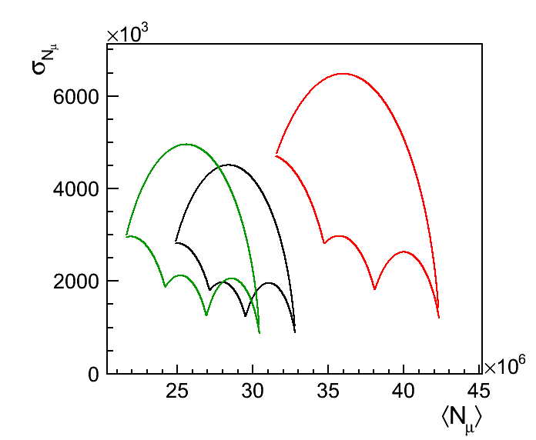
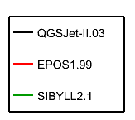
Xmax and Nμ
Correlate different variables
For a particular energy,
each model predicts different phase-space for mean and RMS values,
when we change the composition
This is a very important test to the hadronic models since the data points for a particular energy could be out of the model phase-space
A Multivariate analysis allows us to give very strong constrains and to rule out models
For a energy 10¹⁹eV the data point stays very far away from the phase space allowed by the models
P
He
N
Fe
GAP 2013-004

Slide 13
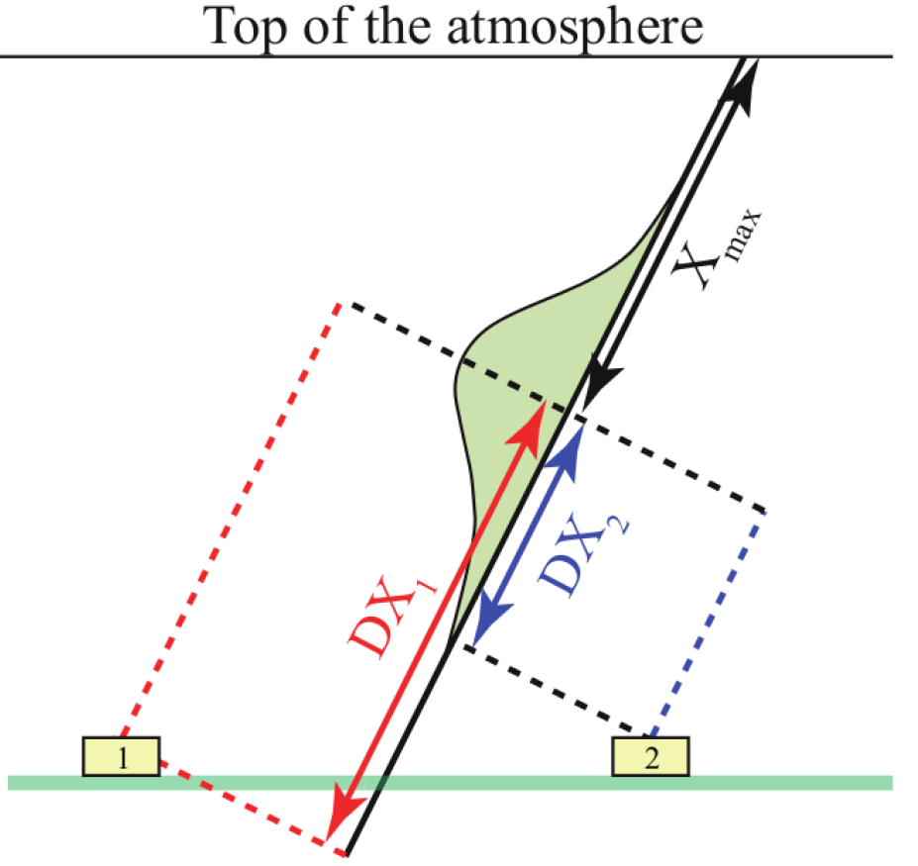
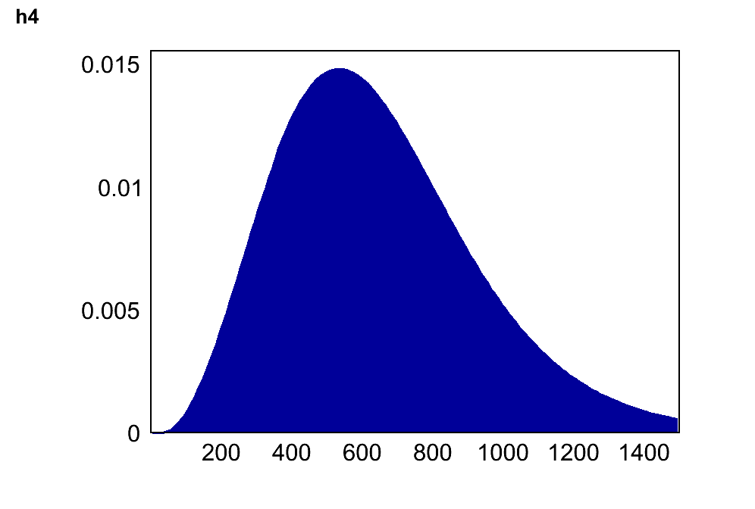
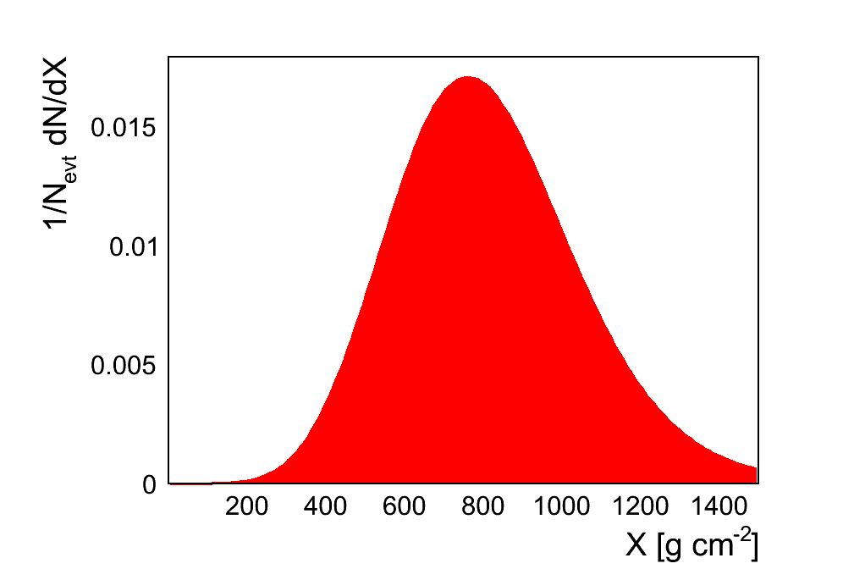
MPD – Muon Profile Depth
We can track some of the muons and recover the Longitudinal Muon Profile Depth
Only for very inclined events and high distances
Proton
Iron
μ
We can recover the Muon Profile
e.m.
Black points, ICRC points with
55 ≤ θ ≤ 65 and E>20EeV
Red points, Eva extension to lower energies
with 55 ≤ θ ≤ 65
Surface Detector
Eva Santos Thesis
GAP 2013-004

Slide 14
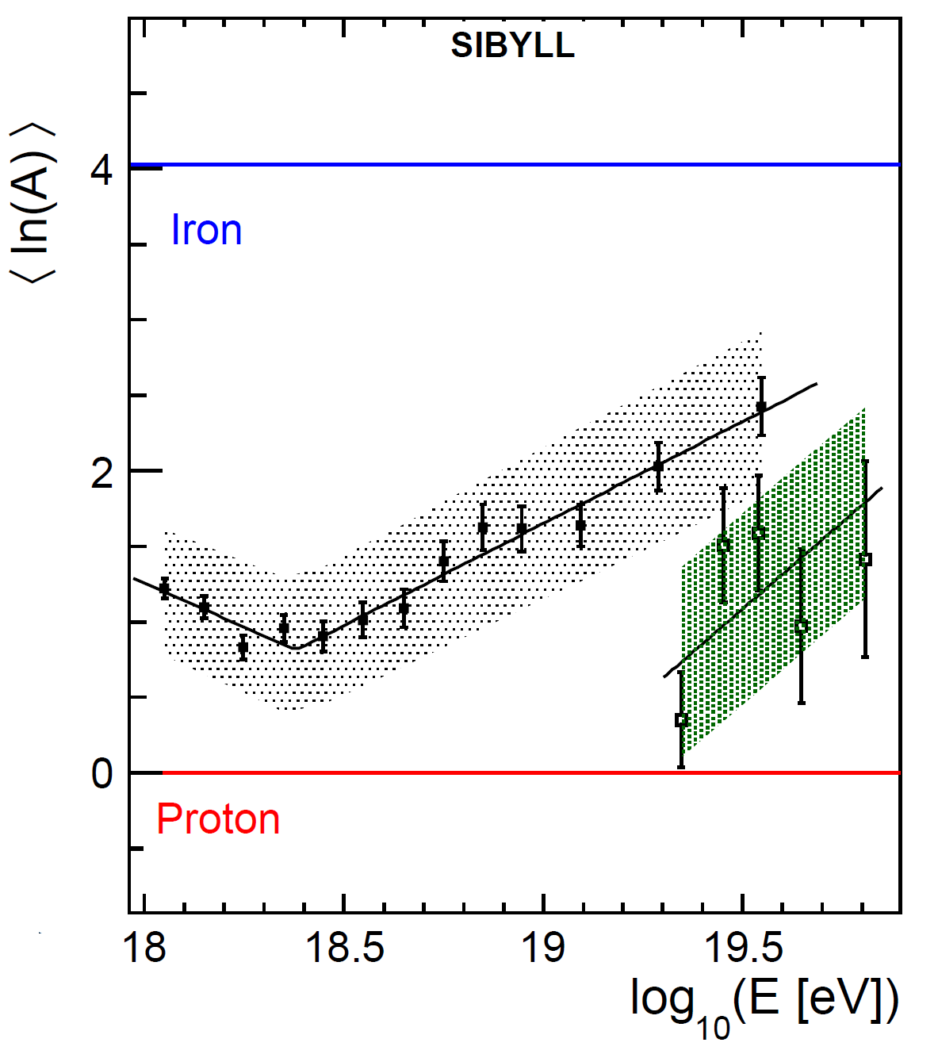





Xmax and X^{μ}max
We can look at the composition with both
Xmax electromagnetic
Xmax Muonic
$lnA$ from $Xmax$ electromagnetic
$lnA$ from $Xmax$ Muonic
EPOS-LHC
QGSJetII-04
$$Old data$$
Iron
$$Xmax$$
$$Xμmax$$
Proton
ICRC 2013, arXiv:1307.5059v1

Slide 15
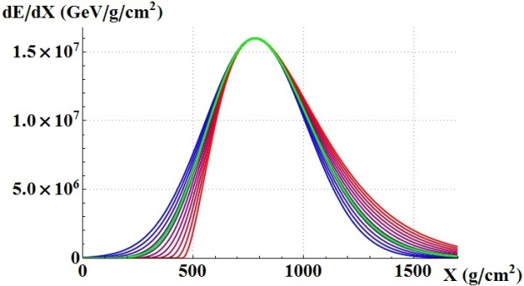

Longitudinal Profile Studies with the Telescopes
Longitudinal Profile studies
$$N=N_{max}{(1+R\frac{X′}{L})}^{R^{−2}}\exp\left(−\frac{X^{′}}{RL}\right),$$
$X^{′}=X−X_{max}$
17.8 < log(E/eV) < 18
L parameter
R parameter
log(E/eV) > 19.2
Allowed phase space
GAP 2014-004

Slide 16
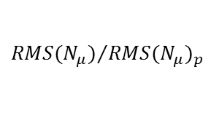
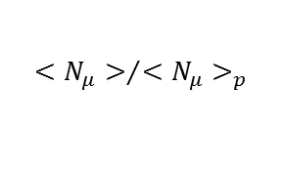
Review
Electromagnetic Xmax
Muon Numbers and Distributions
$${<N_{μ}>}/{{<N_{μ}>}_{p}}$$
$${RMS(N_{μ})}/{{RMS(N_{μ})}_{p}}$$
Combined em and μ
Other Parameters
Lower Energy
Higher Energy

Slide 17
Outlook
The Data suggest a change in the behavior around 10^{18.3}eV
  The question is, Change in composition?
  Or Change in the interactions?
Anisotropies with 99% CL
Electromagnetic Xmax favors heavy composition, but only EPOS contains the data phase space
Combined analysis and other composition variables out of the models phase space for higher energies
A large excess of Muon Number not accommodated by models
Is Fundamental to have a good muon measurement

Slide 18
Thank You!

Slide 19
Back up slides

Slide 20
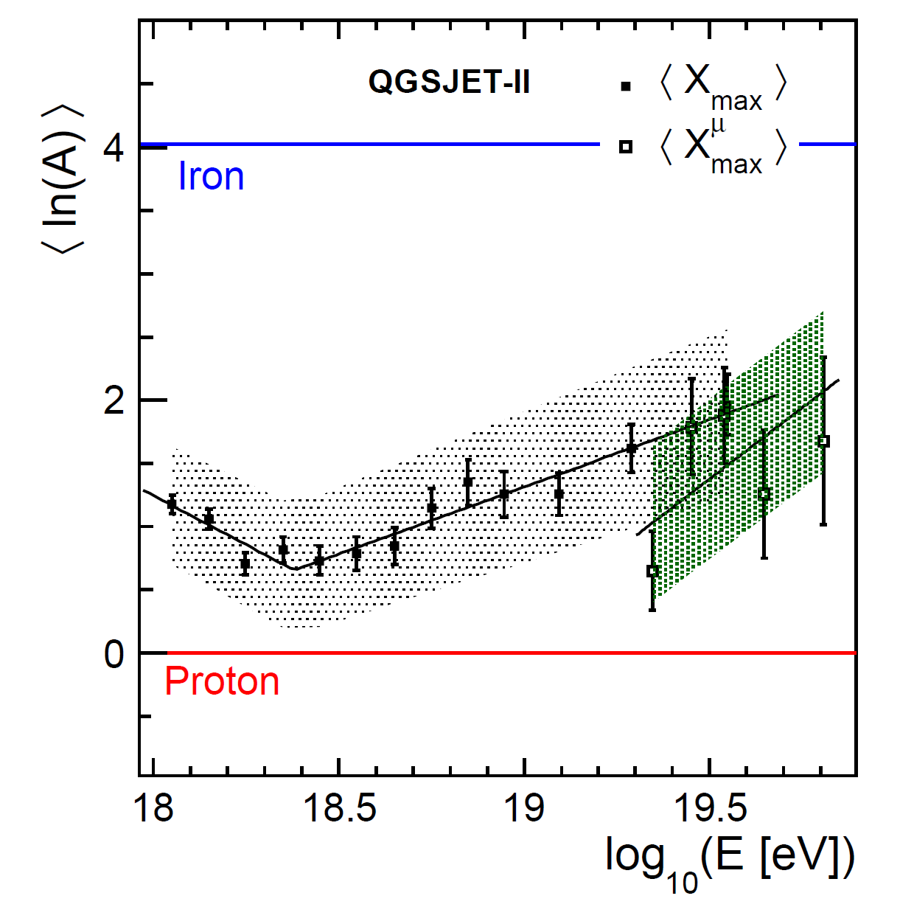
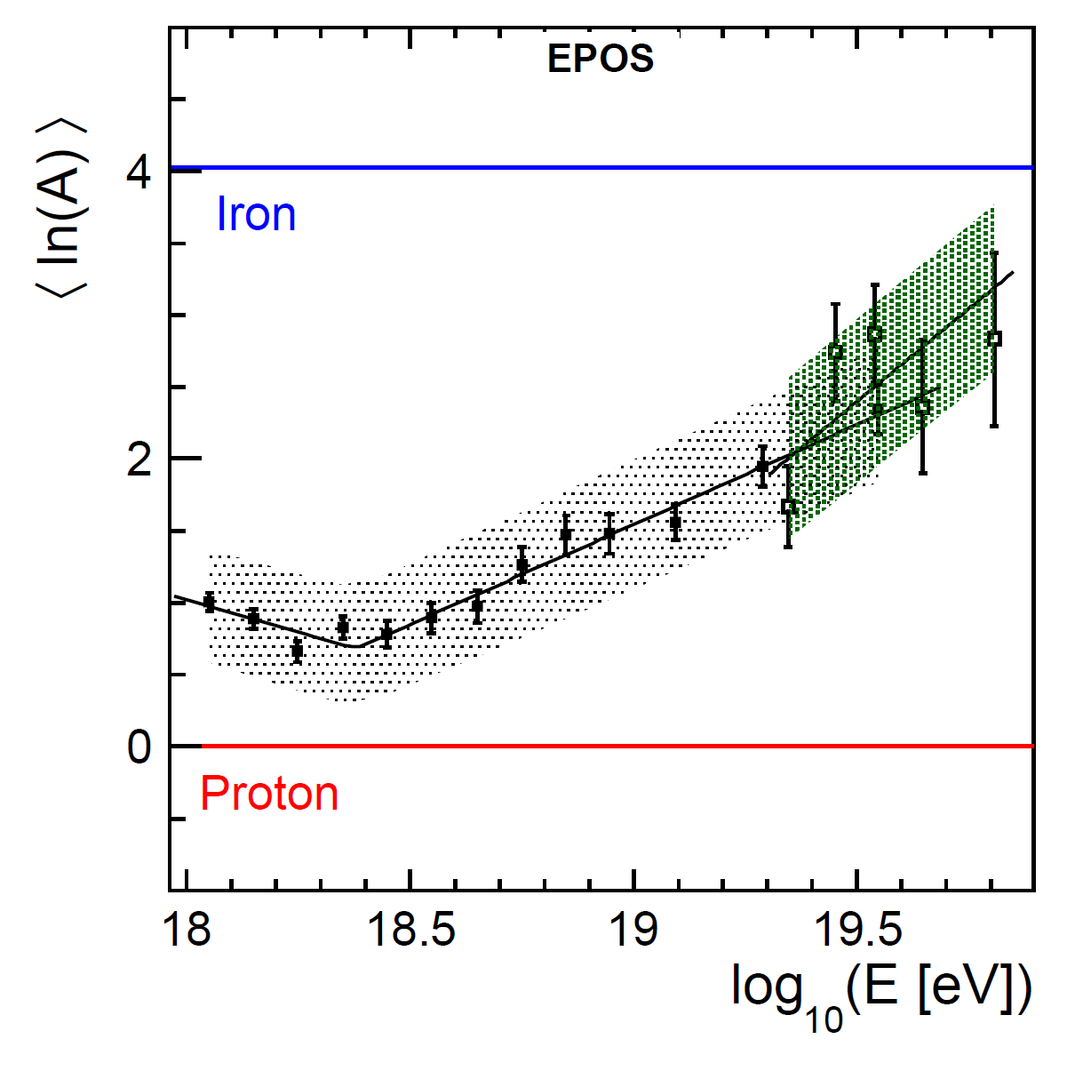
QGSJetII-04
EPOS-LHC
QGSJETII.03
EPOS1.99

Slide 24
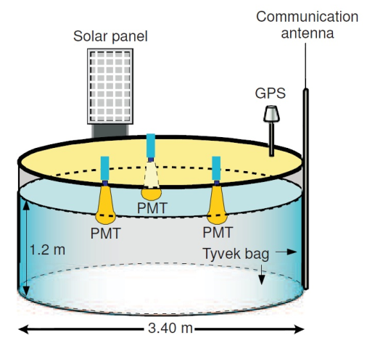
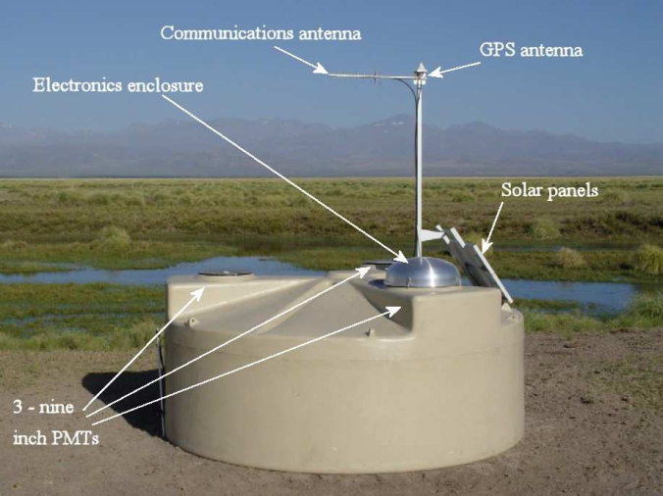
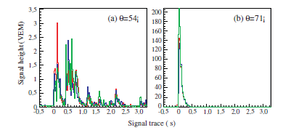
Surface Detectors
2. The Pierre Auger Observatory and Cosmic Rays detection
Surface Detector
1600 Cherenkov tanks ; spaced 1.5km in a triangular grid;
Each tank has: 3PMTs of 9 inches; GPS; wireless communications unit; two 12V batteries powered by solar panel.
100% duty cycle

Slide 25
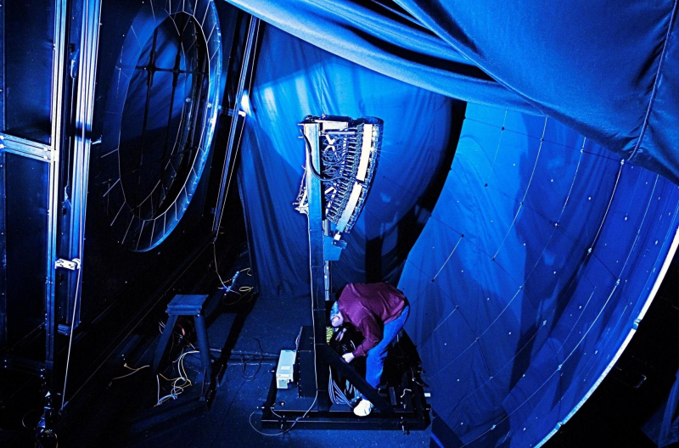
Fluorescence detector
2. The Pierre Auger Observatory and Cosmic Rays detection
Fluorescence Detector
4 stations with 6 telescopes
Each telescope with each with 30º x 28.6º field of view
Camara with 440 PMT pixels (20 x 22)
Several calibrating systems
  Laser system, LIDAR stations, Aerosol monitors, clouds and stars monitoring
10% duty cycle

Slide 26
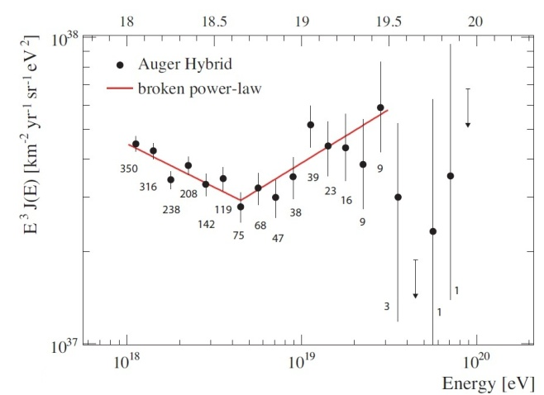
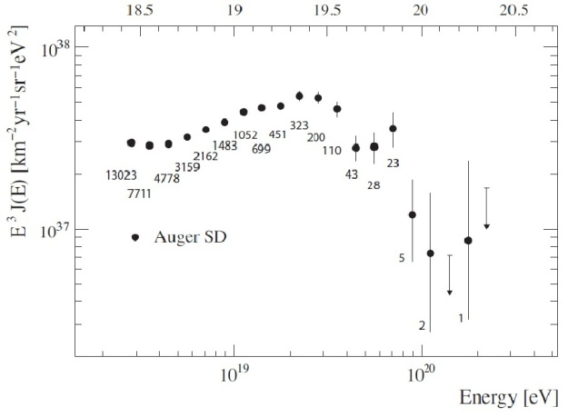
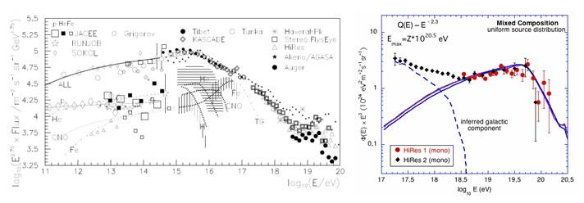
Recent Results - Energy spectrum
Energy Spectrum
Mixed Composition

Slide 27
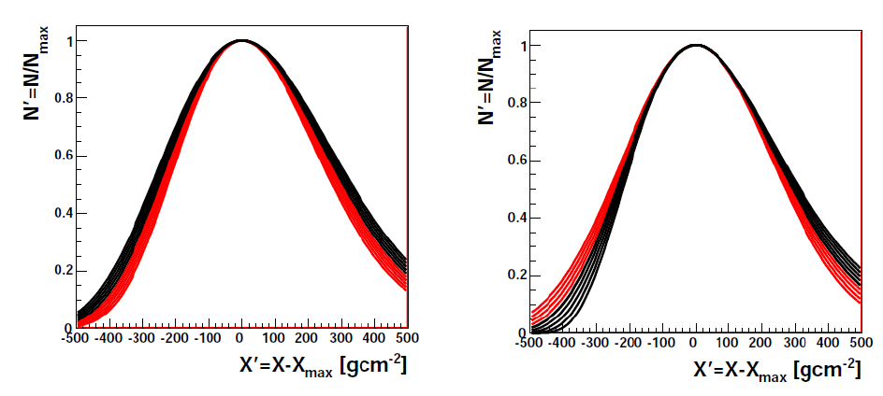
Shape Variables for the USP
S. Andringa et. al., Astropart. Phys. 34 (2011) 360–367
$$N=N_{max}{\exp\left(−\frac{X^{′}}{RL}\right)(1+R\frac{X′}{L})}^{R^{−2}}, { X}^{′}=X−X_{max}$$
Gaussian(L) × Distortion(R)
Gaisser-Hillas rewritten in terms of R and L:
L² = λ . |X₀’|
Measurement of the width of the profile
R² = λ / |X₀’|
Measurement of the asymmetry of the profile
L > 225 g cm⁻²
L < 225 g cm⁻²
R > 0.25
R < 0.25

