Slide 1
Data Acquisition and Performance Studies in Cosmic Ray Experiments
Pedro Jorge Santos Assis
IST
14/01/2009

Slide 2
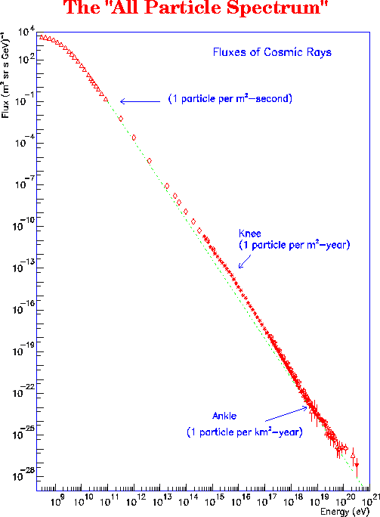
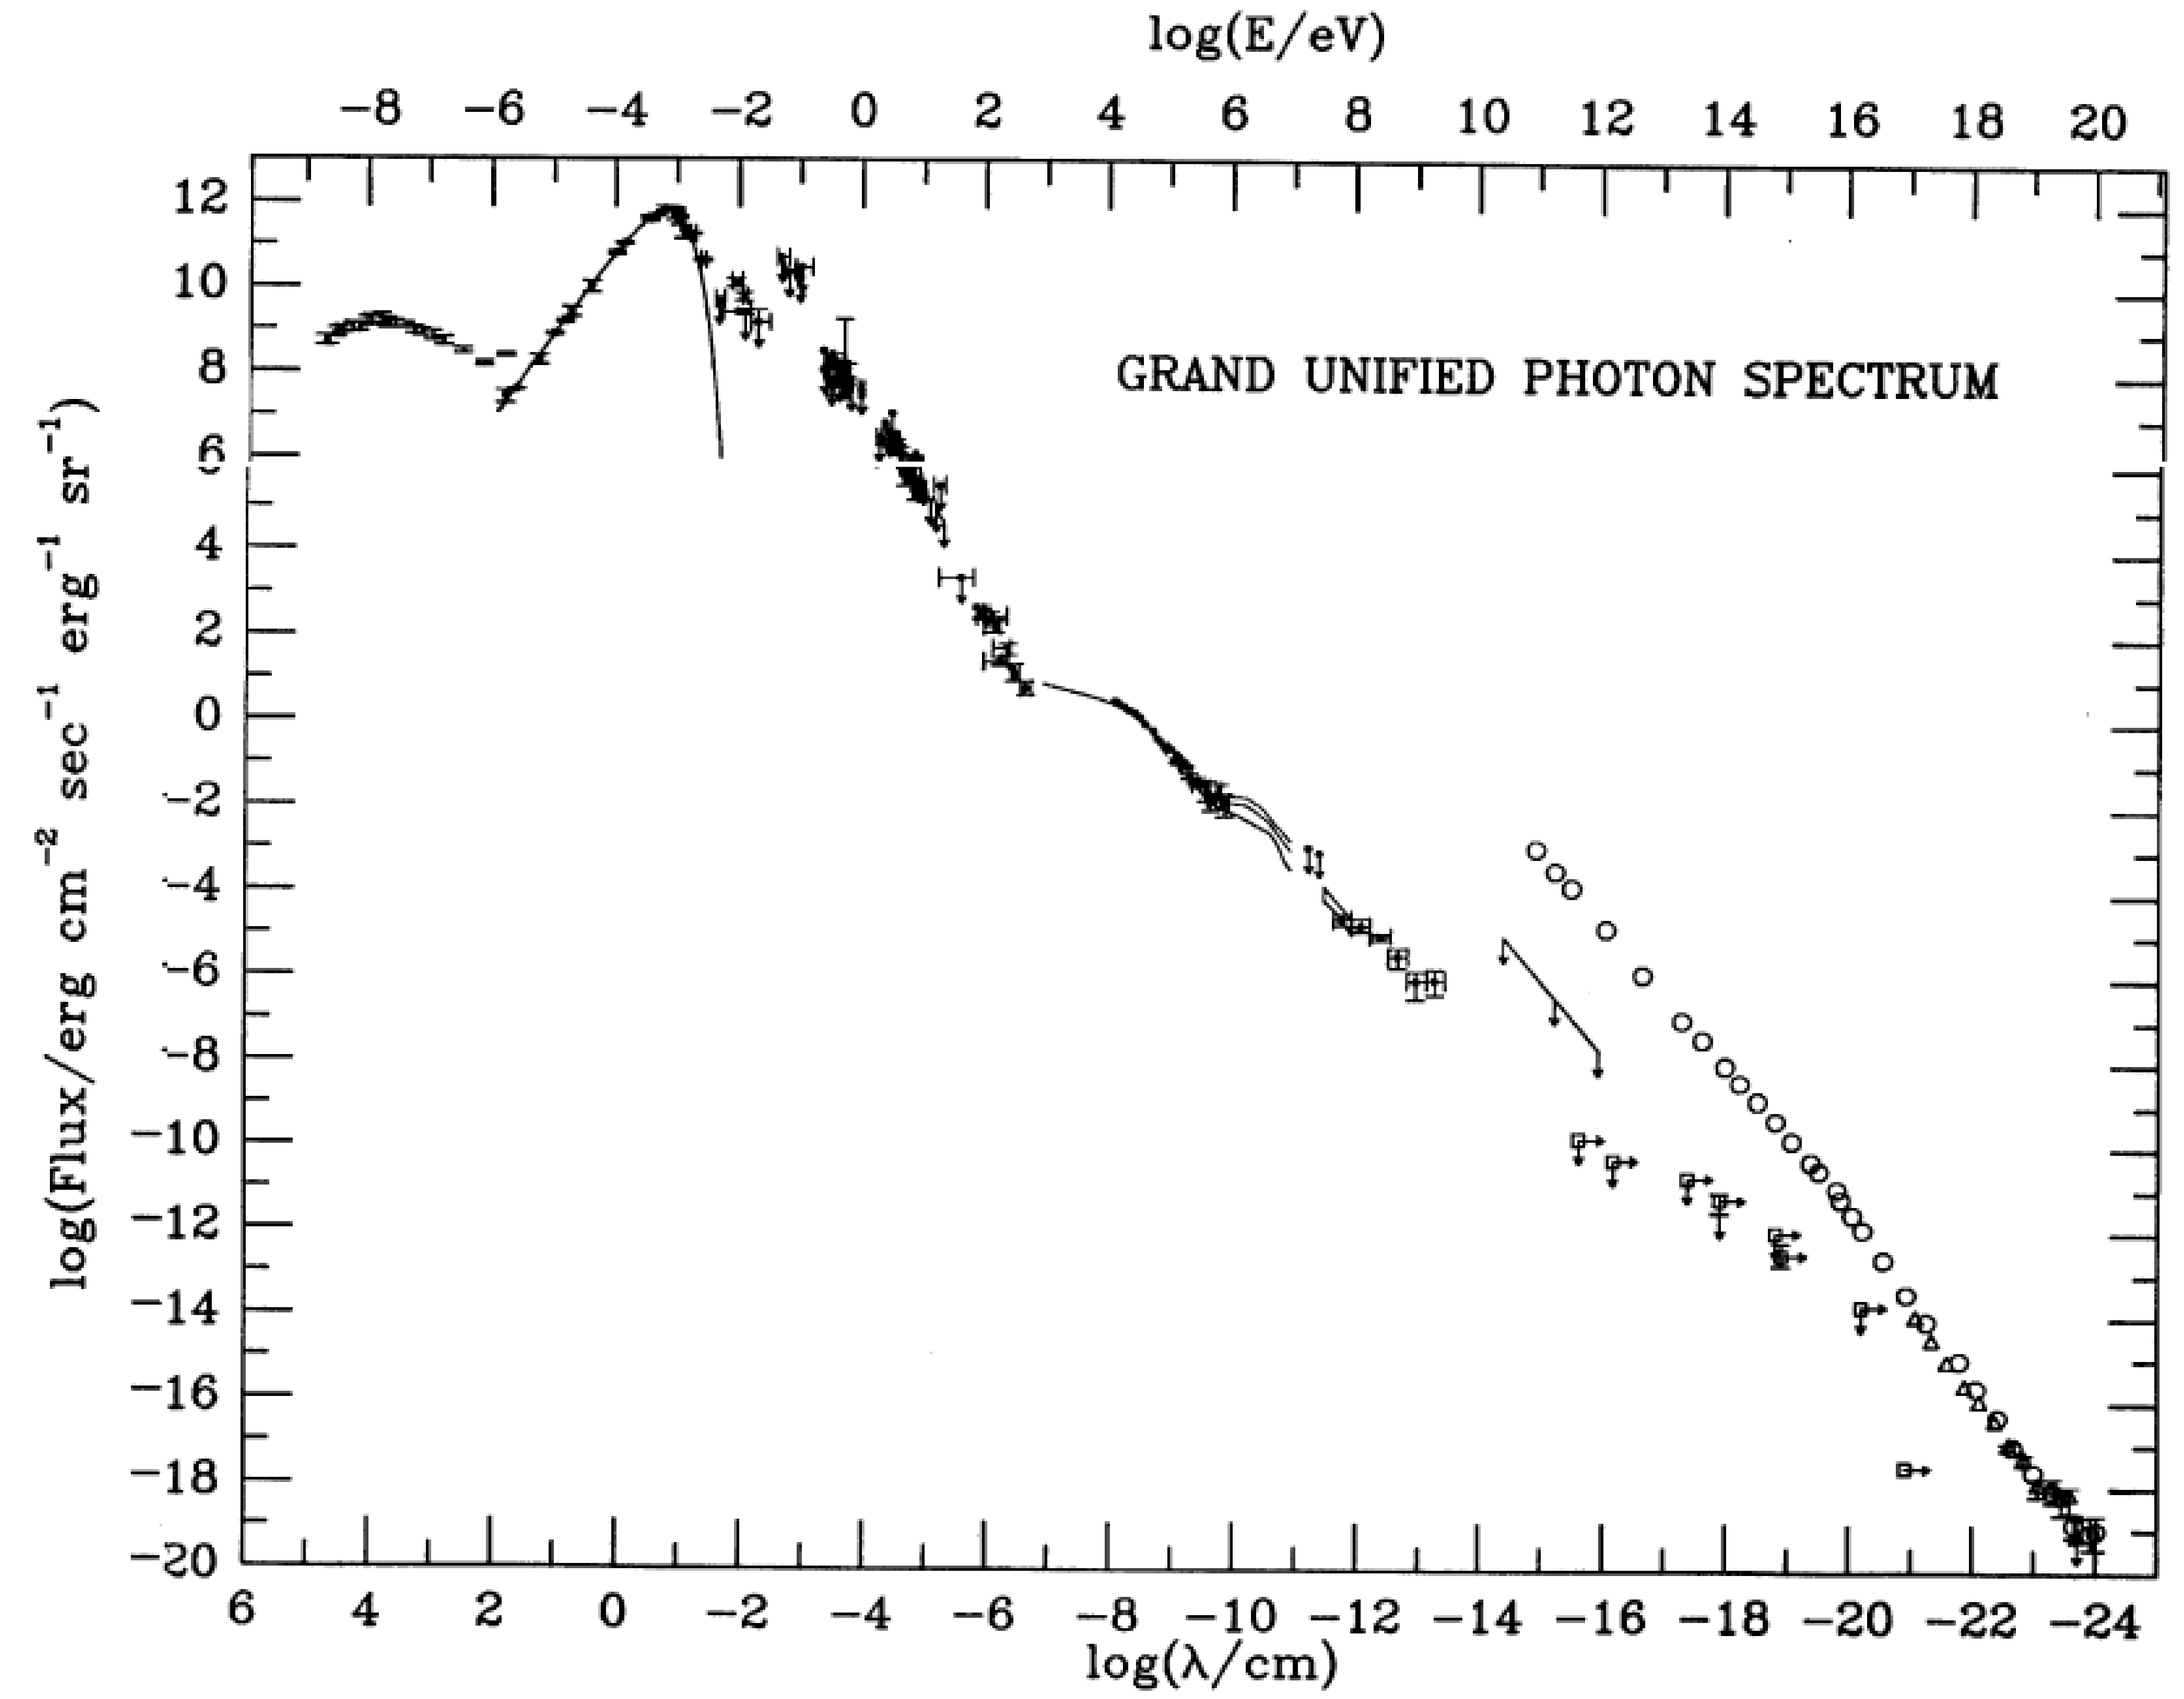
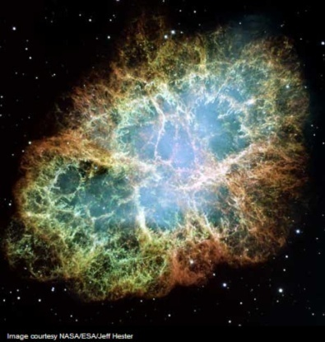
Cosmic Rays

Slide 3
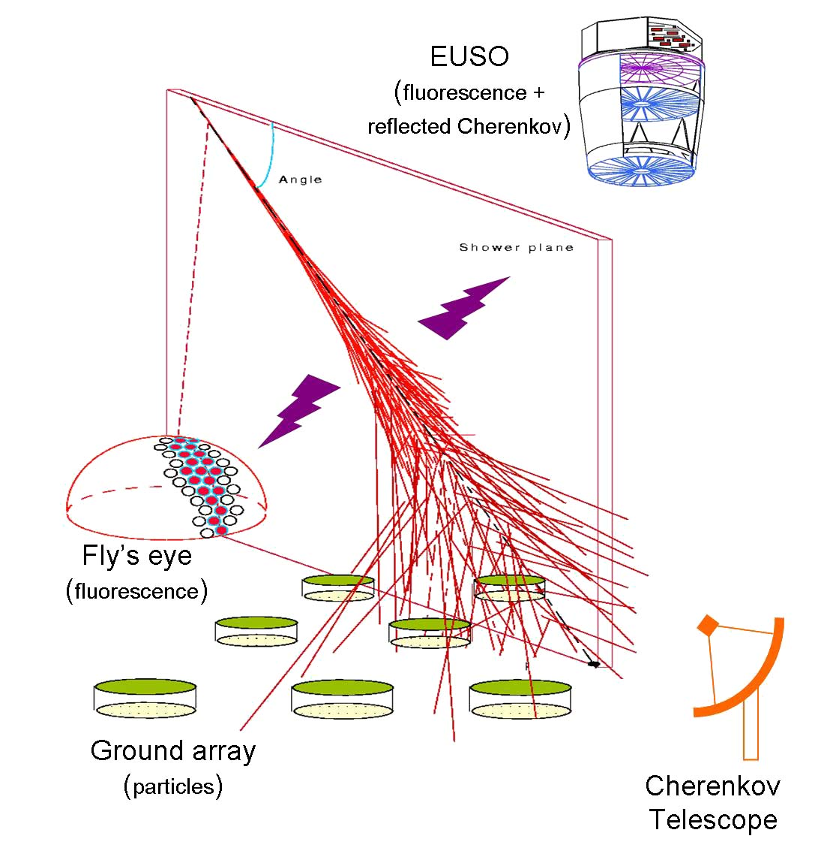
EAS Detection
Ground array
Ex: AGASA
Fluorescence detection
Ex: HiRes
Cherenkov Telescope
Ex: MAGIC
High Statistics:
AUGER
(Array + Fluorescence)
EUSO
(Fluorescence + Cherenkov seen from space)

Slide 4
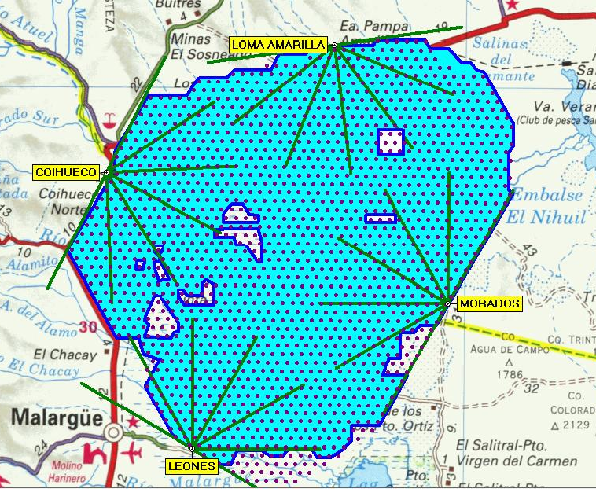
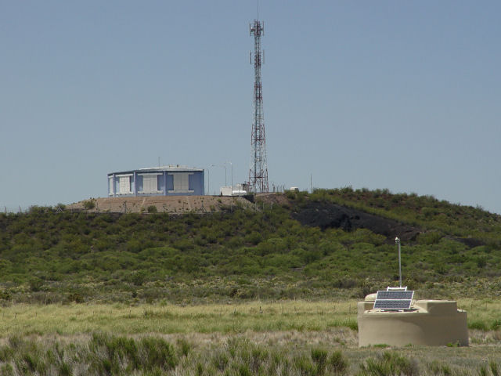
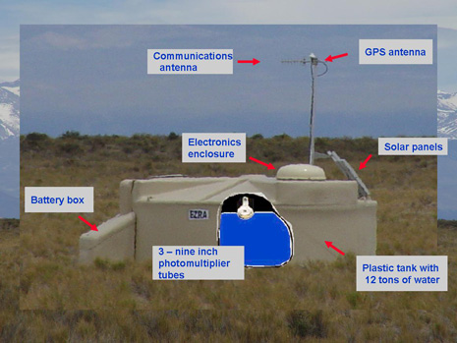
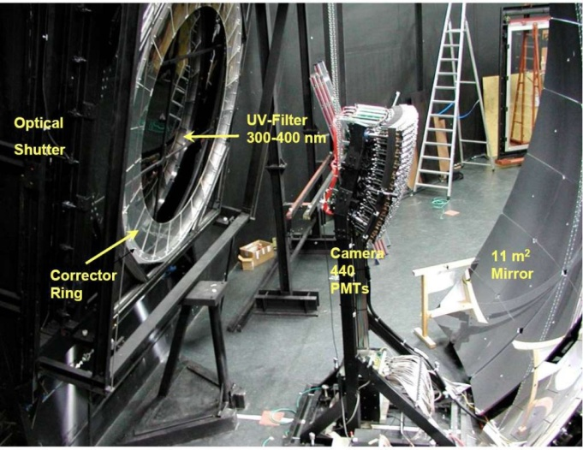
Pierre Auger Observatory
South Site

Slide 5
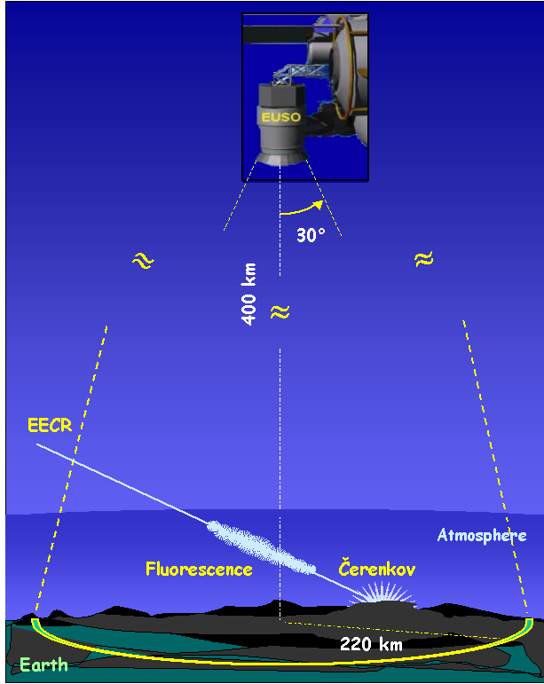
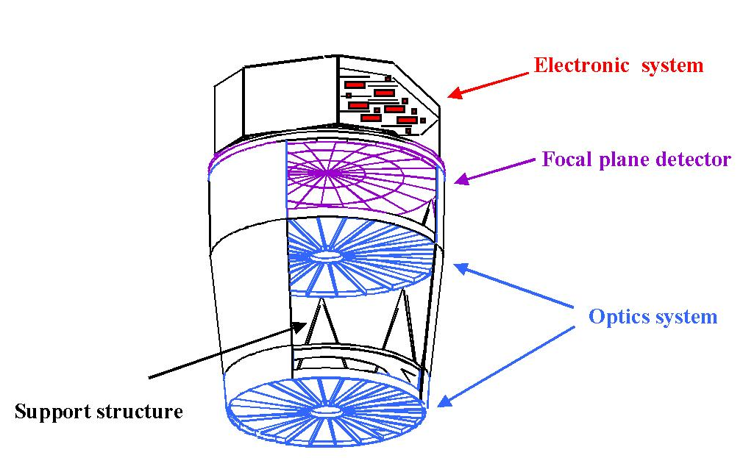
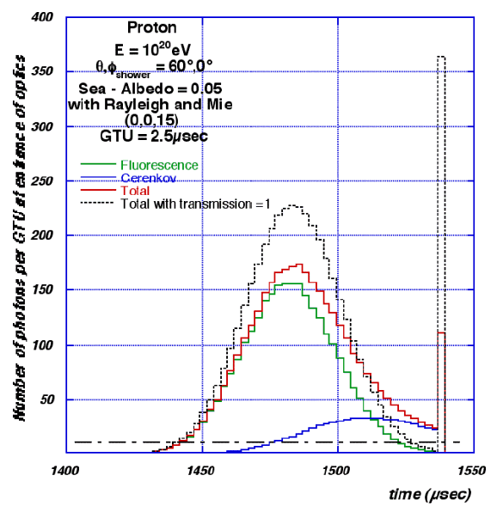
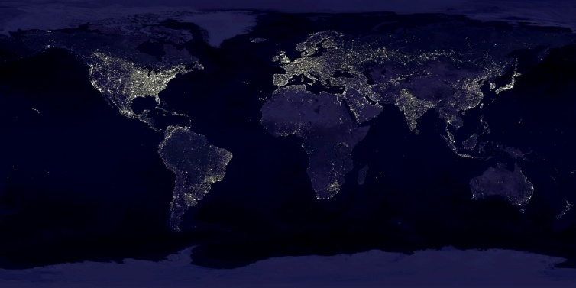
EUSO

Slide 6
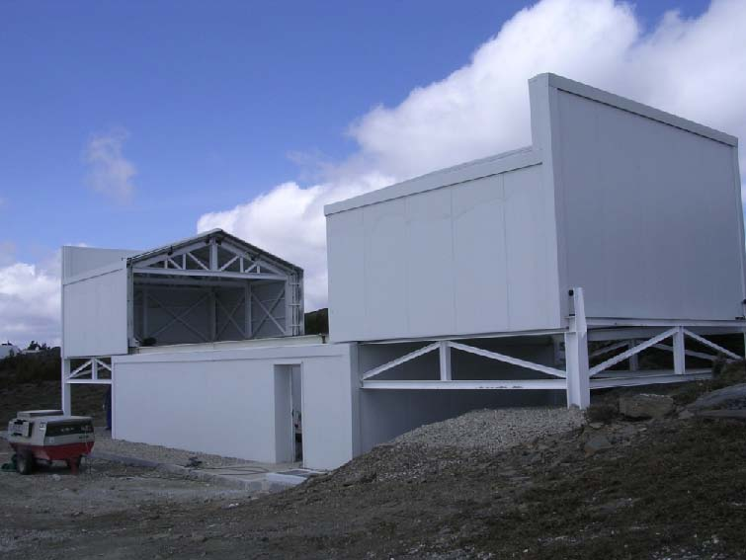
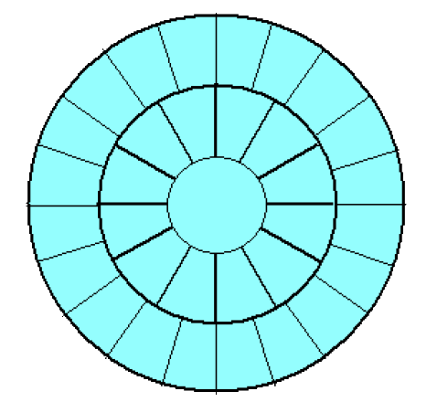
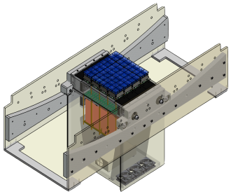
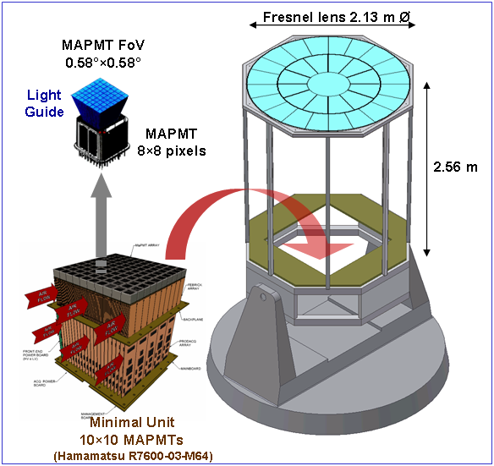
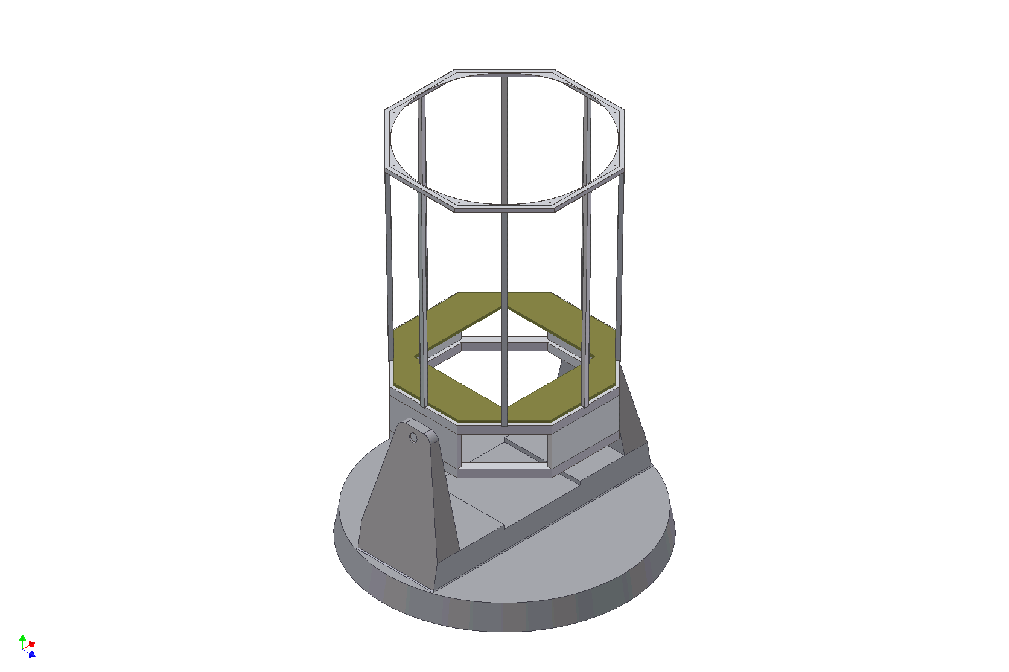


Gamma Air Watch

Slide 7
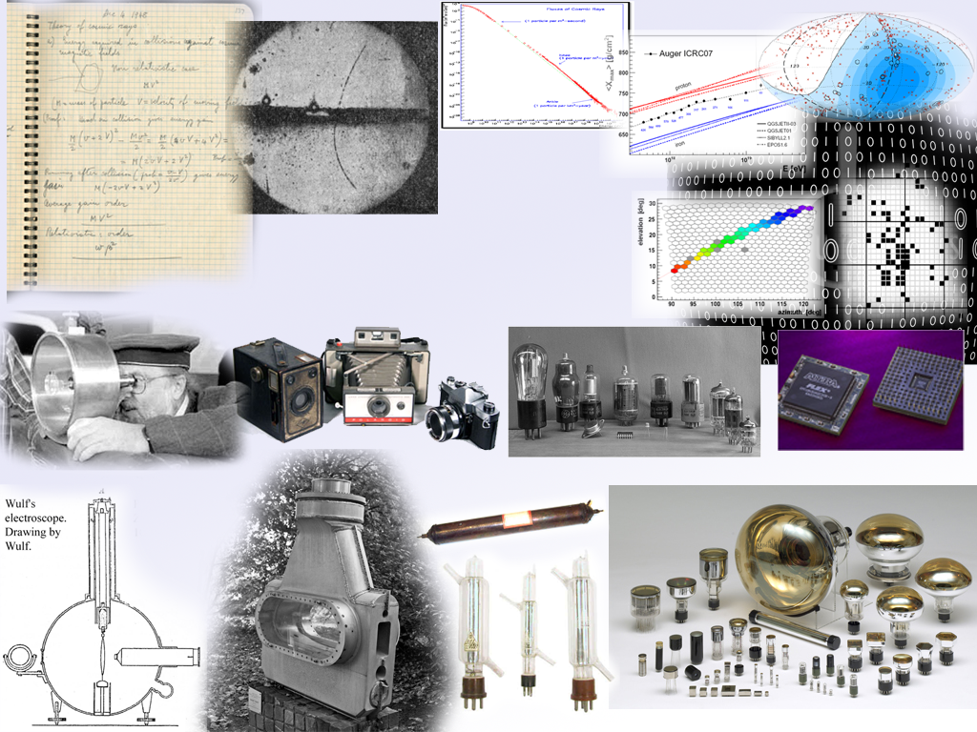
Autonomous
DAQ
Systems
LIP-PAD
Auger
Fluorescence
Detector
ULTRA
TRC
E-CRLab
Trigger
Systems
EUSO
GAW

Slide 8
Autonomous
DAQ
Systems
Autonomous
DAQ
Systems
LIP-PAD
LIP-PAD
Auger
Fluorescence
Detector
ULTRA
ULTRA
TRC
TRC
E-CRLab
Trigger
Systems
EUSO
GAW

Slide 9
Autonomous DAQ systems
Able to instrument small cosmic ray experiments
Develop small DAQ systems
Capable of acquiring PMT signals
Readily available
Highly reprogrammable

Slide 10
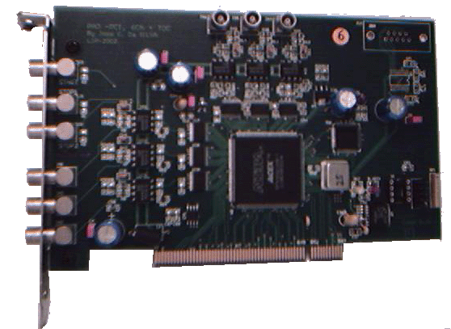
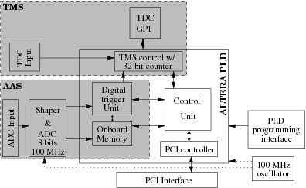
LIP-PAD
“Placa Aquisição Dados”
6 analogue channels (100MHz)
Time measurement (ns)
Fully reprogrammable

Slide 11
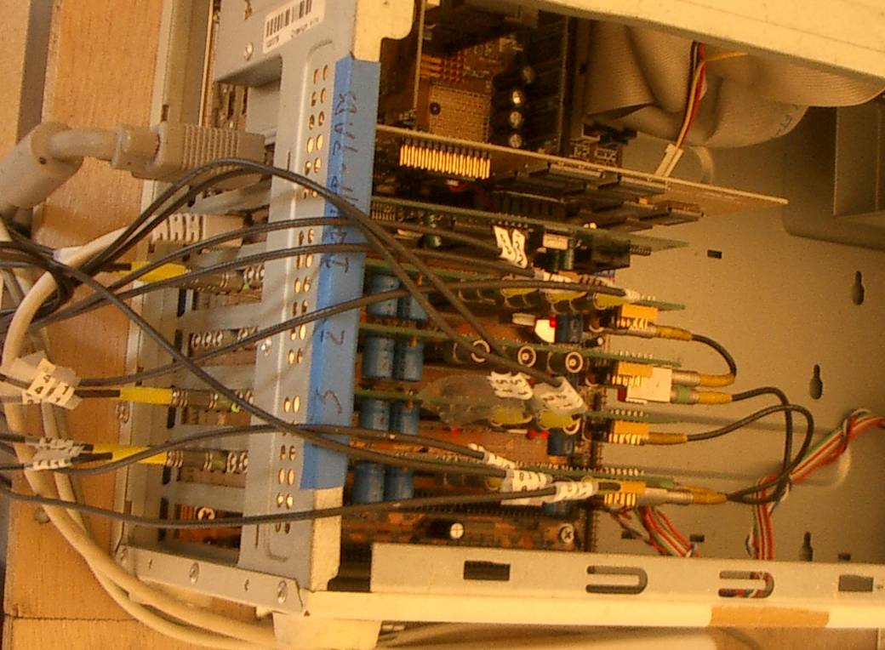
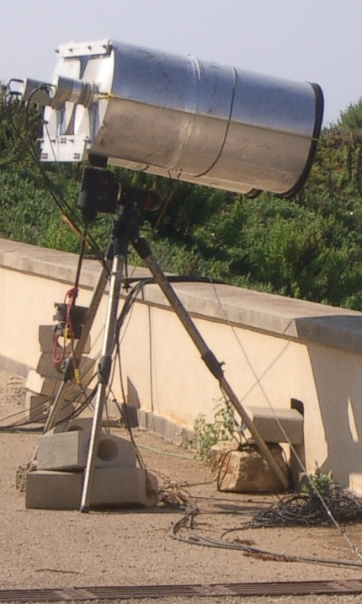
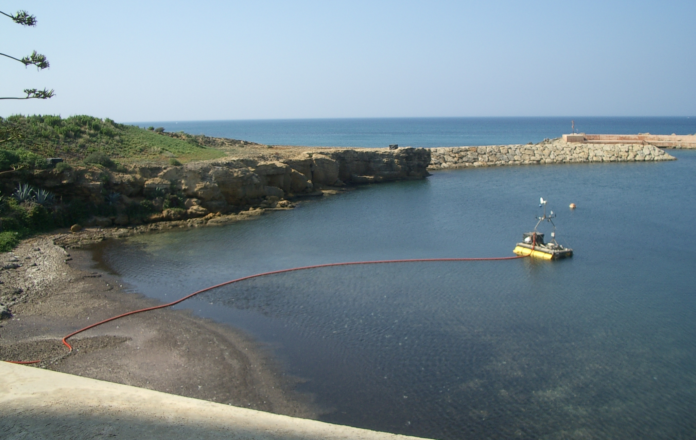
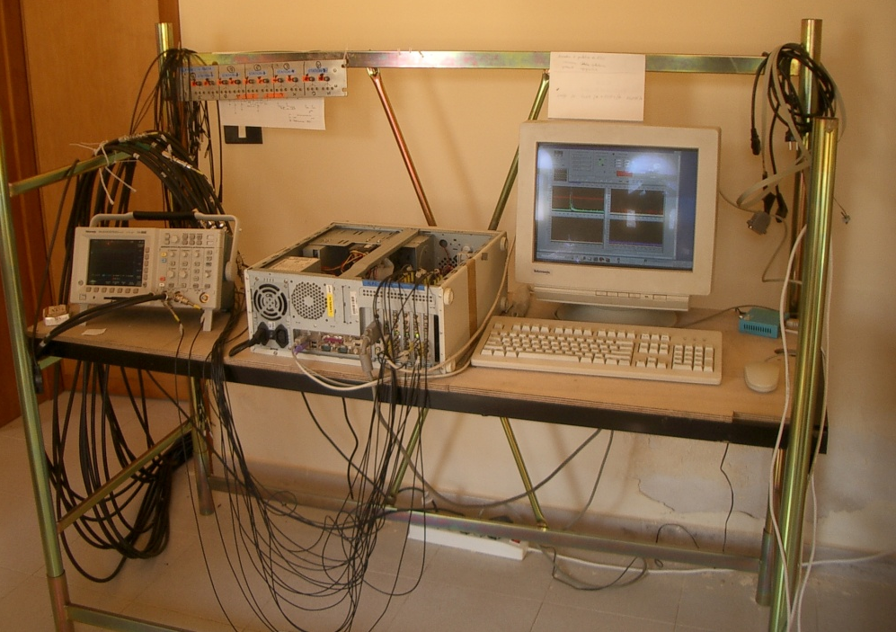
LIP-PAD @ ULTRA

Slide 12
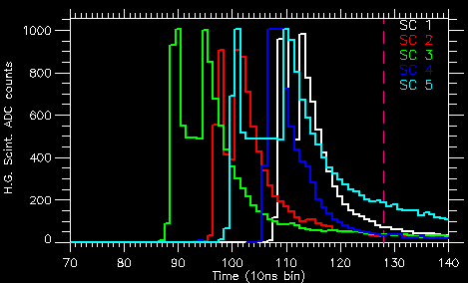
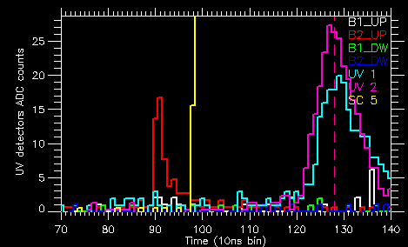
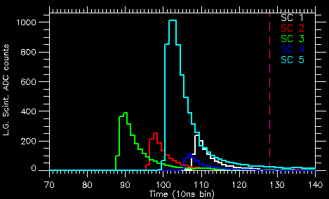
ULTRA event w/ Cherenkov
High Gain PMTs
Low Gain PMTs
Central Station
Cherenkov Light @ UVScope
ULTRA is the first experiment to measure the reflected Cherenkov Light from EAS

Slide 13
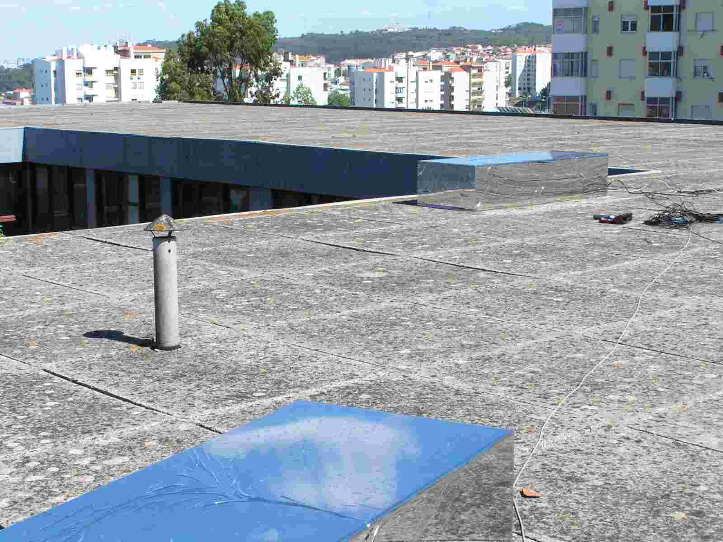
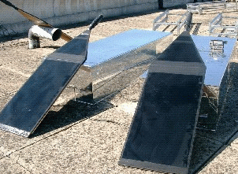
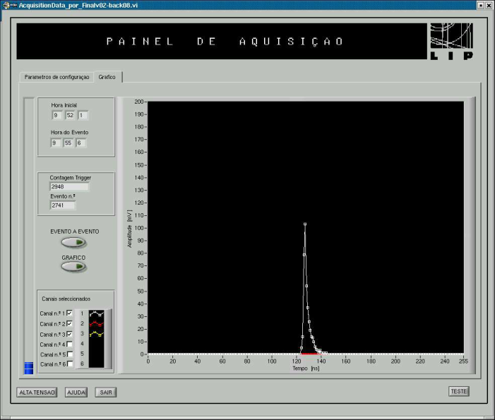
LIP-PAD @ TRC

Slide 14
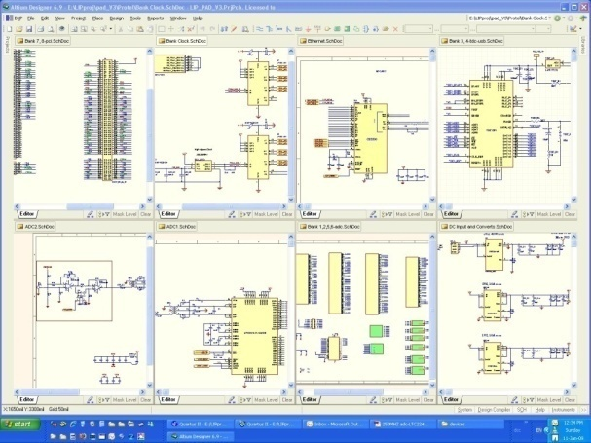
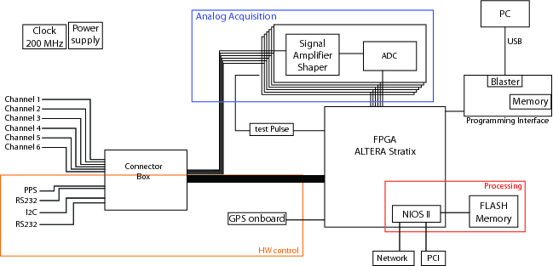
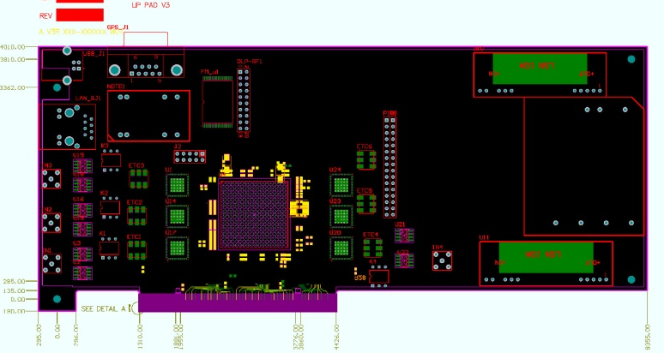
LPV3
LPV3
“Lip-Pad Version 3”
+Speed
+ Processor
+ Network communication
+ HW control capability

Slide 15
Autonomous
DAQ
Systems
LIP-PAD
Auger
Fluorescence
Detector
ULTRA
TRC
E-CRLab
E-CRLab
Trigger
Systems
EUSO
GAW

Slide 16
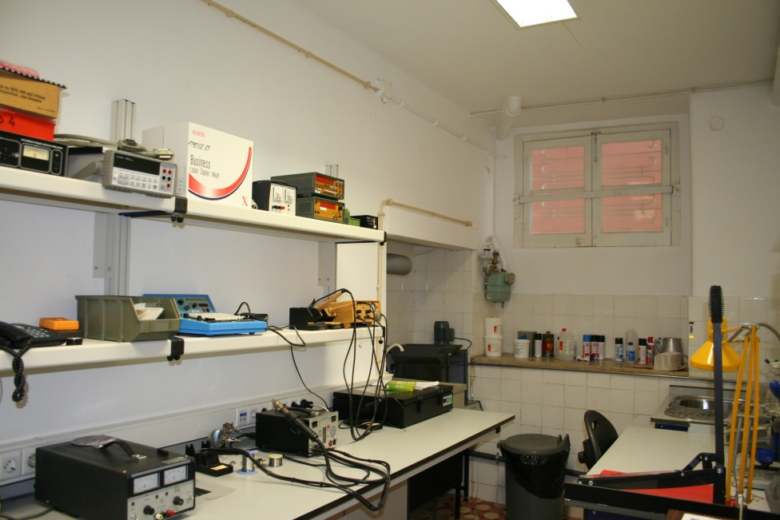
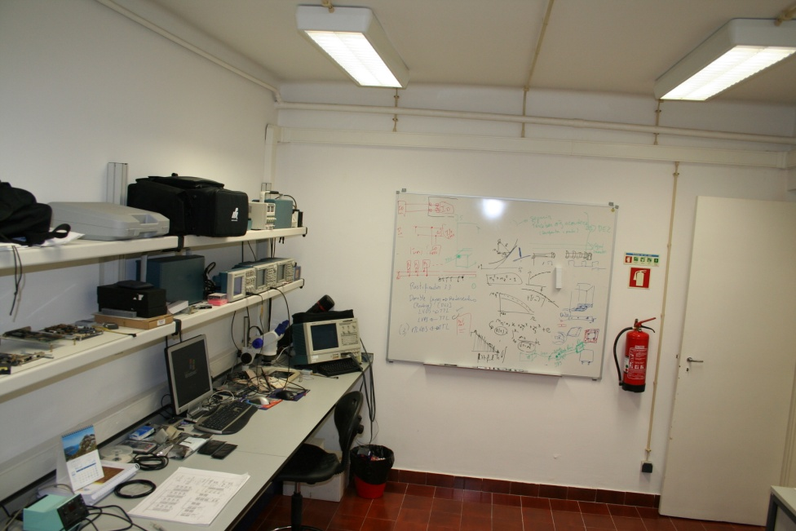
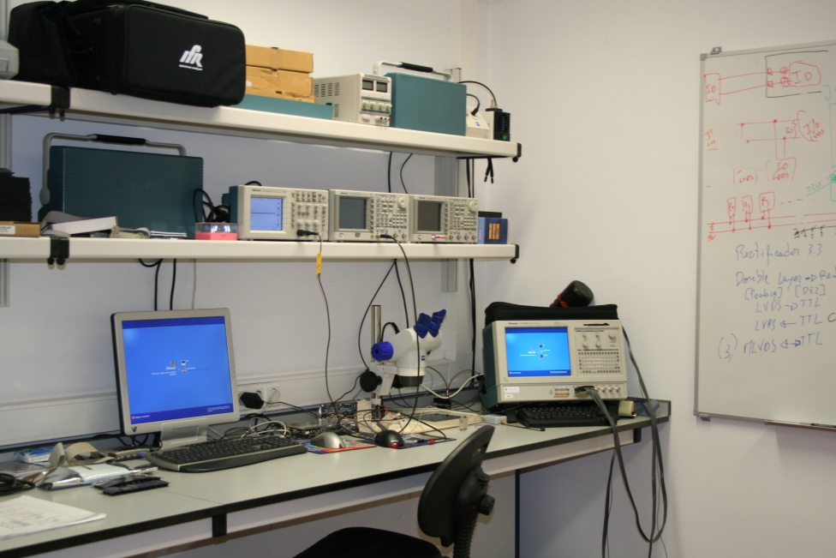
Electronics @ LIP
e-CRLab
electronics for Cosmic Rays Laboratory
2 profiles coexist:
Research
Teaching

Slide 17
Autonomous
DAQ
Systems
LIP-PAD
Auger
Fluorescence
Detector
ULTRA
TRC
E-CRLab
Trigger
Systems
Trigger
Systems
EUSO
EUSO
GAW
GAW

Slide 18
Triggering Systems
Select events from background
High background rejection power
Good efficiency
Online
Development of trigger systems
Algorithms
Implementation in hardware
Develop firmware for DAQ systems

Slide 19
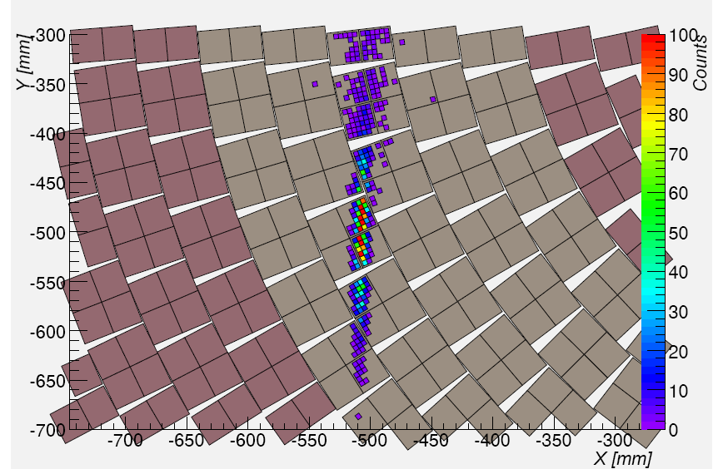
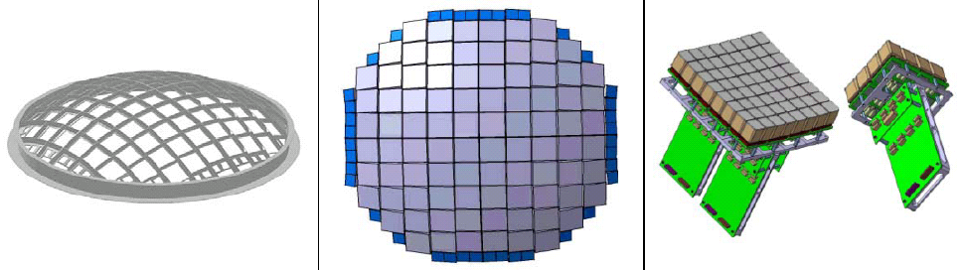
EUSO
Highly pixelated Focal Surface
Trigger:
Reduce necessary bandwith
Online operation
Mass and power budgets important
Nb. of pixels ~ 300.000
Pixel diameter ~ 5 mm
Track sampling ~ 833 ns
Showers appear as lines in the FS
Simple algorithm to
implement in FPGA
Main algorithm based on line recognition of activated pixels
A. Thea
EUSO Focal Surface

Slide 20
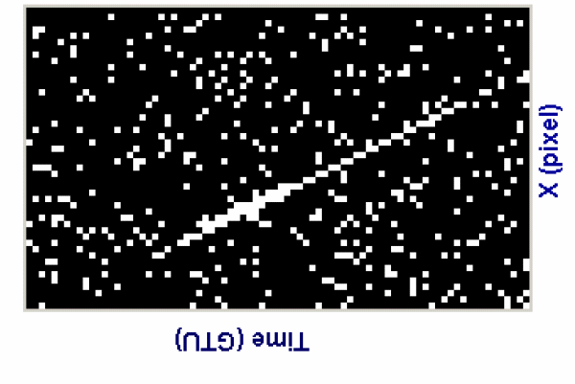
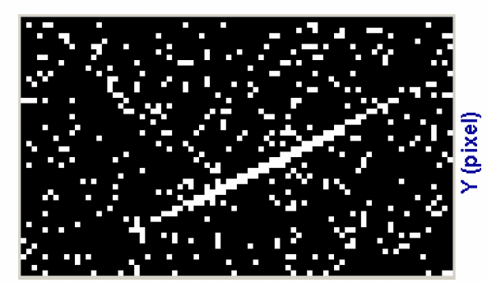
Signal in
Wired-Or
Registers
X wired OR register
Track Find algorithm
Recognize buildup lines with time
X wired OR register
Figure 6.3.1-1 Schematic view of a track along the two projection view (as registered by the read-out electronics). EAS simulated at energy ~5×1020 eV and arrival direction zenith angle ~ 60°.
X wired OR register
X wired OR register
X wired OR register
Time (GTU)
X wired OR register
1 MacroCell
Y wired OR register

Slide 21
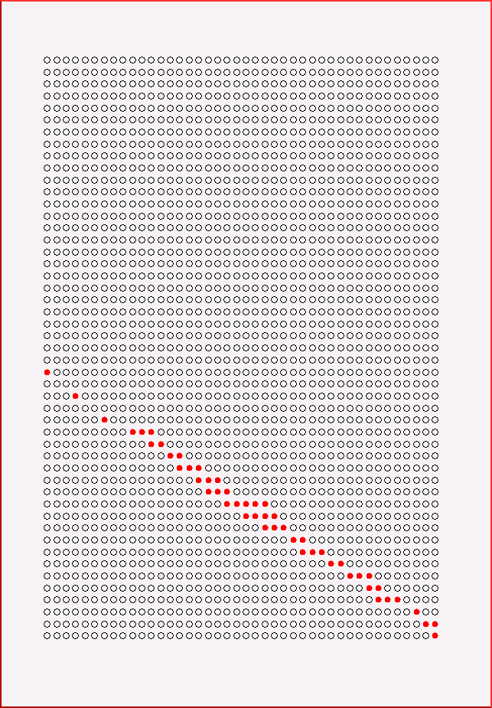
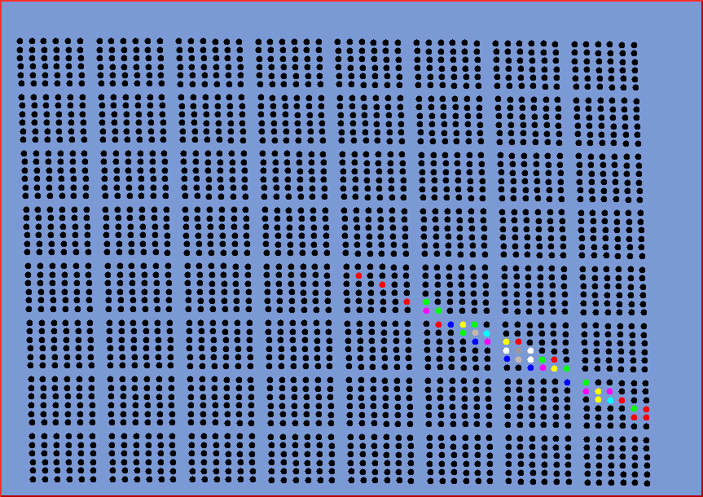
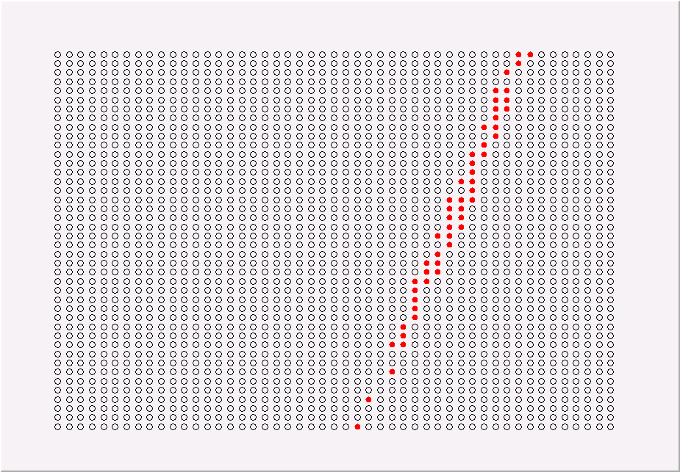
GTU
All GTUs
Y
X
Y
GTU
Shower development
X

Slide 22
Gamma Air Watch

Slide 23
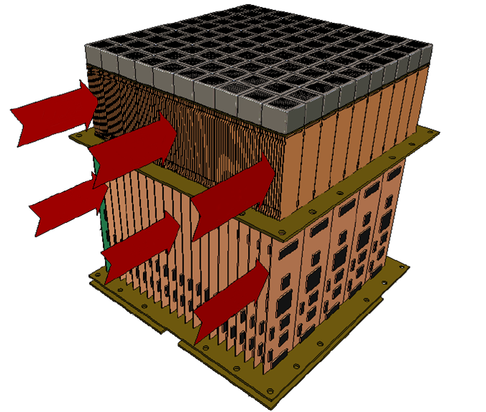

Gaw Focal Surface
MAPMT
FEBrick Array
Air Flow
Backplane
Air Flow
Air Flow
ProDacq array
Air Flow
Air Flow
Mainboard
Front-END
Power Board
(HV & LV)
Air Flow

Slide 24
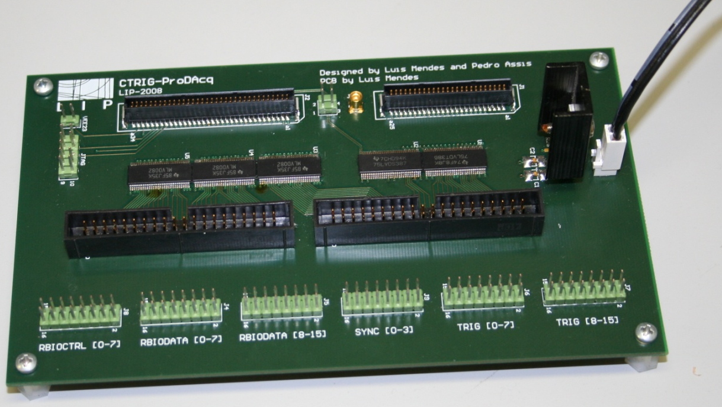
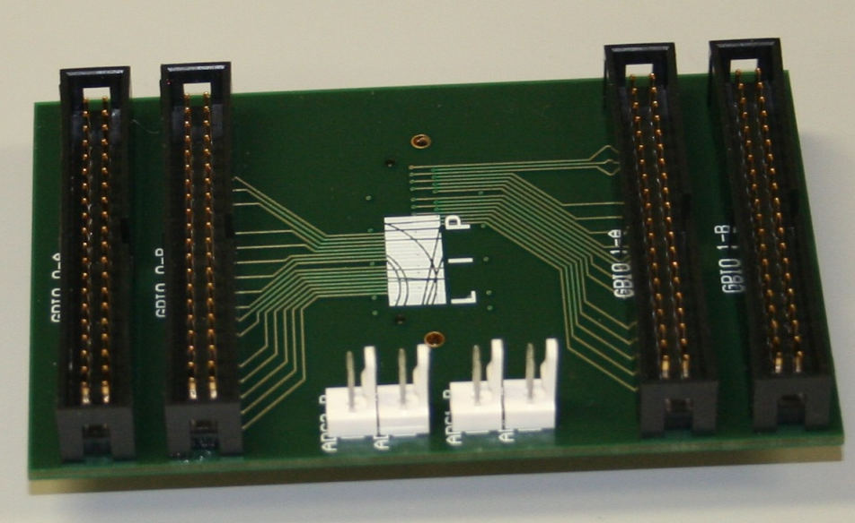
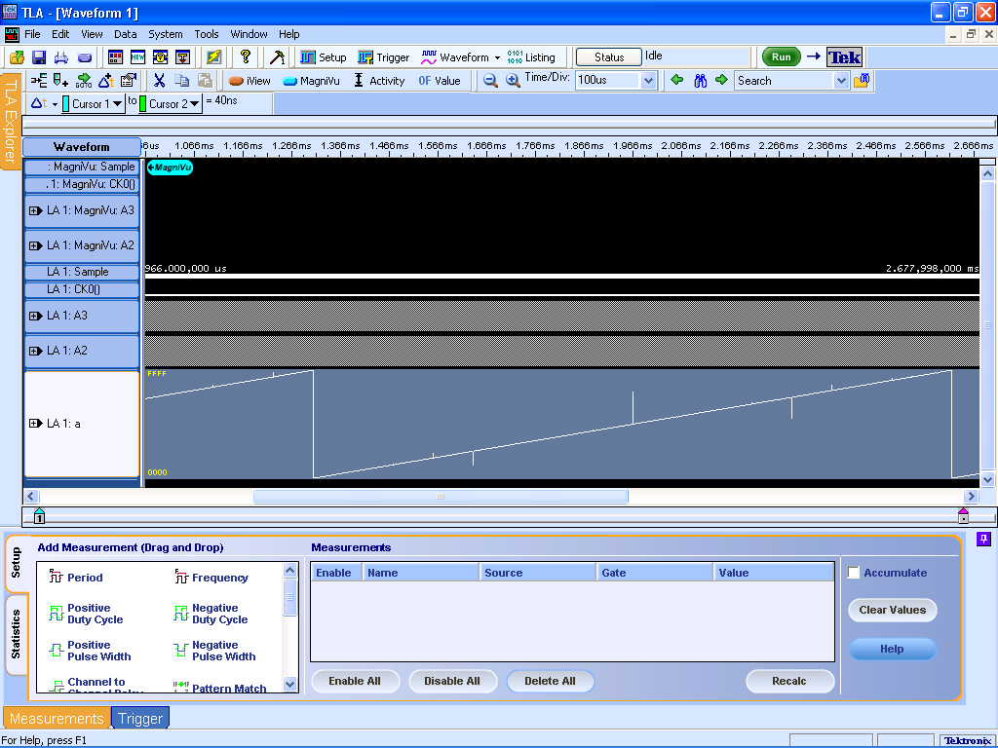
Interface to ProDacq
Cyclic
counter

Slide 25
Autonomous
DAQ
Systems
LIP-PAD
Auger
Fluorescence
Detector
Auger
Fluorescence
Detector
ULTRA
TRC
E-CRLab
Trigger
Systems
EUSO
GAW

Slide 26
Auger Fluorescence Detectors
Detailled studies of the Auger Fluorescence Telescopes
Optical spot
Efficiencies
Comparison with available data

Slide 27
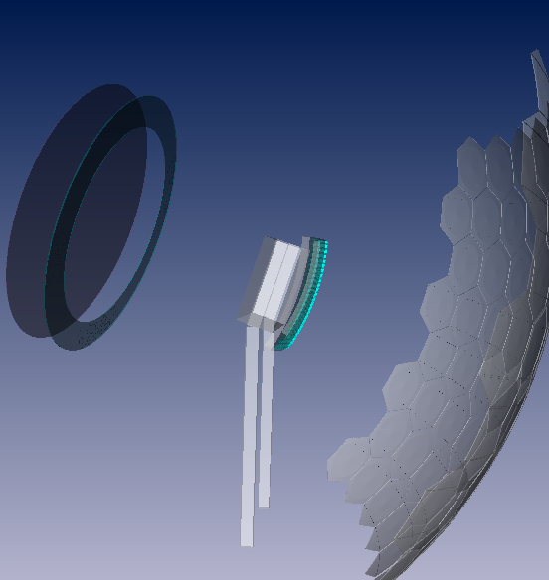

Slide 28
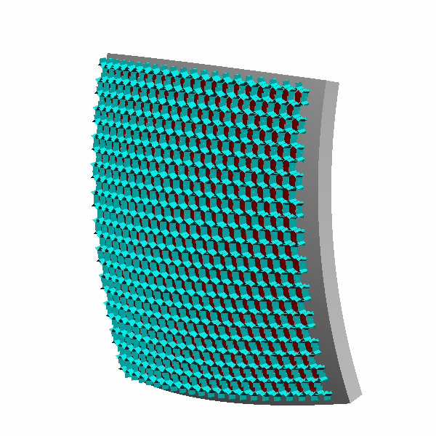
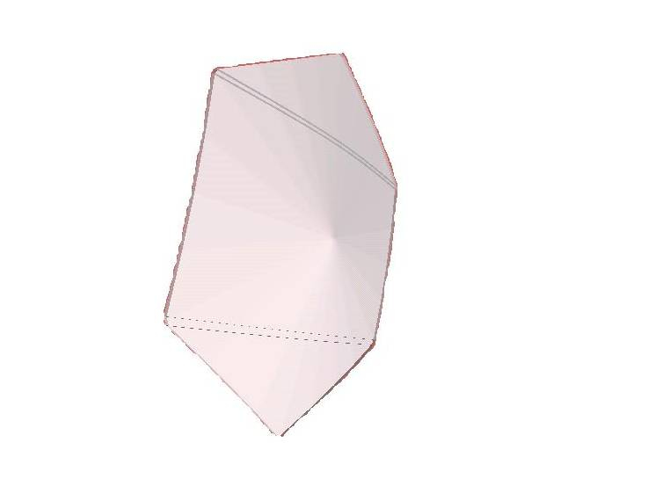



Slide 29

Parallel Rays
0º
15º
30º

Slide 30

a shower in the camera

Slide 31


Optical Spot
Central contribution
(no lens)
Without Camera Obscuration
All photons
Without Camera Obscuration

Slide 32



Optical Aberration
Parallel rays – 0º
ζ
R_{Diaphragm}
Diaphragm
Focal Surface

Slide 33

Optical Spot – Camera Obscuration
Without Camera Obscuration
With Camera Obscuration

Slide 34

Central / peripherical contributions
Fraction of light
KG
LX
All
Central
(No Lens)
Peripherical
(Only Lens)

Slide 35





Spot @ PMTs
Spot at FS
Reflect
Mercedes
Reflect
Mercedes
(lost)
PMT
(direct)
PMT
Density Maps
Large Incidence Angles

Slide 36


Optical Efficiency
Overall Efficiencies
KG: 54.17%
LX: 53.11%
LX (ζ<0.27º): 52.22%

Slide 37





Calibration Studies with point source
Julia Parrisius
Data
Simulation w/ TelSimLX

Slide 38



Studies with Laser Data

Slide 39
Autonomous DAQ Systems
LIP-PAD board used in small cosmic ray experiments
Data for reflected Cherenkov light successfully acquired
New board will increase performance and
autonomy
Auger
Fluorescence
Detector
Detailled Geant4 Simulation
Performance studies
Comparison w/ data
E-CRLab
Trigger
Systems
Design and implementation
Performance estimation

Slide 40






Calar Alto Observatory
Auger North – 20 000km²

Slide 41
Backup slides

Slide 42



Slide 43










DETECTION TECHNIQUE
Charge Integration (Analog)
Single Photon Counting (Digital)
1 TeV gamma triggered event
1 TeV gamma triggered event
pe pile up
1 pe
2 pe
3 pe
0.15° pixel
0.08° pixel
Eq. pe’s
Simulated 1TeV gamma event
3.5 m² area collecting optics
overlapping sectors trigger
8
.5
≥ 3 pixels (≥ 2.15 eq. pe’s) per sector
≥ 14 pixels (pixel-on) per sector

Slide 44

GAW Collection Area with energy

Slide 45

The detection trigger rate for a Crab-like spectrum peaks at 0.7 TeV.

Slide 46

GAW sensitivity
The sensitivity limit for a Crab-like point source in 50 hours observation with 5 sigma detection limit.

Slide 47




Explore Laser Non-Uniformities
Obtain the variations to the expected signal:
Parameterize the expected signal
Apply quality cuts
Solid Angle Rayleigh Attenuation
Mie Scattering
Low Statistics

Slide 48


Mercedes eff. reduced
Optical spot reduced

Slide 49
END -- 2

Slide 50

Spot Size w/ input angle

Slide 51


Lens Efficiency
Filter
Lens
Border Effects
Distance Filter - Lens
R_{In}
Photon Radius at diaphragm (m)

Slide 52
Radius spot
Input Radius
R_{In}
Radius at Focal Surface
R_{FS}
vs

Slide 53


Slide 54

Xmax – Primary Composition
Iron showers develop faster than proton
Slope depends strongly on the interaction models
Auger data
indicates heavier composition at high energy!!!!!
Particle Physics?!...

Slide 55

Energy Spectrum
Ankle
Transition from galactic to extra-galactic sources?
GZK cut-off
Interaction with CMB photons degrades energy

Slide 56

Anisotropies
Search for Sources ( E > 57 EeV )
positions of (318 visible+164invisible) AGNs at z < 0.018 (D< 75 MPc)
19 out of 27 events are within 3.1º of an AGN !!
( The probability of having an isotropic distributions is 10⁻⁵ )

Slide 57


Evidence for Proton Primary?
Energy
E > 57 EeV
Angular aperture
α = 3.1
Distance
z < 0.018 → D < 75 MPc
Low E
High Z
High E
Low Z
The angular aperture suggests that the particle is a proton!

Slide 58
Xmax – Primary Composition
Iron showers develop faster than proton
Slope depends strongly on the interaction models
Auger data
indicates heavier composition at high energy!!!!!
Particle Physics?!...

Slide 59



FD Simulation with Geant 4
Going into detail...

Slide 60



New possibilities…

Slide 61

Cosmic Rays

Slide 62

Cosmic Rays

Slide 63


Extensive Air Showers

Slide 64

Gamma Rays
Crab Nebulae

Slide 65


Slide 66



Slide 67


Slide 70



The pieces…

Slide 71


Slide 72


Slide 73



Slide 74


Slide 75


Slide 76


Slide 78



Slide 79



Slide 80


Slide 81


Slide 82
Results ULTRA

Slide 83
Results in Capo Granitola

Slide 84

4 LIP-PAD boards in a PC
The DAQ system
Trigger Bus
SLAVE
MASTER
SLAVE
SLAVE
Trigger is received from MASTER LIP-PAD
Decides trigger condition
Sends trigger to slave
Trigger is received from MASTER LIP-PAD
Trigger is received from MASTER LIP-PAD
UVscope
ETscope
ETscope
Belenos

Slide 85


UVscope signals
(6 August 2005- UVscope w BG3. Ev # 104
All Sc. saturated
Still central station saturated

Slide 86
REAL signals
Why?
signals happen in the right place (in time)
wrt Belenos:
Δt _{measured} = 1195-892= 303 ns
Δt _{expected} ≈ Δt (cable=50ns)+ Δt (tran. Time=90ns)+ tof(r/d=150ns) ≈ 290 ns
wrt the expected signals in case of charged particle crossing the PMTs
tof(r/d)_{50m} ≈ 150 ns
t _{measured} – t _{expected} ≈ 1195 ns – 1060 ns ≈ 140 ns

Slide 87




(8 June 2005- UVscope w/o BG3. Ev # 62)
(7 June 2005- UVscope w/o BG3. Ev # 72)

Slide 88




More …….
(5 June 2005- UVscope w/o BG3. Ev # 67, 84)
particle
and so on …….
No belenos

Slide 89
Very Preliminary attempt to correlate UVscope signals

Slide 90


Monte-Carlo Dependent to estimate Cherenkov signal

Slide 91


Slide 92

EAS Detection

Slide 93






The Focal surface assembly
PMT
6x6 pixels
Elem. Cells grouped in MacroCells
Mounted 2x2 in support board
Elementary Cell
MacroCell mounted in support structure
EUSO Focal Surface

Slide 94
An event as seen by EUSO
All GTUs
Y
Shower development
X

Slide 95

The Projection in X
X
GTUs

Slide 96
The Projection in Y
GTUs
Y

Slide 97


EUSO
A triggered Event
A non-triggered Event

Slide 98






The .pt Detector Stations
10 stations in high-schools (E# ), 1 central at IST
E8
E 6
6 stations inside Lisboa,
•
E 2
•
•
E1
E 5
•
LIP
•
IST
•
E 4
•
•
•
E 3
12 Km
12 Km
E7
3 in suburbs of Lisboa....
150 Km
...and 2 in the south centre of the country (Beja)
BEJA
E 9
E3 (Lisboa)
E 10

Slide 99

Station of 3 detectors:
Three detector units (with GPS time-tag) are placed at vertexes of a triangle, in the roof of the high-schools.
5 m
(IST roof)
(Amadora roof)

Slide 100


Slide 101

Euso trig eff vs energy
FTR- Fake Trigger Rate

Slide 102


Slide 103

Ch lateral

Slide 104


Slide 105


Slide 106



Slide 107
GZK

Slide 108

Energy loss
Expansion of the Universe
Pair Production
Photonpion production
Compton interactions
Pair Production in field of nucleous
Photodisintegration
Hadron photoproduction

Slide 109


Slide 110


Slide 111

Not just one GZK

Slide 112



Slide 113


Slide 114


Slide 115


Slide 116


Slide 117


Slide 118


Slide 119


Slide 120


