Slide 1
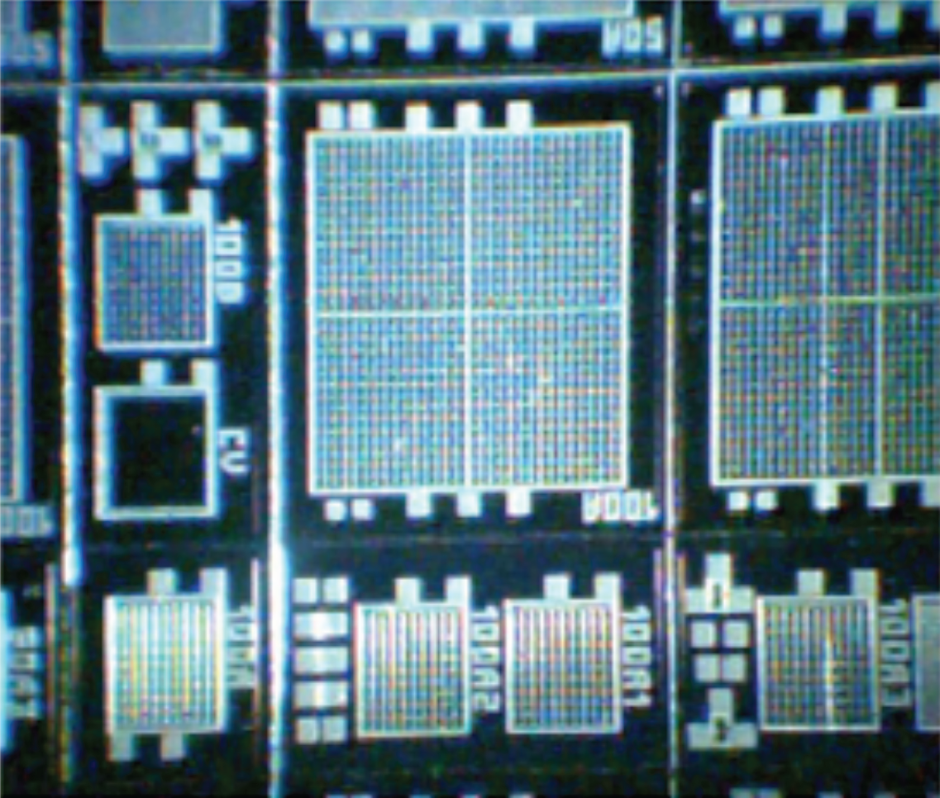

SiPMs @ LIP
R&D towards
a focal surface
P. Assis, P. Brogueira, M. Ferreira,
L. Mendes, M. Pimenta,
P. Rodrigues, T. Schweizer

Slide 2
SiPMs
SiPMs may be a good opportunity to have better FD and Cherenkov Telescopes
SiPMs are getting better:
Photon Detection efficiency going UP
Dark noise going DOWN
Afterpulse going DOWN
Crosstalk going DOWN
Price going DOWN
R&D programmes are necessary

Slide 3
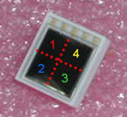
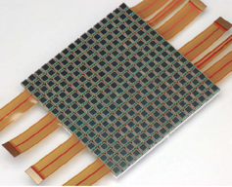
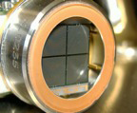
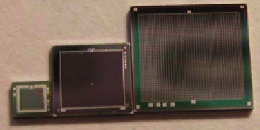
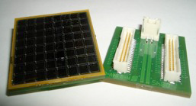
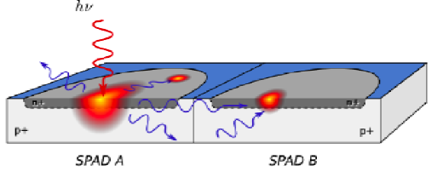
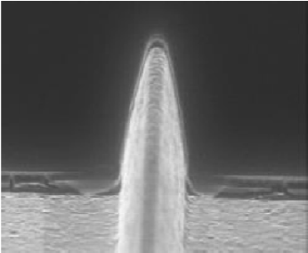
Characterisation@LIP
SiPMs from
Hamamatsu
Dolgoshein/ Excelitas (Perkin&Elmer)
Zecotek
Main Parameters:
PDE
Gain
Darkcurrent
Afterpulses
Crosstalk
Temperature

Slide 4
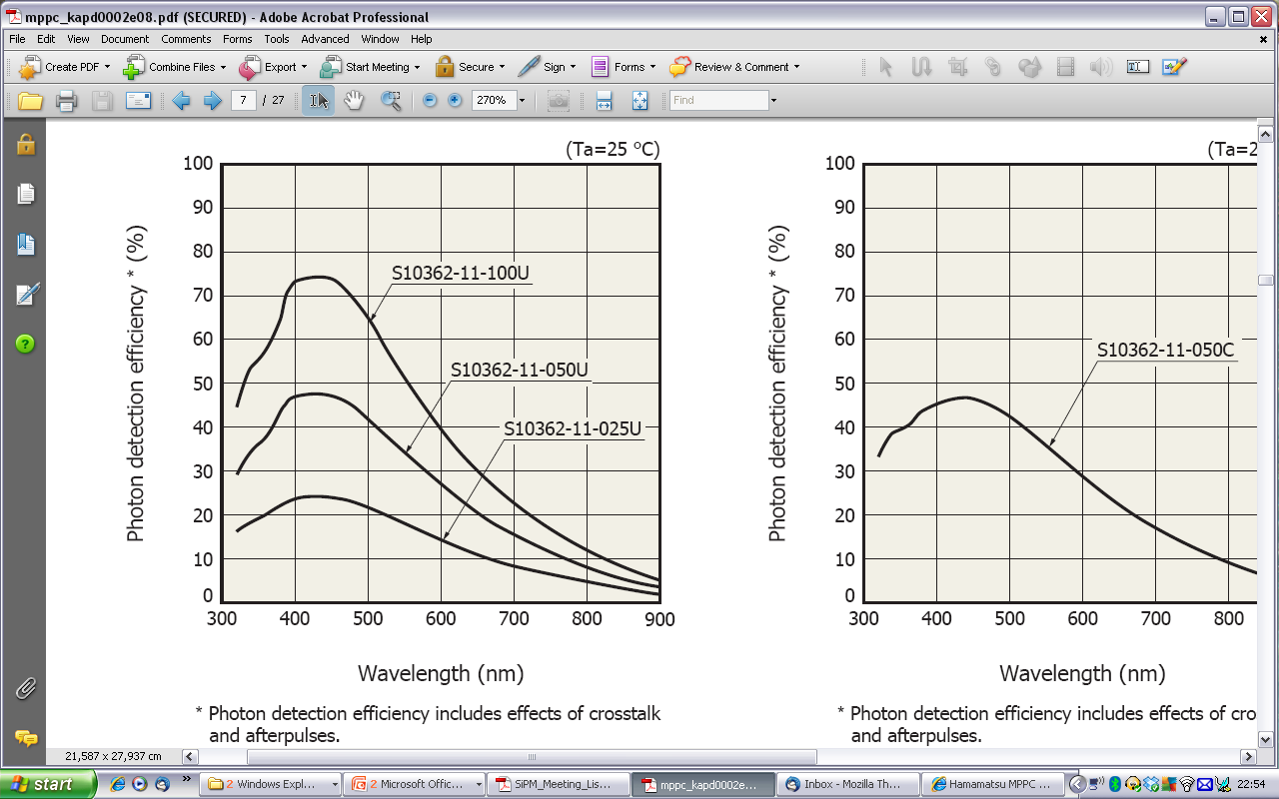
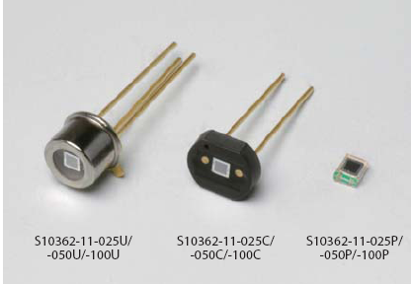
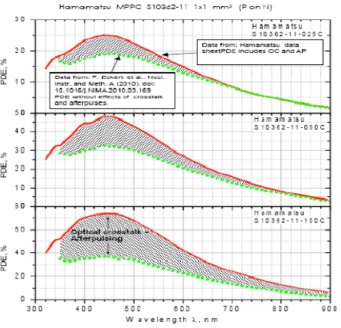
PDE (quoted vs measured)

Slide 5
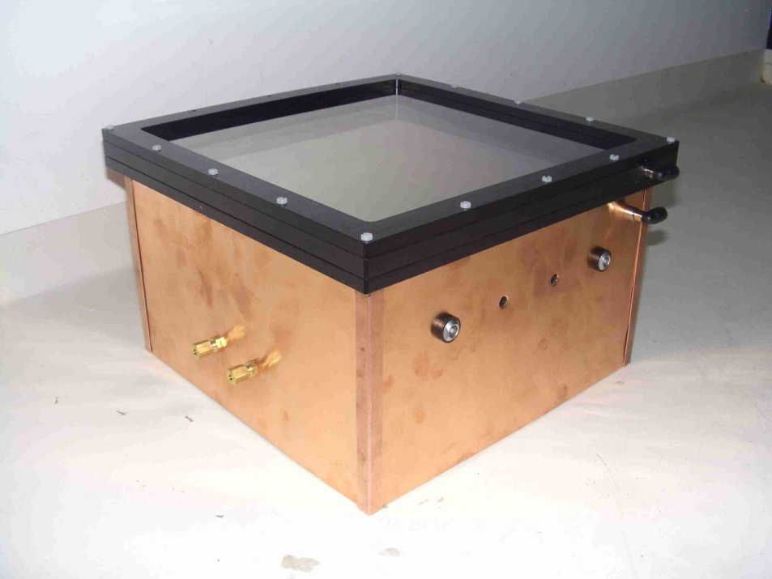
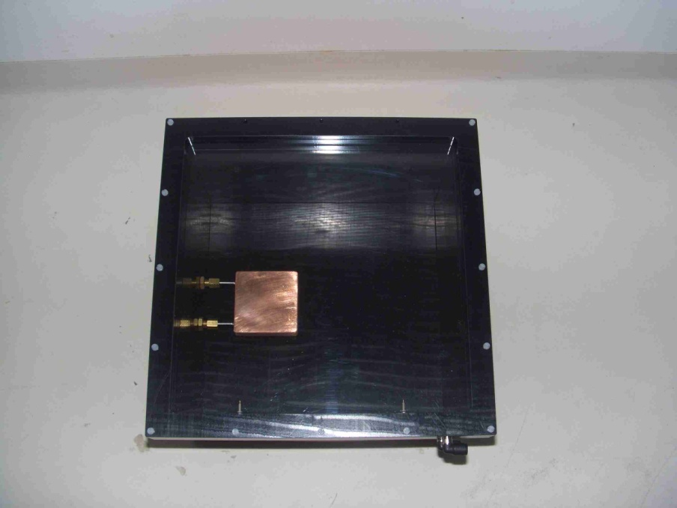
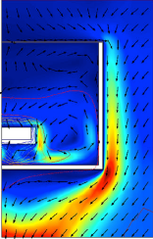
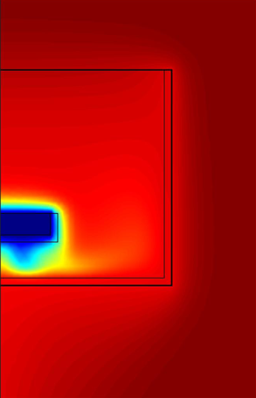
cooling
A solution for liquid cooling is being developed:
Phase change + peltier
Will allow to assess the needs of the cooling system
LIP Coimbra mechanical workshop produced a cooling test box.
Allows testing SiPM at low temperature
Room for reference detectors
Nitrogen atmosphere
Double window PMMA
Allows testing condensation

Slide 6
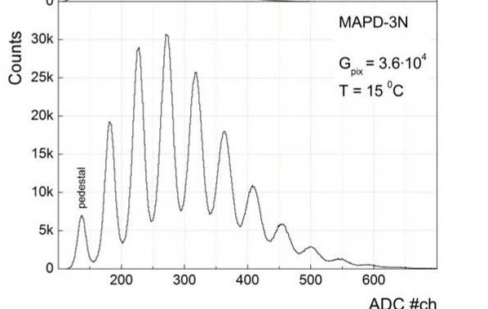
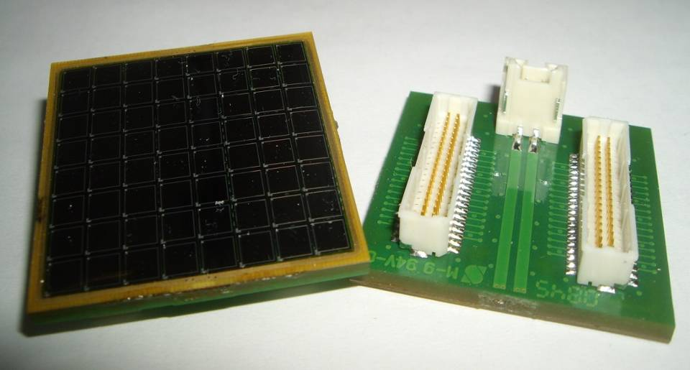
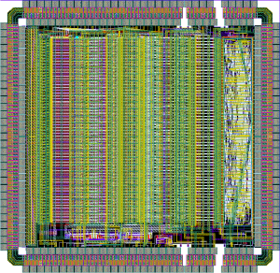
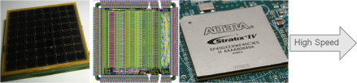
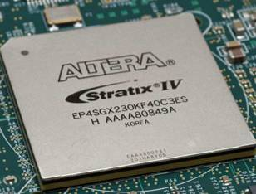
Build up a FS
1m² →10⁵ channels → compact electronics
Main Options:
Digital Photon Counting
Signals digitized early
Data transmitted by high-speed links
Modular scalable design
L1
L1
High Speed
L2
L2
L2
L1
L1

Slide 7
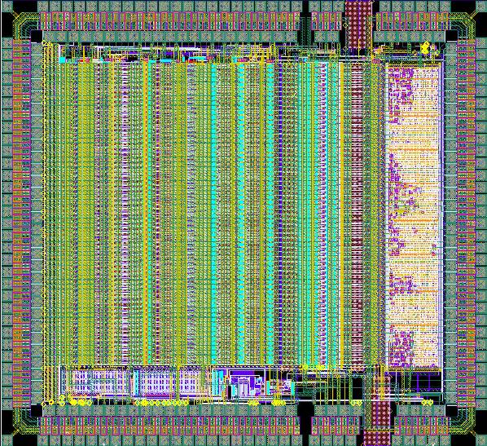
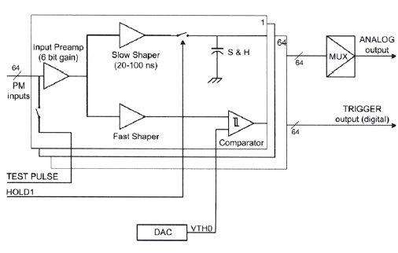
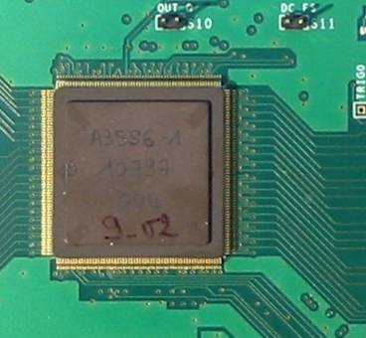
Frontend Readout ASIC
Baseline Option
ASIC MAROC3 (2009)
64 low impedance preamplifier
Variable gain for each channel
Minimum threshold at 100% trigger efficiency: 10 fC
64 logic trigger outputs
12 bits ADC (serial output: pedestal and maximum per channel)
Orsay Microelectronics Group Associated
Notes:
7

Slide 8
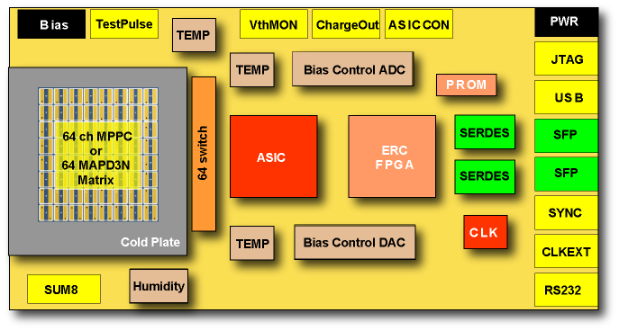
Front-End Prototype Board
Frontend ASIC (MAROC3) readout by an FPGA
Early L0 data reduction and L1 trigger filtering algorithms
Data serialization (SERDES) for high-speed optical serial links
Control of slow-control and monitoring services
Notes:
8

Slide 9
European projects
HEAP-MM
PHOTODAC JRA
Drive the industry to produce enhanced SiPM
2 dedicated runs of production of SiPMs
Dedicated run produce SiPM matrix
Reference characterisation laboratory in Lisbon
MPI, LIP
ASPERA
(C) Improvement of photo sensors (γ-sens)
Small Telescope prototype
RWTH Aachen, LIP

Slide 10
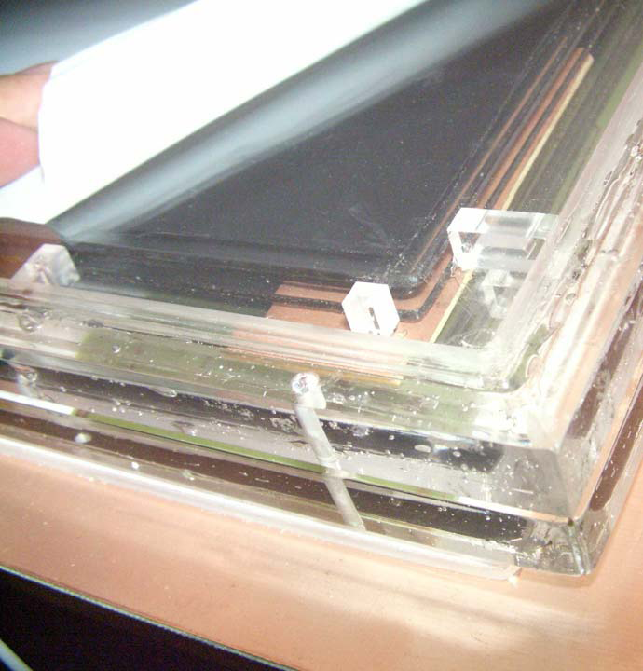
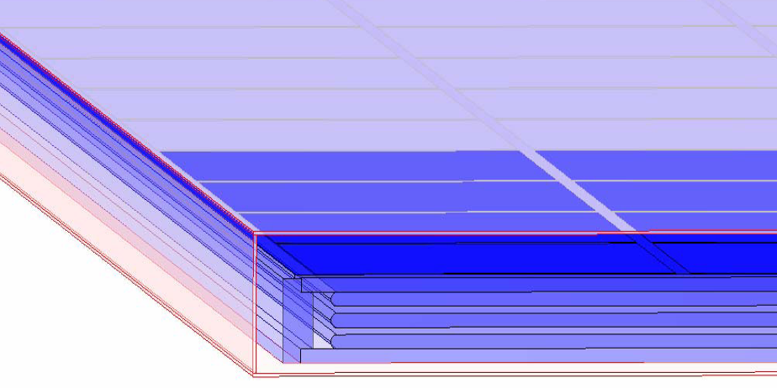
RPCs R&D
LIP Coimbra is developing a prototype for RPC for Cosmic Rays:
Low gas consumption
Low power
Compromise between timing and spatial resolution and field conditions
Ability to operate autonomously in field conditions to be tested

Slide 11
Thank you
SiPMs are getting better and cheaper…
… R&D programmes starting

Slide 12
RPCs - measure the arrival times
Resistive Plate Chambers: gas detectors made with paralel plates. one of the electrodes has a high resistivity to avoid sparks. Plates can be very close together (~mm).
Outstanding time resolution (50 ps) – the standard technique today for large-area time-of-flight measurements on relativistic particles.
Good spatial resolution: Depends on reading electrodes geometry
+HV
Pickup cells
Medium resistivity layer
(e.g. Graphite)
transparent to the induced
signals
High resistivity layer
(e.g. PET)
Resistive electrode
Gas gap
~mm
Resistive electrode
-HV
Resistive electrodes
(e.g. glass)
Pickup cells

Slide 13
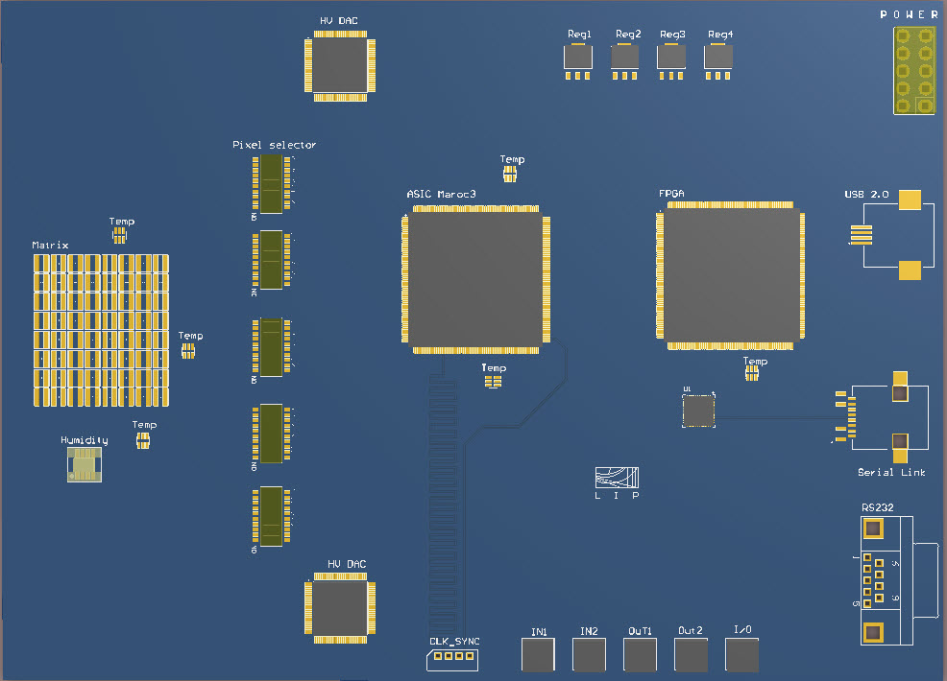
ERC Prototype Board Status and Plans

Slide 14

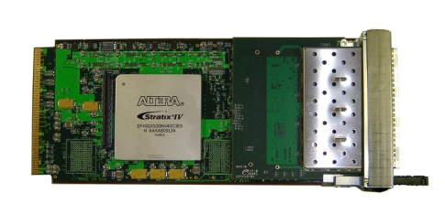
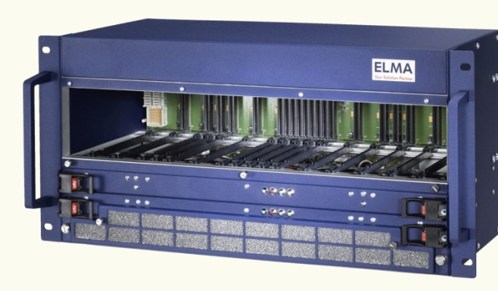
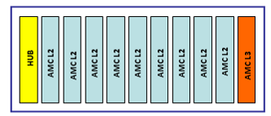
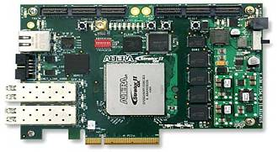
Off-Detector DAQ Organization
AMC L2
36 bi-directional
optical links to the focal plane
AMC L2
AMC L2
MicroTCA crate organization
1 full duplex optical link to the DAQ PC
AMC L3
One optical link into
the PC (PCI-E board)
36 864 channels (20 x 20 SiPM arrays)
Surface area = 94 cm x 94 cm ~ 1 m²
9 AMC cards required for L2 trigger
1 AMC card required for L3 trigger

Slide 15
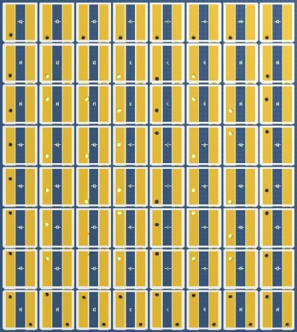

Front-end prototype

Slide 16
WORKING

Slide 17
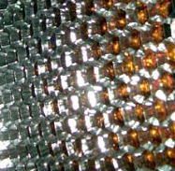
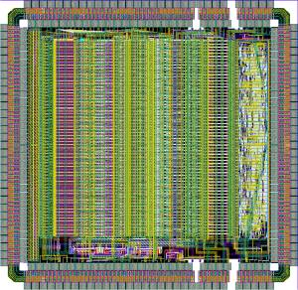
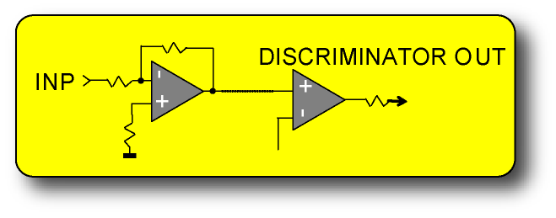
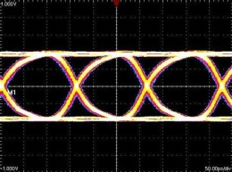
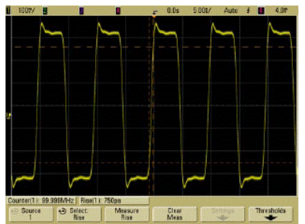
Digital Photon Counting Technique
Improve the energy threshold and spatial resolution
Surface area split in multiple millimeter pixels
Only one photon will be present in each sampling clock (100-200 MHz)
Number of photons is the sum of the active pixels
PMT
pixel
Digital
Digital
N pixels at CLK1
CLK2
CLK1
M pixels at CLK2
Selection trigger algorithms
Notes:
17

Slide 18
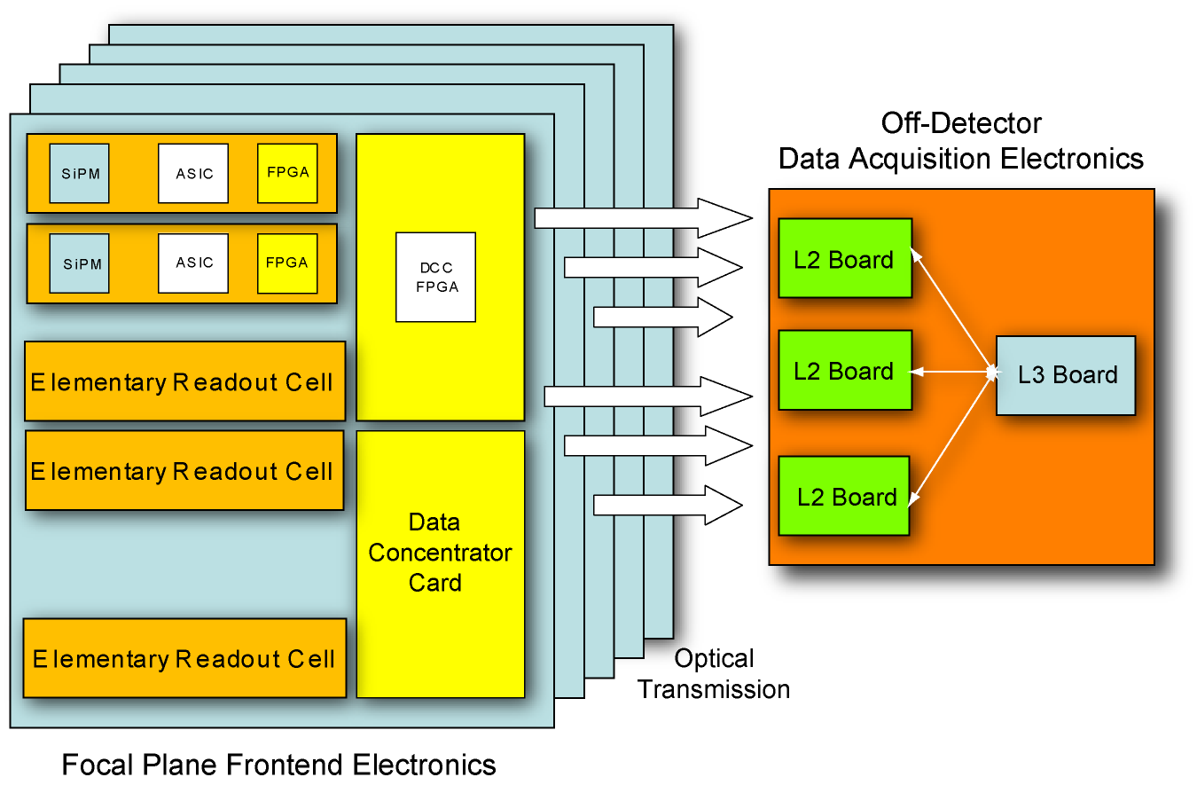
Data Acquisition and Trigger Architecture
Light focal plane, no DAQ electronics on-board to minimize power consumption near the SiPM with minimum interconnections (less than 1 kW for 1 m² area with 37K readout channels)
Extensive use of VLSI ASICs for the Frontend and low-power FPGAs for early data reduction
Use of liquid-cooling for temperature stabilization
Trigger/filtering electronics, based on serial asynchronous switching architectures (xTCA)

Slide 19
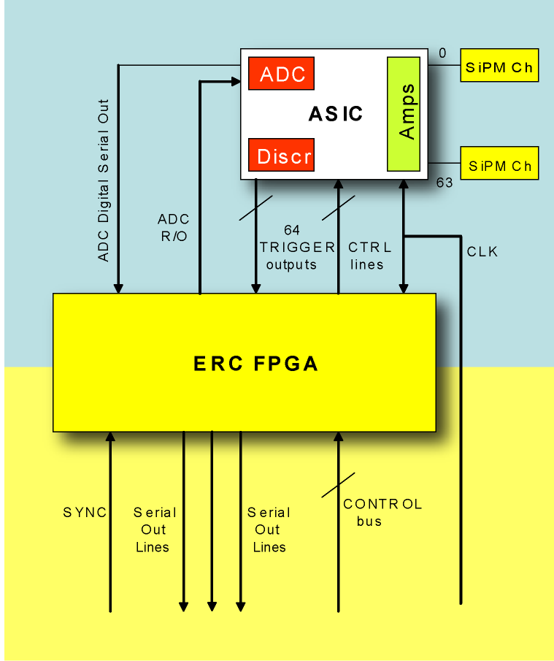
ERC - Elementary Readout Cell
64 SiPM (8x8 configuration) array
64 input channel ASIC with 64 discriminators
Charge output available as option
80 MHz local clock
Total bandwidth between ASIC and ERC FPGA: 5 Gbps at 80 MHz
ERC FPGA performs zero suppression, local threshold and data serialization
Synchronous
Output LVDS serial links
Typical payload: 64 bits + 40 bit Timestamp (clock counter) + overhead + trailer ~ 110-120b
Asynchronous
Notes:
19

Slide 20
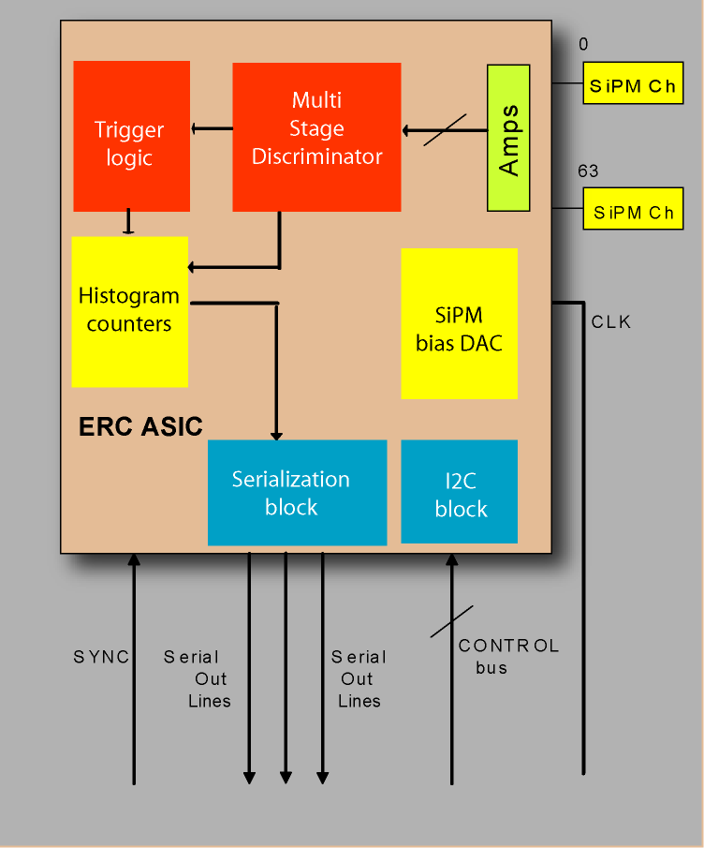
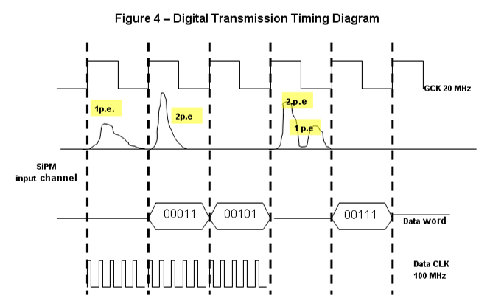
ERC - Elementary Readout Cell (2)
64 SiPM (8x8 configuration) array
ASIC tailored to air fluorescence detection
Multi-stage discriminator for photon counting (up to 5-10 photoelectrons)
In-chip DAC for SiPM bias tuning
In-chip trigger logic
Output LVDS serial links for transmission of histogram counters
Notes:
20

Slide 21
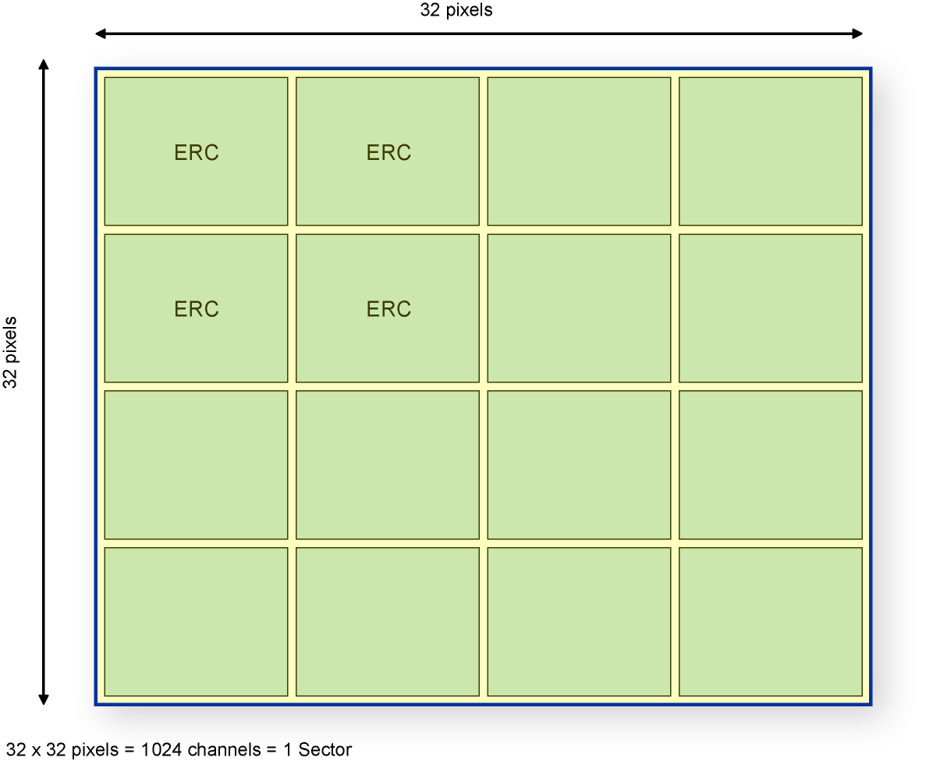
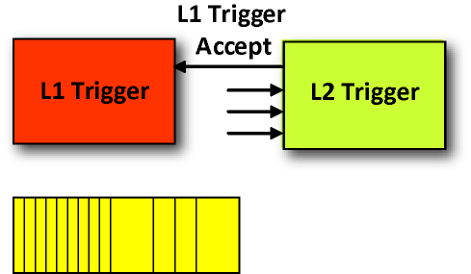
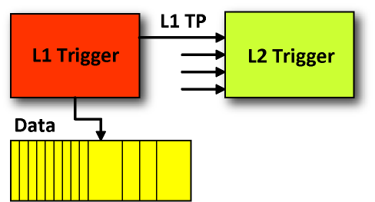
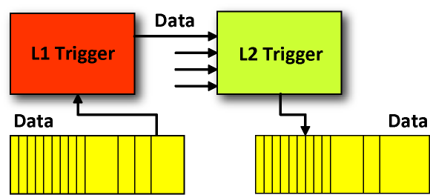
Focal Plane Readout “Sector”
16 ERCs build a “Sector”
Data from the ERC is concentrated in a large FPGA placed in the Data Concentrator Card
One “Sector” forms a 32x32 pixel region where the L1 trigger acts
L1
FPGA
In a GTU, if number of pixels above threshold, L1 Trigger Primitives are sent to the L2 Trigger
L1 TP: Timetag (40 bits) + Nb. of pixels (10 bits)
Data (Timetag 40 bits + Pixel Location 1024 bits)
Trigger Primitives and Accept Data are moved to the off-detector electronics by means of an 3.125 Gbps optical link
Notes:
21

Slide 22
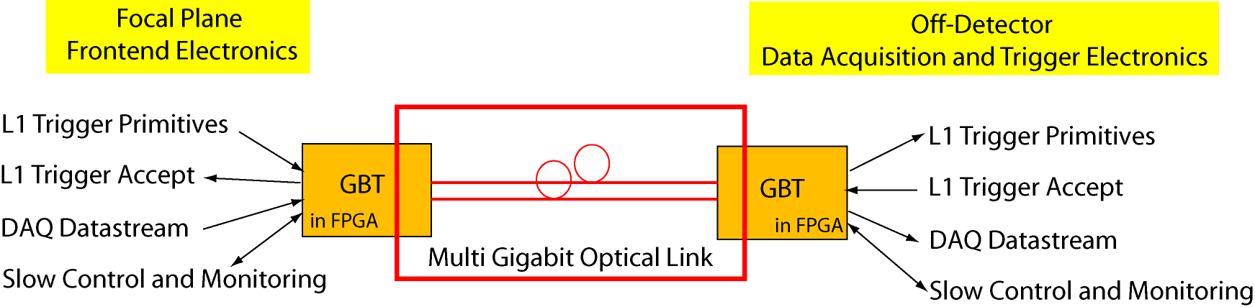
L1-L2 Optical Link
All trigger primitives from the focal plane are sent asynchronously to L2 trigger boards via data links running at their own clocks, for maximum bandwidth
Data and slow-control data streams are sent over the same data lines
Optical link bandwidth split in 5 domains:
- L1 Trigger Primitives (L1 to L2)
- L1 Trigger Accept (L2 to L1)
- DAQ datastream (L1 to L2)
- Slow control/monitoring (L1 to L2)
- Command (L2 to L1)
Slow Control/Monitoring includes:
- Configuration of SiPM bias supply
- Configuration of alarms
- Configuration of ASIC, ERC and L1 FPGA thresholds
- Monitoring of temperature, alarms, bias supply
Notes:
22

Slide 23
Off-Detector DAQ Organization
AMC L2
36 bi-directional
optical links to the focal plane
AMC L2
AMC L2
MicroTCA crate organization
1 full duplex optical link to the DAQ PC
AMC L3
One optical link into
the PC (PCI-E board)
36 864 channels (20 x 20 SiPM arrays)
Surface area = 94 cm x 94 cm ~ 1 m²
9 AMC cards required for L2 trigger
1 AMC card required for L3 trigger

Slide 24

3x3 mm² Silicon Photomultiplers for SPC
Zecotek Photonics, MAPD3-N device
Gain: 7x10⁴ – 1x10⁵ (11-15 fC for 1 p.e.)
Dark current: 1-3 MHz per 3x3 mm² pixel
Temperature sensitivity (dM/dV) ~4-5%/ºC
PDE at 420 nm ~28%, at 360 nm ~20%
Two 64-pixel matrices provided by Zecotek
Hamamatsu Photonics
Gain: 7x10⁵ – 2x10⁶
Dark current: 4-9 MHz per 3x3 mm² pixel
PDE at 420 nm ~32-34%
First batch of 16 MPPC S10362 and S10931 samples delivered by MPI and Hamamatsu
S10362-33-100C
S10931-100P
S10362-33-50C
Notes:
24

Slide 25
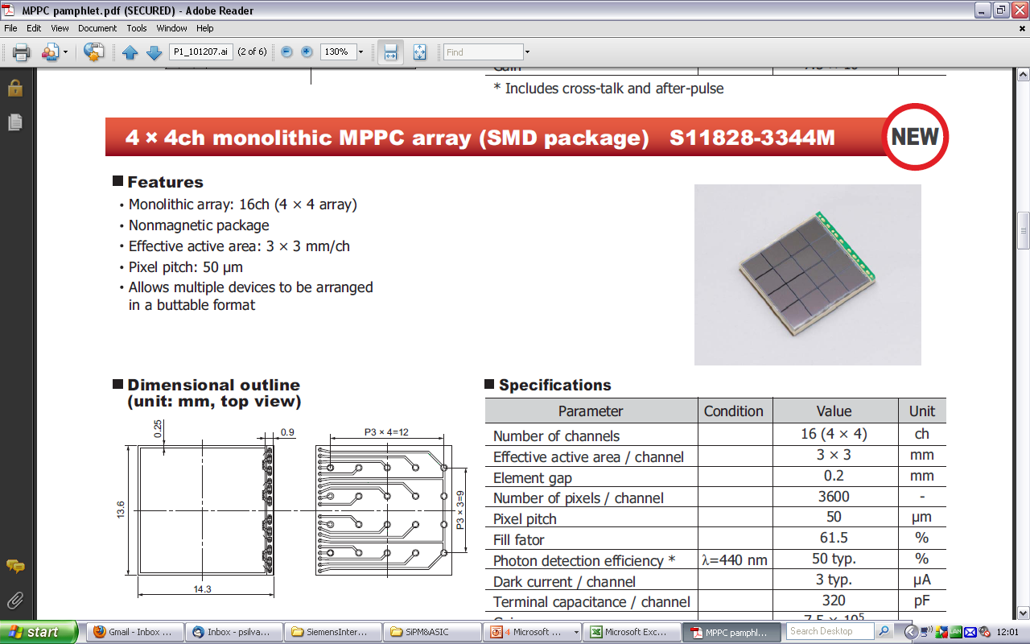
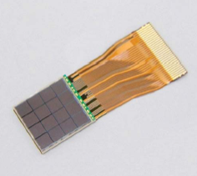
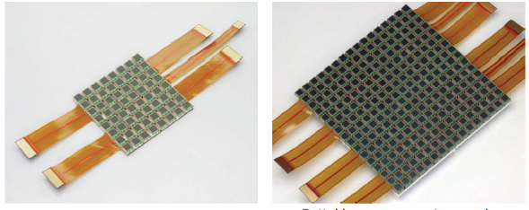
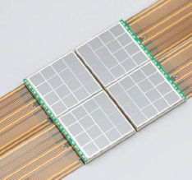

Focal Plane SiPM Carrier Boards
4x4
8x8
16x16
8x8

Slide 26


4x4 SiPM Test Array
S10362-33-100C
S10362-33-100C
S10362-33-100C
S10362-33-100C
S10362-33-100C
S10362-33-100C
S10362-33-100C
S10362-33-100C
S10362-33-100C
S10362-33-100C
S10362-33-100C
S10362-33-100C
17 MPPCs from MPI
S10362-33-50C
S10362-33-50C
S10362-33-50C
S10362-33-50C

Slide 27
Frontend Readout ASIC
Baseline Option
ASIC MAROC3 (2009)
64 low impedance preamplifier
Variable gain for each channel
Minimum threshold at 100% trigger efficiency: 10 fC
64 logic trigger outputs
12 bits ADC (serial output: pedestal and maximum per channel)
AMS SiGe 0.35 um (4 x 4 mm² die)
MAROC3 Evaluation Test Board provided by the OMEGA group
Notes:
27

Slide 28
Design of ERC/L1 Prototype Board
Frontend ASIC (MAROC3) readout by an FPGA
Early L0 data reduction and L1 trigger filtering algorithms
Data serialization (SERDES) for high-speed optical serial links
Control of slow-control and monitoring services
Notes:
28

Slide 29
END

Slide 30

Auger camera display prototype @ e-CRLab
Thank you

Slide 31
Miguel

Slide 32
ERC - Elementary Readout Cell
Miguel Ferreira
21th February 2011
Miguel@Lip.pt

Slide 33

ERC Prototype Board
Bias
Test pulse
Charge Out
LV PWR
USB
TEMP
Humidity
RS232
64 ch SiPM
Matrix
MAROC3
FPGA
Serdes
Opt.transceiver
64 switch
Serdes
Opt.transceiver
SYNC IN
CLK
PROM
Cold plate
MPPC
Bias Control DAC
SYNCOUT
SUM08
JTAG
SUM08
SUM08
Bias Control ADC
CLK EXT

Slide 34





SiPM Analog Input with 50 ohm impedance control

Slide 35



Optical Link up to 3.125Gbps
Transceiver from National Semicondutor

Slide 36

PCB Layer Stack Manager
Setting the Digital and Analog Layers
Setting the Digital and Analog Power Plane

Slide 37
ERC Prototype Board Status and Plans

