Slide 1

Projecto e
Controlo em
Lógica
Digital
Introdução
Fpgas
Laboratório
Verilog
Lógica combinatória
Lógica sequencial
Ferramentas
Simulação
no QuartusII
em Verilog
Osciloscópio
Analisador lógico
Interno
Externo
Máquinas de estados
Clocks
Pll
Advanced verilog
Memories
I/O
Analog devices
Audio
Video
MicroProcessors
Refs:
Cyclone II device Handbook, Altera corp.
Quartus II Handbook , Altera corp.
DE2 documentation
Verilog HDL, S. Palnitkar, Prentice Hall
Inspired on course 6.111 from MIT
Some support material taken from 6.111 (thank you)
So, lets start emitting

Slide 2


Slide 3
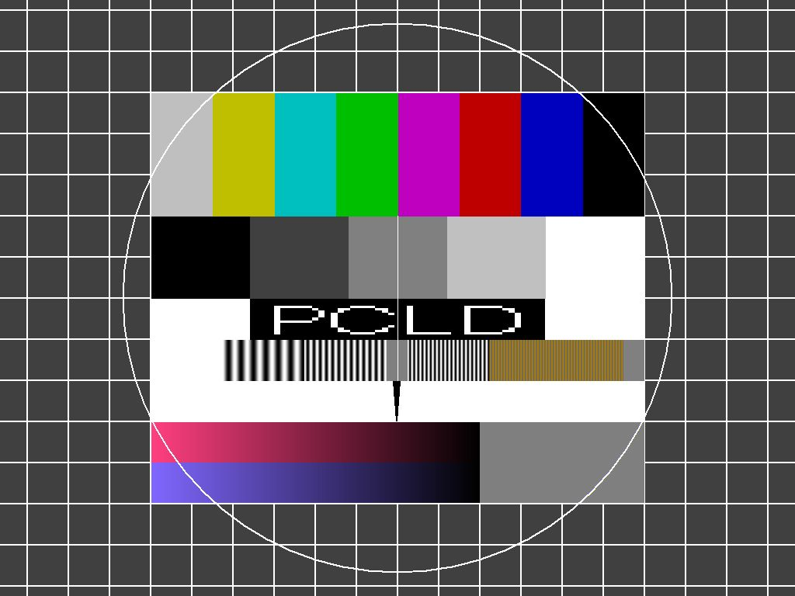
The 3rd lab
The VGA test screen
(It is not a picture!!)
Remember to split the program in blocks!!
(Will be usefull for your next project)

Slide 4
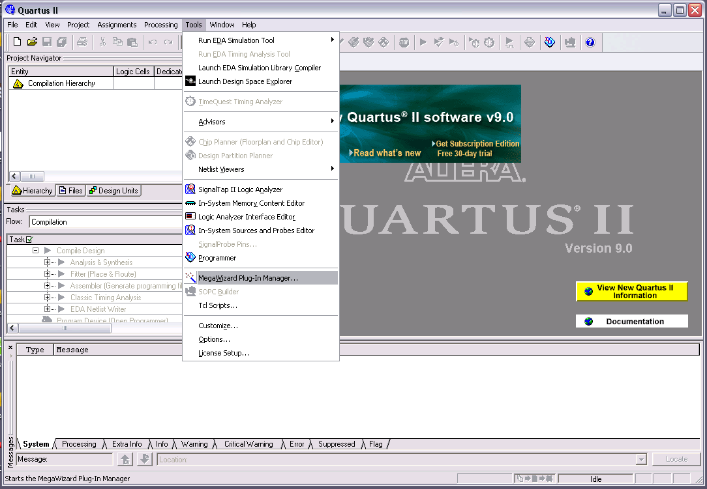
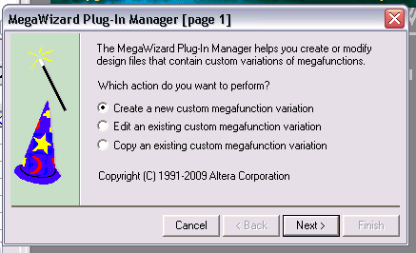
Tools – Mega Wizard

Slide 5
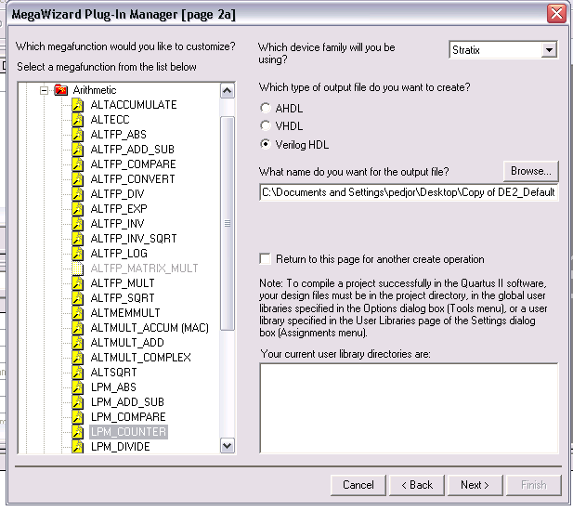

Slide 6
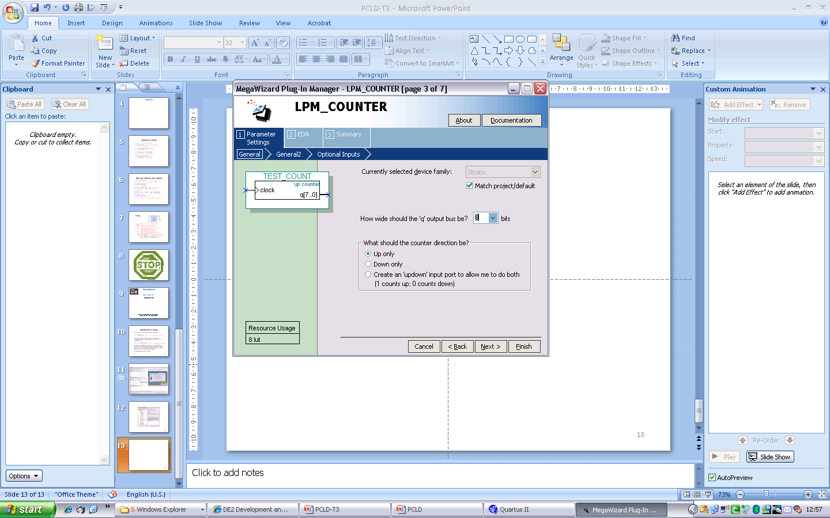
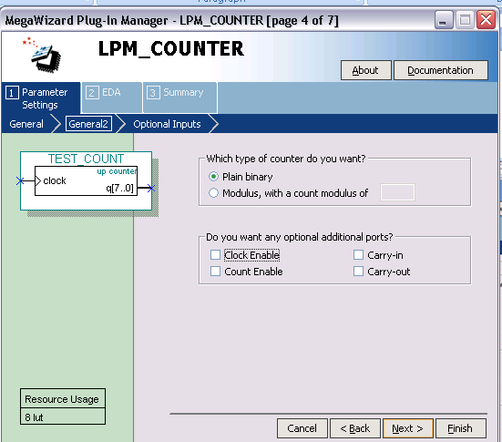
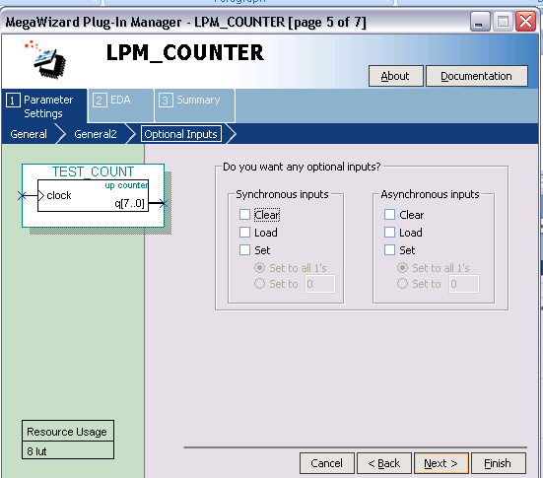

Slide 7
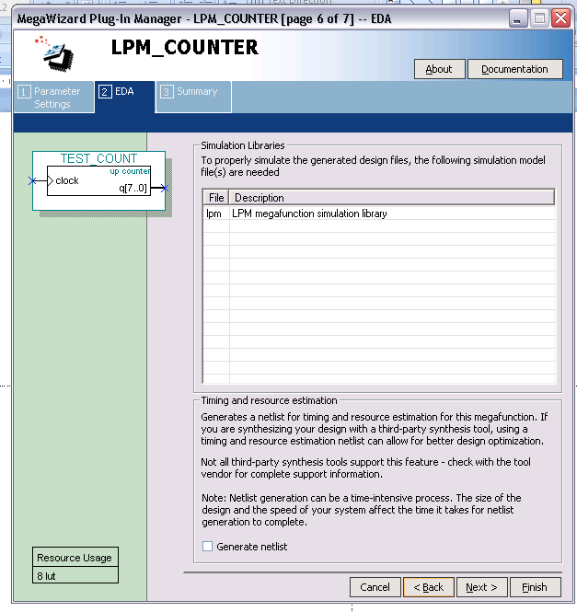
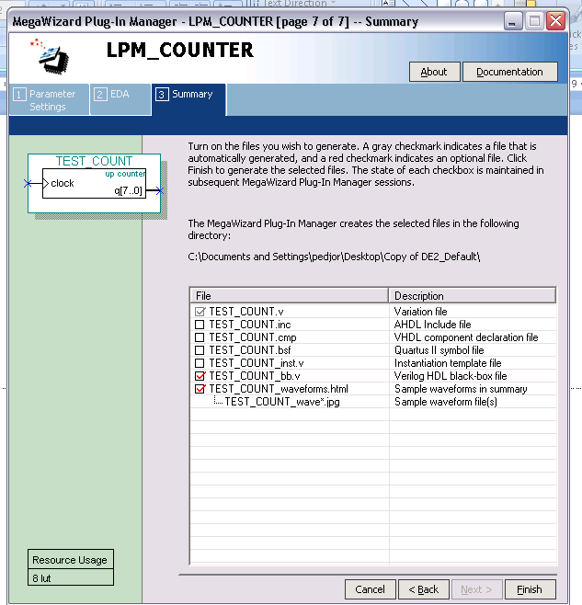

Slide 8
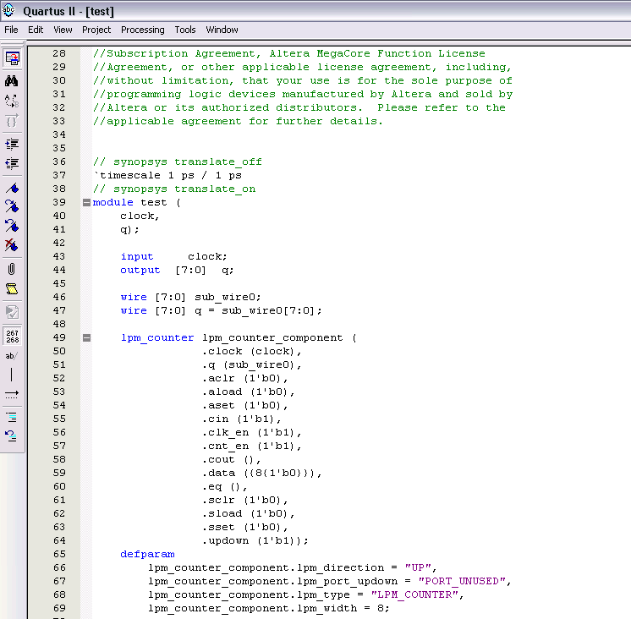
Mega Wizard – What you get
ftp://ftp.altera.com/up/pub/Tutorials/DE2/Digital_Logic/tut_lpms_verilog.pdf

Slide 9
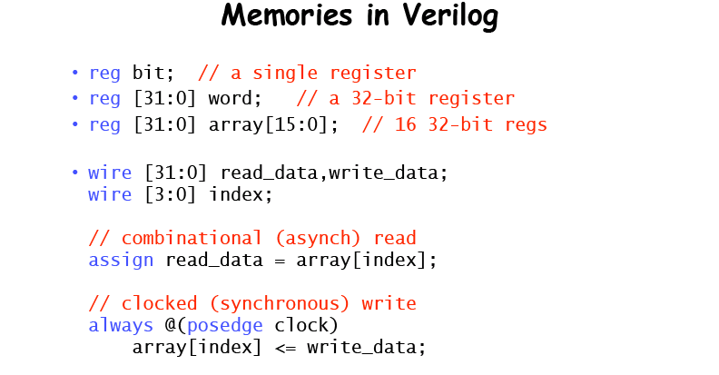
Memories

Slide 10
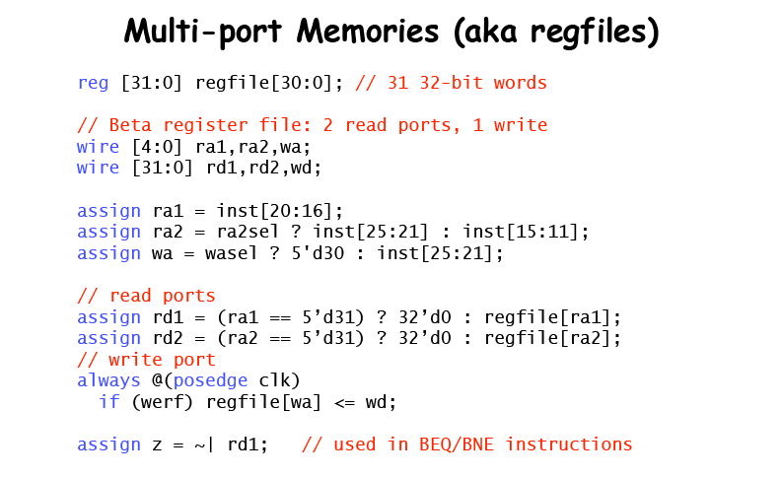
Address
Data

Slide 11
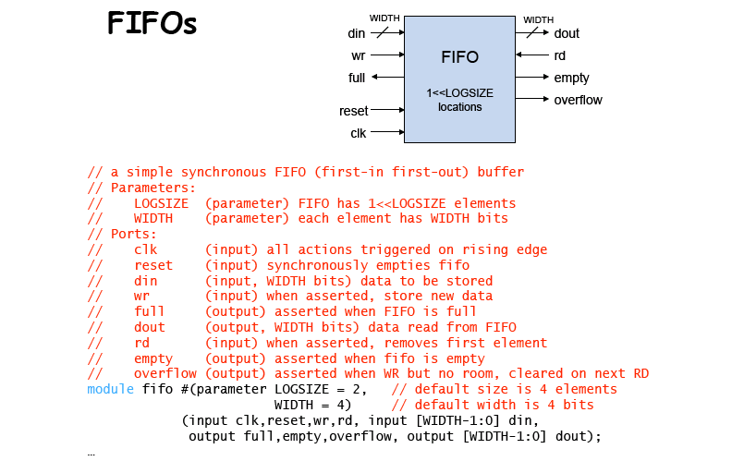

Slide 12
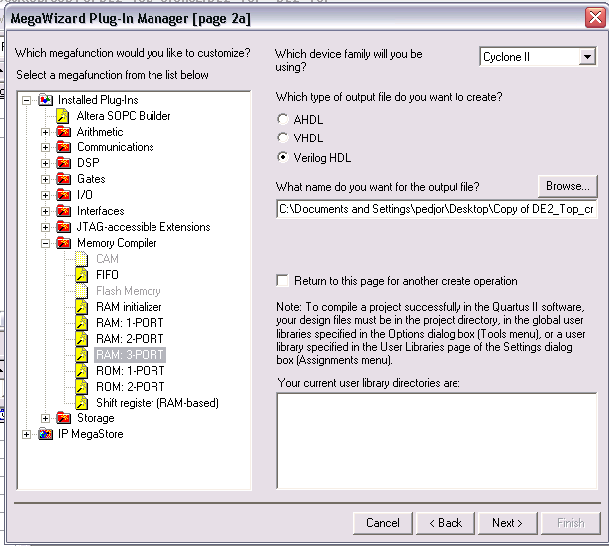

Slide 13
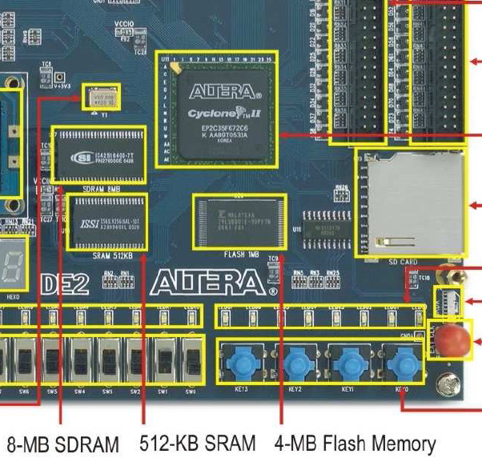
Memories external to the FPGA
When interfacing external memories you should look at the datasheet!
Need to understand the exact protocol, adressing, timing, etc.
Some tools may build you the interface to external memories

Slide 14
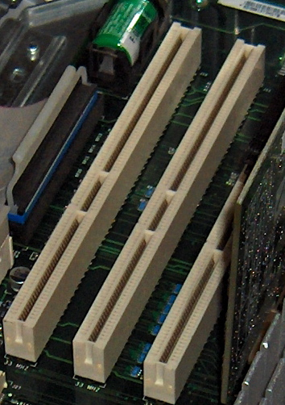
I/O - parallel
Parallel protocols are tipically easy and fast…
However the resources alocated are big (pins)
Tipycally the protocol language is very easy.
Time constraints easy to deal with
e.g.: The PCI protocol

Slide 15
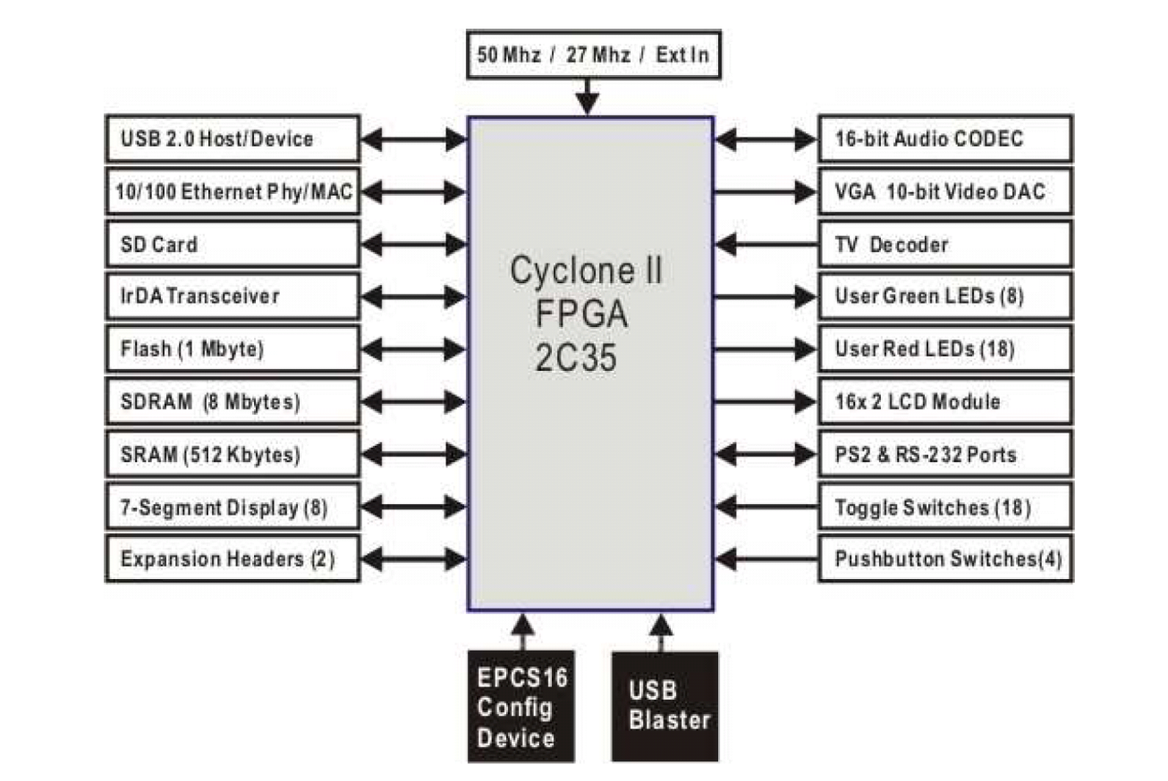
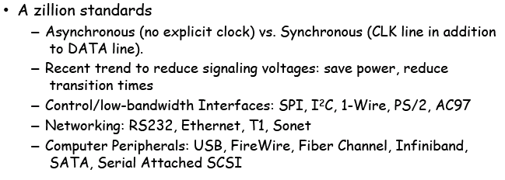
I/O - serial
Readily available:
IrDA, RS232, PS2
You can build some other…
I2C - Inter-Integrated Circuit
Serial Peripheral Interface (SPI)
…
What you kneed to know?
Pinout
Clocking requirements
Protocol (the language)
The commands of the peripherical you are communicating with

Slide 16
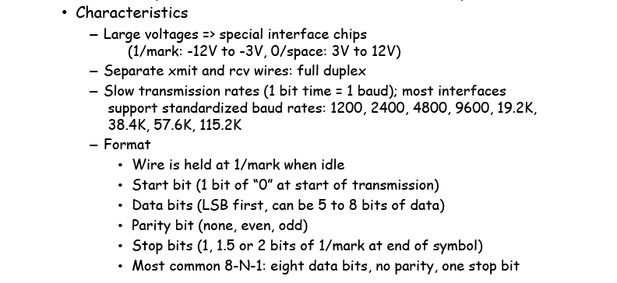
RS232 – The serial port
Sending: easy – Just compose your signal respecting time constraints
Receiving: Need to oversample and understand where the bits are…
and check the protocol format: start, stop, parity

Slide 17
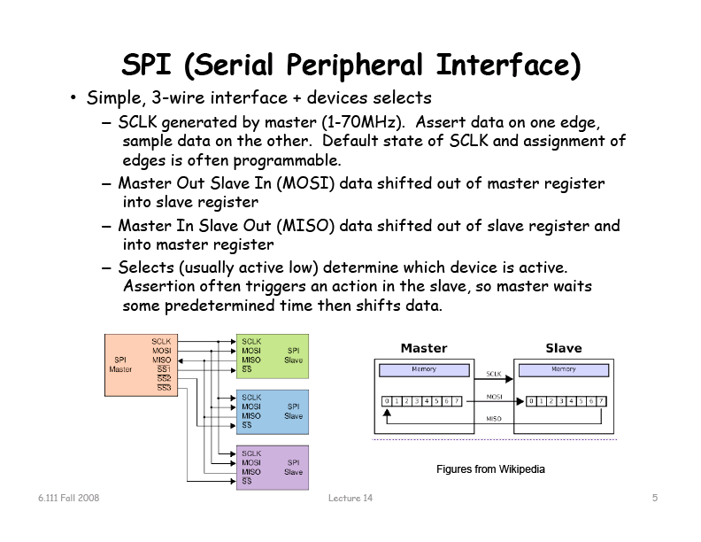

Slide 18
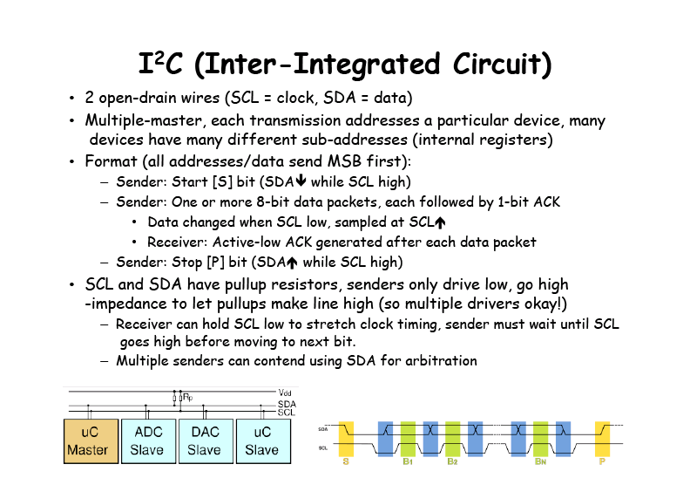

Slide 19
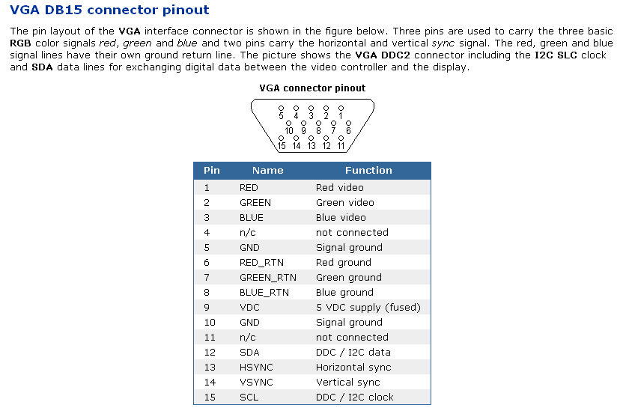
Just two examples in a PC
Sensors like thermometers in the motherboard communicate using I2C
Most PCs have a “hidden I2C Port”

Slide 20
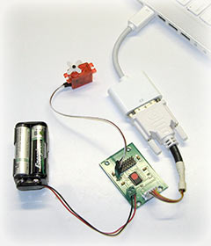
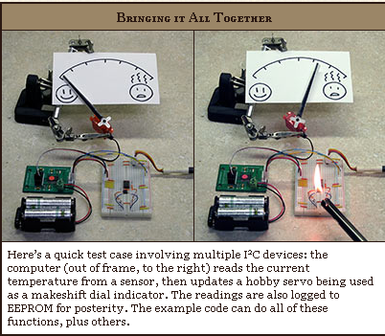
The 25¢ I²C Adapter
(http://www.paintyourdragon.com/?p=43)

Slide 21
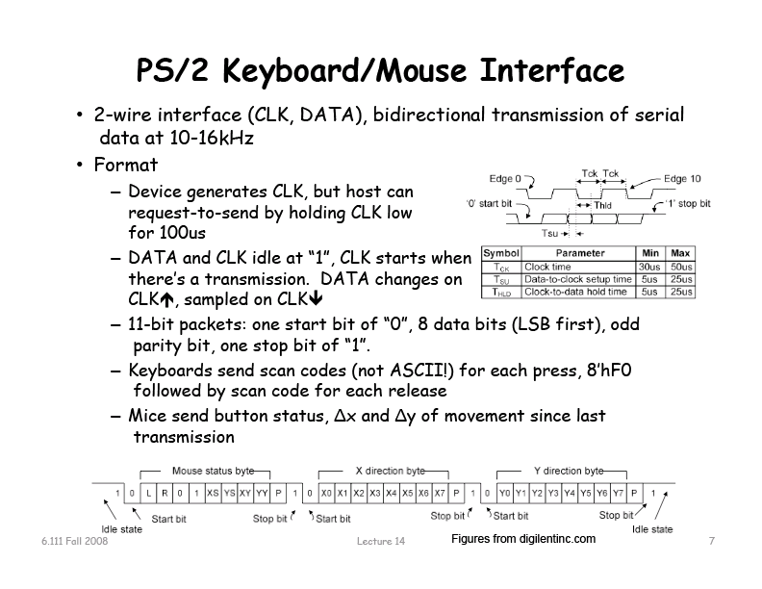

Slide 22
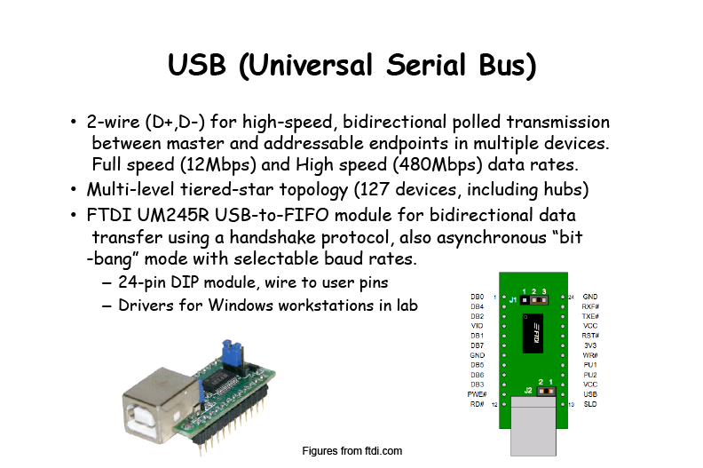

Slide 23
I/O - Analog

Slide 24
I/O – Digital ⬄ Analog
FPGAs are digital devices!
They can’t generate or receive analog signals.
You need to use a DAC or ADC to interface analog devices!

Slide 25
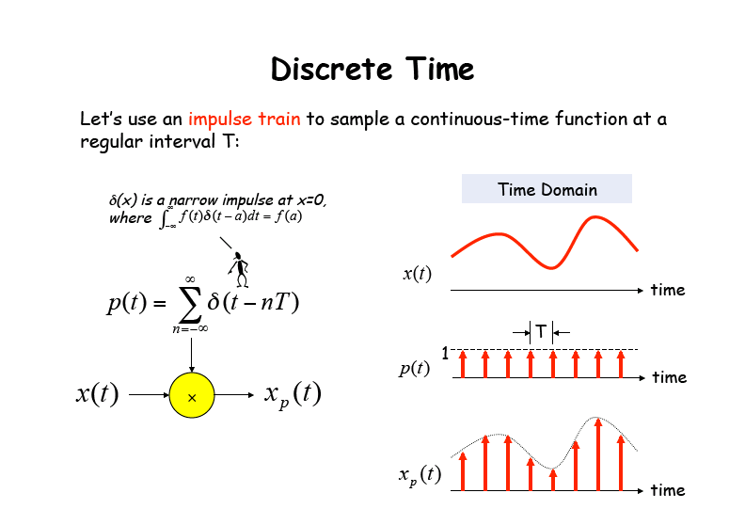

Slide 26
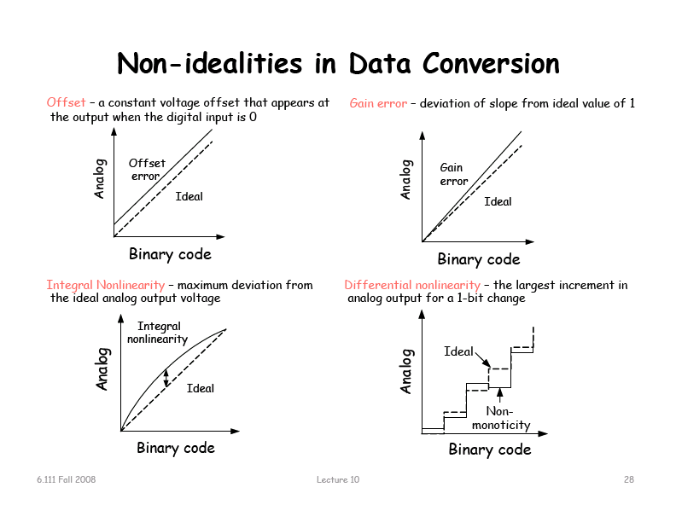

Slide 27
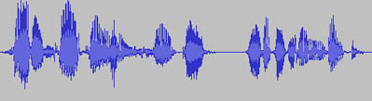
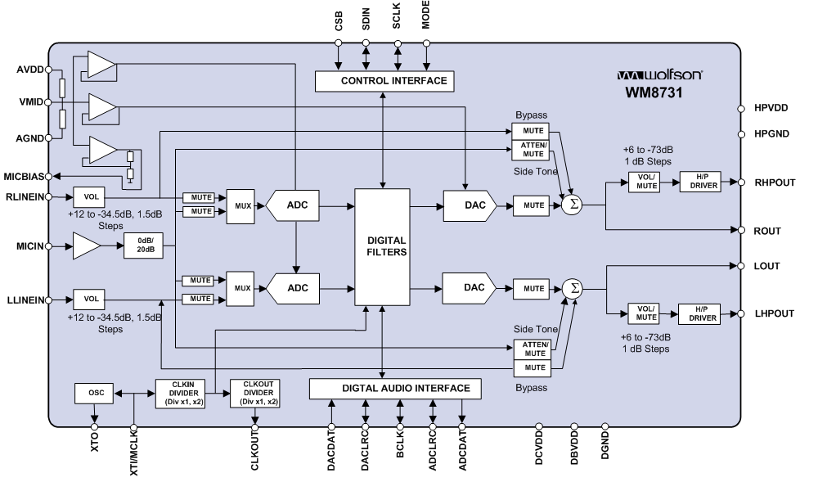
Sound (analog signal)
Means ADC/DAC

Slide 28
BREAK

Slide 29
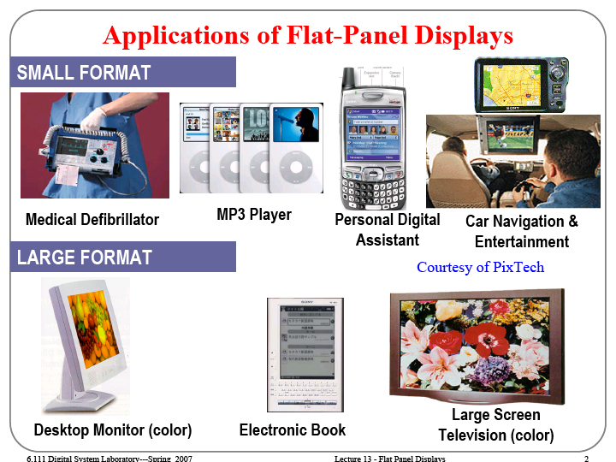

Slide 30
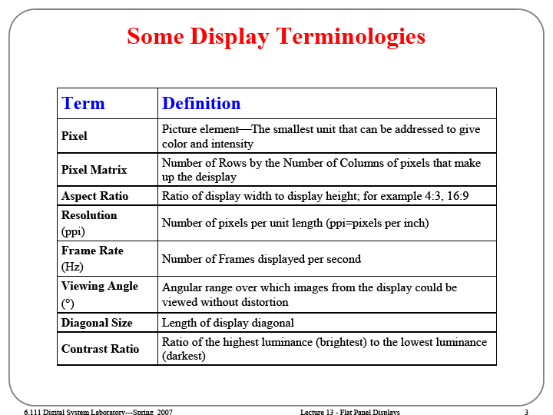

Slide 31
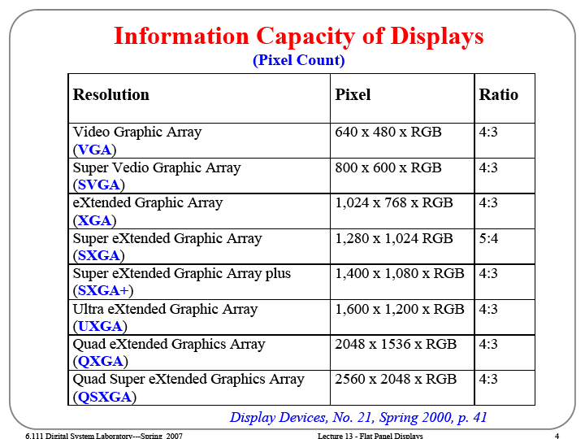

Slide 32
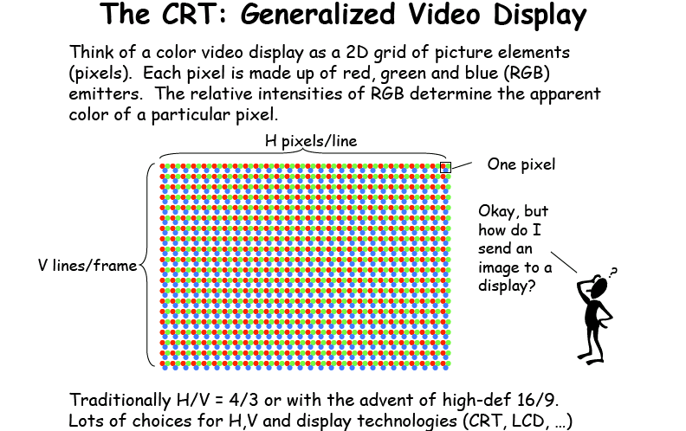
Video(analog signals)
Means DAC

Slide 33
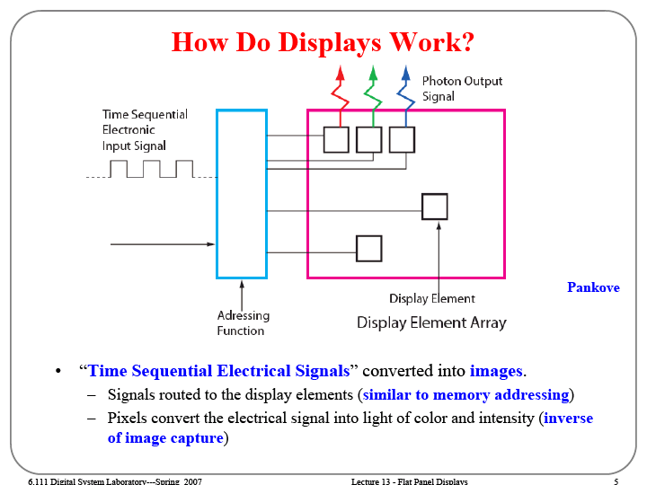

Slide 34
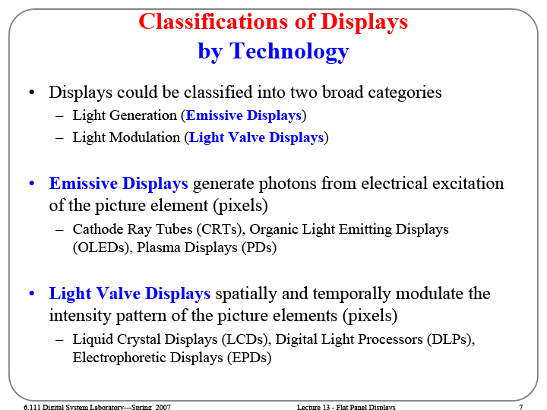

Slide 35
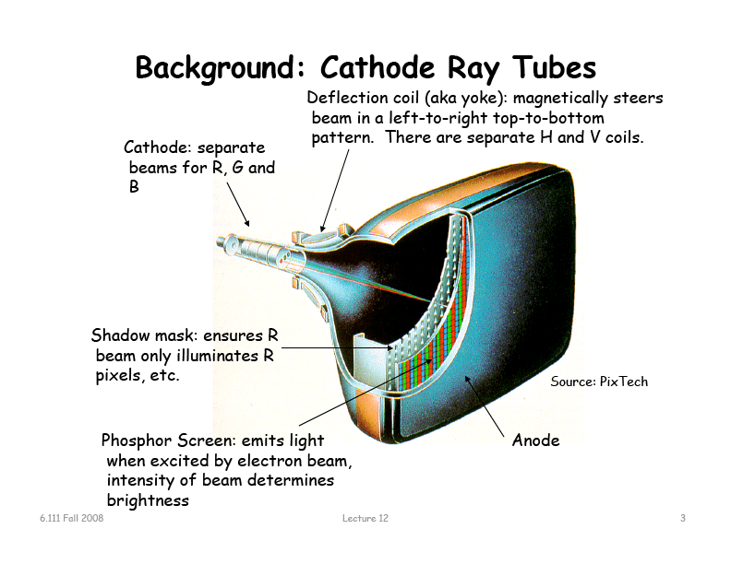

Slide 36
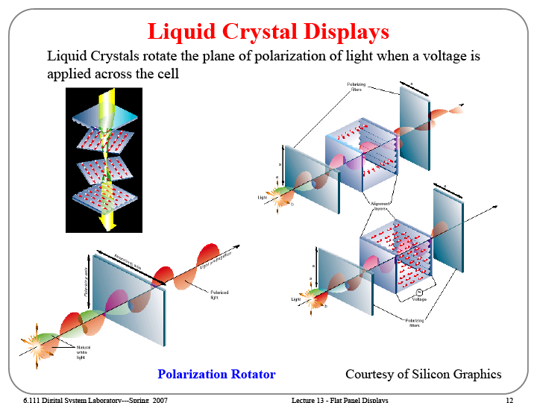

Slide 37
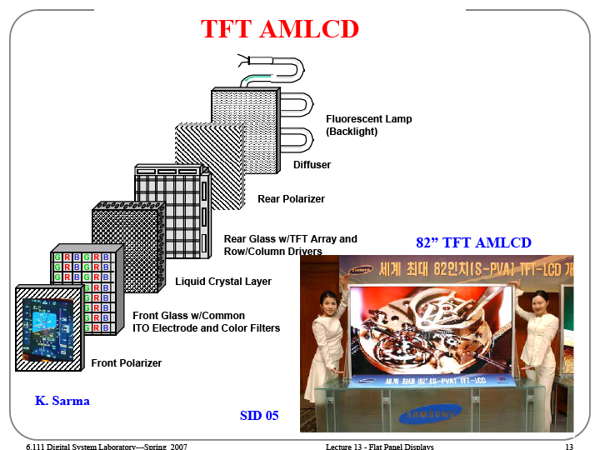
Active Matrix LCD

Slide 38
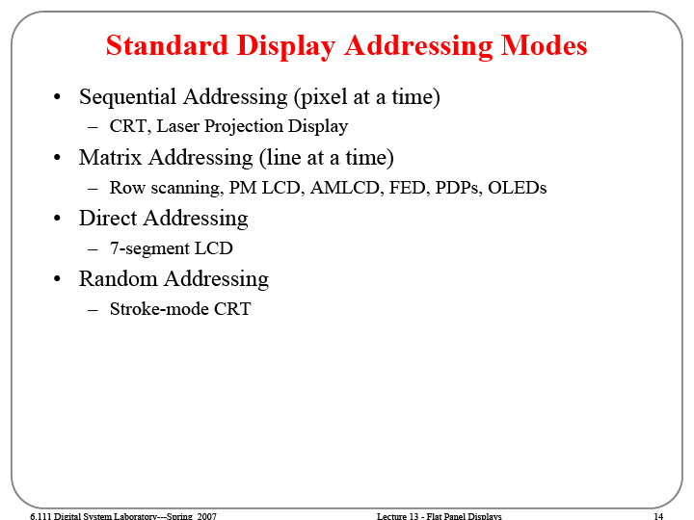

Slide 39
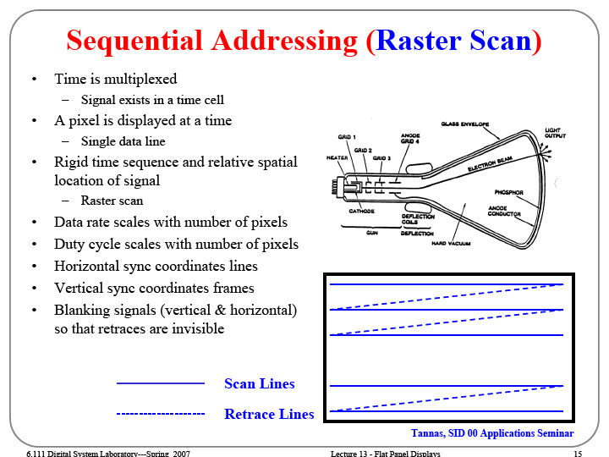

Slide 40
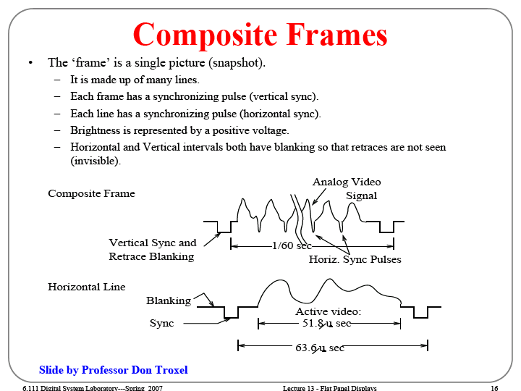

Slide 41
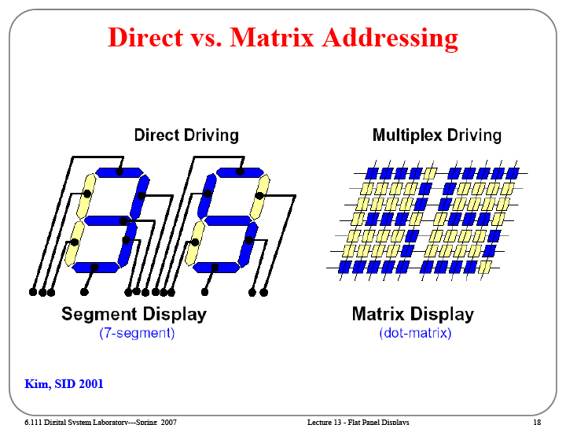

Slide 42
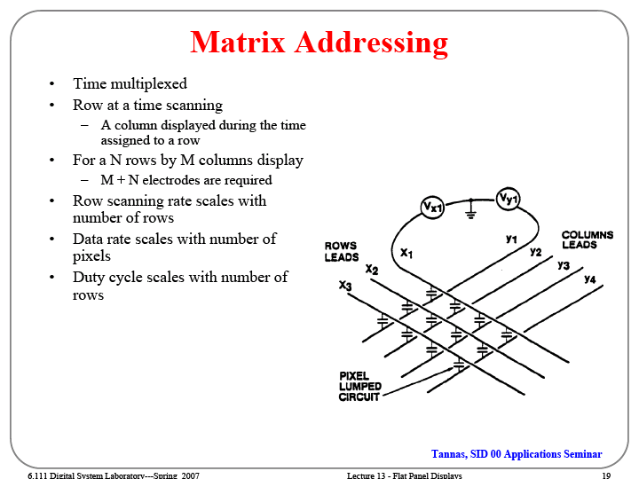

Slide 43
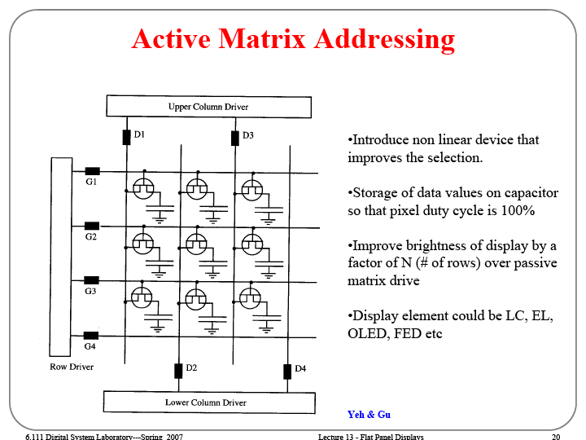

Slide 44
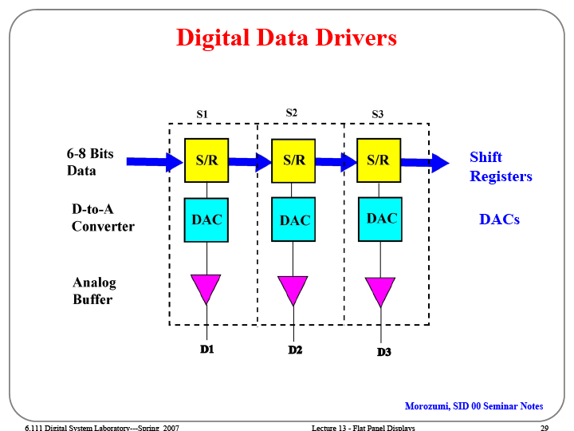

Slide 45
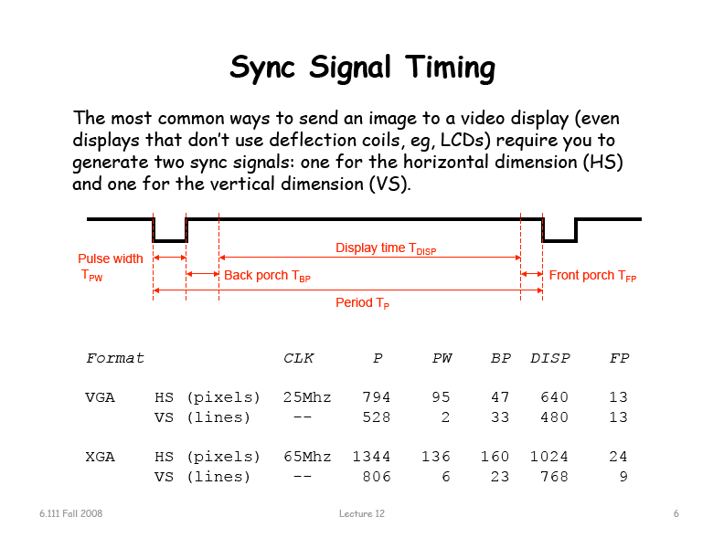

Slide 46
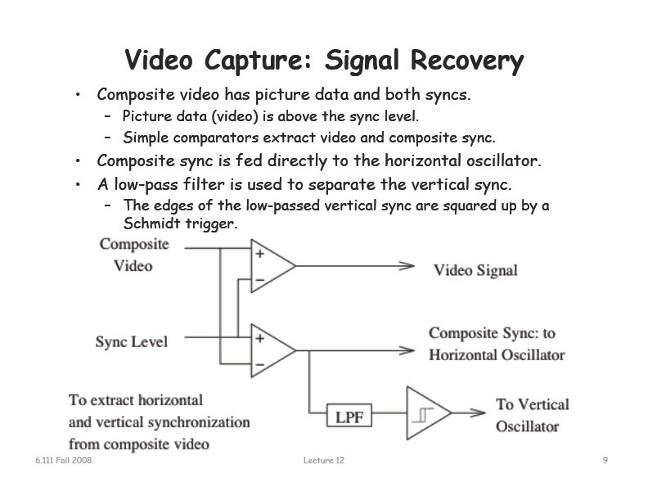

Slide 47
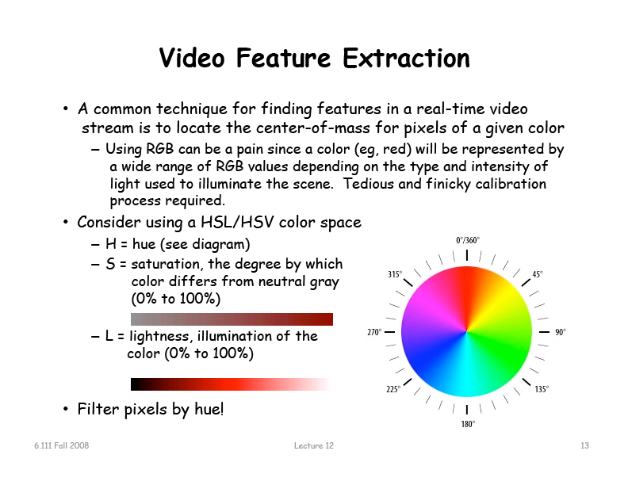

Slide 48
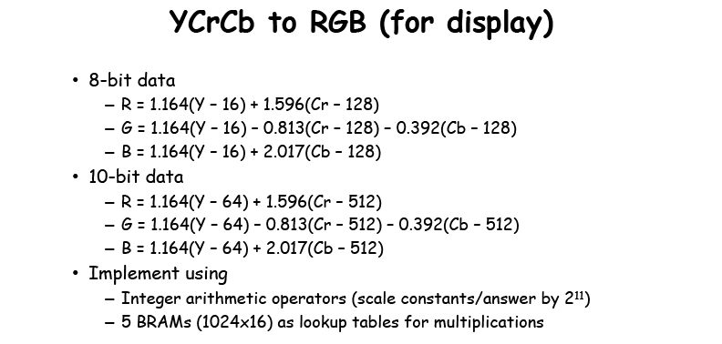




Slide 49

VGA
DE2 User manual: page 37: 4.7 Using VGA
VGA output
· Uses the ADV7123 240-MHz triple 10-bit high-speed video DAC
· With 15-pin high-density D-sub connector
· Supports up to 1600 x 1200 at 100-Hz refresh rate
· Can be used with the Cyclone II FPGA to implement a high-performance TV Encoder

Slide 50



Slide 51


Slide 52


Slide 53


Slide 54


Slide 55


Slide 56


Slide 57


Slide 58


Slide 59


Slide 60


And finally… Microprocessors
Lots of tools and tutorials…
e.g. NIOS IDE (Integrated Development Environment)
DE2 demonstrations
Tools – SOPC builder
http://www.altera.com/education/demonstrations/sopc-builder/sopc-builder-demo.html
ftp://ftp.altera.com/up/pub/Tutorials/DE2/Computer_Organization/tut_sopc_introduction_verilog.pdf
The SOPC Builder is a tool used in conjuction with the Quartus II CAD software. It allows the user to easily create a system based on the Nios II processor, by simply selecting the desired functional units and specifying their parameters.
There are other choices of μ-processors to implements. E.g.: mips
Operating systems can be used. E.g. μ-Clinux™

Slide 62

The lab this week
The VGA test screen
(It is not a picture!!)
Remember to split the program in blocks!!
(Will be usefull for your next project)

Slide 63


Slide 65
Tools – Mega Wizard
ftp://ftp.altera.com/up/pub/Tutorials/DE2/Digital_Logic/tut_lpms_verilog.pdf
Tools – SOPC builder
http://www.altera.com/education/demonstrations/sopc-builder/sopc-builder-demo.html
ftp://ftp.altera.com/up/pub/Tutorials/DE2/Computer_Organization/tut_sopc_introduction_verilog.pdf
The SOPC Builder is a tool used in conjuction with the Quartus II CAD software. It allows the user to easily
create a system based on the Nios II processor, by simply selecting the desired functional units and specifying
their parameters.

Slide 66


Slide 67


Slide 68


Slide 69


