Slide 1
Projecto e
Controlo em
Lógica
Digital
Refs:
Cyclone II device Handbook, Altera corp.
Quartus II Handbook , Altera corp.
DE2 documentation
Verilog HDL, S. Palnitkar, Prentice Hall
Inspired on course 6.111 from MIT
Some support material taken from 6.111 (thank you)
Introdução
Fpgas
Laboratório
Verilog
Lógica combinatória
Lógica sequencial
Ferramentas
Simulação
no QuartusII
em Verilog
Osciloscópio
Analisador lógico
Interno
Externo
Máquinas de estados
Clocks
Pll
DRAFT
Advanced verilog (video, etc.)

Slide 2
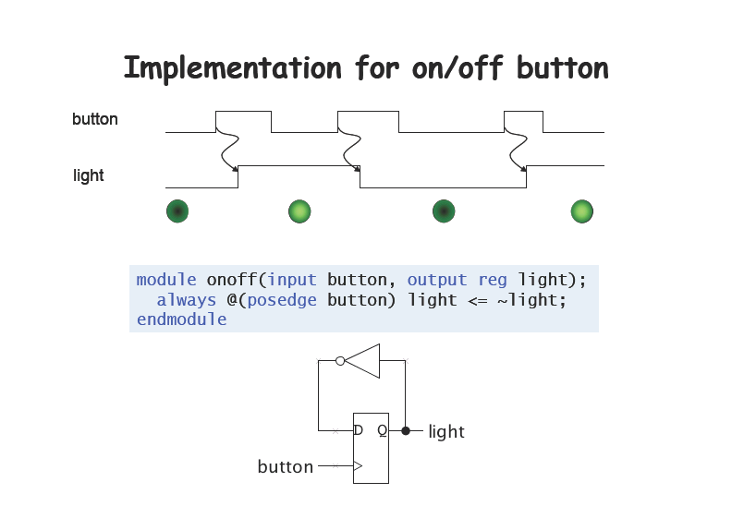

Slide 3
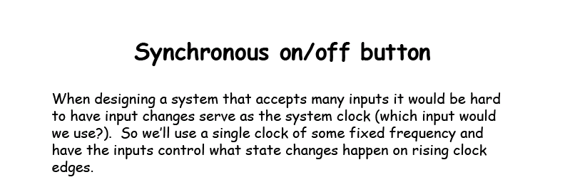


Slide 4
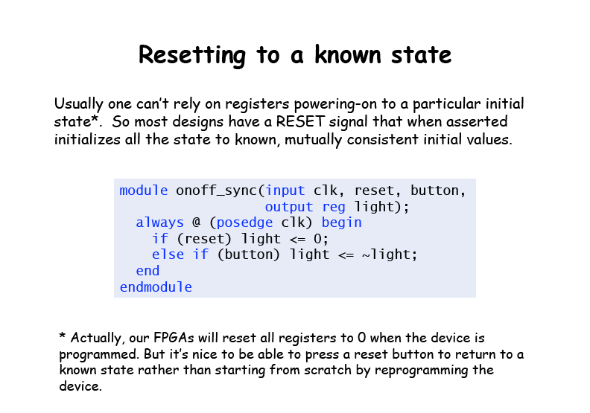


Slide 5
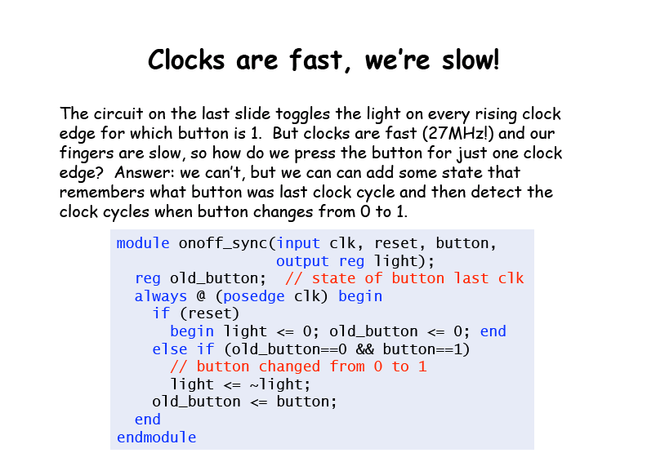

Slide 6
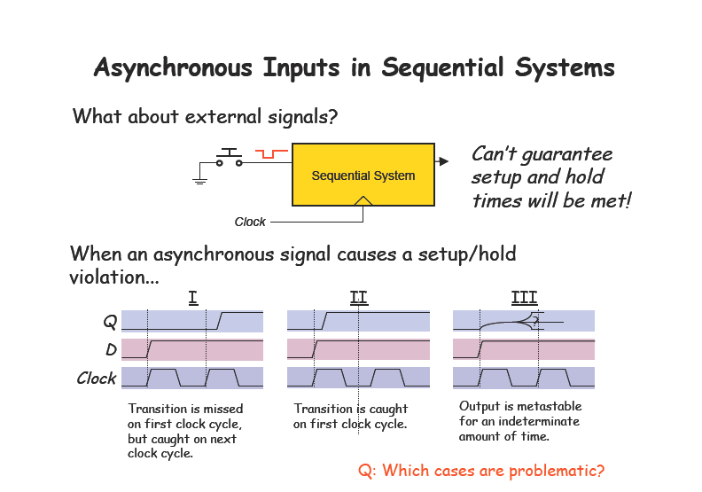

Slide 7
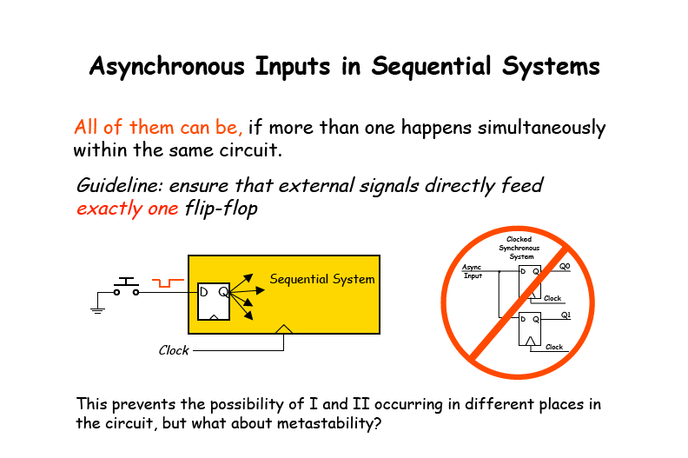

Slide 8
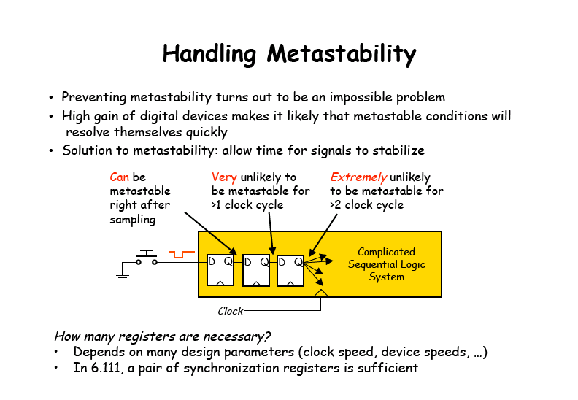

Slide 9
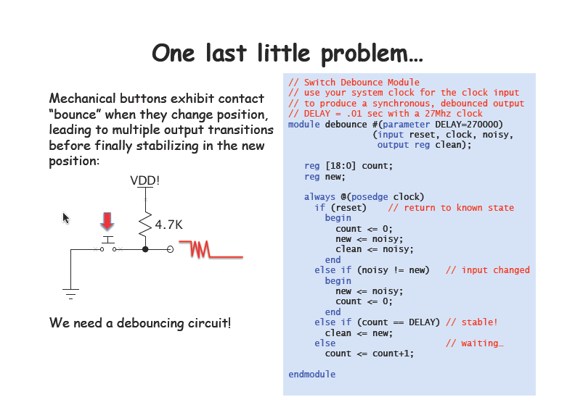

Slide 10
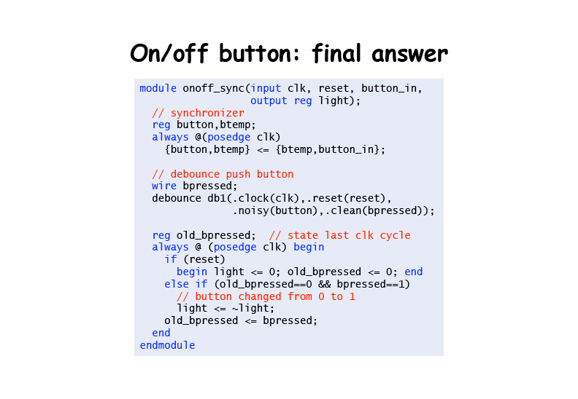

Slide 11
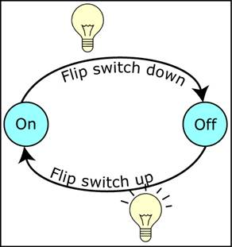
Máquinas de estado
Uma muito simples…

Slide 12
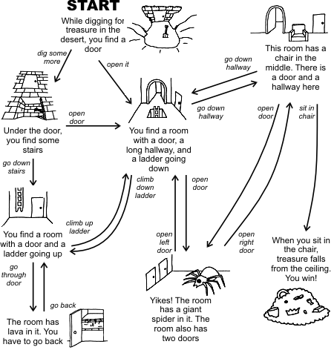
Máquinas de estado
Mas podem ficar complicadas…

Slide 13
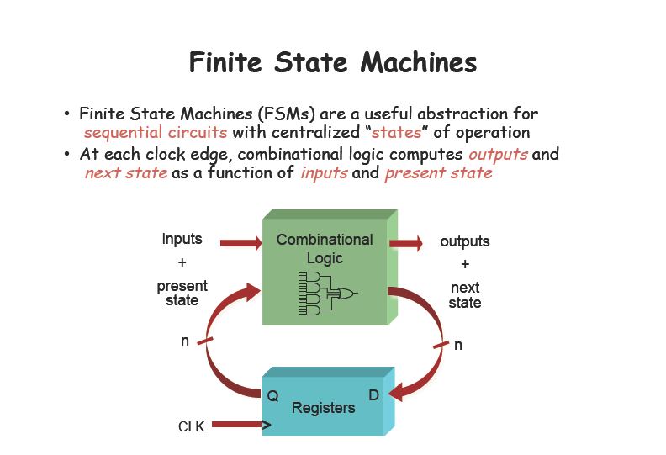

Slide 14
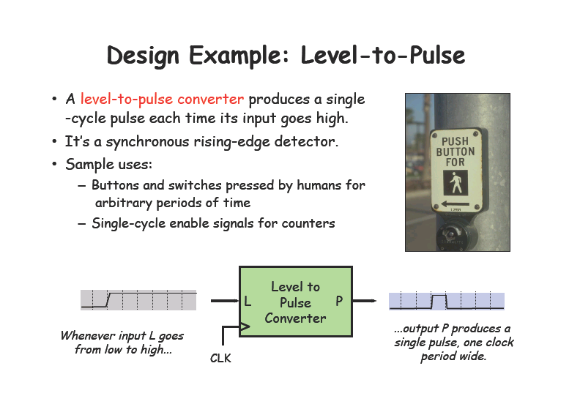

Slide 15
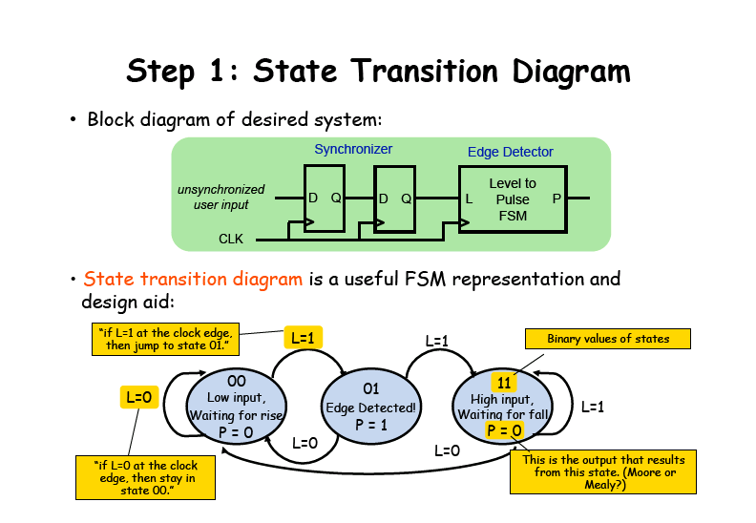
In each state there should be one and only one arc for each input combination

Slide 16
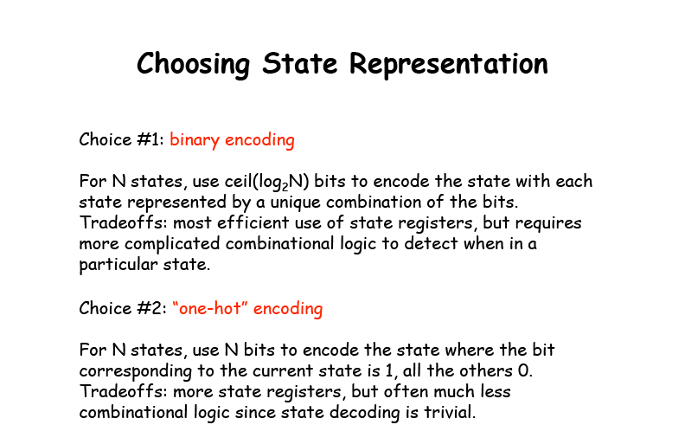

Slide 17
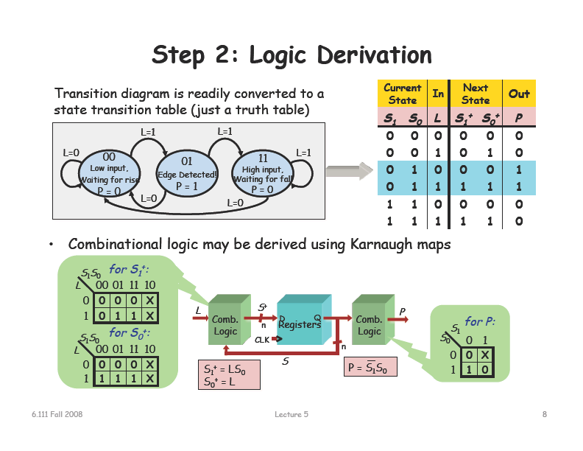

Slide 18
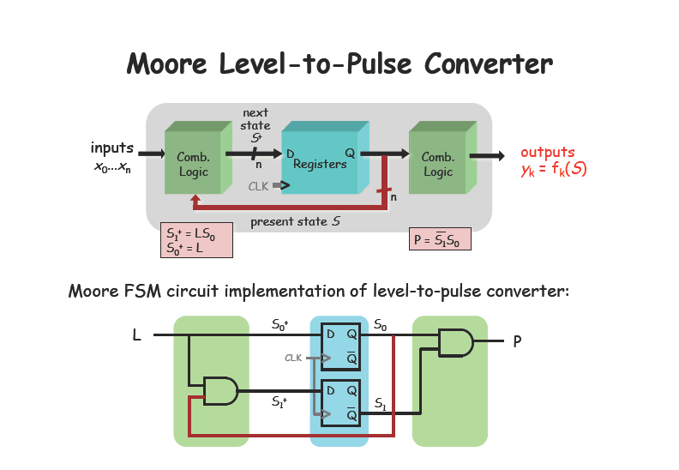

Slide 19
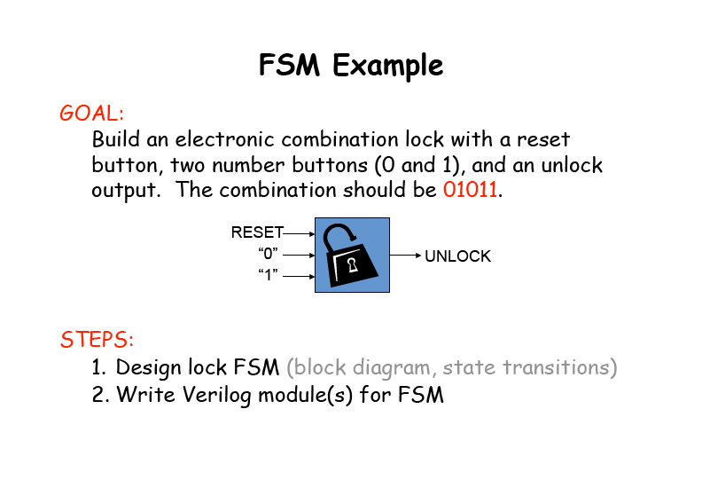

Slide 20
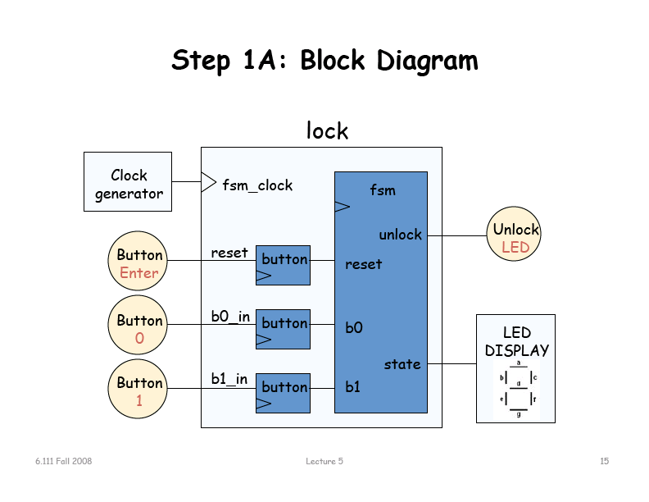

Slide 21
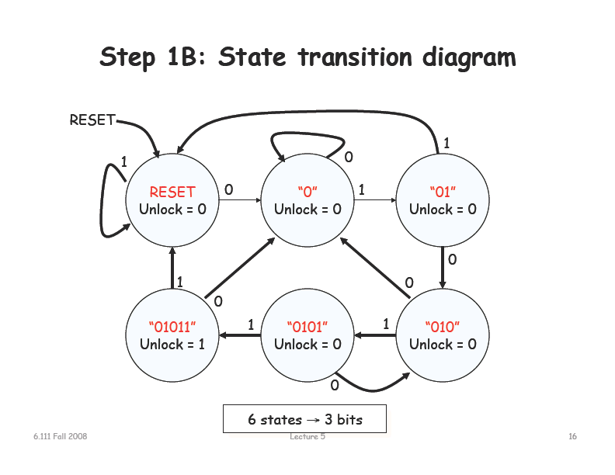

Slide 22
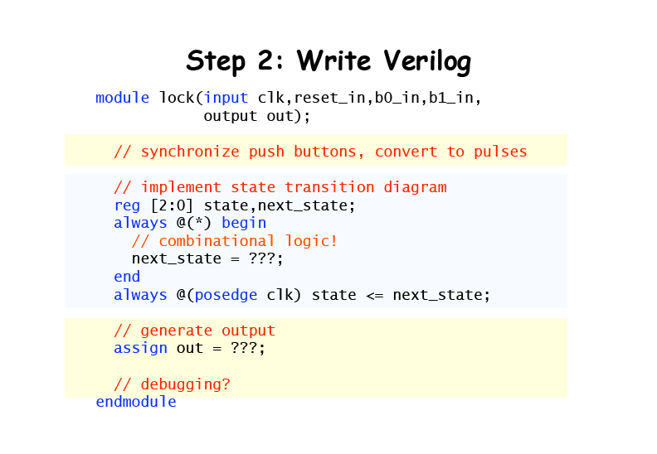

Slide 23
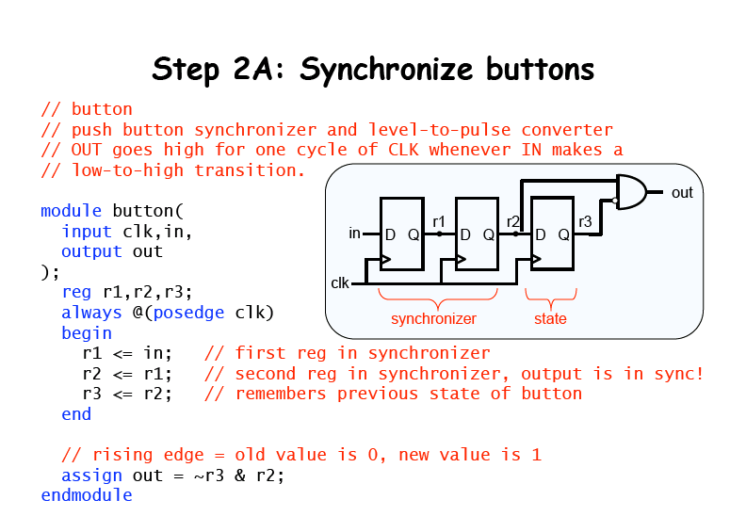

Slide 24
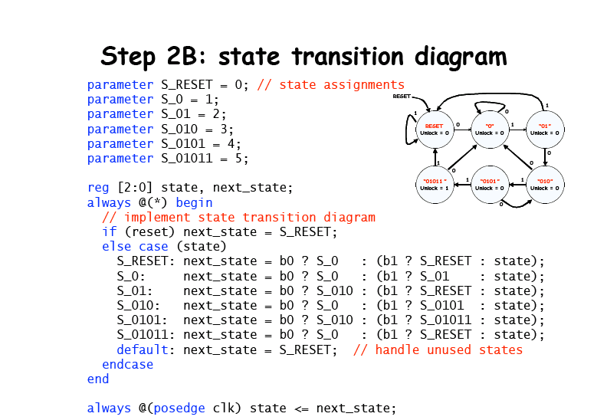

Slide 25
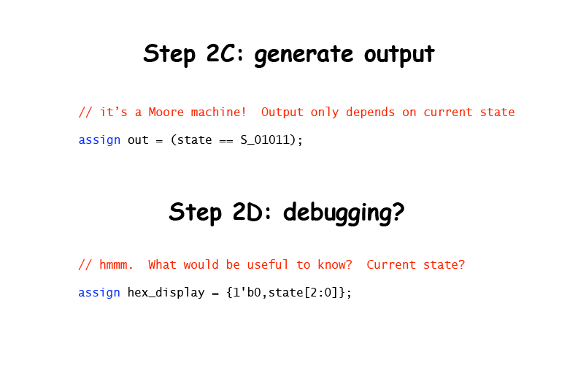

Slide 26
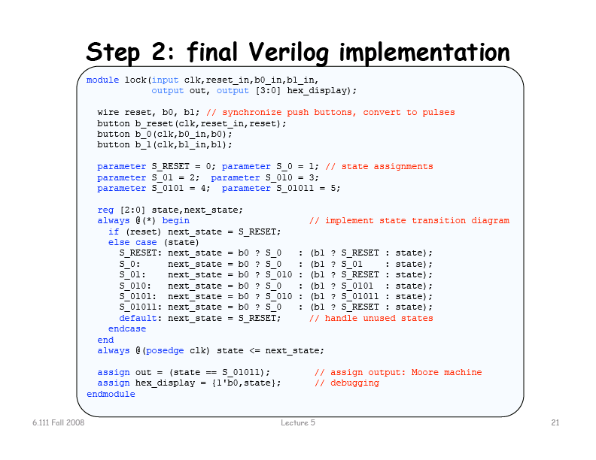

Slide 27
Intervalo

Slide 28
Partitioning state machines
Basically the trick is that you need to put the top one on hold

Slide 29
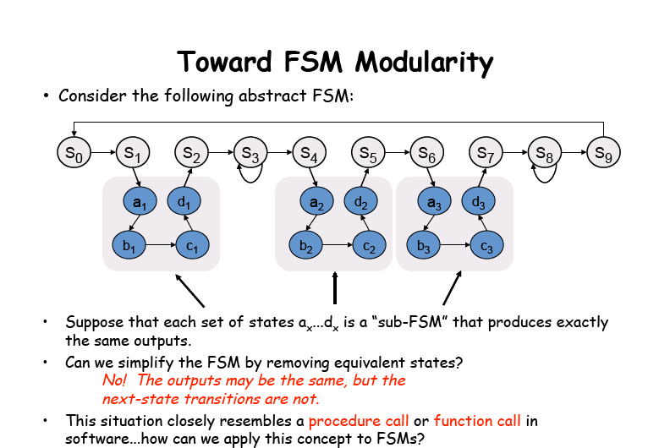
Partitioning state machines
Basically the trick is that you need to put the top one on hold

Slide 30
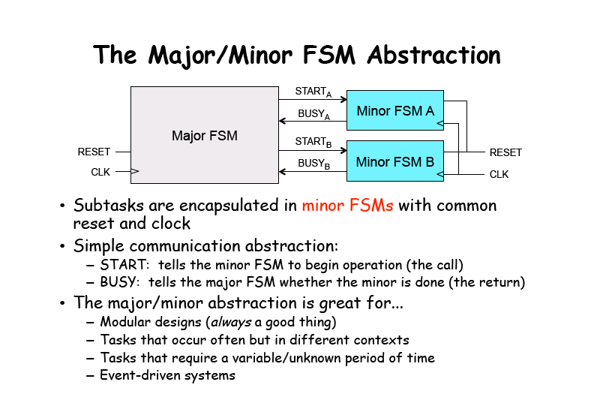

Slide 31
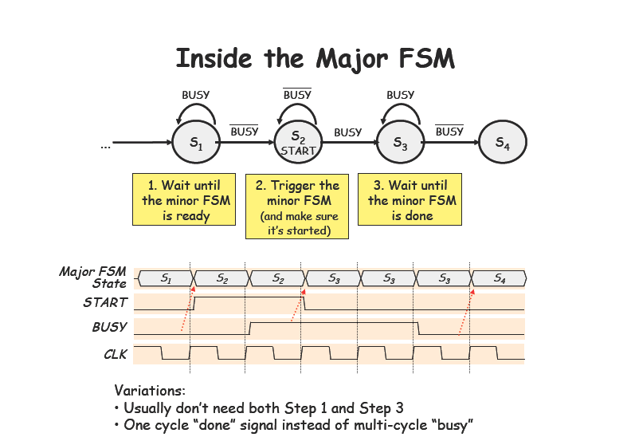

Slide 32
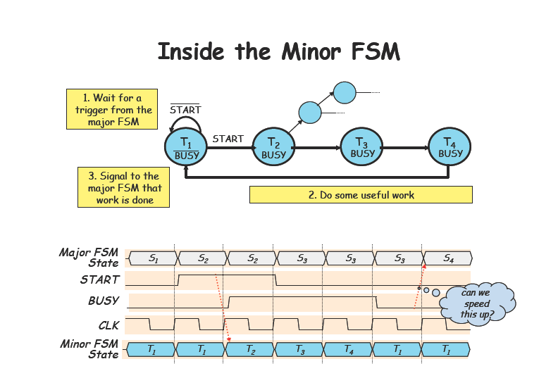

Slide 33
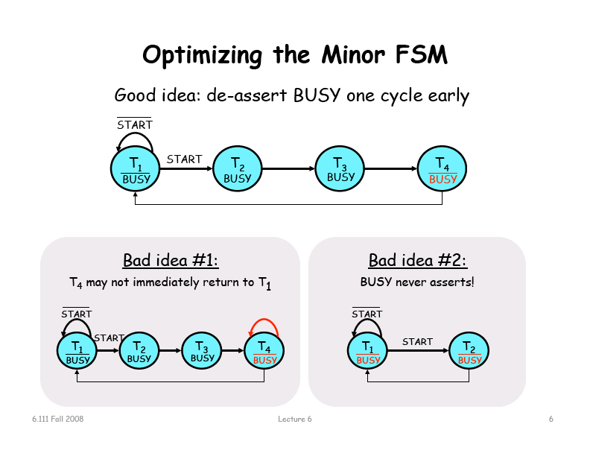

Slide 34
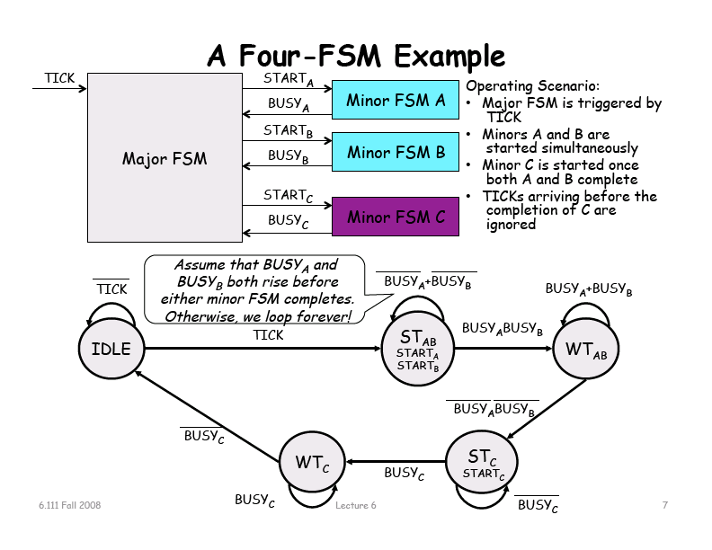

Slide 35
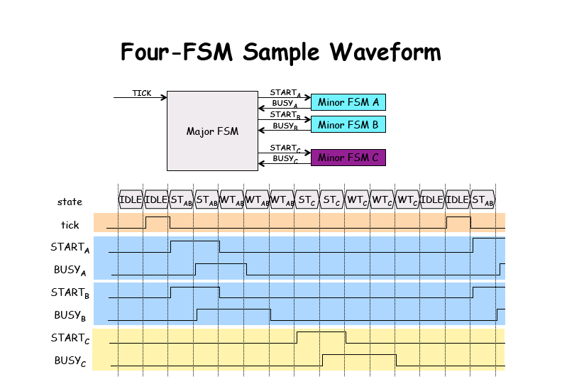

Slide 36
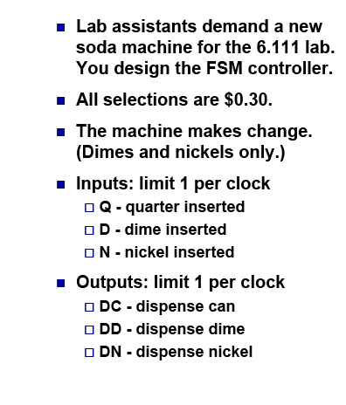
A vending machine

Slide 37
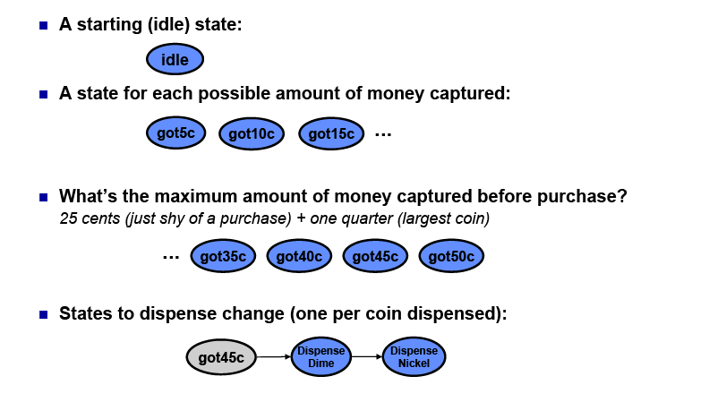
What states?

Slide 38
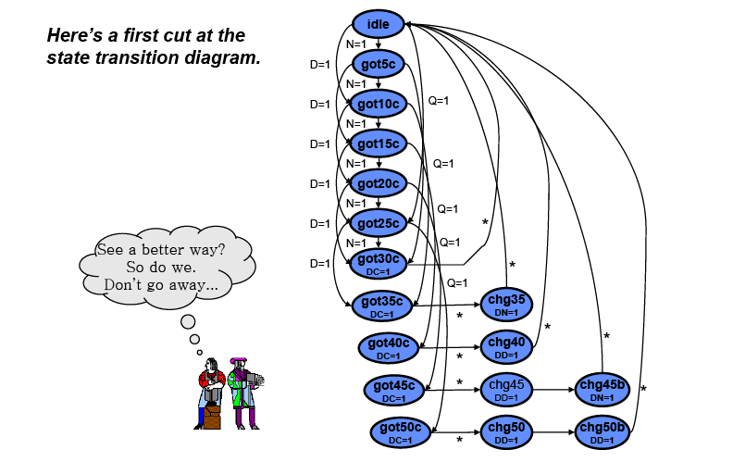
A Moore vender

Slide 39
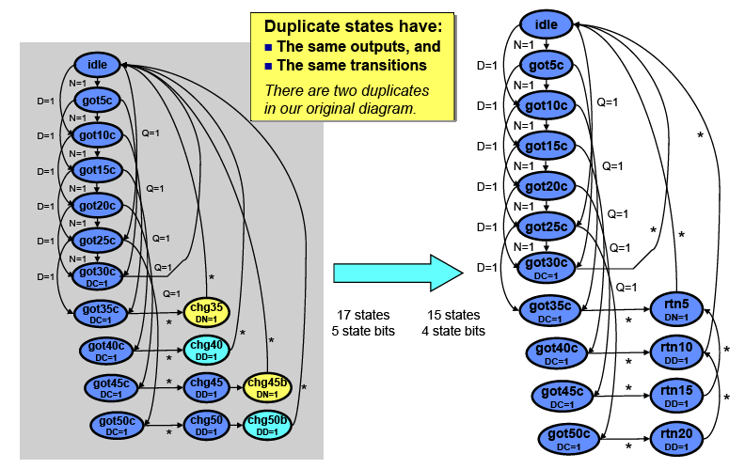
State reduction

Slide 40
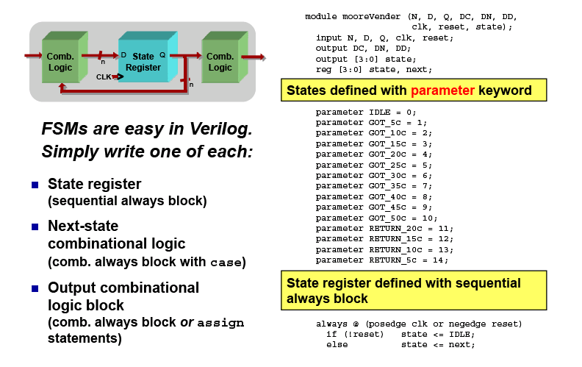
The verilog code

Slide 41
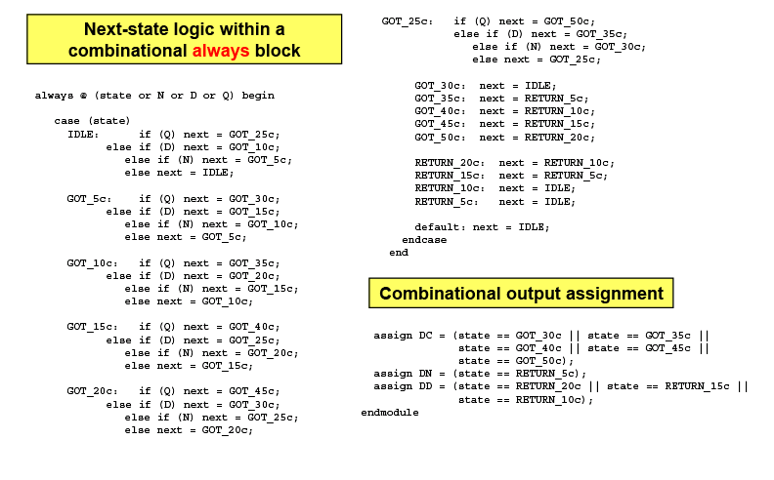
The Verilog code

Slide 42

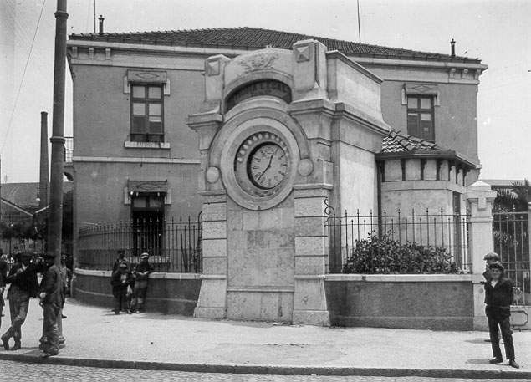
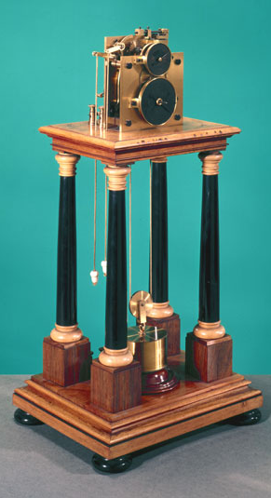
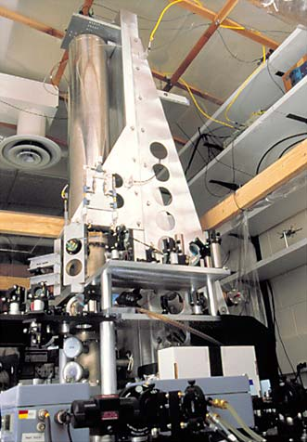
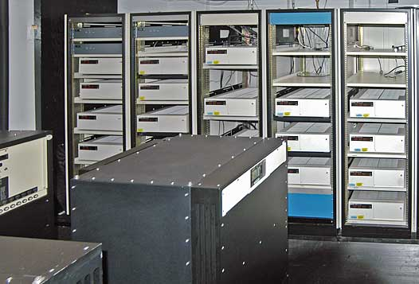
Clocking

Slide 43
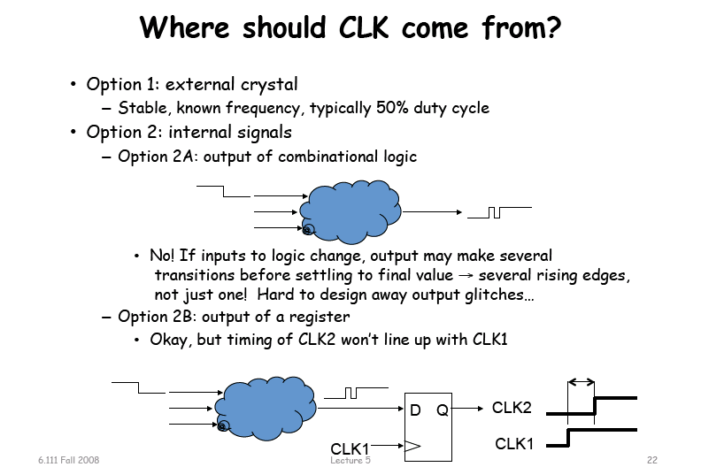

Slide 44
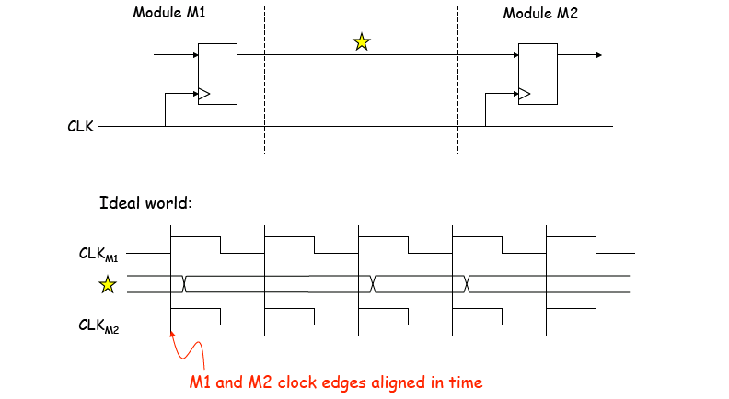
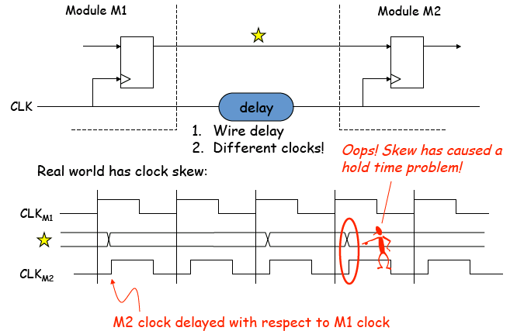
Clocking in and ideal world
Clocking in a not so perfect reality
FPGAs contain global clock lines that have low skew. Number is limited

Slide 45
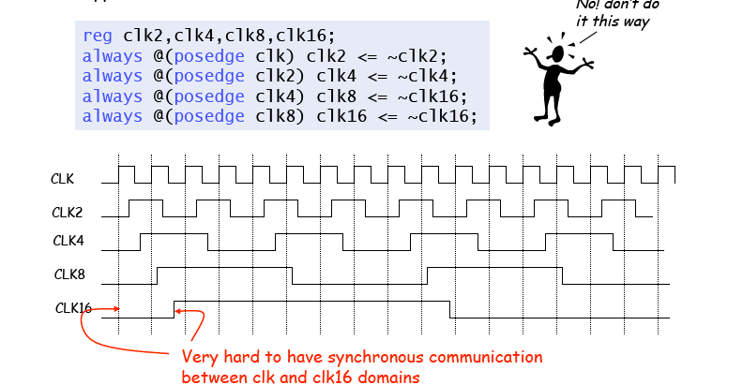
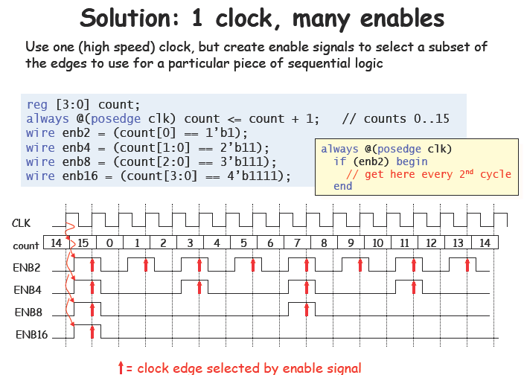
Clocks with periods multiple of two

Slide 46
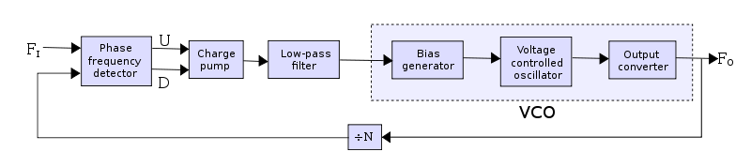
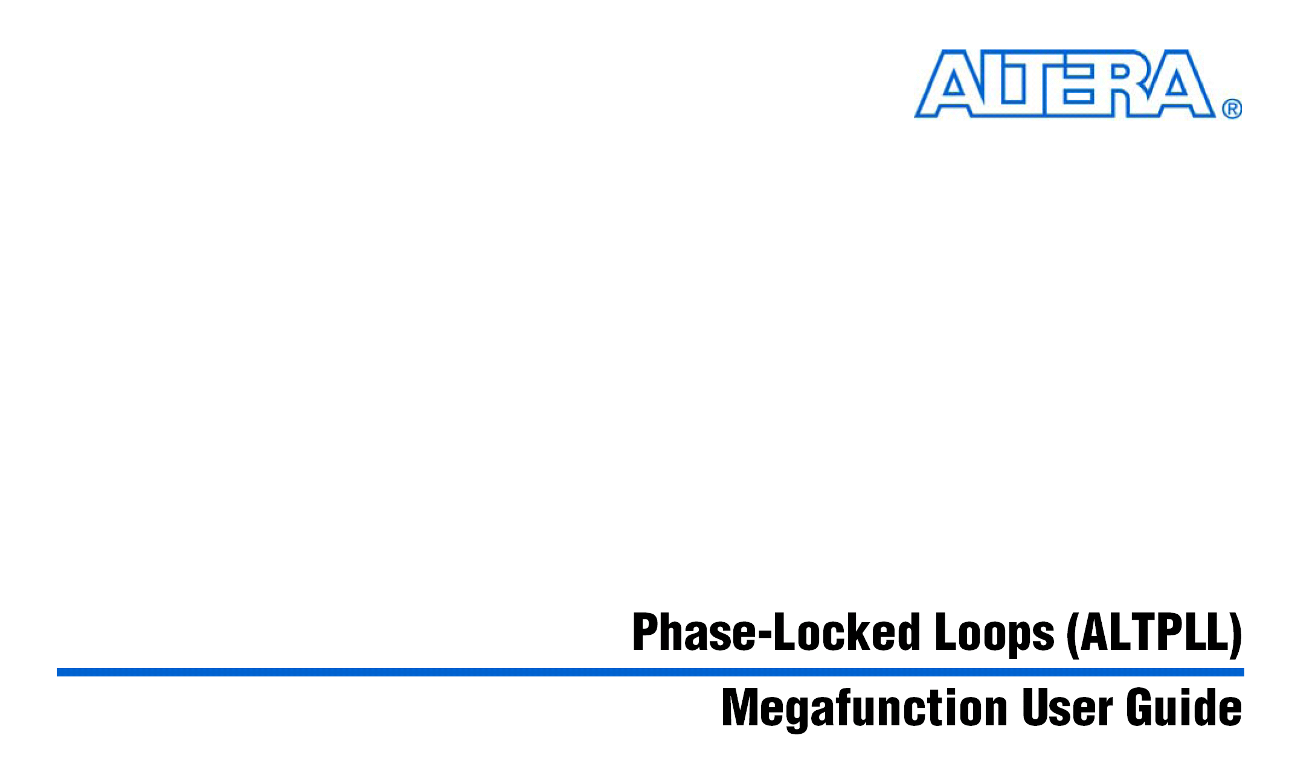
The Phase Locked Loop (PLL)
A feature available in Cyclone II devices that employs a phase-locked loop (PLL). The Cyclone II PLL provides advanced multiplication, programmable duty cycle, phase shifting, programmable bandwidth, manual clock switchover, clock outputs driving all networks, and a source synchronous mode.
You can take advantage of the Cyclone II PLL with the altpll megafunction.

Slide 47
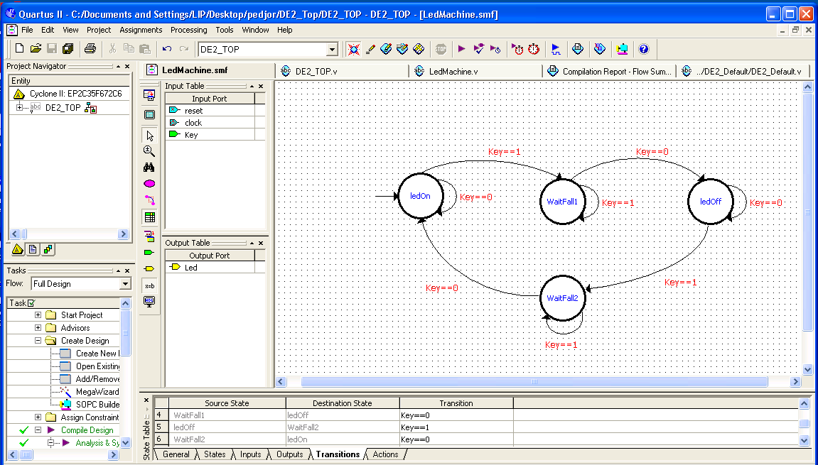
File→new→statemachine
For more information about creating and editing state machine diagrams, refer to the
Quartus II Help.

Slide 48

Define the states output

Slide 49


Slide 50



Slide 51

The “LedMachine” module

Slide 52

The top design
Why is the clock the KEY[2]?

Slide 53
The 2nd lab
The Alarm
Activate the alarm;
Deactivate;
Waiting times.
Code input and verification
Remember to split the program in blocks!!
(you introduce the code to activate and deactivate in the same way)

Slide 55


