Slide 1

Projecto e
Controlo em
Lógica
Digital
Inspired on course 6.111 from MIT
Some support material taken from 6.111 (thank you)
Introdução
FPGAs
Laboratório
Verilog
Lógica combinatória
Lógica sequencial
Máquinas estado
Advanced verilog (video, etc.)
Refs:
Cyclone II device Handbook, Altera corp.
Quartus II Handbook , Altera corp.
DE2 documentation
Verilog HDL, S. Palnitkar, Prentice Hall
Programação de Lógica Digital…

Slide 2
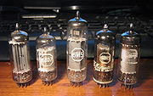
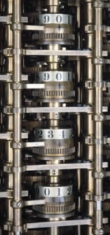
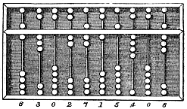
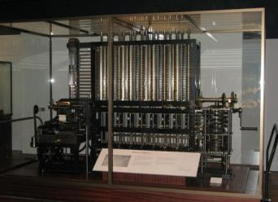
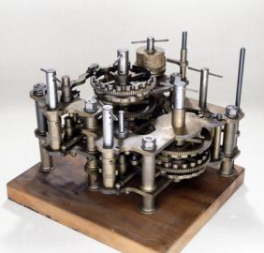

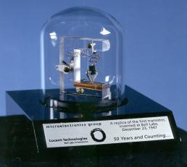
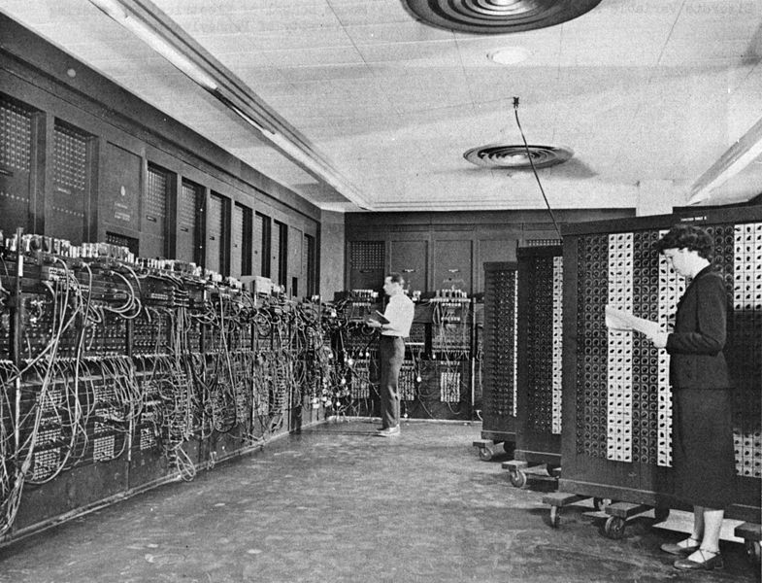
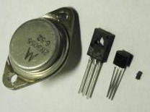
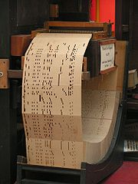
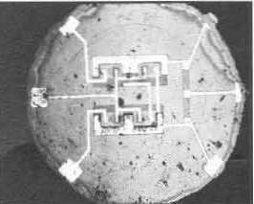
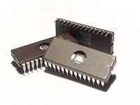
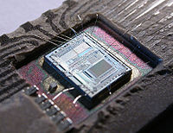
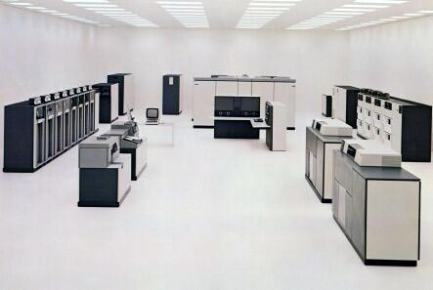

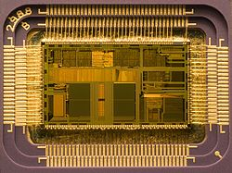
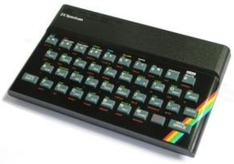



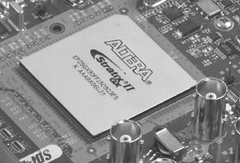

Lógica Digital
Programação
Babbage
difference engine

Slide 3


Lógica Digital
de
Programação
?
Tudo funciona ou por magia ou com gnomos…
Programação de microprocessadores (assembly, c++, etc.)
Dar ao “gnomo” uma lista (consecutiva) de operações a realizar
1 Máquina executa várias tarefas consecutivas
Programação de Lógica Digital (FPGAs+HDL)
Dar ao gnomo uma lista de “objectos” para construir
Várias Máquinas executam várias tarefas em paralelo
Em linguagens de alto nível por vezes confundem-se
2+2?
Resultado x 2?
A=2+2
Cout << A
A=A*2
Cout << A
A=4
4!
A=8
8!
A=2+2
Output A
A=A*2
Output A
Somador: A=4
“ao mesmo tempo”
Multiplicador: A=A*2
Saída ??? (glitches?)
tempo

Slide 4
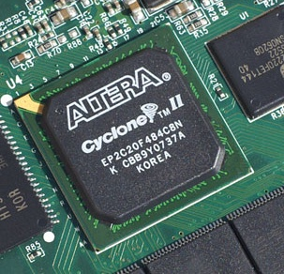
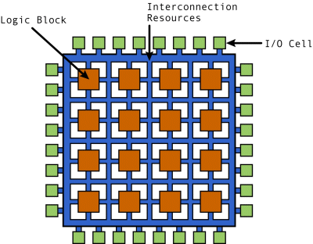
FPGA
Field Programmable Gate Array:
Set of Chips in a bread board.
Control:
Chips functions
Connections

Slide 5
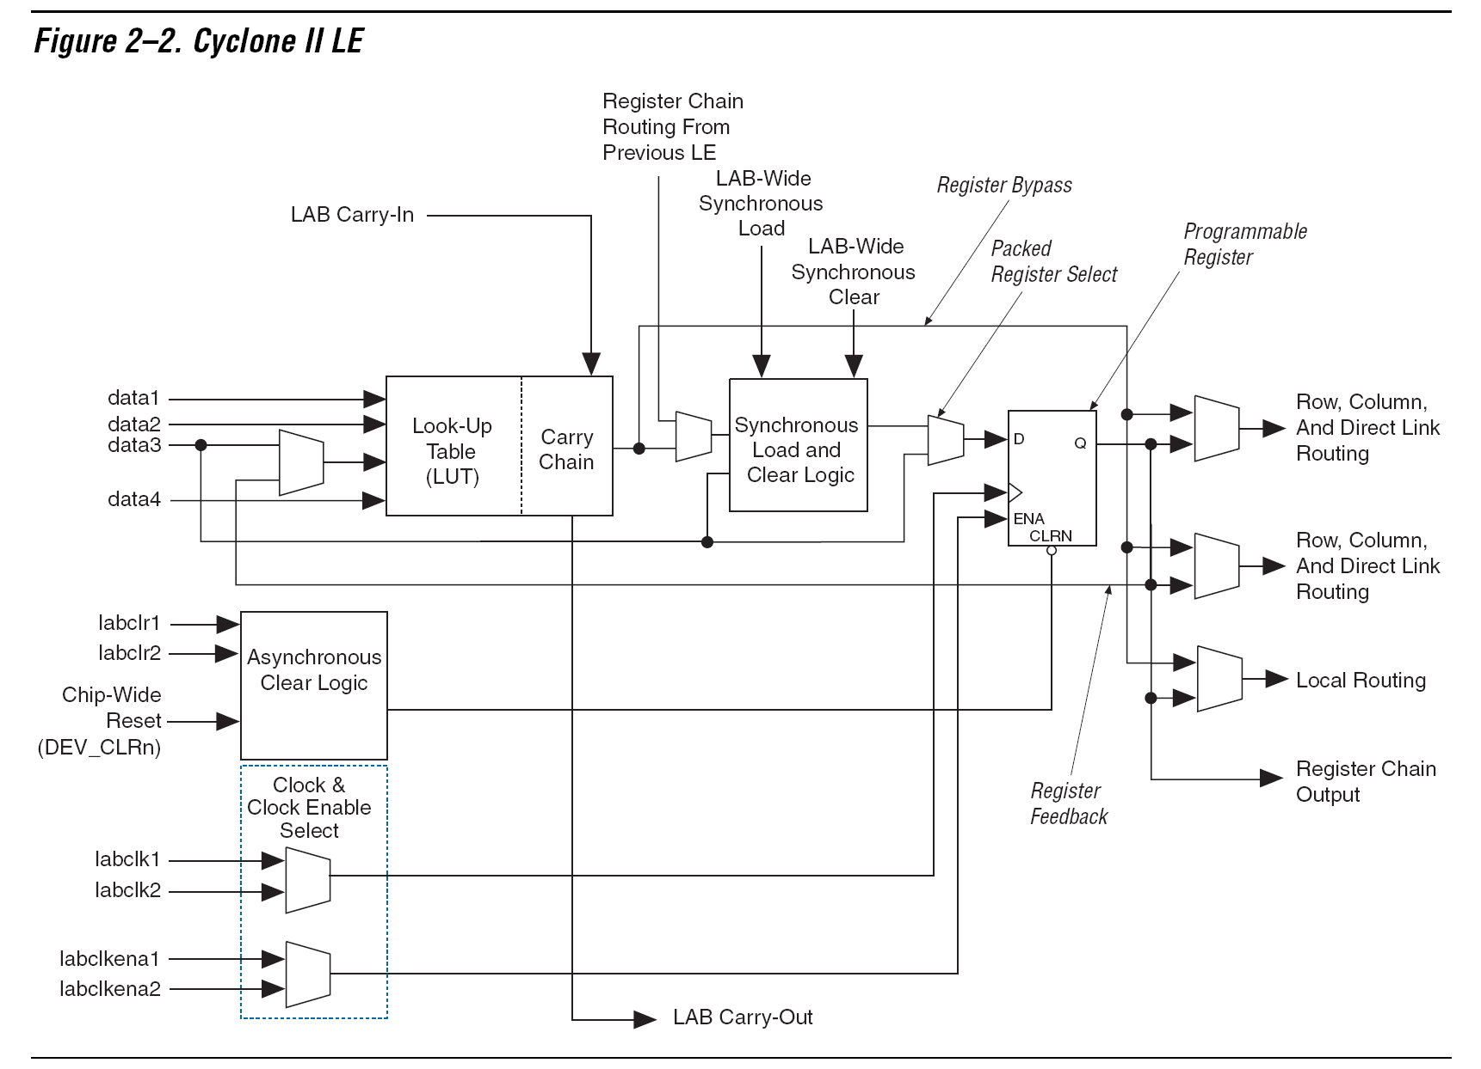
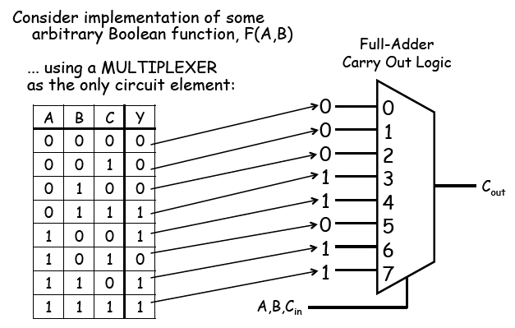
Logic elements

Slide 6
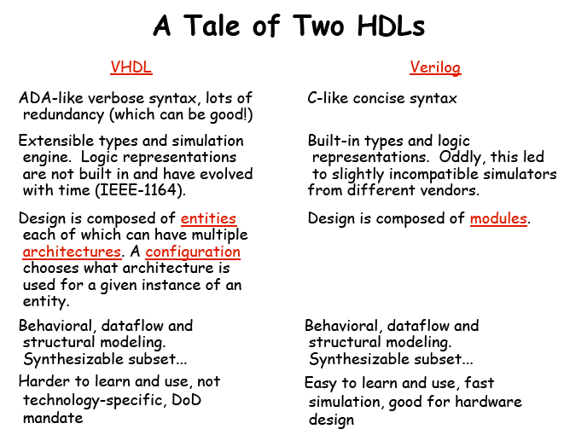
HDL
Hardware
Description
Language

Slide 7
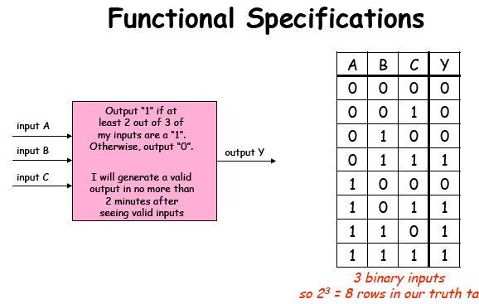
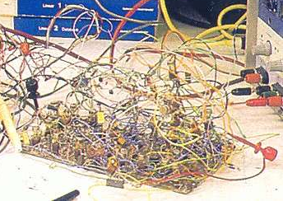
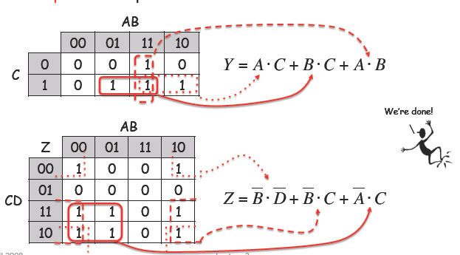
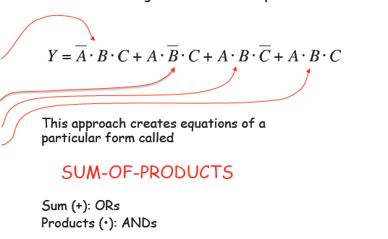
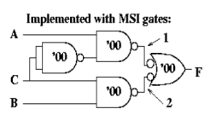
74LS…. vs FPGAs
HDL
code

Slide 8
HELLO WORLD
OL aM unDO
88 88 8888
Primeiro exercício…

Slide 9
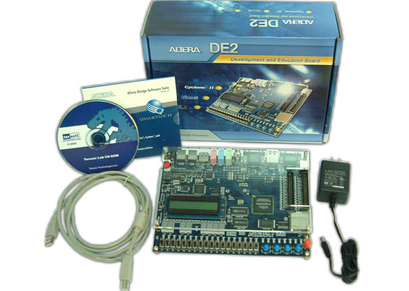
Hardware
OLaMunDO

Slide 10
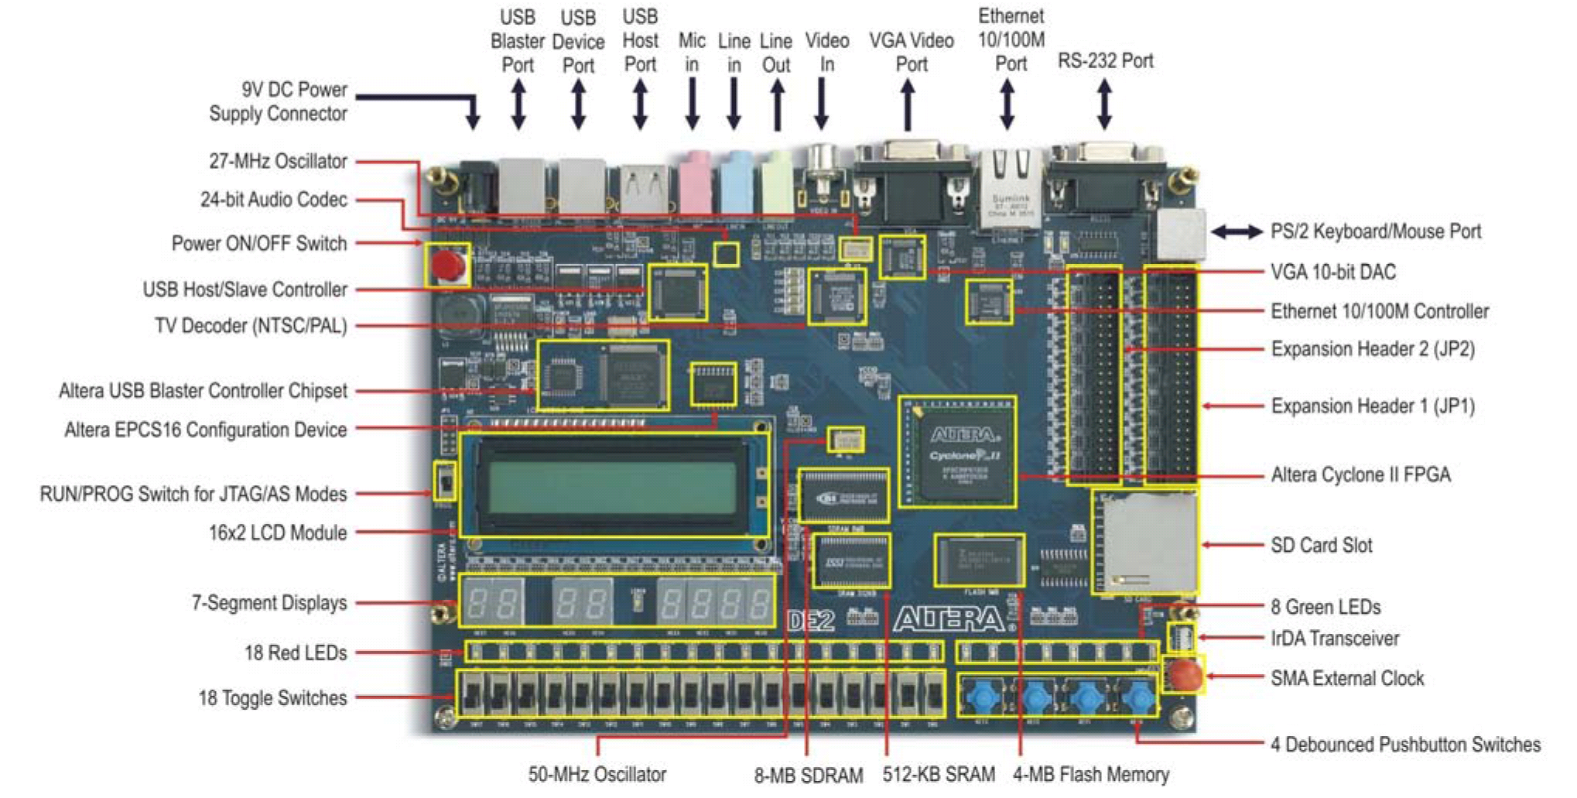
Hardware
OLaMunDO

Slide 11
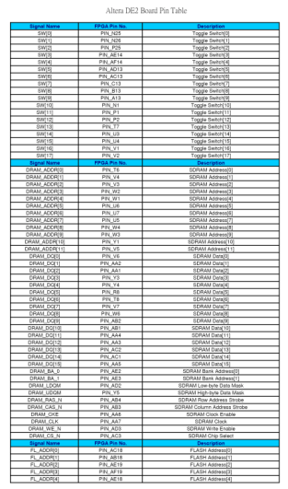
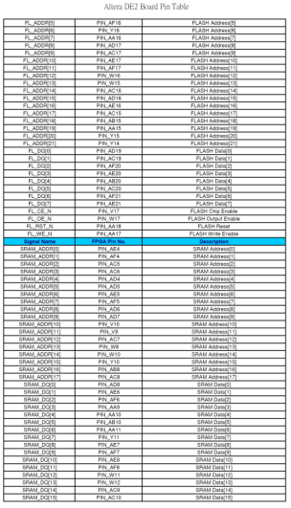
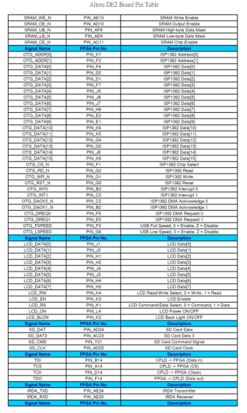
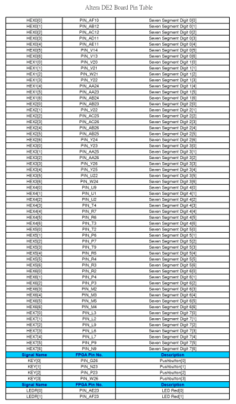
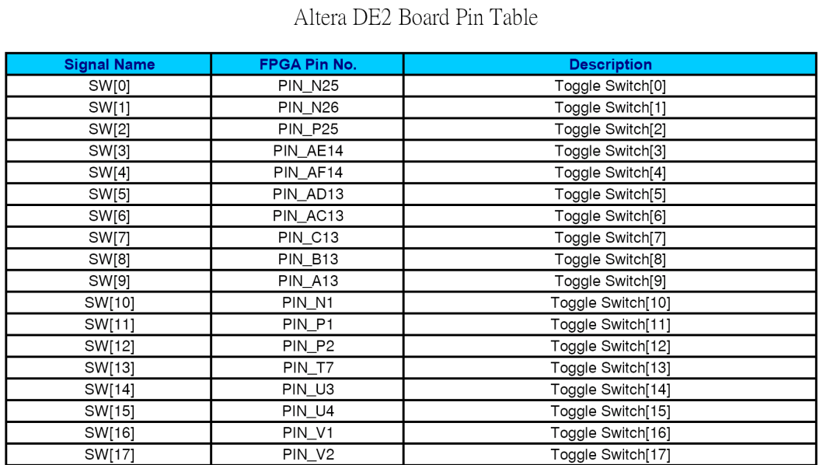
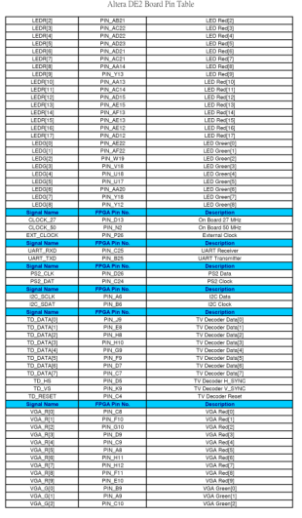
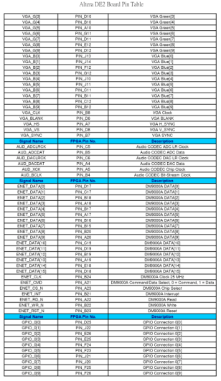
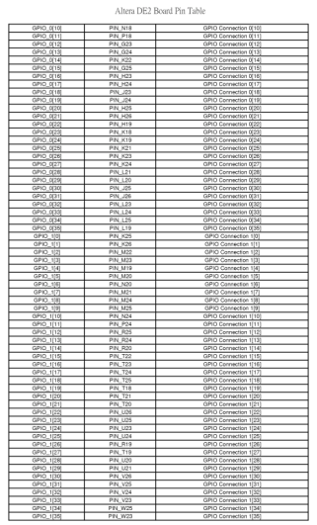
Hardware
OLaMunDO
DE2_Pin_Table.pdf

Slide 12
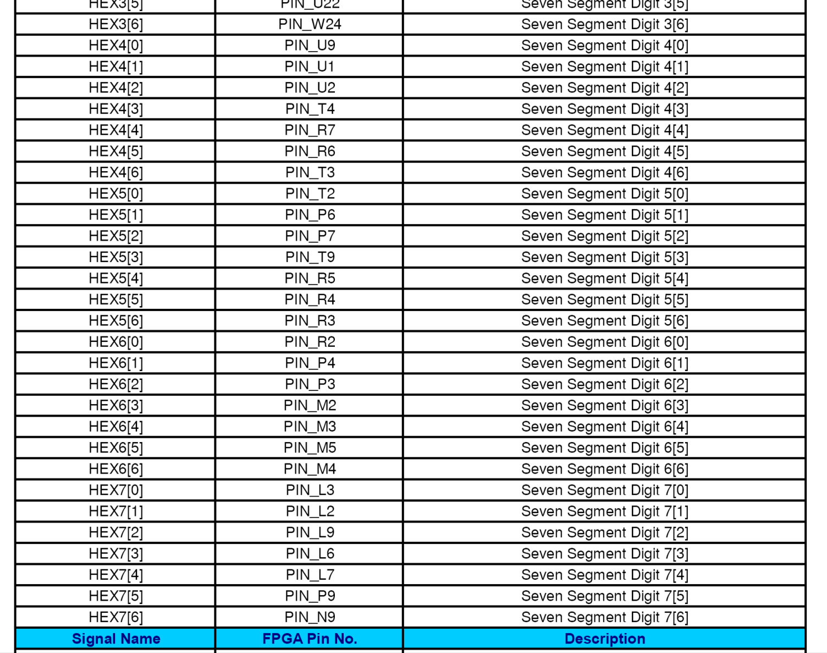

Slide 13


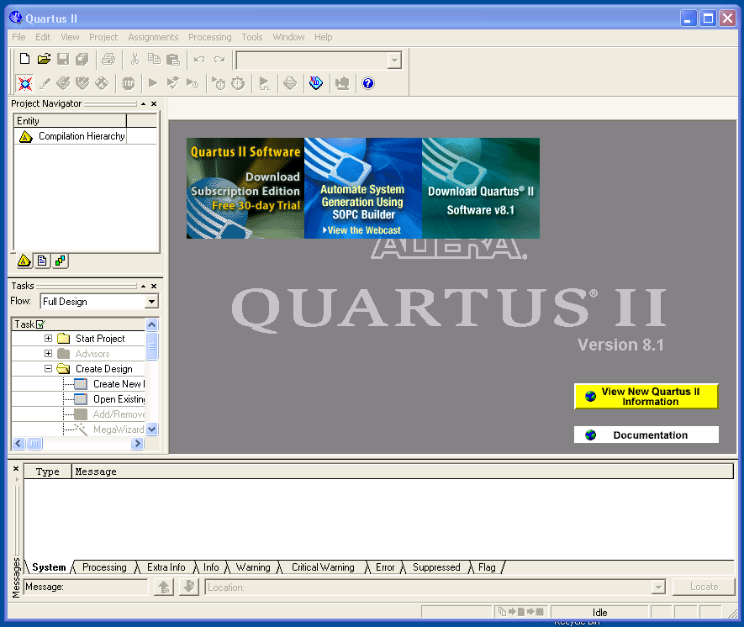
Software
Control
Project
Area Trabalho
Mensagens

Slide 14
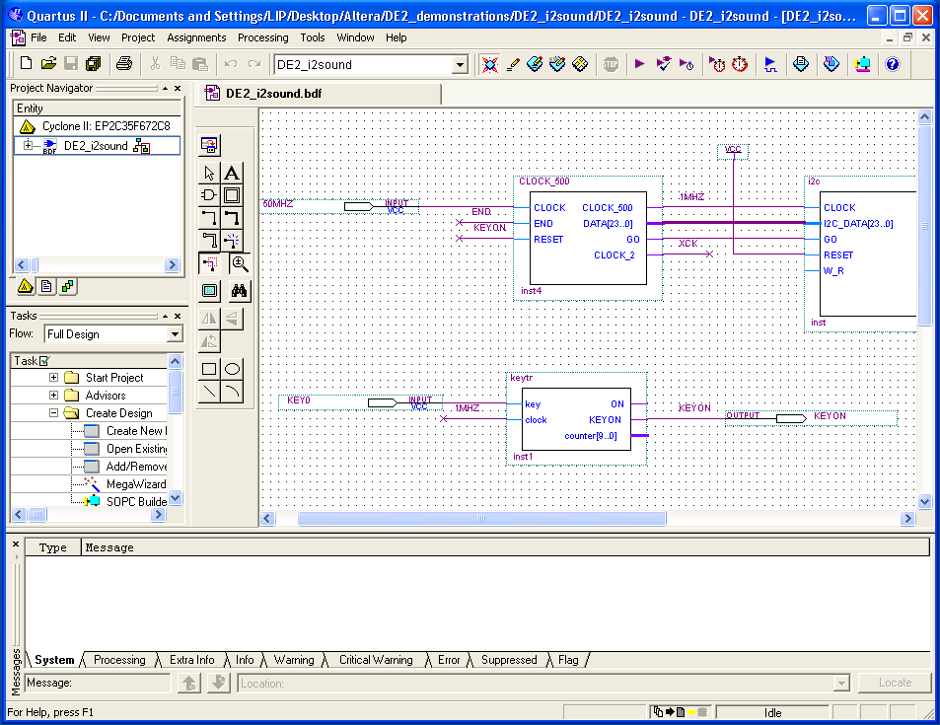
Software - esquemático
Programação esquemático
Input
Lógica
Output

Slide 15
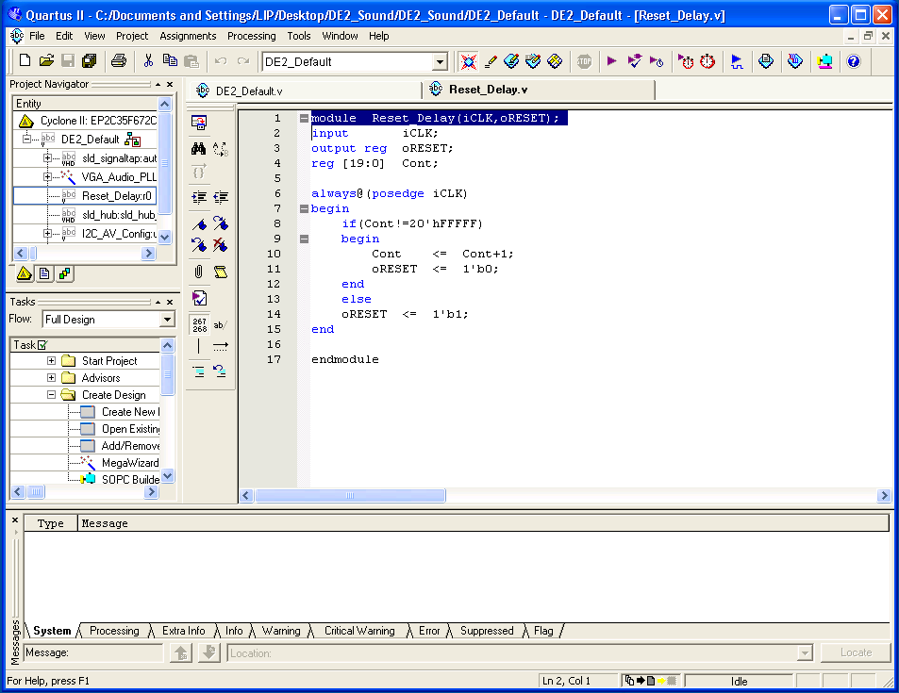
Software - verilog
Programação esquemático
Input
Output
Lógica

Slide 16
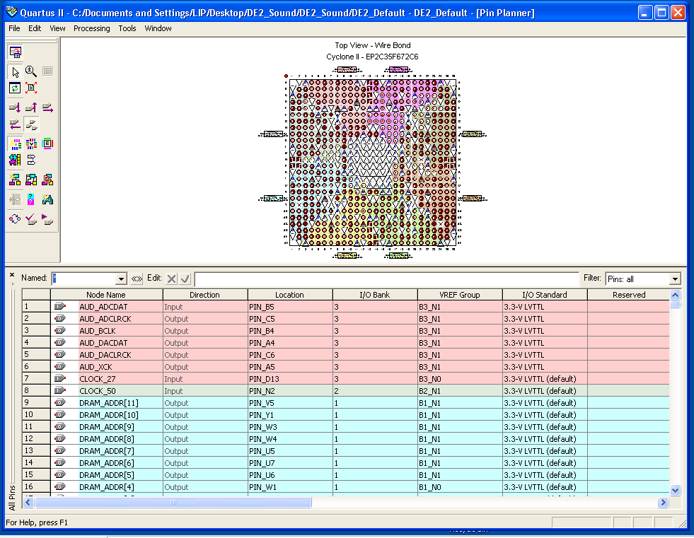

Slide 17
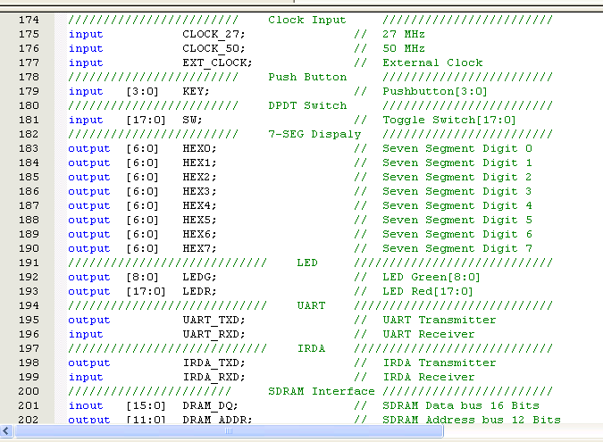
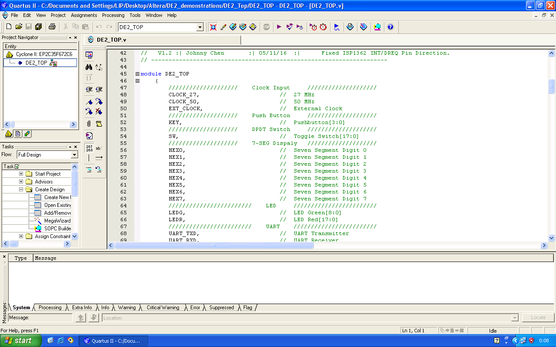
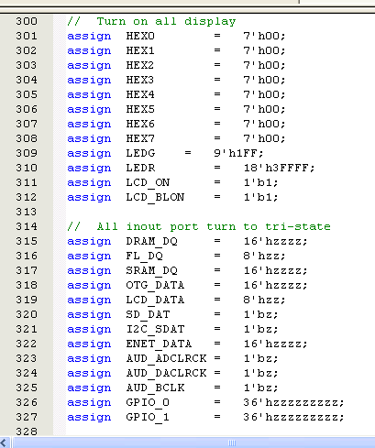
File→Open Project→DE2_top
OL aM unDO
88 88 8888

Slide 18
Entrando no Verilog
Structural: modules, instances
Dataflow: continuous assignment
Sequential behaviour: always blocks

Slide 19
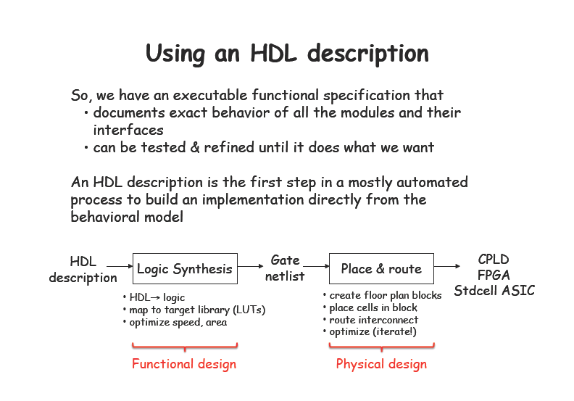

Slide 20
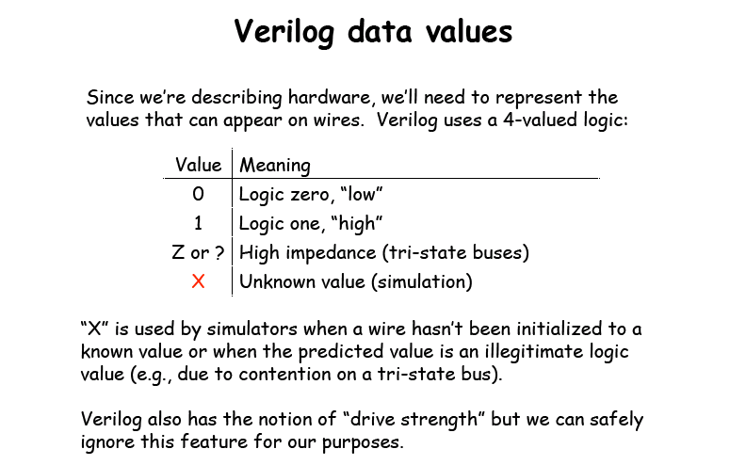

Slide 21
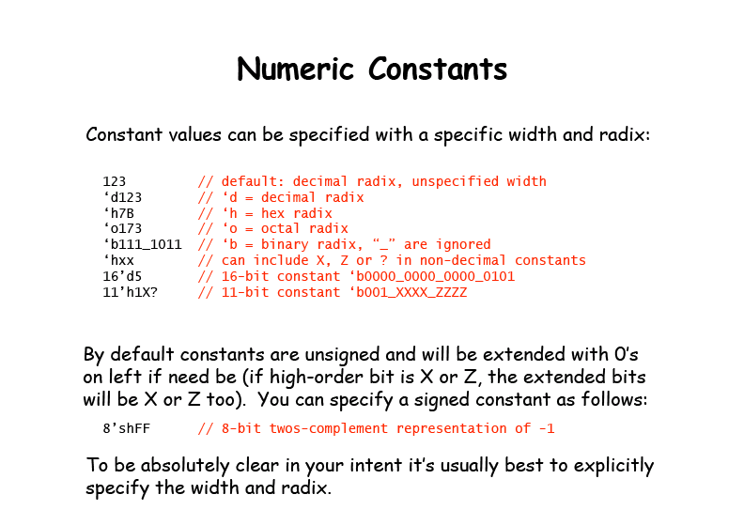

Slide 22
Kill the leds and 7 segment display
assign var_name = value;

Slide 23
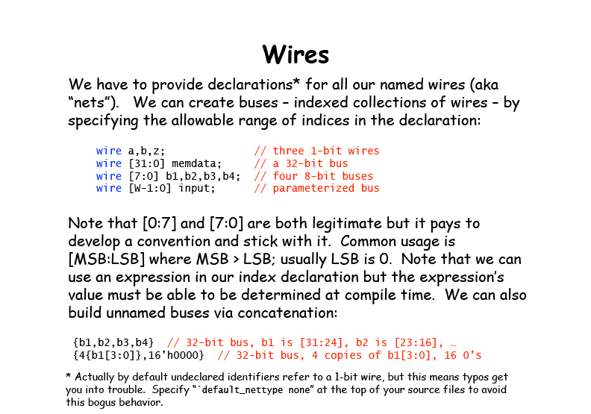

Slide 24
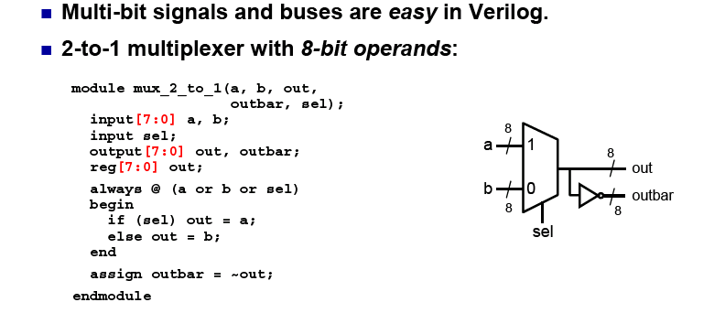
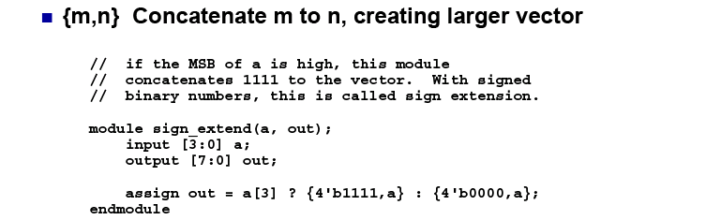
n-bit signals

Slide 25

Integer Arithmetic

Slide 26


Slide 27


Slide 28


Slide 29


Slide 30

Gate Level Description

Slide 31
AND...
assign LEDG[0] = SW[0] & SW[1];
and a1 (LEDR[0], SW[17], SW[16])

Slide 32


Slide 33


Slide 34


Slide 35


Slide 36


Slide 37


Slide 38

Mix Assignments

Slide 39


Slide 40



Danger
If out is not assigned during any pass through the always block, then the previous value must be retained
LATCH
Solution:

Slide 41




Danger
If-else and case statements
are interpreted very literally!
Beware of unintended priority logic
Solution:

Slide 42

Connecting modules to build complex machines

Slide 43

Modules

Slide 44

Top-Level: connect the modules

Slide 45

More on modules

Slide 46

Other useful verilog features (just for reference)

Slide 47
Sequential Logic

Slide 48


Slide 49


Slide 50


Slide 51


Slide 52


Slide 53


Slide 54

Assignment styles for sequential logic

Slide 55

Use nonblocking for sequential logic

Slide 56

Use blocking for combinational logic

Slide 57

= vs <= inside always

Slide 58


Example: A simple counter

Slide 59
Counter 32 bits in the leds...
reg [31:0] count ;
assign LEDR = count[17:0];
always @ (posedge CLOCK_50)
begin
count <= count +1;
end
PWM – Pulse Width Modulation
wire [7:0] H_PWM;
wire [3:0] bright;
assign bright=SW[3:0];
reg [3:0] PWM_count;
always @ (posedge CLOCK_50)
PWM_count<=PWM_count+1;
assign H_PWM=(bright>PWM_count)? 7'hFF : 7'h00;

Slide 60

The Asynchronous counter

Slide 61

The ripple counter in verilog

Slide 62


Logic for a synchronous counter

Slide 63
TOOLS

Slide 64




Tools - Simulation
Verilog
Quartus II
Define the signals :
Inputs – stimulus
Outputs - results
Define the stimulus to the system
Run the simulation and you get the result
http://www.asic-world.com/verilog/timing_ctrl1.html#Example_-_clk_gen
http://fpga4u.epfl.ch/wiki/Image:Simulation.jpg

Slide 65







Tools – Measurement instruments
Waveforms
Logic Levels

Slide 66

Tools – Internal Logic Analyser
Signal-TAP embedded Logic Analyser
Quartus II Handbook Version 9.0 Volume 3: Verification
14. Design Debugging Using the
SignalTap II Embedded Logic Analyzer

Slide 67

Tools – Internal Logic Analyser
CONTROL
Clock definition
Trigger definition
The signal you want to “see”

Slide 68

Tools – Internal Logic Analyser
The logic analyser will collect data from the registers and output it through the JTAG programming interface
Tools – Signal probe
Internal signals can be extracted to output pins and connected to na external logic analyser. Signals can be exchanged easily…

Slide 69

SignalTap step by step
Open DE2 default and compile it!
Program DE2
Tools→Signal TapII Logic Analyser

Slide 70

Setup the hardware (choose the USB blaster)
Define the clock

Slide 71


Slide 72

Choose the signals to observe. Choose Cont 25,24,23,22
Compile the project! You may need to save some files and answer some questions
Program the board

Slide 73


Run Analysis→Green (acquisition in progress, acquiring data
Run Analysis (1 time)
Run Analysis (continuous)
Stop

Slide 74




Finally: data!!
Select the four signals;
Edit→group
Select the group
Edit→Bus Display Format→Unsigned Line Chart
Unzoom

